Slide 1

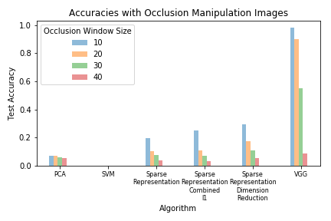
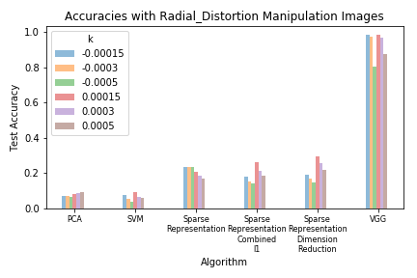
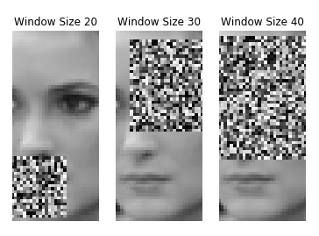
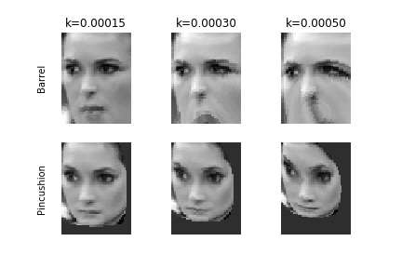
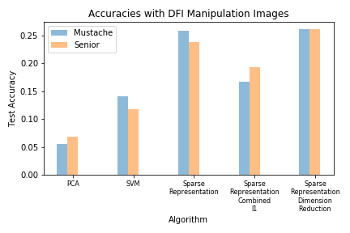
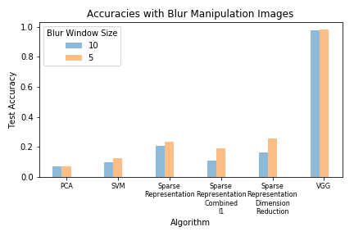
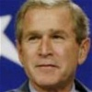
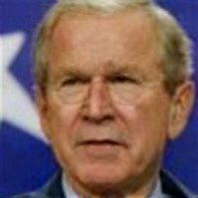
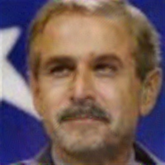
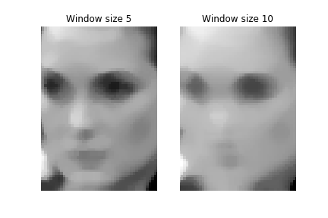
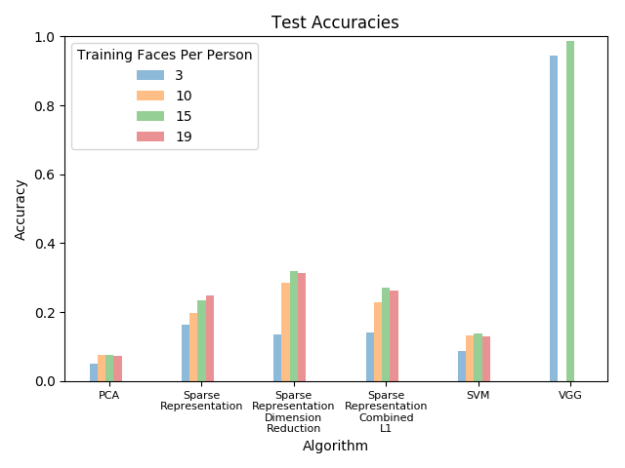
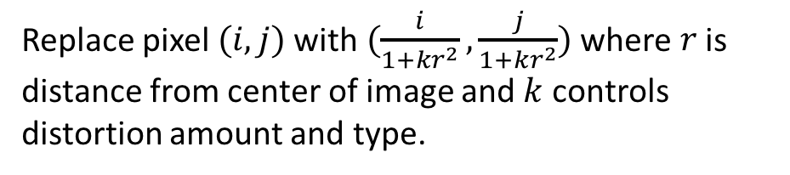
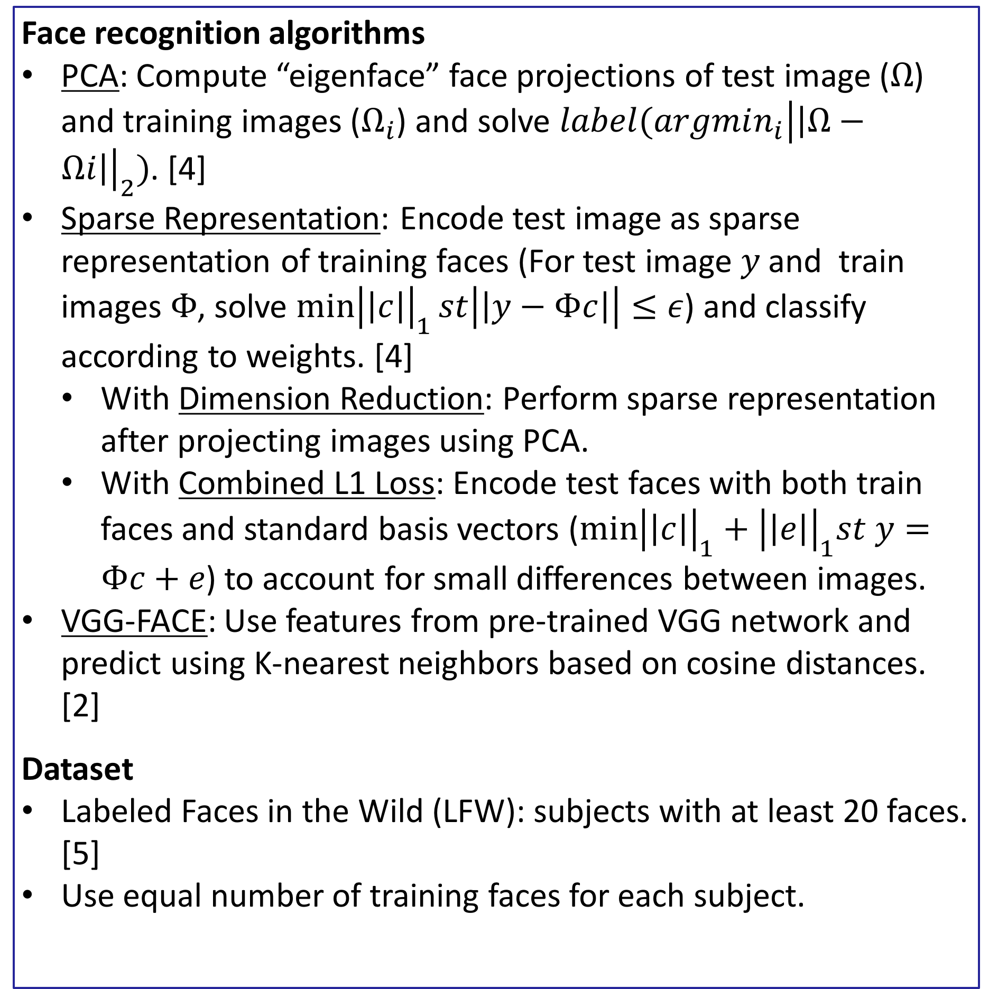
Robustness of Face Recognition to Image Manipulations
COS 429 Computer Vision
Project Adviser: Kyle Genova
Cathy Chen (cc27), Zachary Liu (zsliu), Lindy Zeng (lindy)
Motivation
Face Manipulation
Manipulation Results
Humans can often recognize faces even if they are distorted or occluded.
Computer facial recognition applications must continue to recognize faces even when the face may look slightly different.
Goal: Implement and use a variety of face recognition algorithms and implement image manipulations. Analyze the impact of each manipulation on the accuracy of the algorithms.
Occlusion
Randomly occulde a selected region of a specified windowsize.
Radial Distortion
Impose pincushion and barrel distortion to simulate spherical camera lenses. [1]
Background and Related Work
Fill rectangular region with random pixels in range [0, 255].
Replace pixel $(i,j)$ with $(\frac{i}{1+kr^{2}},\frac{j}{1+kr^{2}})$ where $r$ is distance from center of image and $k$ controls distortion amount and type.
Traditional statistical methods and deep learning used in face recognition problems.
Image manipulations from linear algebras, mimicking lens distortion, neural networks.
Psychology indicates that image manipulation may equalize face recognition ability in human beings. [6]
Deep Feature Interpretation
Use DFI algorithm to make faces look older or to add a moustache to the face. [3]
Blur
Replace each pixel by the average of its neighbors within a specified windowsize.
Face Recognition
original
older
moustache
Results and Discussion
Face recognition algorithms
PCA: Compute “eigenface” face projections of test image ($Ω$) and training images ($Ω_{i}$) and solve $label(argmin_{i}{\left|\left|Ω−Ωi\right|\right|}_{2})$. [4]
Sparse Representation: Encode test image as sparse representation of training faces (For test image $y$ and train images $Φ$, solve ${\min\left|\left|c\right|\right|}_{1}st\left|\left|y−Φc\right|\right|≤ε$) and classify according to weights. [4]
With Dimension Reduction: Perform sparse representation after projecting images using PCA.
With Combined L1 Loss: Encode test faces with both train faces and standard basis vectors (${\min\left|\left|c\right|\right|}_{1}+{\left|\left|e\right|\right|}_{1}st y=Φc+e$) to account for small differences between images.
VGG-FACE: Use features from pre-trained VGG network and predict using K-nearest neighbors based on cosine distances. [2]
Dataset
Labeled Faces in the Wild (LFW): subjects with at least 20 faces. [5]
Use equal number of training faces for each subject.
Compute attribute vector in VGG feature space using similar faces, then interpolate the target face image along this vector.
Apply rectangular uniform convolution filter to each pixel in the image.
VGG-FACE outperforms the statistical methods for face recognition by a large margin (PCA, Sparse Representation).
Overall decrease in performance across all algorithms for manipulated images.
In some cases, we observe a trend that mimics results from studies in psychology: more extreme manipulations decrease test accuracy more for algorithms with higher baseline recognition accuracies.
Baseline Results
Baseline Performance
We test our algorithms on un-manipulated images with different amounts of train faces to mimic different real-world scenarios.
Works Cited
[1] P. Drap and J. Lefèvre, “An Exact Formula for Calculating Inverse Radial Lens Distortions,” Sensors (Basel), vol. 16, no. 6, Jun. 2016.
[2] O. M. Parkhi, A. Vedaldi, and A. Zisserman, “Deep Face Recognition,” British Machine Vision Conference, 2015.
[3] P. Upchurch et al., “Deep Feature Interpolation for Image Content Changes,” arXiv:1611.05507 [cs], Nov. 2016.
[4] A. Ganesh, A. Wagner, Z. Zhou, A. Y. Yang, Y. Ma, and J. Wright, “Face recognition by sparse representation,” in Compressed Sensing: Theory and Applications, Y. C. Eldar and G. Kutyniok, Eds. Cambridge University Press, 2012, pp. 515–539.
[5] G. Huang, M. Ramesh, T. Berg, and E. Learned-Miller, “Labeled Faces in the Wild: A Database for Studying Face Recognition in Unconstrained Environments,” University of Massachusetts, Amherst, 07-49, Oct. 2007.
[6] R. Russell, B. Duchaine, and K. Nakayama, “Super-recognizers: People with extraordinary face recognition ability,” Psychonomic Bulletin & Review, vol. 16, no. 2, pp. 252–257, Apr. 2009.
Acknowledgements
Professor Olga Russakovsky, Dr. Andras Ferencz
Kyle Genova, Riley Simmons-Edler

