Slide 1
Itty Bitty
CSC301 Winter 2015: Team 1

Slide 2


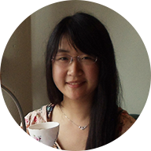

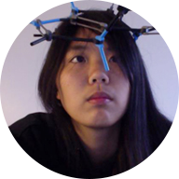
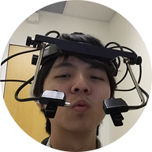

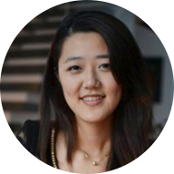
The Team
Ben Shaft
Eric Snyder
Catherine Wang
Eugene Cheung
Christina Chen
Inks Lin
Cindy Wu
Sharon Hogan

Slide 3
The Problem
Help people learn computer science material with an interactive piece of software

Slide 4
The Material
Bitwise operations
Conversion between bases

Slide 5
The Solution
Itty Bitty
Web-based application with mini games/tutorials
Designed to teach base conversion and bitwise operations to anybody

Slide 6

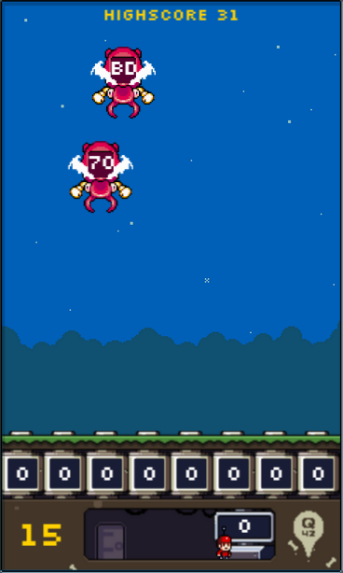
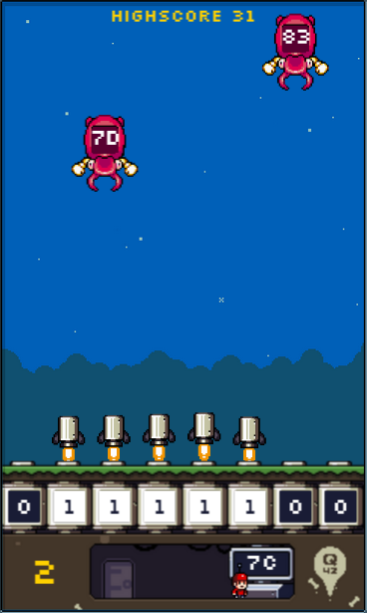
Existing Products
Flippy Bit And The Attack Of The Hexadecimals From Base 16

Slide 7
Existing Products
Codecademy: http://www.codecademy.com/courses/python-intermediate-en-KE1UJ/0/1
Tutorialspoint (C): http://www.tutorialspoint.com/cprogramming/c_bitwise_operators.htm
Tutorialspoint (C++): http://www.tutorialspoint.com/cplusplus/cpp_bitwise_operators.htm

Slide 8
Thank you

