Slide 1
Django, part 1
Jean-Matthieu Gallard, 09/04/15, TUM

Slide 2
Overview
Python
Django, overview & starting from scratch
Model
Fields & X-to-X relationships
Model API
Controller
In-depth example & ModelForm
Routing with urls.py
View
Template syntax
Templates settings & static files
Admin-site & User model

Slide 3
Python
Conceived in the late 80’s
8th most popular language on the TIOBE index
High-level multipurpose multiparadigm interpreted language
Use GC & Dynamic typing (duck typing)
Significant indentation instead of curly brace
No needs for semicolon
#Hello World
def hw():
s = 'Hello'+" World!"
x = 1 + 1.5 == 2.5
if(x):
print(s)
hw()

Slide 4
Python, class paradigm
No keywords (abstract, static, public, ….)
No interfaces
But multiple inheritance allowed
No parametric polymorphism
class MyInt:
myType = "integer"
def __init__(self, value):
self.value = value
def incr(self):
self.value += 1

Slide 5
Python, pros & cons
Pros
Easy to learn
Less code for the same result
Multiparadigm
Multiplatform

Slide 6
Python, pros & cons
Pros
Easy to learn
Less code for the same result
Multiparadigm
Multiplatform
Cons
Slow
Python2 legacy
Different paradigm from C/Java-like language
Not made for the web (fixed by frameworks like Django)

Slide 7
Python, pros & cons
Pros
Easy to learn
Less code for the same result
Multiparadigm
Multiplatform
Cons
Slow
Python2 legacy
Different paradigm from C/Java-like language
Not made for the web (fixed by frameworks like Django)
Matter of taste
Indentation based syntax
Dynamic typing
No keywords

Slide 8

Django, the D is silent

Slide 9

Django
Born in 2003, released in 2005 (BSD license)
MVC Framework (with its own nomenclature)
Template engine ported to other language (js: swig, php: twig, …)
Version 1.8 since April 1 2015
Can use Python2
Easy to install/use

Slide 10
Django, project & apps
An app is a Web application that does something – e.g., a Weblog system, a database of public records or a simple poll app.
A project is a collection of configuration and apps for a particular Web site.
A project can contain multiple apps. An app can be in multiple projects.

Slide 11
Django, project & apps
An app is a Web application that does something – e.g., a Weblog system, a database of public records or a simple poll app.
A project is a collection of configuration and apps for a particular Web site.
A project can contain multiple apps. An app can be in multiple projects.
A project layout:
mysite/
manage.py
mysite/
__init__.py
settings.py
urls.py
wsgi.py
someapp1/
migrations/ **
templates/ *
admin.py
models.py
tests.py
urls.py *
views.py

Slide 12
Django, starting a project
Assuming you have python and Django installed:
$ django-admin startproject mysite

Slide 13
Django, starting a project
Assuming you have python and Django installed:
$ django-admin startproject mysite
Configure the settings, especially the database ones.
Then migrate it:
$ python manage.py migrate

Slide 14
Django, starting a project
Assuming you have python and Django installed:
$ django-admin startproject mysite
Configure the settings, especially the database ones.
Then migrate it:
$ python manage.py migrate
Start the development server:
$ python manage.py runserver
Go to http://127.0.0.1:8000/

Slide 15
Django, adding an app
To create an app:
$ python manage.py startapp someapp1

Slide 16
Django, adding an app
To create an app:
$ python manage.py startapp someapp1
Add it to the installed app in settings.py:
INSTALLED_APPS = (
'django.contrib.admin',
#[…]
‘someapp1', )

Slide 17
Django, adding an app
To create an app:
$ python manage.py startapp someapp1
Add it to the installed app in settings.py:
INSTALLED_APPS = (
'django.contrib.admin',
#[…]
‘someapp1', )
If there is some models defined:
$ python manage.py makemigrations someapp1
$ python manage.py migrate

Slide 18
Django, settings.py
DEBUG: allows detailed error page. Always false in production
TEMPLATE_DEBUG: deprecated in 1.8

Slide 19
Django, settings.py
DEBUG: allows detailed error page. Always false in production
TEMPLATE_DEBUG: deprecated in 1.8
DATABASES: dictionary containing the DB settings
DATABASES = {
'default': {
'ENGINE': 'django.db.backends.postgresql_psycopg2',
'NAME': 'mydatabase',
'USER': 'mydatabaseuser',
'PASSWORD': 'mypassword',
'HOST': '127.0.0.1',
'PORT': '5432',
}
}

Slide 20
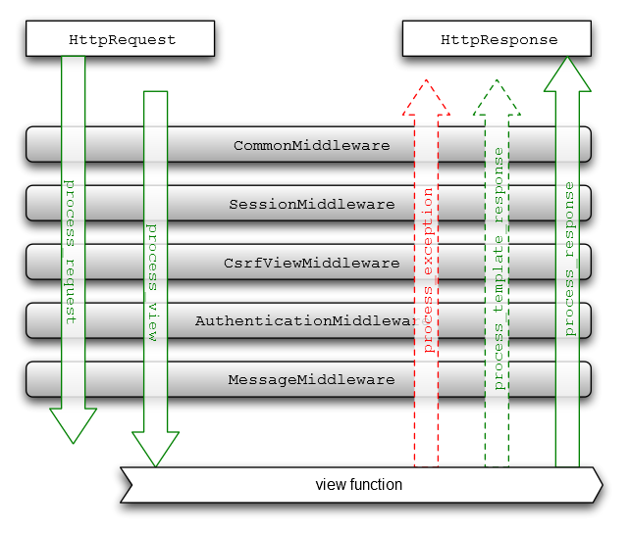
Django, settings.py
DEBUG: allows detailed error page. Always false in production
TEMPLATE_DEBUG: deprecated in 1.8
DATABASES: dictionary containing the DB settings
INSTALLED_APPS: all enabled apps
MIDDLEWARE_CLASSES: middleware to use
DATABASES = {
'default': {
'ENGINE': 'django.db.backends.postgresql_psycopg2',
'NAME': 'mydatabase',
'USER': 'mydatabaseuser',
'PASSWORD': 'mypassword',
'HOST': '127.0.0.1',
'PORT': '5432',
}
}

Slide 21
Django‘s MVC
Develop a basic application
Model
Controller
View
View
Template

Slide 22
Model, models.py overview
from django.db import models
class Person(models.Model):
first_name = models.CharField(max_length=50)
last_name = models.CharField(max_length=50)
birth_date = models.DateField()
def baby_boomer_status(self):
"Returns the person's baby-boomer status."
import datetime
if self.birth_date < datetime.date(1945, 8, 1):
return "Pre-boomer"
elif self.birth_date < datetime.date(1965, 1, 1):
return "Baby boomer"
else:
return "Post-boomer"
def _get_full_name(self):
"Returns the person's full name."
return '%s %s' % (self.first_name, self.last_name)
full_name = property(_get_full_name)

Slide 23
Model, fields and X-to-X relationships
Data fields
BooleanField
CharField
DateField
DecimalField
IntegerField

Slide 24
Model, fields and X-to-X relationships
Data fields
BooleanField
CharField
DateField
DecimalField
IntegerField
Relationships
ForeignKey, many-to-one relationship
ManyToManyField, will create an intermediary join table if not defined
OneToOneField
from django.db import models
class Car(models.Model):
manufacturer = models.ForeignKey('Manufacturer')
# ...
class Manufacturer(models.Model):
# ...

Slide 25
Model, model API
save(), synchronized change (create/update) to the DB
delete()

Slide 26
Model, model API
save(), synchronized change (create/update) to the DB
delete()
Construct a QuerySet to fetch object using Manager: MyModel.objects
all() to get all
filter(cond1=val1), enforce specific condition
exclude(cond1=val1), reverse of filter
get() if there is only one (return an object)
QuerySet are lazy, evaluate them using iteration or list() for example
from blog.models import Blog
b = Blog.objects.get(id=2)
b.category = some_category
b.save()

Slide 27
Controller, views.py overview
from django.http import HttpResponse
from box.models import Box
from django.shortcuts import get_object_or_404, render, redirect
from django.forms import ModelForm
from django.contrib.auth.decorators import login_required
class BoxCreateForm(ModelForm):
class Meta:
model = Box
fields = ['tag', 'storage']
def badCount(request):
nb_box = Box.objects.count()
return HttpResponse(nb_box + ' boxes')
def index(request):
box_list = Box.objects.all()
return render(request, 'index.html', {'box_list': box_list})
@login_required
def create(request):
form = BoxCreateForm(request.POST or None)
if form.is_valid():
form.save()
return redirect('box:index')
return render(request, 'create.html', {'form':form})

Slide 28
Controller, routing with urls.py
urls.py
from django.conf.urls import include, url
urlpatterns = [
url(r'^author-polls/', include('polls.urls', namespace='author-polls', app_name='polls')),
url(r'^publisher-polls/', include('polls.urls', namespace='publisher-polls', app_name='polls')),
]
polls/urls.py
from django.conf.urls import url
from . import views
urlpatterns = [
url(r'^$', views.IndexView.as_view(), name='index'),
url(r'^(?P<pk>\d+)/$', views.DetailView.as_view(), name='detail'),
]

Slide 29
View, template
{{variable}} to print a variable
{% if bool %} … {% else %} … {% endif %} for branching
{% for a in a_set %} … {% endfor %} to iterate over a set
{% function %} to execute a function
{% block BlockName %} … {% endblock %} to define blocks
{% extends "base.html" %}
{% block content %}
{% if list %}
<ul>
{% for item in list %}
<li>{{item.tag}}</li>
{% endfor %}
</ul>
{% else %}
<p>No items are available.</p>
{% endif %}
<p><a href="{% url 'item:create' %}">Create an item</a></p>
{% endblock %}

Slide 30
View, templates loader
Django 1.7
App directories loader, look inside somapp1/templates
Filesystem loader, use TEMPLATE_DIR
TEMPLATE_DIRS = (
os.path.join(BASE_DIR, 'templates'),
)

Slide 31
View, templates loader
Django 1.7
App directories loader, look inside somapp1/templates
Filesystem loader, use TEMPLATE_DIR
Django 1.8
TEMPLATE setting
TEMPLATE_DIRS = (
os.path.join(BASE_DIR, 'templates'),
)
TEMPLATES = [
{
'BACKEND': 'django.template.backends.django.DjangoTemplates',
'APP_DIRS': True,
'DIRS': [
os.path.join(BASE_DIR, 'templates'),
],
},
]

Slide 32
View, static files
Relative paths won’t work with templates inheritance
Use static file for CSS/js and images
In settings.py:
STATIC_URL = '/static/'
STATICFILES_DIRS = (
os.path.join(BASE_DIR, "static"),
)
In the templates:
{% load staticfiles %}
<link href="{% static 'bootstrap.min.css' %}" rel="stylesheet">

Slide 33
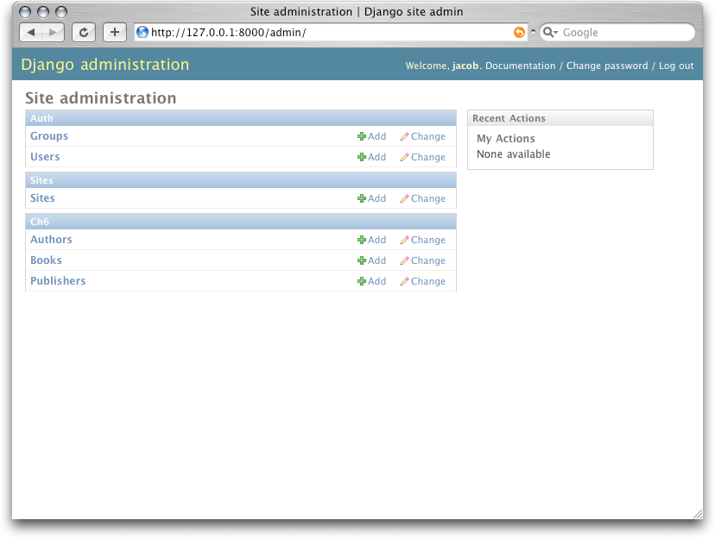
Admin site
Django provides a fully-fledged admin site with the django.contrib.admin app
Create an admin superuser
Set up settings.py (set up by default)
Set up the route (set up by default)
Hook models to the admin site
Customize the admin site (optional)
In someapp1/admin.py:
from django.contrib import admin
from item.models import Item
admin.site.register(Item)

Slide 34
User model
Django provide an authentication model with the django.contrib.auth
Use the provided model to create views for login, registration, ect…

Slide 35
User model
Django provide an authentication model with the django.contrib.auth
Use the provided model to create views for login, registration, ect…
OR use the default views adding the required routes and templates
Login template:
{% extends "base.html" %}
{% block content %}
<form method="post">
{% csrf_token %}
{{ form.as_p }}
<input type="submit" value="Login" />
<input type="hidden" name="next" value="{% url 'index' %}" />
</form>
{% endblock %}
urls.py:
url('^login/','django.contrib.auth.views.login', {'template_name': 'login.html'}, name='login'),

Slide 36
User model, extending it
Provided user model is basic, to extend it:
Override the default user model with AUTH_USER_MODEL in settings.py
Not supported by migrations, do it before setting up the DB
Not recommended for reusable apps

Slide 37
User model, extending it
Provided user model is basic, to extend it:
Override the default user model with AUTH_USER_MODEL in settings.py
Not supported by migrations, do it before setting up the DB
Not recommended for reusable apps
OR Add a one-to-one model linked to the user (proxy-model)
Called a profile model
very useful if you don’t want to change the auth
Use signals to link there creation/modification to user creation/modification
from django.contrib.auth.models import User
class Employee(models.Model):
user = models.OneToOneField(User)
department = models.CharField(max_length=100)

Slide 38
Django, pros & cons
Pros
Easy to learn
Easy to setup / deploy in dev
Build in admin & authentication

Slide 39
Django, pros & cons
Pros
Easy to learn
Easy to setup / deploy in dev
Build in admin & authentication
Cons
Non usual nomenclature / conventions
Big overhead

Slide 40
Django, pros & cons
Pros
Easy to learn
Easy to setup / deploy in dev
Build in admin & authentication
Cons
Non usual nomenclature / conventions
Big overhead
Matter of taste
Python
Lack of diversity (one way of doing things)

Slide 41
Thank you for your time!
Any Questions?
Jean-Matthieu Gallard

