Slide 1
ESB with Openshift
COMPANY
GEPARDEC IT SERVICES GMBH
SUPERVISOR
DI (FH) PETER KULCZYCKI
ING. THOMAS HERZOG B.SC. / ESB IN OPENSHIFT

Slide 2

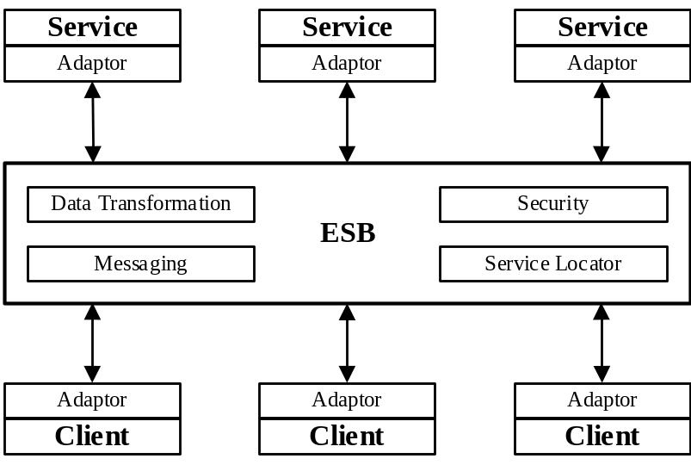

Content
Infrastructure as Code
Openshift Basics
MicroProfile Specifications
Prototype Design / Implementation
Demo
Evaluations
http://dev.solace.com
https://www.openshift.com/
ING. THOMAS HERZOG B.SC. / ESB IN OPENSHIFT

Slide 3
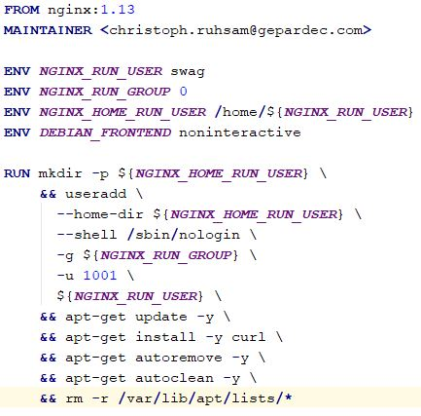
Infrastructure as Code
Consistency
All systems are consistent with the definition
Repeatability
Changes can be repeated with same outcome
Reproducibility
System and changes can be reproduced
Disposable
Dispose and Re-Create instead of heavy updates
ING. THOMAS HERZOG B.SC. / ESB IN OPENSHIFT

Slide 4
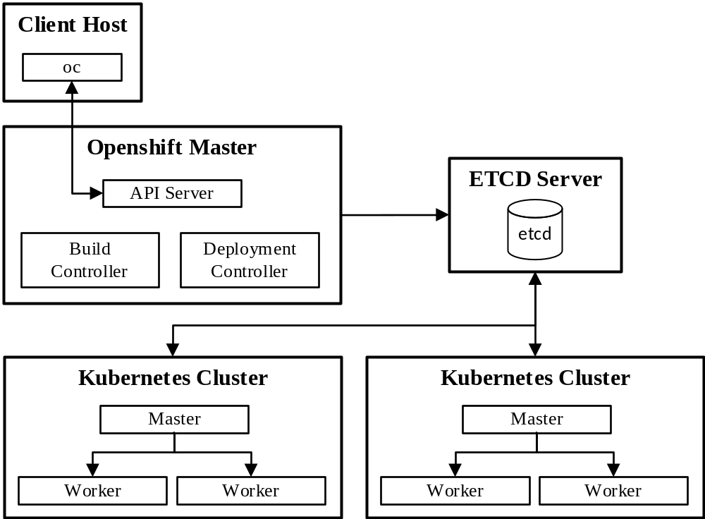
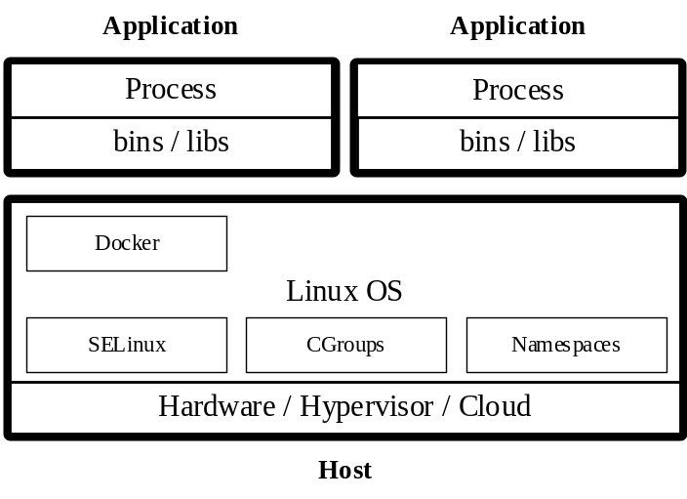
Openshift Basics
Docker
Openshift / Kubernetes Cluster
ING. THOMAS HERZOG B.SC. / ESB IN OPENSHIFT

Slide 5
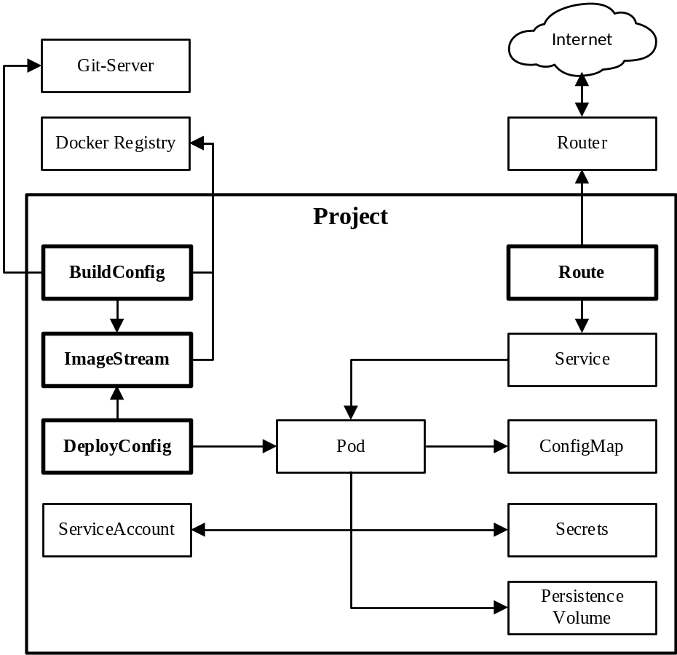
Openshift Basics
Kubernetes
Openshift
Namespaces not protected
Direct usage of Docker Images
Only cluster state ensured
No rollout behaviors
  Starts Pods
  Stops Pods
No application templates
Project isolates Namespaces
Abstraction of Docker Image (IS)
Automated Build -> Deployment
Different Rollout behaviors
  Canary releases
  Blue – Green Releases
Lots of application templates
Openshift Project
ING. THOMAS HERZOG B.SC. / ESB IN OPENSHIFT

Slide 6



Microprofile Specifications
MicroProfile-Config
ConfigSource, Parameter Injection
MicroProfile-Fault-Tolerance
Resilience, Retries, Timeouts, Fallbacks
MicroProfile-Health
Health endpoint ready / liveness probes
MicroProfile-Metric
Counter, Timer, node state, runtime state
MicroProfile-OpenTracing
Service / Method call chain tracing
https://microprofile.io
https://wildfly-swarm.io/
https://github.com/Netflix/Hystrix
ING. THOMAS HERZOG B.SC. / ESB IN OPENSHIFT

Slide 7



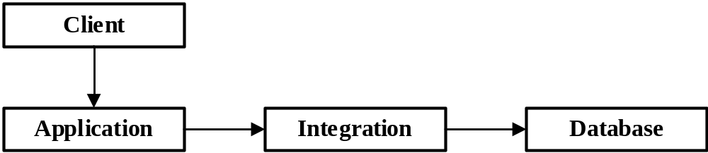
Prototype
https://www.keycloak.org/
https://www.jaegertracing.io/
https://www.graylog.org/
https://microprofile.io
https://wildfly-swarm.io/
https://www.openshift.com/
ING. THOMAS HERZOG B.SC. / ESB IN OPENSHIFT

Slide 8
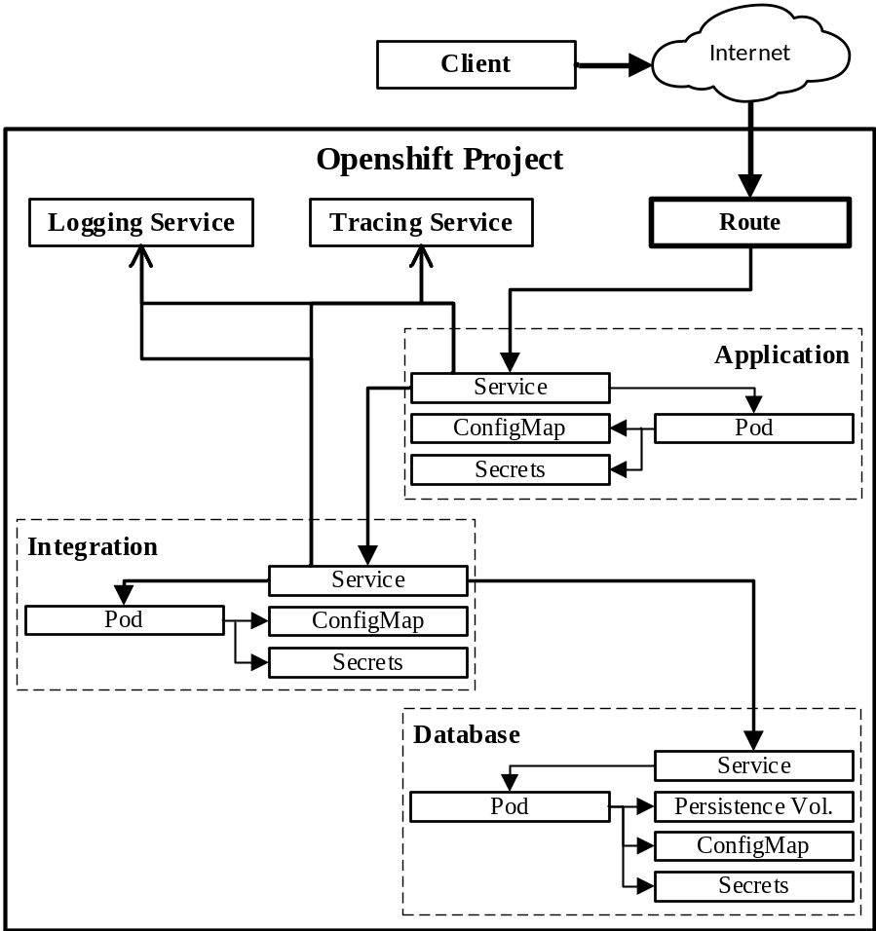
Prototype Openshift Project
Legacy Database
Only accessed by the integration service
Integration Service
Performs database access and data transformation
Application Service
Consumes data loaded by the integration service
Client
Consumes data loaded by the application service
ING. THOMAS HERZOG B.SC. / ESB IN OPENSHIFT

Slide 9

Prototype Monitoring
Jaeger (Opentracing)
Tracks spans of calls
Graylog
Log aggregation over all services
Keycloak
Oauth2 authentication between services/client-service
Swagger-UI
Tooling for testing documented REST-API
https://www.jaegertracing.io/
https://www.keycloak.org/
https://www.graylog.org/
https://swagger.io/
ING. THOMAS HERZOG B.SC. / ESB IN OPENSHIFT

Slide 10

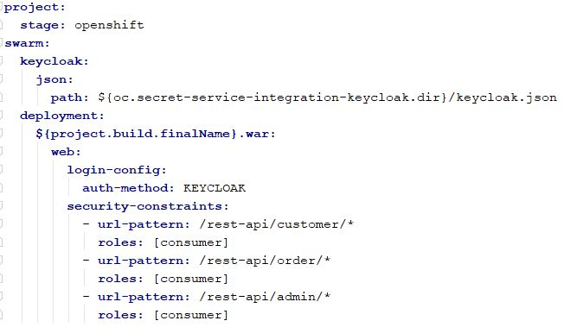


Prototype Implementation Security
Secured Service
1. Declare Wildfly-Swarm Keycloak fraction
2. Inject secret holding adapter config
3. Mount injected secret volume
3. Configure Openshift stage security
ING. THOMAS HERZOG B.SC. / ESB IN OPENSHIFT

Slide 11
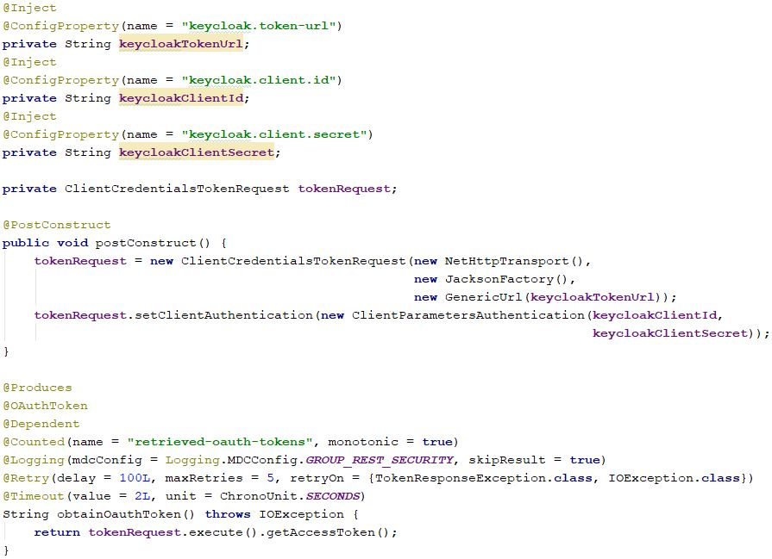


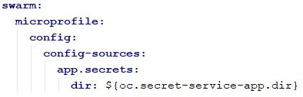
Prototype Implementation Security
Secured Service Consumer
1. Inject secret holding adapter config
2. Mount injected secret volume
3. Define where to load injected configurations
4. Implement Oauth2 token retrieval
ING. THOMAS HERZOG B.SC. / ESB IN OPENSHIFT

Slide 12
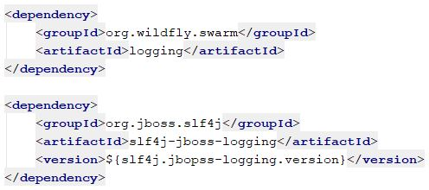
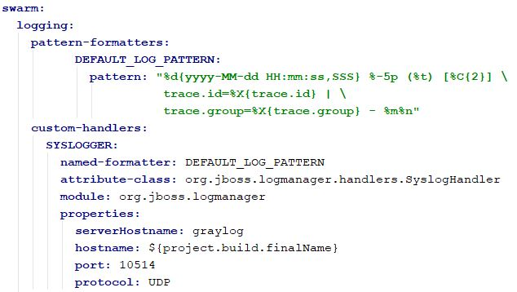
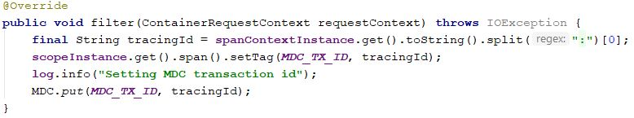
Prototype Implementation Logging
All Services
1. Declare logging fraction and log implementation
2. Capture OpenTracing trace id to connect service logs to current trace
3. Configure log formatter and syslog log handler
ING. THOMAS HERZOG B.SC. / ESB IN OPENSHIFT

Slide 13

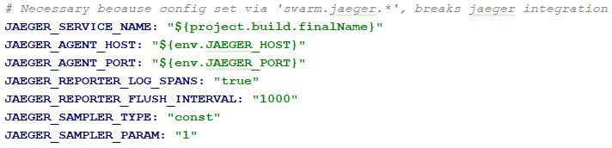
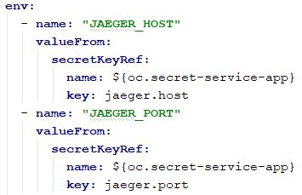

Prototype Implementation Tracing
All Services
1. Declare OpenTracing fraction
3. Configure OpenTracing fraction
2. Inject Jaeger host/port from secret into env variables
4. Annotate traceable type or method with @Traced
ING. THOMAS HERZOG B.SC. / ESB IN OPENSHIFT

Slide 14
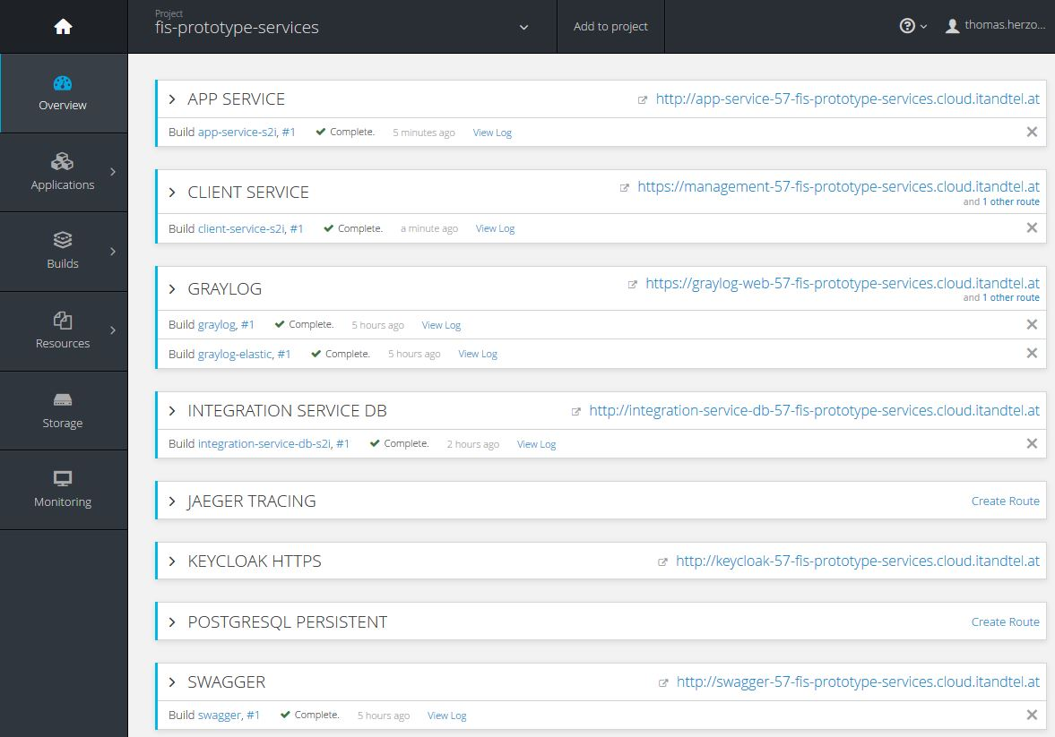
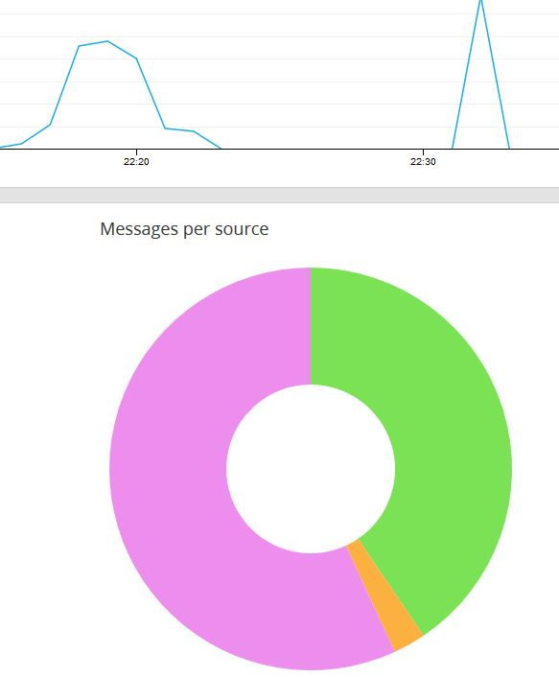
Prototype DEMO
ING. THOMAS HERZOG B.SC. / ESB IN OPENSHIFT

Slide 15
Evaluations
Goals of the thesis
Multistage Configuration
How to configure different kind of services for multiple stages in Openshift, with least of effort ?
API-Management
How to manage different version of services in Openshift ?
Transformers and Adapters
How to integrate adapters and transformer services in Openshift ?
Security
How to secure services in Openshift ?
ING. THOMAS HERZOG B.SC. / ESB IN OPENSHIFT

Slide 16
Evaluation Multistage Configuration
MicroProfile-Conifg
Abstraction form underlying configuration source (ENV, System Props, properties files, custom source)
@Inject @ConfigProperty(name=“project.developers”) private Developer myProp;
project.developers=[{“name”: “Thomas”}, {“name”: “Erhard”}]
Wildfly-Swarm project-stages.yml / project-<stage>.yml
Wildfly-swarm configurations support ENV, System Props and Maven Props
java –jar –s other-projet-stages.yml –Dswarm.project.stage=dev
Openshift ConfigMap / Secret
Application environment provides configuration and secrets and protects them
One project, one stage, one configuration, same binary
ING. THOMAS HERZOG B.SC. / ESB IN OPENSHIFT

Slide 17

Evaluation API-Mangement
Need for API Management
Used by multiple clients
External clients could be involved
Are all clients known ?
Requirement for good API Management
Design a stable API from the beginning
Keep abstraction between internal and external models
Plan your migrations well
Keep only backward compatible as long as needed
Public services need API access tracking
https://www.benfranklinplumbingmn.com
ING. THOMAS HERZOG B.SC. / ESB IN OPENSHIFT

Slide 18
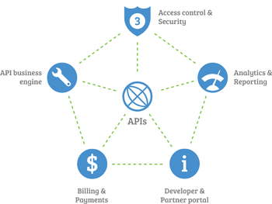
Evaluation API-Mangement
Path Versioning
/rest-api/customer/v1/list
Content-Type / Accept Header Versioning
Accept: application/vnd.myapp.user.v1+json;qs=0.9
Accept: text/json; version=1;qs=0.5
Query Parameter Versioning
/rest-api/customer/get/1?version=2
Swagger
Annotations, CodeGen, UI
https://swagger.io/
https://blog.cloud-elements.com
ING. THOMAS HERZOG B.SC. / ESB IN OPENSHIFT

Slide 19
Evaluation Transformers and Adapters
Global Public Service API (mostly REST)
Clients use provided / generated client or integrate it manually. (Swagger CodeGen)
Public API must abstract from underlying models, no model pass through
Data Transformation
Java-Code, Dozer, XSD, JSON, YAML, … possible in microservice itself
If separately needed, then build up the same way as the other services (act as proxy service)
Adapter
Not needed for internal service hosted on ESB (Openshift)
Service in Openshift can act as Adapter for external service
Adapter can be provided for external service
ING. THOMAS HERZOG B.SC. / ESB IN OPENSHIFT

Slide 20
Evaluation Security
Openshift Project
Isolates services within a namespace (Controlled internal/external access)
Openshift Secrets
Only reference secret name and property keys, but never values
Normal JEE-Security
Security Constraints, EJB-Security, Deltaspike-Security, JEE8-Security-API, …
Microprofile-Config
No source code has access to configuration source
ING. THOMAS HERZOG B.SC. / ESB IN OPENSHIFT

Slide 21
Thank you for your attention
Any questions ?
ING. THOMAS HERZOG B.SC. / ESB IN OPENSHIFT

