Slide 1
ESB with Openshift
Company: Gepardec IT Services GmbH
Supervisor: DI (FH) Peter Kulczycki

Slide 2
Content
Openshift Basics
Microprofile Specifications
Prototype Design
Prototype Implementation
API-Management
Demo
Evaluations

Slide 3
Openshift Basics
Docker
Openshift / Kubernetes Cluster

Slide 4
Openshift Basics
Kubernetes
Openshift
Namespaces not protected
Direct usage Docker Images
Only cluster state ensured
No rollout behaviors
Starts Pods
Stops Pods
No application templates
Project isolates Namespaces
Abstraction of Docker Image (IS)
Automated Build -> Deployment
Different Rollout behaviors
Canary releases
Blue – Green Releases
Lots of application templates
Openshift Project

Slide 5



Microprofile Specifications
microprofile-config
ConfigSource, Parameter Injection
microprofile-fault-tolerance
Resilience, Retries, Timeouts, Fallbacks
microprofile-health
Health endpoint ready / liveness probes
microprofile-metric
Counter, Timer, node state, runtime state
microprofile-opentracing
Service / Method call chain tracing
https://microprofile.io
https://wildfly-swarm.io/
https://github.com/Netflix/Hystrix

Slide 6




Prototype
https://www.keycloak.org/
https://www.jaegertracing.io/
https://www.graylog.org/
https://microprofile.io
https://wildfly-swarm.io/
https://www.openshift.com/

Slide 7
Prototype Openshift Project
Legacy Database
Only accessed by the integration service
Integration Service
Performs database access and data transformation
Application Service
Consumes data loaded by integration service
Client
Consumes data from the application service

Slide 8

Prototype Monitoring
Jaeger (Opentracing)
Tracks Spans of calls
Graylog
Log aggregation over all services
Keycloak
Oauth2 authentication between services
Swagger-UI
Tooling for testing documented REST-API
https://www.jaegertracing.io/
https://www.keycloak.org/
https://www.graylog.org/
https://swagger.io/

Slide 9

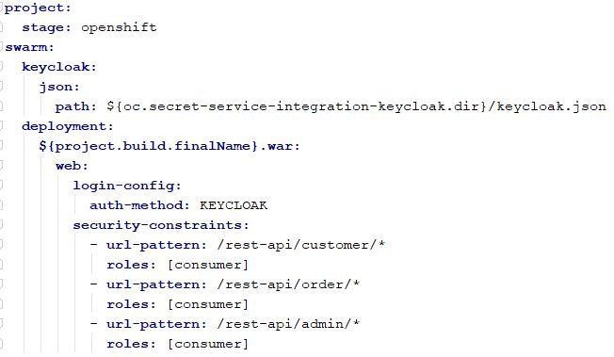


Prototype Implementation Security
Secured Service
1. Declare Wildfly-Swarm Keycloak Adapter
2. Inject secret holding adapter config
3. Mount injected secret volume
3. Configure Openshift stage security

Slide 10
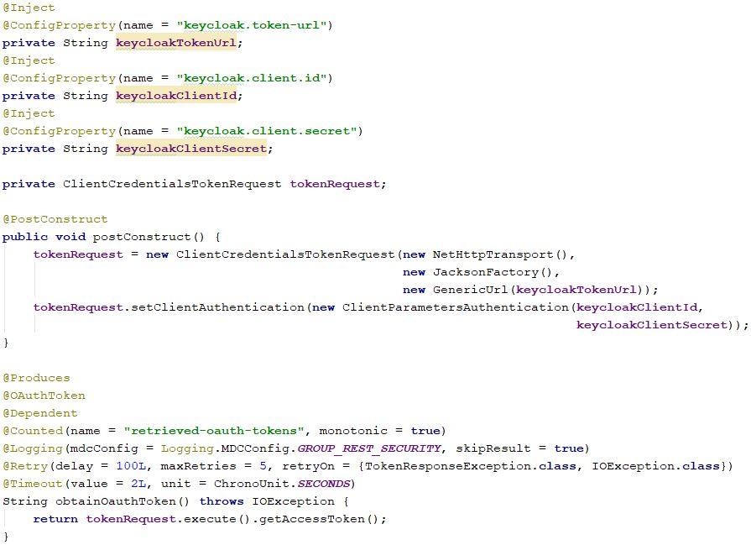


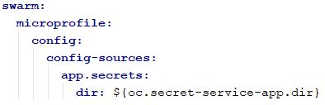
Prototype Implementation Security
Secured Service Consumer
1. Inject secret holding adapter config
2. Mount injected secret volume
3. Define where to load injected configurations
4. Implement Oauth2 token retrieval

Slide 11
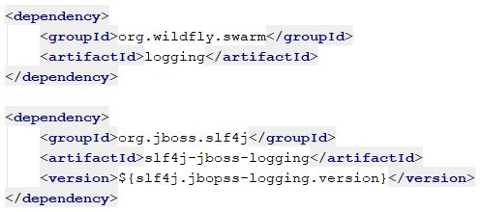
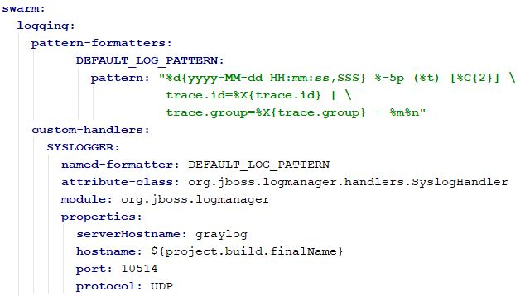
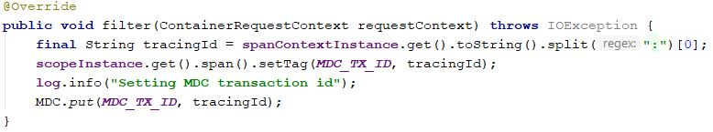
Prototype Implementation Logging
All Services
1. Declare logging fraction and log implementation
2. Capture OpenTracing trace id to connect service logs to current trace
3. Configure log formatter and syslog log handler

Slide 12

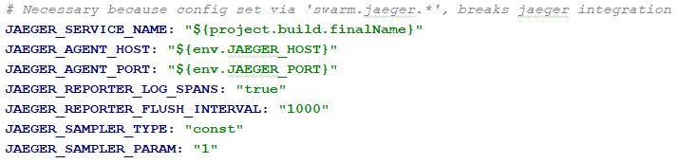
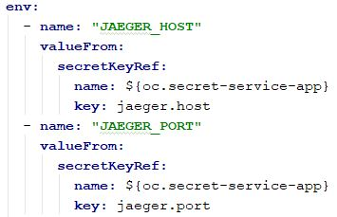

Prototype Implementation Tracing
All Services
1. Declare OpenTracing fraction
3. Configure OpenTracing fraction
2. Inject Jaeger host/port from secret into env variables
4. Annotate traceable type or method with @Traced

Slide 13
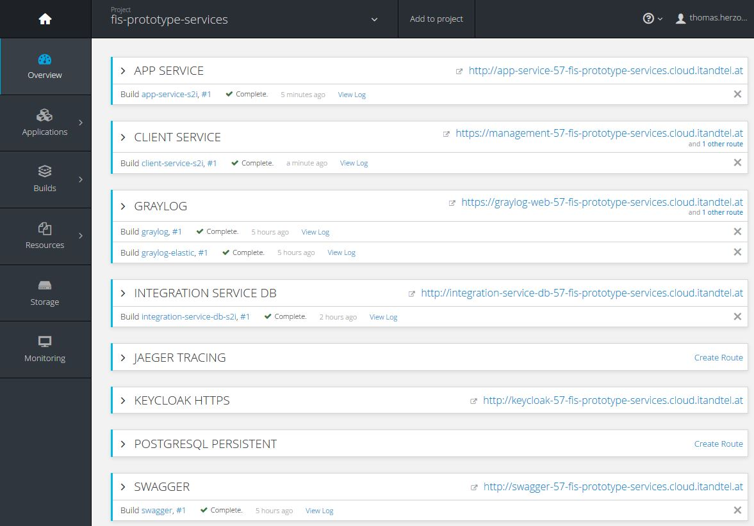
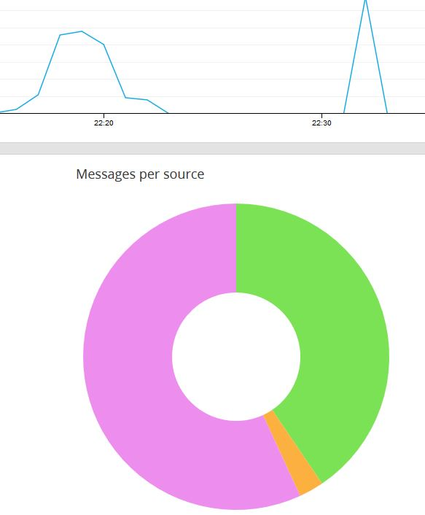
Prototype DEMO

Slide 14

API-Management
Need for API Management
Used by multiple clients
External clients could be involved
Are all clients known ?
Requirement for good API Management
Design a stable API from the beginning
Keep abstraction between internal and external models
Plan your migrations well
Keep only backward compatible as long as needed
Public services need API access tracking
https://www.benfranklinplumbingmn.com

Slide 15
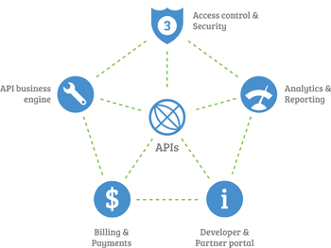
API-Management
Path Versioning
/rest-api/v1/customer/list
Content-Type / Accept Header Versioning
Accept: application/vnd.myapp.user.v1+json;qs=0.9
Accept: text/json; version=1;qs=0.5
Query Parameter Versioning
/rest-api/customer/get/1?version=2
Swagger
Annotations
CodeGen
UI
https://swagger.io/
https://blog.cloud-elements.com

Slide 16
Security
Openshift Project
Isolates services within a namespace (Controlled internal/external access)
Standard JEE-Security
Security Constraints, EJB-Security, Deltaspike-Security, EE8-Security-API, …
Developers don’t touch secrets anymore
Only reference secret name and property keys, but never values
Secrets
Annotations
CodeGen
UI

