Slide 1
Scopus FAST Replacement Project Elaboration Phase Report
June 17-18, 2014
NYC
Notes:
Attendees: Slaton, Jim; Kortekaas, Mark; Allen, Bradley P; Shillum, Chris A; Swenson, Eric; McBeath, Darin W; Kohler, Curt; Griffiths, Gillian; Benson, David; Mahaya, Donald; Stark, Wesley; van Acker, Saskia

Slide 2
Agenda
Time | Topic | Goal
Tuesday
1-1:30 PM | Opening remarks and logistics | Get alignment on day’s objectives and process
1:30-5:00PM | Elaboration phase review | Report on PoC implementation and evaluation and recommendation
Wednesday
1pm – 1:30pm | Questions review | Address any questions raised from previous day
1:30pm – 2:30pm | Financial and Schedule review | Present draft recommendation for FAST Replacement execution phase
2:30pm – 4pm | Draft Business Case Review | Discuss and iterate on business case components as a group
4pm – 5pm | Pre-IRB planning and next steps | Summarize decisions, determine tasks for business case preparation, and finalize IRB date for business case review

Slide 3
Project overview
Project Description
The goal of the Scopus FAST Replacement Project was to develop PoCs for two technology options (Solr and Mark Logic), evaluate the options against a set of consistent criteria, and perform detailed analysis and planning for next stage. The project is undertaken to reduce operating costs for search and to provide a platform for delivering search solutions addressing future product requirements. The estimated total savings is $3.2m and resolves the dependency on MS/FAST hosting for search. The overall objective for the project is to complete the migration of the FAST Search for Scopus by mid-2015.
Current Status Summary
Technology scoring done with final sizing/cost information Captured data on load times and performance test results Completed Feature/Functions checklists and architecture documentation Preliminary schedule for the release prepared High Availability and Disaster Recovery support folded into the sizings Finalized cloud hosting and logistics Business Case proposal completed for review at the Hothouse
Milestones | Date
Performance test harness smoke test | Feb 10,2014
Feature/function definitions and checklist | Feb 24, 2014
POC systems developed | Mar 24, 2014
Feature/function checklist and deviance analysis for POCs | Apr 7,2014
Alternative search solution cost/benefit analysis | Apr 21, 2014
Draft Business Case as input for Hothouse | Apr 21, 2014
Milestones | Date
Hothouse | June 18, 2014
Business Case Ready for Review/Approval | July 2, 2014
Final Business Case Pre-approved/submitted to ELS PGO | July 10, 2014
IRB | July 21, 2014
Key Team Members
Name | Role
Brad Allen | Chair
Mark Kortekaas | Technology Owner
Chris Shillum | Product Owner
Eric Swenson | Scopus Representative
Dave Benson | Finance
Darin McBeath | Project Architect
Jim Slaton | Analysis & Planning Lead
Risks & Issues
Description | Assignee | Impact | Status
Availability of MarkLogic consultant for POC | Darin McBeath |  | Closed
Encounter Solr problems during POC | Darin McBeath |  | Closed
Complex feature requirements conflict with performance requirements | Jim Slaton | High | Closed

Slide 4
Technology options
Evaluated: currently viable alternatives
MarkLogic 7.0-2.2
Extensive internal experience across ELS Technology, especially within STEPS
Experience within RE at LN L&P, RBI
Evaluated with respect to one architecture
Unified: search and content repository using same cluster
SolrCloud v4.6
Extensive internal Solr experience across ELS Technology, especially within Clinical Key, JUMP teams.
First implementation of SolrCloud for Elsevier. RBI has implemented in their migration from FAST.
Same search engine as chosen for ScienceDirect

Slide 5
MarkLogic POC not completed
ML Properties access wouldn’t work due to inherent join, which impacted performance. It was envisioned that Properties could be quickly updated with all of the counts. Instead, counts would need to be kept in with the documents, driving the re-index of all newly cited documents.
POC Index was at 4.8TB. May have to grow up to 6TB to implement all features.
All content was in one database to model the current XOCS implementation. This was modelled this way due to licensing costs. This model caused performance constraints and deployment constraints.
ML performance was bad. 5x degradation in author/affil performance as core load increased. Since all content was in one database, the load of one content type impacted the performance of others. The core load was at 50 QPs, not even up to the 65 QPS required.
Can’t size/cost as ML didn’t meet requirements. Didn’t even test during content updates, nor did we add the retrieval (content/metadata) calls that the current web services drive.
Would’ve needed to invest up to $10,000 more to further test for the POC. All of the budgeted funding with ML consultant ($20,000) was used.
Recommended (and approved) to document final report and conclude the ML evaluation.

Slide 6
Benefits of SolrCloud
Simplifies the management of indexing content across multiple shards
Simplifies the load-balancing of queries across multiple replicas
Simplifies the distributed searching across multiple shards, providing for improving performance horizontally by adding smaller machines. We aren’t dependent on cloud provider to release instances with larger memory footprint.
Manages the redirection of queries when a shard becomes non-responsive
Works across Availability Zones with only 10 ms increase in avg query time. We are still well below the required query time.

Slide 7
PoC key assumptions
Use content snapshot and query log sample to drive testing
~8.1M affiliation profiles, ~49.7M author profiles, ~50.1M core records
~2.5M queries taken from Scopus logs
Focused on features specific to Scopus that were not already proven during 2013 SD Hothouse
Make updates to offline SolrCloud index as to not impact query performance and promote index one time a day at a minimum
Search engine unified w/content repository for MarkLogic

Slide 8
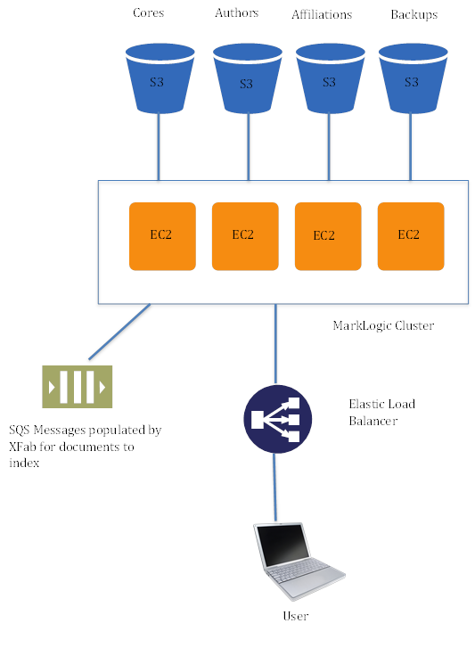
PoC Architecture – MarkLogic
Pros
Mature enterprise ready application server
It is an XML database and as such does more than just search
Professional support and dedicated resources for ongoing improvements
Cons
Limited HW flexibilty due to all content types in one database
High licensing cost compared to other search solutions being evaluated
Database configuration can be time consuming to match requirements and interplay with document structure, configuration and query construction can be complicated

Slide 9
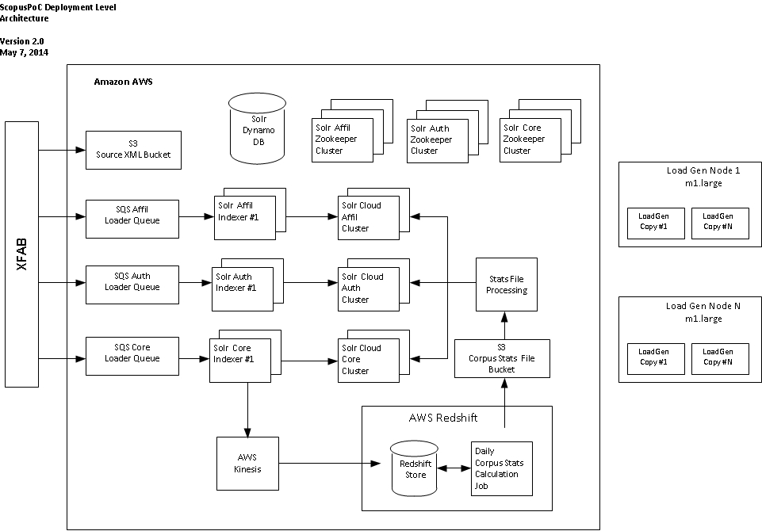
PoC Architecture – SolrCloud
Pros
Mature offering
Solr experience within Elsevier
Open Source (cost savings?)
Extensible/Flexible
Add handlers, parsers, etc.
Target specific content types to appropriately sized AWS EC2 instance types
Availability of 3rd party plugins (e.g. QPL)
Scalable
Cloud friendly
Apache Foundation supported, generally wider community support
Cons
No internal Elsevier experience with SolrCloud
Stop the world GC.
Lack of “Rack-Awareness” or control of shard-replica placement in cluster.

Slide 10
PoC Evaluation
Functionality
Does the PoC support the functionality currently implemented in Scopus?
How well do PoC query answer counts match those of Scopus?
Performance
How well does the PoC handle simulated Scopus query traffic?
How long does the PoC take to build and update an index?
Cost
What is the cost of a production version?
Relevance
Not evaluated (was covered in SD evaluation, which showed availability of relevance customization interfaces)

Slide 11
Functionality – approach
The PoC teams inspected each PoC to determine working support for a specific set of queries driven by an enumeration of current Scopus features
Evaluation team documented presence/absence of support for each query in the PoC
Discrepancies and potential mitigation are addressed in PoC reports
Answer counts were also gathered for specific queries and compared to known Scopus counts

Slide 12
Functionality – results (1 of 2)
Feature | MarkLogic | SolrCloud
Field Weightings | Used combo of Index-time weighting and query-time weighting | Supports either index-time or query-time weighting. Query-time was used for POC.
Related Articles | Tested via LoadTesting, but quality of results not evaluated. No custom functionality expected based on current Scopus related documents functionality. These were queries based on related references, authors, and keywords. | Tested via LoadTesting, but quality of results not evaluated. No custom functionality expected based on current Scopus related documents functionality, anticipated to be ok. These were queries based on related references, authors, and keywords.
Stemming | Utilized built-in support | Utilized KStem. Decision was made in Hothouse that Basis Technologies will be used. This is the same one as being used for ScienceDirect.
Wildcards | Utilized built-in support. Doesn’t work with stemming. Without adding index that significantly increases the index size, performance is impacted on searches with leading wildcards | Doesn’t work with stemming. Without adding reversewildcard index that significantly increases the index size, performance is impacted on searches with leading wildcards
Stop Words | No built-in support. Customized work to remove at query time. | Implemented using build-in support for the required fields. This removed the stop words at query time when they weren’t part of a phrase.
Spelling suggestions | Did not implement in POC, but is supported by ML if we provide the custom dictionary. | Did not implement in POC. Anticipate implementing Scopus/Scirus custom dictionary
Synonym Expansion | Did not implement in POC | Implemented using build-in support for the required fields.
High Cardinality Facets |  | After tuning, very little impact to query responses.
Exact Facet Counts |  | Ran various tests that all returned exact counts
Storing XML Markup | Does by default. | Did some basic testing to validate. After the fact confirmation the ability to use a special HTML style filter. Has been implemented by SD.

Slide 13
Functionality – results (2 of 2)
Feature | MarkLogic | SolrCloud
Exact Highlighting | Used built-in function | Used default simple highlighter. If not sufficient, other options may be performance hit or cost. SD uses the same highlighter.
Exact Phrase | Possible bug prevented this from working efficiently otherwise could lead to estimated counts and/or worse performance | Significantly increases the size of the index. 1.7% of user queries are exact phrases.
Loose Phrase |  | Doesn’t expand wildcards. Assuming that Solr 4.8 addresses this and is used for the project. 8-9% of user queries are loose phrases.
Field-level exact match, starts-with, ends with | Can be made to work with exact-value and wildcard | Implemented in two fields required based on query analysis.
Scoped Queries | Found a bug in MarkLogic | Not implemented in POC. The SD solution won’t support the complexity that Scopus requires, however follow-on work to the POC has identified a suggested algorithm, or potentially purchase external solution. Needs investigation from Gillian if deep scopes are still required.
Proximity Searches | Validated as part of feature/count testing | Validated as part of feature/count testing
Complex boolean support
Sorting |  | All current sorting options for search results & facets are supported.
Return Fields | Large data impact performance | Large number of fields impact performance
Multi-language support | Special multi-language support was not implemented. | Special multi-language support was not implemented, beyond ascii character folding.
Answer count | Minor variations. Several of them weren’t run due to data not existing in POC. Some may require customization. | Minor variations. Several of them weren’t run due to data not existing in POC. Some may require customization.

Slide 14
Costs – HW/hosting costs by search functionality –
Feature/function | SolrCloud
SCOPUS - Core Abstract | $ 559,273
SCOPUS - Dummy Abstract | $ 90,637
SCOPUS - Author | $ 171,765
SCOPUS - Affiliation | $ 60,165
Scopus - Patent | $ 87,813
Shared (vpc, route53,storage, kinesis) | $ 22,264
Shared Orchestration, Monitoring, Patching, etc.) | $ 105,191
Services (Search Service, CTO) | $ 24,468
TOTAL | $1,121,580
These are steady state costs for a full year (2016) that show contribution costs to the total for comparison

Slide 15
Single Region vs Multi-Region
Multi-Region Approach
Duplicate entire Production stack to second region
Current issue to resolve – Kinesis only currently runs in US-EAST. We would assume it will be EU-WEST as well by the time this project releases.
If we try to index in one region and copy to another, it will either lead us to an eventual consistency model or greatly delay “switching” time
CAFÉ will be modified to write to S3/SNS/SQS in 2 regions.
Solr pipeline will be modified to verify indexes are in sync before switching

Slide 16
Single Region VS Multi Year cost
These costs were shared during the hothouse as comparison. The final costs will change some.
Desire from Business is for 99.99% uptime, but in a disaster, data could be up to 24 hours old.
Decision in Hothouse to follow the “Tier 3” classification and run Single Region.

Slide 17
Performance – approach
Query performance testing was based on ~2.5M queries harvested from Scopus production logs to build a full query set for
Three sets of the full query set were used
91,533 affiliation record queries
289,655 author record queries
2,179,581 core records queries
Tests were performed by sending the subsets to the PoC systems
Cache priming was permitted prior to beginning the testing runs
Timings were made with no updates running as early on assumption of updating to off-line index was agreed on.
Times measured were client response times and compared with known average Scopus response times
Index performance testing was based on wall clock timing a full bulk load of each content set, along with two different sized subsets of content updates

Slide 18
Performance – results
Test | MarkLogic | SolrCloud
Affiliation Query (target of 4 qps) | Achieved 32 QPS standalone and exhausted all queries in under the hour allotted. Also surpassed all specific query type measurements/ Requirements. Only achieved 13 QPS in combination and navigators had problems. | Achieved 27 QPS and exhausted all queries in under the hour allotted. Also surpassed all specific query type measurements/requirements
Author Query (target of 9 qps) | Achieved 18 QPS standalone.. Also surpassed all specific query type measurements/requirements. Tested standalone but really needed tested in combination w/others. Only achieved 16 QPS in combination and navigators had problems. | Achieved 20 QPS and exhausted all queries in under the hour allotted. Also surpassed all specific query type measurements/requirements
Core Query (target of 65 qps) | Unable to meet QPS or response time targets. Only reached 50 QPS before things started failing. | Achieved 95 QPS. Also surpassed all specific query type measurements/requirements
Affiliation Load | 22:23 across all three types (affil, author, cores) combined | ~2:30 hours for full batch 38 minutes for 250K profiles ~1:10 hours for 750K profiles
Author Load | 22:23 across all three types (affil, author, cores) combined | ~5 hours for full batch ~1 hour for 250K profiles ~2:30 for 750K profiles
Core Load | 22:23 across all three types (affil, author, cores) combined | ~17:30 hours for full batch ~3:20 hours for 400K records ~7:30 hours for 1.2M records
**All SolrCloud load times could be tuned lower by adding additional index boxes. A performance limit was never hit.

Slide 19
Future requirements
“ I want to find the right author using their name and keywords related to their research” - this is presently not possible in the author collection because it is not in any way linked to the documents.
Interested in the functionality Darin mentioned of keeping “side” meta-information – if we could include some keyword info in the author index in that way we could finally crack this one.
Looking at what is coming down the road in the world of ROS – term suggestion at various levels and clustered by discipline ; - guided search (user types “bridge” and gets option to choose a number of directions – dentistry, construction, chemistry etc.
At least some minor ability to employ semantic technologies in combination with keyword search – some expression of relationships in triples etc.
Patents in a shared index (Patents 2.0 project). This is to allow mixed results of core documents and patents.
Sorting on things like usage metrics, altmetrics, tweet count, etc.

Slide 20
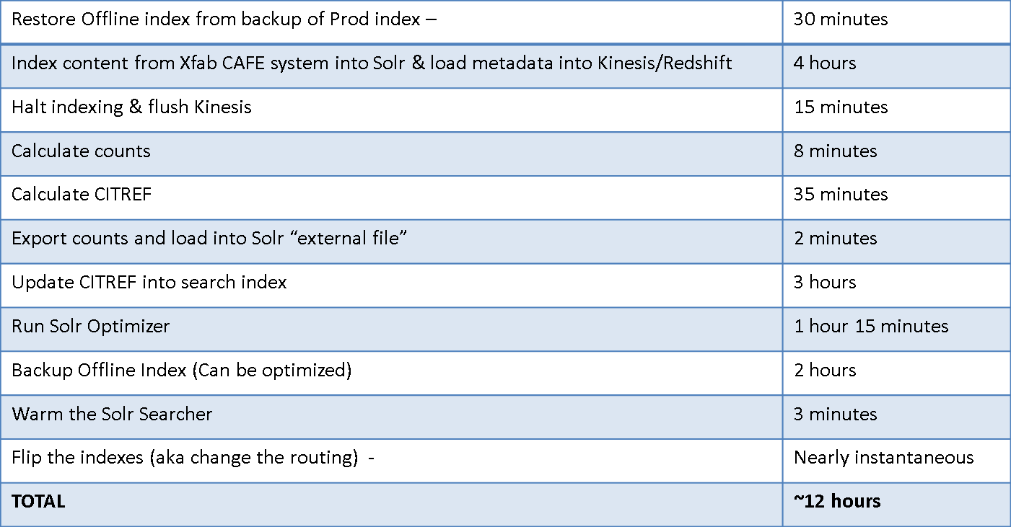
Index Switching Vs. Realtime Updates
 | Activities
Requirement | Completely in-sync indexed content with displayed counts (article citation counts, author published counts, institution published counts, Citref IDs, etc.)
Solution | The recommended architecture envisions indexing into an offline index for a time period, calculating all required counts, updating the index, and “flipping” to make the index live. Another control factor could be added that would instigate a flip after XX number of documents have been indexed. This might be useful if a large tuning batch has been submitted that drives many updates.
Indexing Pipeline Characteristics (Cores are the example)
Business Goal | It is the future goal of the business to tune the indexing pipeline to flip every 1 hour with indexed content and in-sync counts. This will not be achieved in this project. Currently content appears in the Scopus index every 6 hours into the Author/Institution cluster and every 12 hours in the Main (core/dummy) cluster.

Slide 21




Architecture of “Citation Counting”
SolrCloud Shards
Solr Loader
Indexed content
Citref data
Load counts into “external file” &
Update shard with citref (for cores)
Extracted metadata
Calculated Counts
External File
Manage metadata loading
Cache daily calculations
Calculate counts & citref

Slide 22
Choice of Kinesis/Redshift
 | Activities
Options Considered | Kinesis/Redshift HPCC Spark/Shark
Pros & Cons
Direction | Kinesis/Redshift due to low cost, east of use, fast ramp up, and fast performance. Due to the modularized architecture we can replace Redshift if a better approach is available.
 | Pros | Cons
Kinesis/Redshift | Resilient AWS service Low cost SQL interface ease to use Low ramp-up time Very Fast Both Redshift & Kinesis Proven during POC | Little Operational Experience
HPCC | RE asset Can scale for capacity Low cost Very Fast Could leverage Scival code | Not AWS proven, only prototyped Would require another POC RE hosted reliability issues Latency with exporting from AWS Long ramp-up time
Spark/Shark | Faster EMR engine than Hadoop Extensible for new data SQL interface w/Shark Opensource | New ELS technology No Operational Experience

Slide 23
Synchronization of counts
Current Architecture | Both MarkLogic and FAST are used for citation counting. FAST calculates counts while indexing content and updates static counts in the search index. The FAST counts are used for sorting, returned for display in search results, etc. FAST also sends a copy of the counts, on a per document basis, back to Xfab to load into MarkLogic The Metadata Retrieval service returns the FAST counts upon request (often to 3rd parties) CTO calculates citation counts dynamically upon request to display its table of information. Scopus has made changes to insure that any counts shown on one page consistently are from one source. As can be seen, discrepancies can exist (due to timing) between the three sources of counts
Proposed Architecture | Use the SolrCloud index as the source of all count As a final step of offline indexing, calculate all citation counts (including author-document and institution document counts) and load into the index before it is made live. The SolrCloud counts are used for sorting, returned for display, etc. SolrCloud will NOT send a copy of the counts back to Xfab and the counts will no longer be stored in MarkLogic. The Metadata Retrieval Service will be modified to contact SolrCloud for retrieval of any counts. CTO will be modified to build multiple SolrCloud queries and use Year facet counts for display in the table NOTE: There is very low use of CTO. This was performance tested during the POC and the proposed capacity includes supporting the volume of additional CTO queries. All counts that are displayed by Scopus will come from one source. As can be seen, discrepancies should no longer exist in the Scopus product for these counts. Journal Evaluation counts are calculated by Xfab currently on a monthly basis. Any change to this mechanism is not in the scope of this project. Sciverse Author Retrieval API currently uses Scival HPCC for citation counts. Any change to this mechanism is not in the scope of this project.

Slide 24
Cost/complexity drivers in functionality
Content types
Patents under Scopus
Dummy records in Scopus
Database Size & Indexing Performance
Exact Phrase
Large number of CIP fields returned (and subsequently need to be stored)
Stored XML markup
Citref Indexing
Query Performance
Large cardinality facets
Number of facets
Number of fields returned in results (especially XML)
Wildcard & Stemming
Leading Wildcards
Limiting Wildcard expansion
Complexity/Cost
Perfectly in-sync counts
Tombstone Queries
Scoped Search

Slide 25
Cost – included and excluded in estimates
Included | Excluded
Labour required to build, test and certify search solutions (e.g. PMO, regression testing, release management, performance testing, customer documentation) | TIO Labor (no incremental resources required out of TIO)
Consulting (FAST for exit and search consulting depending on solution chosen) | Contingencies
Hosting in Amazon cloud and Direct Connect
On-going support and maintenance of the search solution
Tools to support search

Slide 26
Costs – summary costs per option -

Slide 27
Conclusions
The evaluation results support the recommendation of SolrCloud to replace FAST
PoC functionality given sufficient time in execution phase will be met. Building off the ScienceDirect implementation will ease this
PoC performance goals were met and exceeded
MarkLogic was unable to meet the performance goals
By virtue of its open source implementation, SolrCloud supports customizability that may be needed to fit future requirements
Eliminating or relaxing some current requirements can further reduce cost and risk, e.g.
Eliminating exact phrase searching results in smaller indexes resulting in reduced HW cost
Relaxing the exact consistency of counts
Getting rid of Citref or lowering frequency of Citref updates (every 24 or 48 hours)

Slide 28
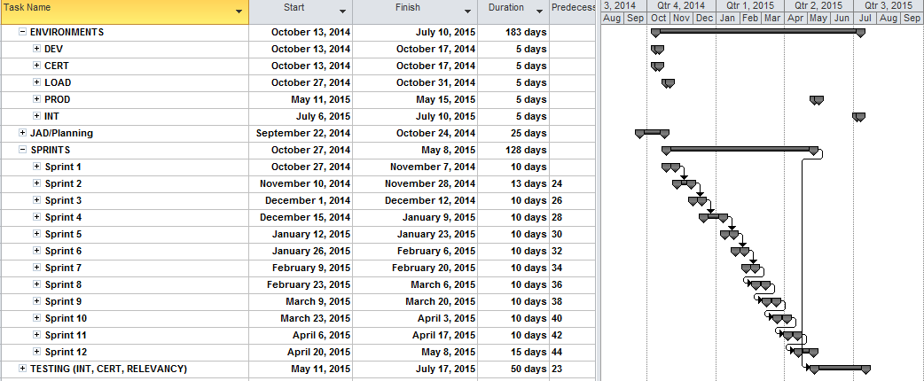
Proposed Timing
Notes:
1. Assumes August approval on business case.
2. Mid-October JAD to ‘kick off’.
3. Agile:
a. Functional Testing with iterations and full CERT cycle on the back-end.
b. Performance Testing starting with sprint 2.
If we don’t hit a summer release, the next opportunity would be January 2016.
FAST Proserve resources can ramp down after the last FAST release before this project releases.
FAST OPS resources should stay around until FAST retires.

Slide 29
Business Case Components for discussion
Financial Summary
Tangible Benefits
Intangible Benefits
Key Milestones/deliverables
Risks & Issues

Slide 30
BC Component - Cost Model
Notes:
Complete the above cost model for the cost already incurred during the elaboration phase and estimated project costs for Execution. Include any Transition phase costs in the Execution columns.
Core Team Cost: Include the cost of employees and core team contractors, as well as any internal labor contingency.
Incremental Cost: Include the cost of consultants or contractors that must be hired for the project, as well as all other costs associated directly with the project
Total Labor: The total internal and external for Execution/Transition should match the totals on slide 18.
Total Cost Execution Phases should match the Total Cash Expense – One Time (total all years) on slide 21.

Slide 31
BC Component - Investment Business Case Summary
Year |  | 2014 | 2015 | 2016 | 2017 | 2018 | 2019 | Total
Cash Benefits
Incremental Revenue |  | 0 | 0 | 0 | 0 | 0 | 0 | 0
Cost Savings |  | 0 | 524 | 3236 | 3236 | 3236 | 3236 | 13467
Other Incremental Benefits |  | 0 | 0 | 0 | 0 | 0 | 0 | 0
Total Cash Benefits |  | 0 | 0 | 0 | 0 | 0 | 0 | 0
Cash Expense – One Time
Total Cash Expense – One Time |  | -936 | -3315 | 0 | 0 | 0 | 0 | -4251
Cash Expense – Run Costs
Total Cash Expense – Run Costs |  | 0 | -996 | -1430 | -1441 | -1451 | -1462 | -6780
Net Cash Flow
Net Cash Flow - Discounted |  | -9360 | -3787 | 1805 | 1795 | 1785 | 1774 | 2436
Profit & Loss Account
Total Cash Expense – Capitalization |  | 724 | 2379 | 0 | 0 | 0 | 0 | 3103
Amortization |  | 0 | -259 | -1034 | -1034 | -776 | 0 | -3103
Total Profit & Loss Account |  | -212 | -1667 | 771 | 761 | 1009 | 1774 | 2436
Notes:
Includes cost and benefits associated with the execution and transition phases of a project.
Copy from Investment Business Case rows as follows:
Year – Row 12
Reference to rows in Investment Business Case
Incremental Revenue – row 21
Cost Savings – row 22
Other Incremental Benefits – row 23
Total Cash Benefits – row 25
Total Cash Expense One Time – row 58
Total Cash Expense - Run Costs – row 80
Net Cash Flow – row 86
Total Cash Expense - Capitalization – row 92
Amortization – row 93
Total Profit & Loss Account – row 96

Slide 32
BC Component - Tangible Benefits
Tangible Benefit | Benefit Type | Value | Owner | Due Date
Consistency of citation counts throughout the SCOPUS product. |  |  |  | 2015-Jul-18
Simplifies the management of indexing content across multiple shards |  |  |  | 2015-Jul-18
Simplifies the load-balancing of queries across multiple replicas |  |  |  | 2015-Jul-18
Simplifies the distributed searching across multiple shards |  |  |  | 2015-Jul-18
Manages the redirection of queries when a shard becomes non-responsive |  |  |  | 2015-Jul-18
5 year Cost Savings |  | $13.5m |  | 2020
Notes:
Complete the table with all tangible benefits the project is expected to deliver
Choose one of the benefit types:
Revenue Growth
Cost Innovation
Revenue Protection
Regulatory Compliance

Slide 33
BC Component - Intangible Benefits
Intangible Benefit | Owner | Due Date
Up-to-date search industry-standard search technology for Scopus which is in active development by a large open source community |  | 2015-Jul-18
The ability to leverage Elsevier operational expertise to operate and maintain the system without dependency on a third party vendor. |  | 2015-Jul-18
Improved content processing and information access performance will with reduced indexing latency and the ability to perform large-scale re-indexing in temporary cloud environments when needed. |  | 2015-Jul-18
Efficiency, availability and performance gains through elasticity of environments, ability to distribute geographically, and strategic fit through the deployment of search in the Amazon Cloud. |  | 2015-Jul-18
Notes:
Complete the table with all intangible benefits the project is expected to deliver

Slide 34
BC Component - Project Key Deliverables & Milestones
Deliverable | Planned Completion Date
SOLR Scopus search cluster | 2015-July-18
SOLR Search Service upgraded for SCOPUS searches | 2015-July-18
SCOPUS web application changes and fabrication pipeline updates needed to support searching on SOLR. | 2015-July-18
Query migrations for alerts, saved search, search history, RSS | 2015-July-18
Patent search (replacement for WINDEX) | 2015-July-18
API’s for SCIVERSE API’s and SCAPI SCIVERSIFY (current APIs) | 2015-July-18
Synchronization of counts on Scopus Pre-calculating cardinalities to be stored in SOLR for sorting purposes Modifying CTO to use SOLR for dynamic count queries (instead of MarkLogic) | 2015-July-18
Retirement of FAST Search including Windex/Hub components | 2015-Oct-10
Notes:
List high-level key project milestones, including go live and post deployment closure activities. (Includes project Execution and Transition phases)

Slide 35
BC Component - Risks & Issues
Risk | Likelihood | Impact | Mitigations
Impact to Scopus usage due to differences in relevance ranking of performance between Solr and FAST | L | H | Regular relevance testing during implementation testing will ensure that Solr relevance is at least as good as FAST, and performance testing will ensure that query performance is at least as good as FAST. In addition, the event of a major unforeseen impact following the Solr migration, the system can be rolled back to the FAST environment which wlll be retained for 3 months following go-live
Lack of ‘as is’ documentation of FAST/ resource availability for FAST. | M | L | Allocate some FAST budget to supporting the effort
Testing time for relevancy tuning is an unknown | M | L | Build into plan to accomplish this as the iterations happen instead of all at the end
Migration effort and impacts for FAST Search Clients | H | L | Costs for developing a proxy service have been included – this is expected to mitigate impacts to users of the search service as the migration occurs
Lack of experience with Solr search within Scopus | H | L | Utilize experienced resources from Clinical Key teams. Budget FAST and other consulting dollars if needed.
Notes:
Provide details of the risks and issues for the project
Likelihood: High, Medium, Low
Impact: Minor, Moderate, Severe

Slide 36
BC Component - Risks & Issues
Risk | Likelihood | Impact | Mitigations
Project is not approved in time to achieve critical release dates Project needs to start on time to meet critical Scopus release date in 2015 to avoid business impacts due to the renewal season. If these cannot be achieved, a one-year delay may be necessary, leading to deferral of cost savings | H | M | Request that stakeholders approved project promptly
Project does not meet timeline to achieve critical release dates Project needs to meet key milestones in order to avoid business impacts due to the Scopus renewal season. If these cannot be achieved, a one-year delay may be necessary, leading to deferral of cost savings | H | M | Close project monitoring and regular steering committee meetings with goal to take action early if the project is not meeting its schedule
Notes:
Provide details of the risks and issues for the project
Likelihood: High, Medium, Low
Impact: Minor, Moderate, Severe

Slide 37
Appendix
Detailed spreadsheet from sizing and cost analysis
Links to supplemental materials
Activities required prior to IRB (snapshot)
Investment Project Phases (diagram)

Slide 38
Build labour costs SolrCloud – Scopus
38

Slide 39
Supplemental materials
# | Documents | Type | Sharepoint Link
1 | Hothouse Agenda & Presentation | PPT | https://elsshare.science.regn.net/sites/AGProducts/ScopusSearch/Shared%20Documents/Hothouse%20documents/ScopusSearchHothouse_Final.pptx
2 | POC Eval: MarkLogic Results | Word doc | https://elsshare.science.regn.net/sites/AGProducts/ScopusSearch/Shared%20Documents/Hothouse%20documents/MarkLogicreport.docx
3 | POC Eval: SOLR Results | Word doc | https://elsshare.science.regn.net/sites/AGProducts/ScopusSearch/Shared%20Documents/Hothouse%20documents/SolrPOCResults-v1.2.docx
4 | AWS Infrastructure Sizing | Spreadsheets | https://elsshare.science.regn.net/sites/AGProducts/ScopusSearch/Shared%20Documents/Hothouse%20documents/SC%20FAST2SOLR%20AWS%20Sizing%20-%20Revised%2006%2016%202014.xlsx
5 | Labor Estimates Breakdown (Resourcing Model) | Spreadsheets | https://elsshare.science.regn.net/sites/AGProducts/ScopusSearch/Shared%20Documents/Business%20Case%20Prep/SC%20to%20SOLR%20resourcing%20model.xlsx
6 | FBC - DRAFT | Spreadsheets | https://elsshare.science.regn.net/sites/AGProducts/ScopusSearch/Shared%20Documents/Business%20Case%20Prep/Scopus%20to%20SOLR%20Investment_Business_Case%20v_3_2a.xlsm
7 | Business Case Prep (BC drafts, Resourcing Model, templates, timelines) | Sharepoint site / Shared Documents | https://elsshare.science.regn.net/sites/AGProducts/ScopusSearch/Shared%20Documents/Forms/AllItems.aspx?View=%7b9B6927F3%2dE6FE%2d4635%2dA9E2%2dEF0E54FEB1E6%7d
8

Slide 40
Activities required prior to IRB (for projects costing >1m)
Build and complete Business Case Materials
Business Unit (BU) Project Support notifies ELS PGO of intent to submit BC for review, requests IRB placeholder and plans a series of BC readiness and review meetings w/relevant Core Team Members to complete the business case and obtain necessary approvals
CTO (Mark Kortkekaas) responsible for arranging pre-meet with Dan Olley
BU Finance Director (Bob Munro replacement or delegate) responsible for arranging pre-meet with CFO
Project Sponsor or Delegated Project Sponsor responsible for arranging pre-meet with Managing Director of BU (Olivier Dumon)
A pre-meeting must be arranged to review the business case with Stuart Whayman (typically attended by the CFO and Budget Holder); and with Dan Olley (typically attended by the CTO and/or the Senior Technology Leader.)
Arrange Pre-Meet with CIO (Dan Olley), CFO (Stuart Whayman) & BU Managing Director (Olivier Dumon)
Obtain Pre-Approvals & Submit documentation to ELS PGO in order to secure timeslot
Documentation and written approvals must be provided to the Elsevier PGO seven business days prior to the requested IRB meeting.
IRB meeting will be confirmed by ELS PGO once documents and approvals are received.
The Business Case is a Microsoft PowerPoint slide deck which serves to capture all of the required information to enable the relevant decision makers to approve or decline funding for the Execution phase. The slide deck contains guidelines of how to complete each slide, on the notes pages - relies upon input from Product, Technology and Finance.
The Investment Business Case is to be completed by the Business Controller. Additionally, the Oracle Code Details worksheet submitted for the Elaboration phase is updated and submitted with the other business case documentation to extend the project code through the execution phase. If multiple tasks are required for tracking project costs of various work streams, the Task Detail tab on the Oracle Code Details worksheet is used to capture the task details.
BU Project Support collects approvals from Project Sponsor, Finance Director, Managing Director of BU
ELS PGO collects approval from CIO and CFO
Notes:
Some details pulled from ELS PGO Governance site, and catered to AGRM

Slide 41
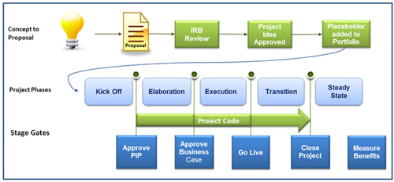
Investment Project Phases
Notes:
Projects over 1m require IRB approval. The Elsevier Investment Review Board meets twice monthly to manage the Elsevier project portfolio through allocation of investment funds, gating of project proposals, and verification of benefits delivered. Agenda items may include review of investment proposals, centrally-funded elaboration phases, and investment project business cases. Change requests for large extensions of schedule or budget also require IRB approval. Based on progress, the IRB may request specific project reviews be added to the meeting.
Graphic pulled from ELS PGO Governance site
Red Circle signifies where we are in the process for SCFAST2SOLR

Slide 42
Restore Offline index from backup of Prod index – | 30 minutes
Index content from Xfab CAFE system into Solr & load metadata into Kinesis/Redshift | 4 hours
Halt indexing & flush Kinesis | 15 minutes
Calculate counts | 8 minutes
Calculate CITREF | 35 minutes
Export counts and load into Solr “external file” | 2 minutes
Update CITREF into search index | 3 hours
Run Solr Optimizer | 1 hour 15 minutes
Backup Offline Index (Can be optimized) | 2 hours
Warm the Solr Searcher | 3 minutes
Flip the indexes (aka change the routing) - | Nearly instantaneous
TOTAL | ~12 hours
Notes:
For slide 17

