Slide 1
Plotting with Python
Advanced Research Computing Technology and Innovation Core
Web: https://arctic.gsu.edu Email: arc@gsu.edu Slack: gsu-hpc@slack.com

Slide 2
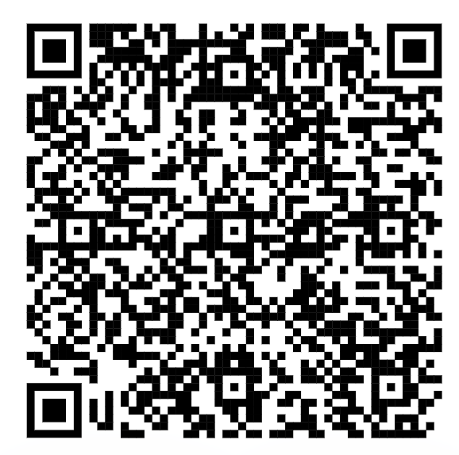
Introduction to Python - Prerequisites
Python 3.8+
pip install numpy
pip install matplotlib
pip install jupyter
pip install pandas
Download gapminder dataset
https://swcarpentry.github.io/python-novice-gapminder/files/python-novice-gapminder-data.zip

Slide 3
Introduction to Python - Outline
What is python?
Built in types and their operators
Single value
Multiple value
Control Structures
Methods and Classes
Programming Principles

Slide 4
What is python?
Programming Language
Extend by writing in python or C
Pros:
Write extensions in Python or C
Automated Memory Management
Simple Syntax
Cons:
Slower than alternatives

Slide 5
Why use Python if it is slower than C?
C requires a lot of know-how
Takes longer to code structures
Python has tons of libraries optimized in C
Numpy
Pandas
PyTorch
TensorFlow
i.e. widespread adoption leads to optimizations

Slide 6
Getting Started – Types
Boolean – True/False
string
None
Numbers
int (whole numbers)
+/- 2,147,483,647 (sys.maxint)
float (decimal numbers)
~1.797 * 10^308 w/ 15 digits
“sys.float_info”
complex
two floats
real & imaginary

Slide 7
Numeric Operators
Operator | Description
x + y | Addition
x - y | Subtraction
x * y | multiplication
x / y | quotient
x // y | floored quotient (i.e 3.0 to 3.99 = 3)
x % y | remainder
abs(x) | Absolute value (or magnitude for complex)
pow(x, y) or x**y | exponent

Slide 8
Variables
Storing stuff for later
Rules
Must start with a letter or _
Cannot start with a number
Can only contain alphanumeric characters
Case sensitive

Slide 9
Variables - Pitfalls
Types are important
Python is strongly typed
everything has a type
Python is dynamically typed
type decided at runtime
What does this mean?

Slide 10
Exercises
Now we have a fancy calculator!
Add 2 and 5
Divide 10 by 4
How many times does 256 go into 1064?
What’s left over?
2 to the 10 power?
Multiply 1.1 by 3
is 3.3 == 1.1 * 3?

Slide 11
Exercises
What values do the variables mass and age have after the following statements? mass = 47.5 age = 122 mass = mass * 2.0 age = age - 20

Slide 12
Exercises
Assigning values. What does this print out? first, second = ‘Grace’, ‘Hopper’ third, fourth = second, first print(third, fourth)
What types are the following variables? planet = ‘Earth’ apples = 5 distance = 10.5

Slide 13
Comparison Operators
Operator | Description
a == b | a and b are equal
a != b | a and b are not equal
a > b | a greater than b
a >= b | a greater than or equal to b
a < b | a less than b
a <= b | a less than or equal to b
a is b | object identity

Slide 14
Logical Operators
Not (!) | A | !A
 | T | F
 | F | T
or | A | B | A or B
 | T | T | T
 | T | F | T
 | F | T | T
 | F | F | F
and | A | B | A and B
 | T | T | T
 | T | F | F
 | F | T | F
 | F | F | F

Slide 15
Python - Truth Value Testing
Most types will return a Boolean when used with comparison and logical operators
Object returns true UNLESS
__bool__() returns false
__len__() returns zero
Translation (False)
False, None
Zero of any numeric type (0, 0.0, 0j, Fraction(0, 1)
Empty Lists (this will come later)

Slide 16
Assignment Operators
Operator | Description
x = y | Assign y to x
x += y | add x + y and assign to x
x -= y | x – y and assign to x
x *= y | x * y and assign to x
x /= y | x / y and assign to x
x //= y | x // y and assign to x
x **= y | x**y and assign to x

Slide 17
More Types - sequences
List
mutable sequence [ ]
tuple
immutable sequence ( )
range
immutable sequence of numbers
range(start, stop, step)
str
immutable sequence of Unicode characters “ “ or ‘ ‘

Slide 18
More Types - Dictionaries
Two sequences put together
{ }
Key – Value pairs
{ “key”: value, “key2”: value }

Slide 19
Sequence Operators
Operator | Description
x in s | True if an item of s is equal to x, else false
x not in s | False if item of s is equal to x, else True
s + t | concatenation of s and t (i.e. all elements of s and t in one)
s * n | add s to itself n times
s[i] | ith item of s. starts at 0
s[i:j] | all items between index i and j (doesn’t include j)
s[i:j:k] | items between I and j stepped by k
len(s) | Returns length of s (number of elements)
min(s) | smallest element of s
max(s) | largest item of s
s.count(x) | number of occurences of x in s
s.index(x[, i[, j]]) | index of first occurrence of x in s (optional: at or after I, before j)

Slide 20
More Sequence Operators - Mutable
Operator | Description
s[i] = x | item I of s is replaced by x
s[i:j] = t | slice of s from I to j is replaced by t len(t) == len(s[i:j])
del s[i:j] | s[i:j] = []
s.append(x) | appends x to the end of sequence
s.clear() | del s[:], not same as del s
s.extend(t) | extends s with content of t (i.e. s+=t)
s *= n | updates s with it’s contents repeated n times
s.insert(i, x) | inserts x into s at index i
s.pop(i) | retrieves item at i and deletes from s
s.remove(x) | removes first item from s where s[i] == x

Slide 21
Exercises
return a sequence of even numbers, from 0 to 100.
return a sequence of odd numbers from 0 to 100.
with the list [‘a’, ‘b’, ‘c’, ‘d’, ‘e’] slice ‘a’, ‘c’, ‘e’
with the list [‘a’, ‘b’, ‘c’, ‘d’, ‘e’] slice ‘b’ and ‘d’
with the same list, return a list of ‘a’ and ‘e’

Slide 22
Hints
You can use list(range(i, j, k)) to get a print of the list
shift start from first solution
i and j do not have to be defined
i or j can be defined without the other
you can use other operators inside slices or define another list directly from elements of s

Slide 23
Solutions
range(0, 100, 2)
range(1, 100, 2)
for 3-5: s = [‘a’, ‘b’, ‘c’, ‘d’, ‘e’]
s[::2]
s[1::2]
[s[0] + s[-1]] or s[::len(s)-1]

Slide 24
Control Structures
python normally completes sequentially
however, programs aren’t linear
what executes?
if … elif … else
Repeating over and over
while …
for …

Slide 25
Conditional flow
if Boolean:
do this if true
elif Boolean:
do this if first not true and this one true
else:
do this if nothing is true

Slide 26
Python Truth Value Testing (truthiness)
Any object is considered true unless:
__bool__ method returns False
__len__ method returns zero
Built in objects that are false
None, False
zero of any numeric type
0, 0.0, 0j, Decimal(0), Fraction(0, 1)
empty sequences
‘’, (), [], {}, set(), range(0)

Slide 27
Repeating things
while x:
Does something as long as x evaluates as true
for item in s:
repeats operation for every element (item) of s
Controlling execution in loops
skip this iteration: continue
stop iterating: break

Slide 28
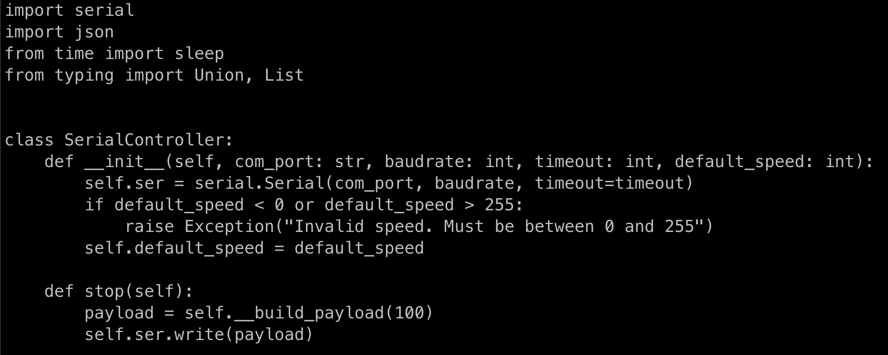
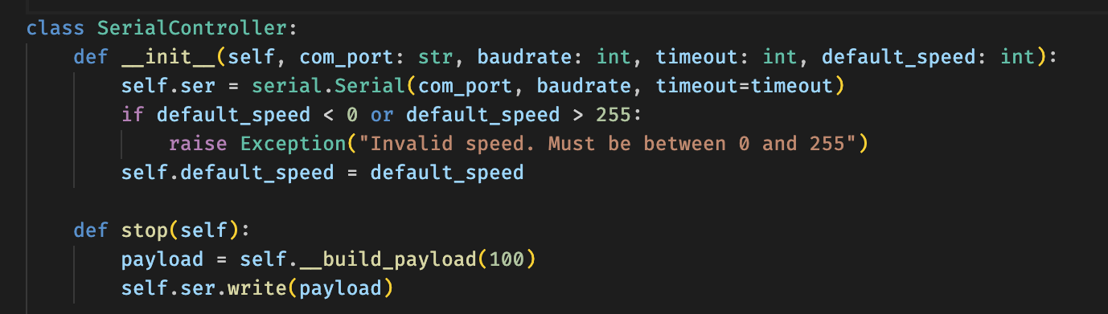
Moving to editing and executing files
Code editors
Visual Studio Code
notepad++
python3 ./path_to_file.py

Slide 29
More Exercises
Print the first 10 natural numbers using a while loop (while cond: print(…))
Count the total number of digits in 299,792,458.
Calculate the sum of all numbers from 1 to 60
Display the first 10 numbers of the Fibonacci sequence

Slide 30
Summary so far…
What types are available…
What you can do with them…
How to do it…
Control what gets done…

Slide 31
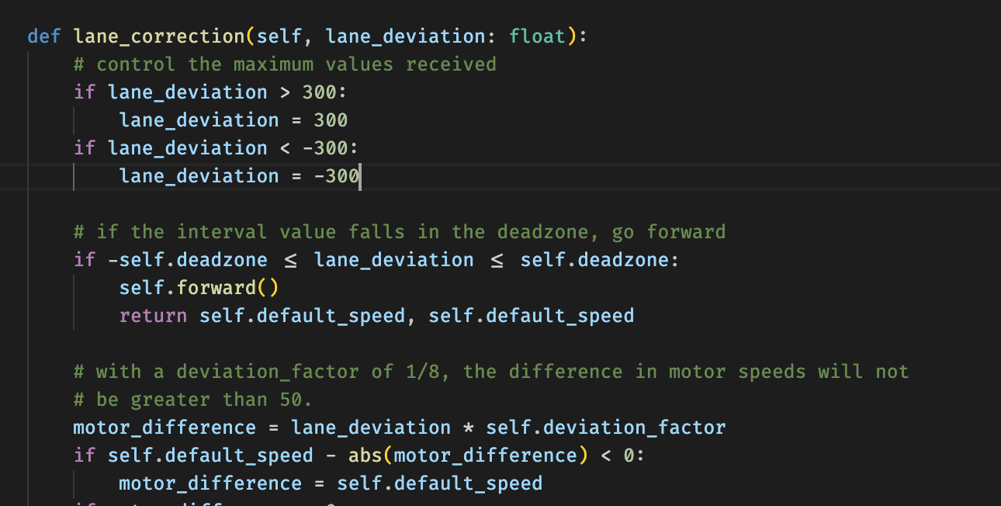
Writing reusable code
Methods
`def method_name(inputs)`

Slide 32
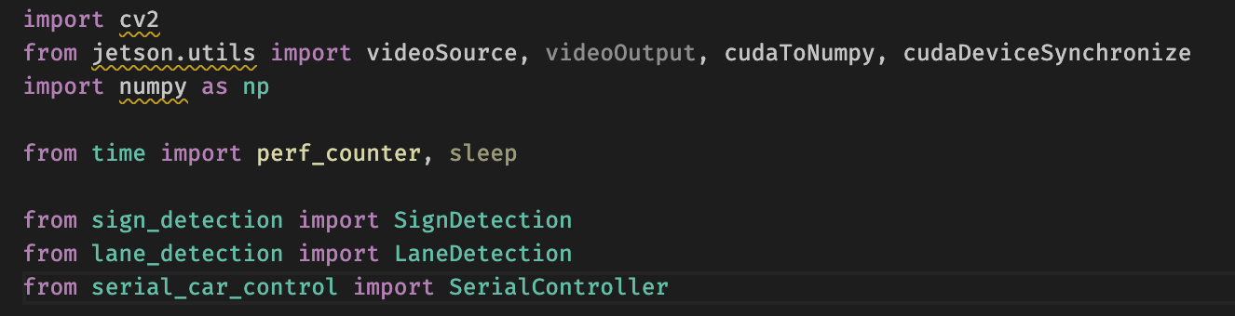
Using reusable code
import x [as rename]
from x import y

Slide 33
Exercises
Create methods for the previous exercises that can take an input…
Print the first n natural numbers using a while loop
Count the total number of digits in a number.
Calculate the sum of all numbers from 1 to n
Display the first n numbers of the Fibonacci sequence

Slide 34
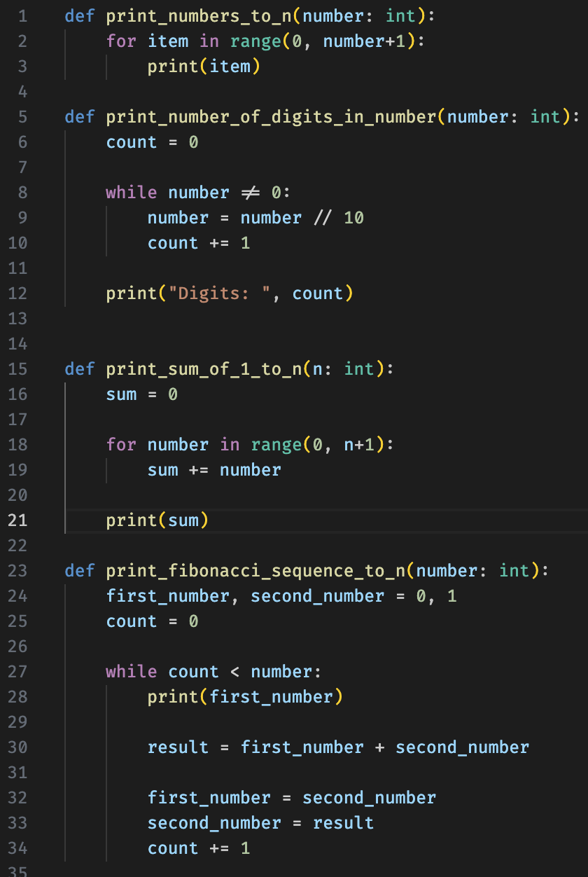
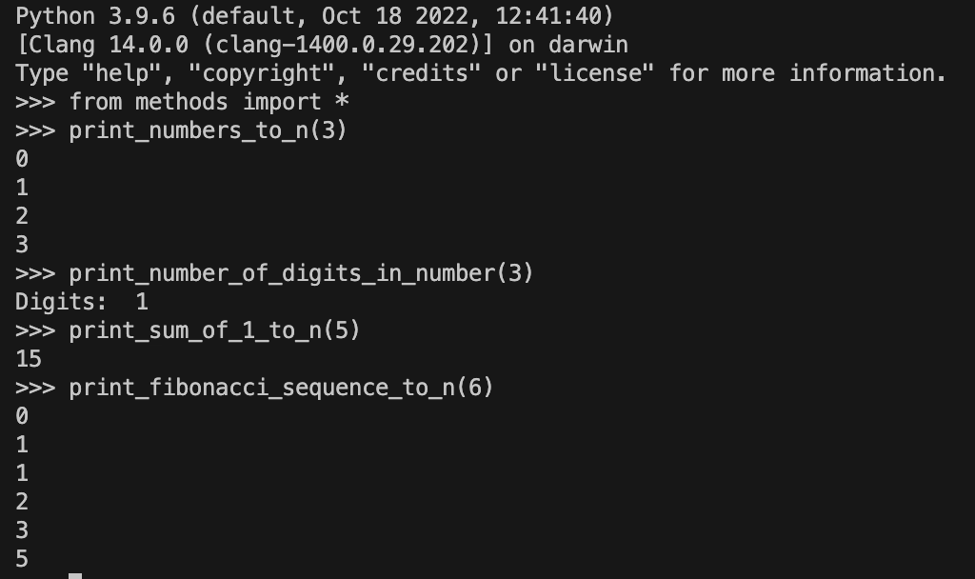
Solutions

Slide 35
Working with Data: Libraries
Pandas Dataframes
2 - dimensional table
columns have names
importing data
read_csv(“path_to_file.csv”, index_col=‘string’)
index: Column that describes each row
DataFrame.info() to get information on columns
DataFrame.columns stores columns as list
DataFrame.T to transpose
DataFrame.describe() returns summary stats

Slide 36
More Pandas
DataFrame.loc[…, …]
selects values by their label
can be sliced with :
DataFrame.iloc[…, …] gets integer location
Can use comparisons to get array of Booleans (called a mask)
Can use mask as a slice to get values
Aggregate on these values
Use dir(DataFrame) to see all functions

Slide 37
Pandas Exercises
Load the gapminder dataset for Europe
GDP per capita for all countries in 1982
GDP per capita for Denmark for all years
GDP per capita for all countries for years after 1985
GDP per capita for each country in 2007 as a multiple of GDP per capita for that country in 1952

Slide 38
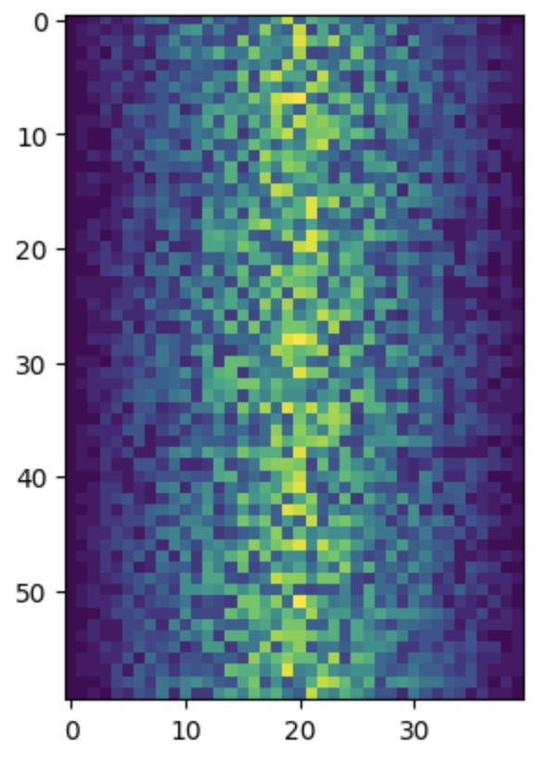
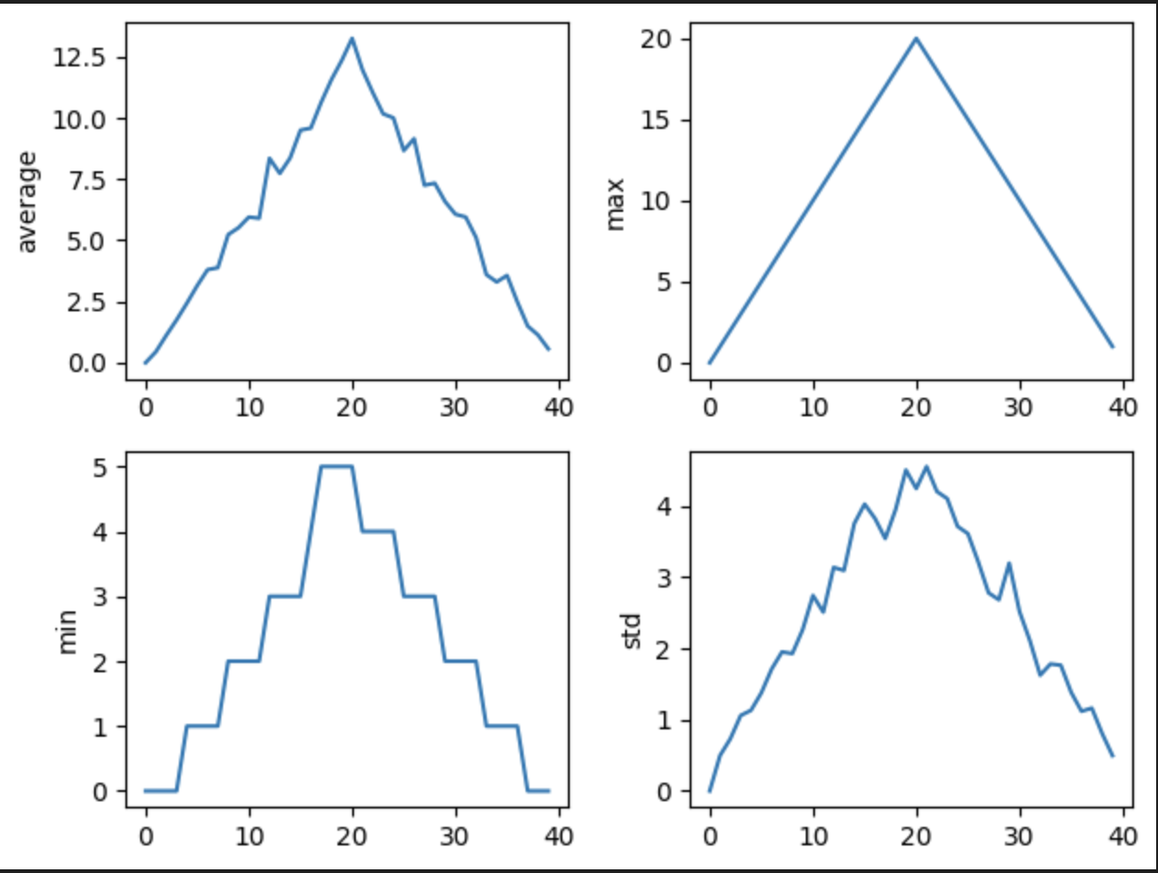
Visualizing Data: matplotlib
Can get data from an array and create multiple plots

Slide 39
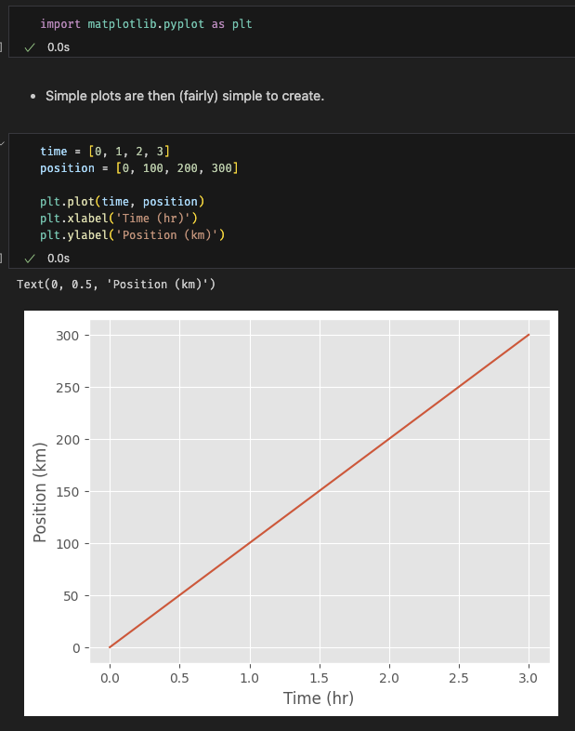
matplotlib
Python plotting library can show inline graphs with jupyter

Slide 40
Q & A
Contact us
https://arctic.gsu.edu
https://gsu-hpc.slack.com
arc@gsu.edu

Slide 41
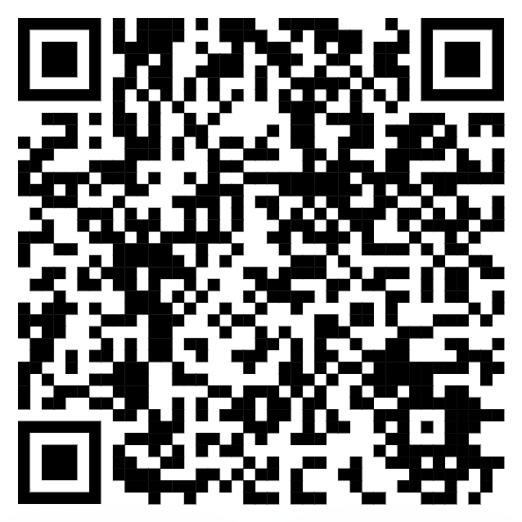
How did we do?
https://gsu.qualtrics.com/jfe/form/SV_82j2u3OumE3HYRU

