Slide 1

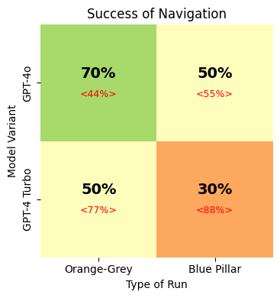

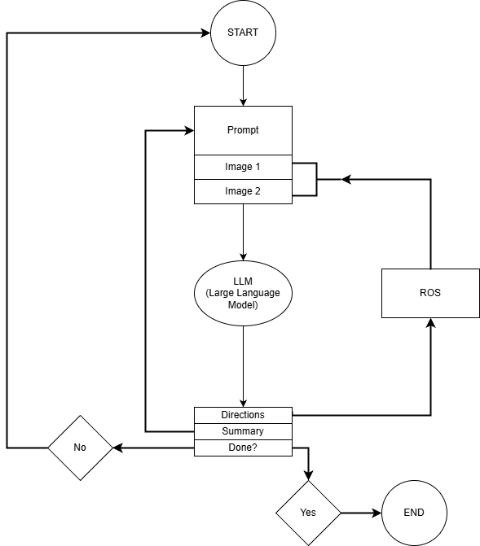


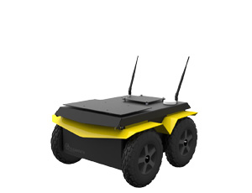
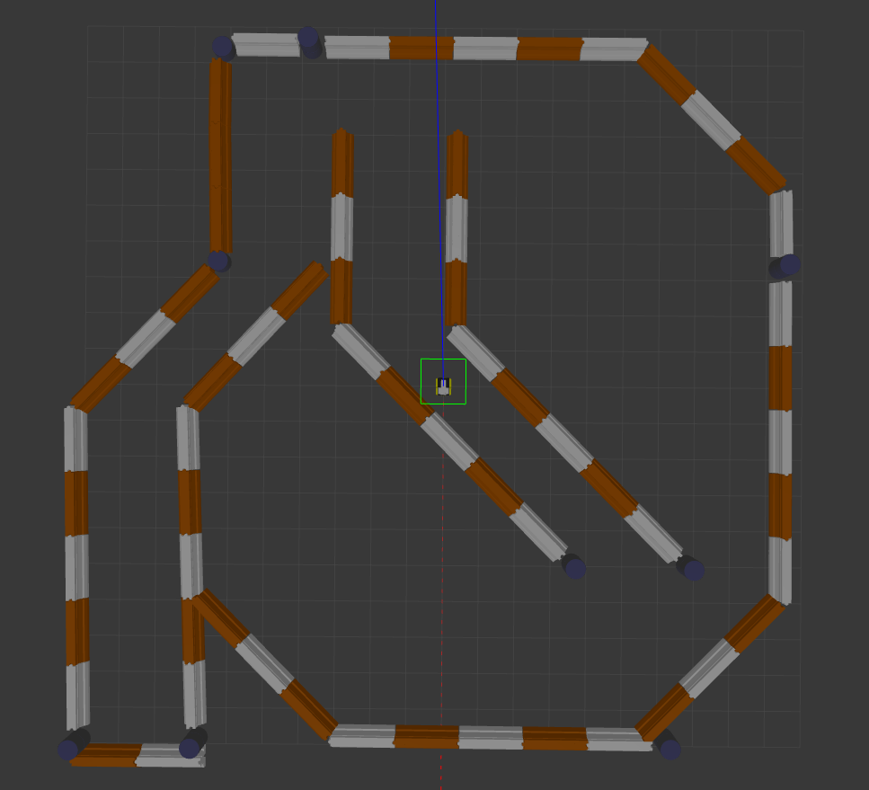



Robotic Navigation Using Large Language Models
Chinmay Chandra & Jonathan Lee
This work is supported by The Center for Undergraduate Research Experiences and the Pace University Robotics Lab, with thanks to Professor David Benjamin .
This study investigates the potential of large language models (LLMs), specifically GPT-4o and GPT-4 Turbo, to assist in robotic navigation tasks within simulated maze environments. Despite LLMs being fundamentally trained as next-token predictors on internet-scale data, they demonstrate emergent reasoning and perception capabilities that may be applicable to spatial navigation challenges. Further, we found that models with a built-in multi-modal design* significantly outperforms the one where such capabilities were added later to the model.
Experiment
Prompt Design
Conclusion
Design:
Simulated maze environment built on ROS/Gazebo with custom hardware patches
Moderate-complexity maze with corridors, junctions, and dead ends
Two navigation objectives:
  Contact grey wall, then orange wall after a 180° turn
  Contact blue pillar (more difficult due to scarcity of blue pillars)
Limited environmental knowledge to require genuine LLM navigational reasoning
Sensor configuration:
  Front-facing RGB camera
  LIDAR sensor generating point cloud data
Role | Content
System | Goal/Target Movements Allowed Available Data Navigation Strategy Additional Notes Expected Response Format Instructions for Response
User | Lidar and Front camera images
AI | Summary
Although GPT-4 Turbo, a stronger model, completes tasks with fewer trials, our findings indicate that GPT-4o's native multi-modal design gives it a distinct advantage in visual navigation tasks. Despite having fewer parameters, GPT-4o outperforms GPT-4 Turbo in navigation, suggesting that built-in vision capabilities enable better multi-modal reasoning.* This highlights distinct designs: while GPT-4 Turbo is optimized for speed and language problem-solving, GPT-4o’s strength lies in its integrated perception and cognition. Our results suggest that models natively designed with multi-modal capabilities are better suited for tasks demanding environmental interaction than those in which such capabilities are added after the model was originally built.
Introduction
Results
LLMs are positioned as cognitive navigators that interpret visuals without pre-defined instructions
This approach is comparable to a human driver navigating an unfamiliar road
Images below show the maze and the robot used for LLM evaluation
The LLM receives no prior information about the maze
The goal is to demonstrate emergent navigation capabilities through:
  Zero-shot visual reasoning
  Adaptive decision-making
This represents a shift from pattern-matching to cognition-based navigation
The approach could enable more flexible robotic systems
These systems would be generalizable across diverse, unfamiliar environments
2x2 Grid – Navigation Success
Future Work
Method
Refine Prompts by Model Behavior:
Study each model’s behavior and adapt prompts to better suit their unique strengths.
Test Reasoning Models:
Create new tasks to evaluate how reasoning models like o1 and Deepseek-R1 handle complex reasoning challenges.
Build a Visual-Reasoning Pipeline:
Use a visual model to interpret images and pass the output to a separate reasoning model for analysis and directions.
Use RAG for Spatial Memory:
Store point clouds and past visuals in a RAG system to build an evolving overhead map for better navigational reference.
Python framework manages interface between simulated robot and LLM
ROS captures camera view and LIDAR data at each step
LLM processes visual inputs with instructions, returning JSON
Python controller executes movement commands
System recaptures sensor data after movement if goal not reached
References
2×2 design: 2 goals × 2 LLMs
10 trials per condition with fixed starting positions
Performance metric: navigation rounds to reach goal, Failure/Success
Unsuccessful attempts classified as DNF
Malformed outputs marked as Discards (Percentage displayed within <>)
Design enables analysis of LLM performance across goal conditions
Kim, M. J., Pertsch, K., Karamcheti, S., Xiao, T., Balakrishna, A., Nair, S., Rafailov, R., Foster, E., Lam, G., Sanketi, P., Vuong, Q., Kollar, T., Burchfiel, B., Tedrake, R., Sadigh, D., Levine, S., Liang, P., & Finn, C. (2024, June 13). OpenVLA: an Open-Source Vision-Language-Action Model. arXiv.org. https://arxiv.org/abs/2406.09246
OpenAI, Hurst, A., Lerer, A., Goucher, A. P., Perelman, A., Ramesh, A., Clark, A., Ostrow, A., Welihinda, A., Hayes, A., Radford, A., Mądry, A., Baker-Whitcomb, A., Beutel, A., Borzunov, A., Carney, A., Chow, A., Kirillov, A., Nichol, A., . . . Malkov, Y. (2024, October 25). GPT-4O System Card. arXiv.org. https://arxiv.org/abs/2410.21276
OpenAI, Achiam, J., Adler, S., Agarwal, S., Ahmad, L., Akkaya, I., Aleman, F. L., Almeida, D., Altenschmidt, J., Altman, S., Anadkat, S., Avila, R., Babuschkin, I., Balaji, S., Balcom, V., Baltescu, P., Bao, H., Bavarian, M., Belgum, J., . . . Zoph, B. (2023, March 15). GPT-4 Technical Report. arXiv.org. https://arxiv.org/abs/2303.08774
Task | GPT-4o |  | GPT-4 Turbo
 | Average Number of Rounds | Average Number of Rounds When Successful | Average Number of Rounds | Average Number of Rounds When Successful
Grey-Orange | 13.3 | 12.43 | 7.2 | 9
Blue Pillar | 13.4 | 7.2 | 5 | 3.67
*Our conclusions are based on the evidence we've gathered. Since the models are not open source, we acknowledge that our analysis involves some degree of informed speculation.

