Slide 2
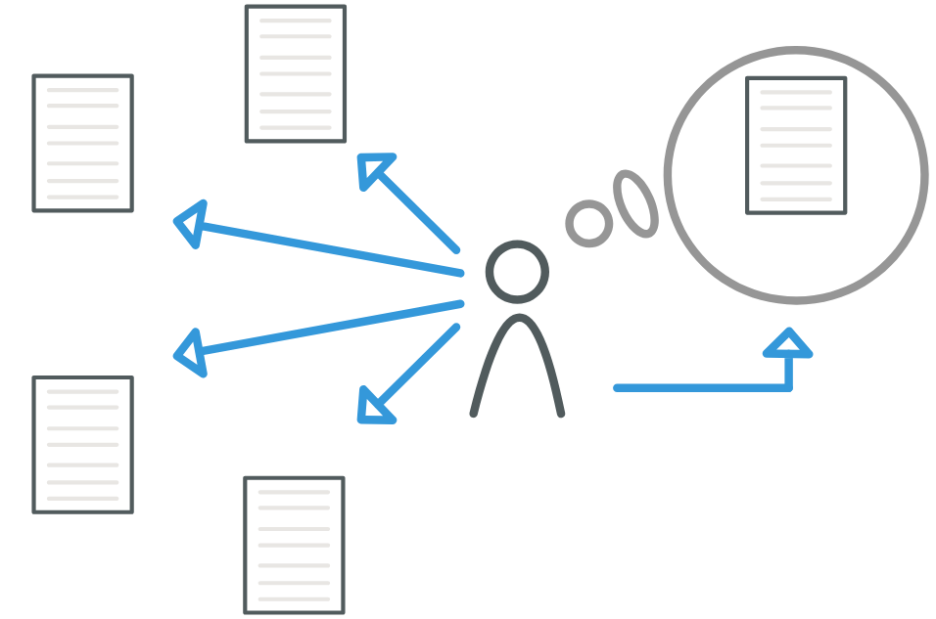
o1
o2
oideal
scoring
o3
o4

Slide 3
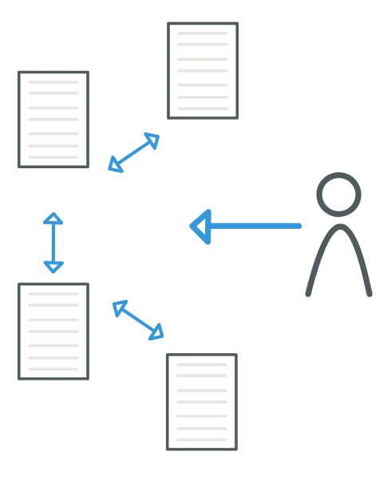
o1
o2
Ranking
o3
o4

Slide 4

≻
≻
o3
o1
o2

Slide 5
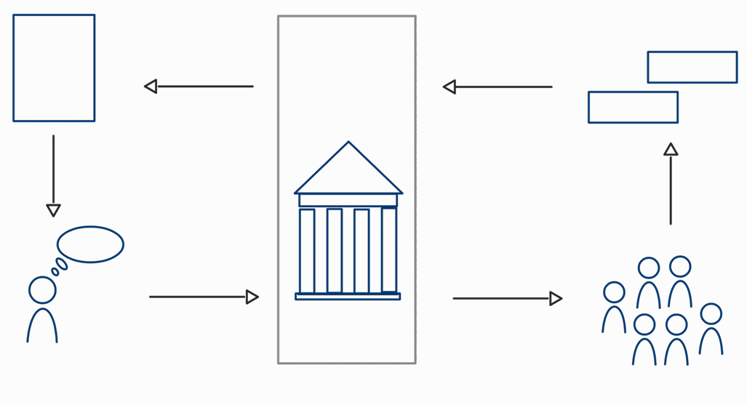
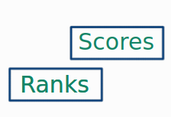
Decision
Statistical
analysis
Scores
Ranks
Ranks
Funding
institution
Applicant
Expert panel

Slide 6
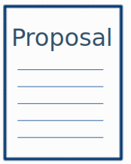
Proposal
Statistical
analysis
Scores
Ranks
Ranks
Funding
institution
Applicant
Expert panel

Slide 7
Decision
Statistical
analysis
Scores
Ranks
Ranks
Funding
institution
Applicant
Expert panel

Slide 8
