Slide 1
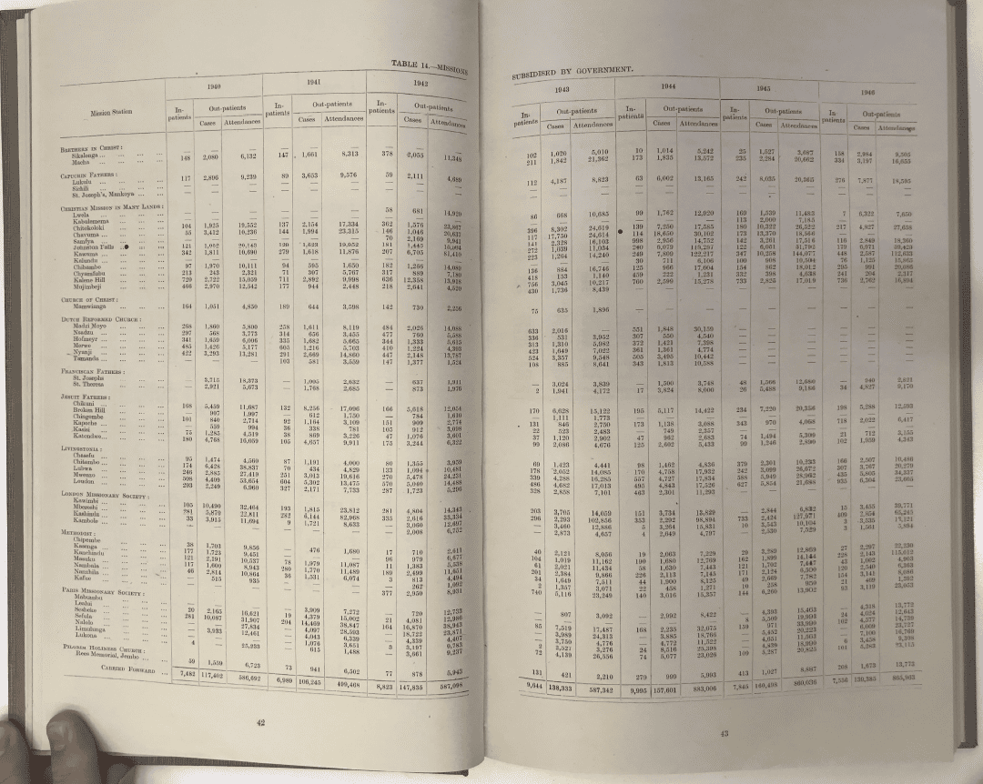
The Long Shadow of Mission Medicine
Colonial missionary healthcare, institutional trust, and the spatial burden of disease in Sub-Saharan Africa
Dr Michael Chanda Chiseni
Stellenbosch University, Laboratory for the Economics of Africa's Past (LEAP)
Northern Rhodesia medical report, Table 14: mission stations subsidised by government, 1940 to 1946
Wellcome Early-Career Award | 355277/Z/26/Z | January 2027
1
Notes:
[0:10] Good morning. I'm Michael Chiseni, an economic historian. My project asks why people who can reach a clinic often don't use it, and whether colonial mission medicine is part of the answer.

Slide 2
Clinics are within reach, but many people don't use them
The usual explanations
[Insert map: within-country variation in facility births or DTP3 by DHS cluster, Zambia, with health facilities overlaid]
Poverty
Distance
Facility quality
...leave a gap: similar communities still differ in use
Missing piece: why trust varies
Sources: Peters et al. 2008; Ensor and Cooper 2004; Gilson 2003; Østergaard 2015; Weiss et al. 2019
Chiseni | Wellcome Early-Career Award interview | 355277/Z/26/Z
2
Notes:
[0:50] Across Sub-Saharan Africa, many communities live within reach of a health facility. Yet antenatal care, facility births and childhood vaccination remain low, and disease burden varies enormously within countries. The usual explanations are poverty, distance and the quality of facilities. They matter, but they leave a gap: communities with similar income, schooling and distance to a clinic still differ in how readily they use it. Health-systems research points to trust. Where people don't trust the system, they delay care, bypass clinics and stop treatment early. What the field lacks is an explanation of why trust is high in some places and low in others. That is the gap I address.
VISUAL TO ADD: replace the dashed box with one map of within-country variation (for example facility births or DTP3 by DHS cluster in Zambia) with health facilities overlaid.

Slide 3
For decades, missionaries ran most of the Western healthcare Africans met
Hospitals in Northern Rhodesia
Trust deficit
Coercive colonial medical campaigns in central Africa still lower trust and vaccination (Lowes and Montero 2021)
89
Government (for Africans)
Mission hospitals
Trust dividend
Living near a colonial medical mission in India still predicts better health (Calvi and Mantovanelli 2018)
26
12
12
My hypothesis: mission medicine left a dividend in some places and a deficit in others
1933
1953
Source for chart: Chiseni (2025), African Studies 84(1-2), Figure 3 and text
Chiseni | Wellcome Early-Career Award interview | 355277/Z/26/Z
3
Notes:
[0:55] In British colonial Africa, the first Western healthcare most communities encountered was run by missionaries, often decades before colonial states built public health systems. In Northern Rhodesia, which I studied for my PhD, the government ran twelve hospitals for Africans throughout the colonial period. Mission hospitals grew from 26 in 1933 to 89 by 1953, mostly in rural areas. The experience was uneven. In some places it was care; in others it came with coercion and attacks on local healing. Recent research shows both legacies can last: coercive colonial medical campaigns in central Africa still lower trust and vaccination today, while living near a medical mission in colonial India still predicts better health. My hypothesis is that mission medicine left a trust dividend in some places and a deficit in others.
OPTIONAL: replace the bar chart with Figure 3 of the African Studies paper (full 1925 to 1953 series).

Slide 4
Four questions, one causal chain
I control for where missions chose to go and where the state built hospitals
Mission medical exposure, 1890s to 1950s
Institutional trust
Health-seeking
Disease burden
Direct route: facilities that survive today
RQ1 Map
Where was mission care?
RQ2 Link
Trust, behaviour and burden today
RQ3 Channels
Facilities, health workers, norms, coercion
RQ4 Meaning
How communities see it
Chiseni | Wellcome Early-Career Award interview | 355277/Z/26/Z
4
Notes:
[0:45] I ask four questions. First, where exactly was mission healthcare: individual hospitals and dispensaries, not just mission stations? Second, do communities exposed to it show different trust and health-seeking today, and does that predict disease burden? Third, through which channels: surviving church health facilities, generations of health workers, religious norms, or memories of coercion? Fourth, how do communities themselves understand this history? The diagram shows the chain I'll test: historical exposure, to trust, to health-seeking, to disease burden, alongside a direct route through facilities that survive today.

Slide 5
I've already built this for Zambia, from records others haven't used
76 to 91%
of missions are missing from the atlases most studies use (Jedwab et al. 2022)
Blue Book church returns
Every mission station, by society
Colonial medical reports
Facility type and yearly patient numbers
= open, facility-level dataset for British Africa
Northern Rhodesia medical report, Table 14: subsidised mission stations, in- and out-patients, 1940 to 1946
Chiseni | Wellcome Early-Career Award interview | 355277/Z/26/Z
5
Notes:
[0:50] This is the kind of source I work with: a page from a Northern Rhodesia medical report listing every government-subsidised mission station by society, with in-patients and out-patients year by year. Most quantitative work on missions uses missionary atlases. Jedwab and colleagues show these atlases miss between 76 and 91 percent of missions and over-represent prominent early stations, which biases results. I combine two administrative sources: the Blue Book church returns, which list every mission station, and the medical reports, which add facility type and patient numbers. I've done this for Zambia and published the method. This project scales it across British colonial Africa and releases the dataset openly.
OPTIONAL: add your 1953 Zambia mission-hospital map (Figure 2, African Studies 2025) beside the table photo.

Slide 6
48 months, five work packages
Year 1
Year 2
Year 3
Year 4
WP1 Historical dataset
1 to 18
WP2 Linking to today
12 to 30
WP3 Causal analysis
24 to 42
WP4 Zambian fieldwork
20 to 32
WP5 Synthesis
42 to 48
Research assistant
1 to 24
Milestones (diamonds): v1 dataset and data paper (m18), first article (m30), fieldwork coded (m32), burden and mediation article (m42), open dataset and policy briefs (m48)
Chiseni | Wellcome Early-Career Award interview | 355277/Z/26/Z
6
Notes:
[0:40] The project runs for 48 months in five work packages. WP1 builds the dataset from UK archives with a research assistant, best-documented territories first, with version one at month 18. WP2 links it to geo-located health surveys, Afrobarometer, high-resolution disease-burden maps and a database of nearly 99,000 public health facilities. WP3 tests causality and mechanisms. WP4 is fieldwork in four Zambian communities. WP5 delivers the open dataset, papers and policy briefs.
Background: London archive trip months 2 to 4 (PI 6 weeks, RA 3 weeks). Ethics applications start month 1.

Slide 7
Separating the effect of mission medicine from where missions chose to go
The objection
Missionaries chose healthier, more accessible, richer places.
A simple comparison would mix up the effect of medicine with the effect of place.
Jedwab, Meier zu Selhausen and Moradi (2022)
1
Control for location drivers
Malaria, railways, cash crops, state hospitals
2
Medical vs non-medical stations
Same choice of location, different medical exposure
3
Societies' medical propensity
Some societies did far more medical work than others
4
Dose-response and distance decay
Effects grow with exposure, fade with distance
Report sensitivity bounds, not a claim of perfect exogeneity
Chiseni | Wellcome Early-Career Award interview | 355277/Z/26/Z
7
Notes:
[1:00] The obvious objection is that missionaries chose where to go, and chose healthier, more accessible, richer places. I address that in layers. I control for the factors known to drive mission location, and for where the colonial state built its own hospitals. I compare mission stations that had a hospital or dispensary with stations that didn't: both faced the same choice of location, but only one offered medicine. I use differences between missionary societies in how much medical work they did as a source of variation in exposure. And I check dose-response: effects should grow with years of operation and patient numbers, and fade with distance. For the trust channel, I state the assumptions, test how strong hidden confounding would have to be to overturn the result, and triangulate with fieldwork. The aim is an honest, bounded estimate.

Slide 8
Asking communities what this history means
2
communities with long mission-hospital histories
2
comparison communities without
~50
semi-structured interviews (40 to 60)
8
focus groups, women and men separately
Matched on today's access to care, province and language
30
days in the field with 4 Zambian assistants
Who we talk to
Elders, health workers, healers, church and traditional leaders, young people
1
community feedback visit before publication
Chiseni | Wellcome Early-Career Award interview | 355277/Z/26/Z
8
Notes:
[0:35] Numbers can't tell us what a mission hospital meant to people. So I'll work in four Zambian communities: two with long mission-hospital histories, two without but with similar access to care today. Around fifty interviews and eight focus groups, held separately for women and men, with elders, health workers, healers, leaders and young people. Communities will review and help interpret the findings before publication.
Note: traditional healers and church leaders are added to the sample as a refinement since submission (say so on slide 9 if you adopt it).

Slide 9
What the reviewers asked, and what has changed
DRAFT: update after reviews
Reviewers asked
My response
How is trust measured?
DHS blood-test refusal, Afrobarometer clinic experience, and fieldwork accounts
Is the mediation credible?
Total effect is primary; trust share via sequential g-estimation with sensitivity bounds
Is continental coverage feasible?
Coverage audit: [N] territories, [years]; core set by month 18
Since submission
[Add only real updates: advisory group names, Zambian partner, coverage audit, new papers or talks]
Chiseni | Wellcome Early-Career Award interview | 355277/Z/26/Z
9
Notes:
[1:15] DRAFT. Rebuild this slide once the reviewer comments arrive (Section 5 of Interview_Preparation.md). Pick the 2 or 3 points that recur or touch the core design.
Script template: The reviewers raised three main points. [Point 1 in a few words]: [your response in one or two sentences]. [Point 2]: [...]. [Point 3]: [...]. Since submission, I have [real updates only].

Slide 10
I've already done the hardest part once
2022
PhD, Lund: built the Zambian dataset
This award adds
Scaling across many archives
Causal mediation
Spatial epidemiology
Leading a team
2024
Missions and HIV today (EHDR)
2024
Open-access Springer monograph
2024
Gender and schooling (with J. Bolt)
2025
Mission healthcare (African Studies)
Forthcoming
IV design: missions and wealth (Elgar)
Postdoc
Six months of fieldwork in rural Zambia
Sole author: thesis, monograph, EHDR, African Studies, Elgar chapter
Chiseni | Wellcome Early-Career Award interview | 355277/Z/26/Z
10
Notes:
[0:45] I'm well placed because I've already done the hardest part once. For my PhD at Lund, I built the geo-referenced dataset of mission activity in Zambia. It underpins a sole-authored, open-access monograph with Springer, an article on mission healthcare in African Studies, and an article in Economic History of Developing Regions linking missionary exposure to HIV and sexual behaviour today. I've used instrumental-variable designs across several papers and led six months of fieldwork in rural Zambia. This award will let me scale across archives, add causal mediation and spatial epidemiology, and learn to lead a team.

Slide 11
Stellenbosch gives me the historical-data core; partners bring the health expertise
LEAP, Prof. Johan Fourie: sponsor and mentor
Advisory group: health systems [name], qualitative [name]
LEAP colleagues digitising African historical records
Me and the research assistant
Zambia: [partner], fieldwork team, communities
Centre for Geographical Analysis: GIS training
Networks: AEHN, WEHC, KEMRI-Wellcome facility data
An African host: close to field sites and policy audiences, and the skills stay on the continent
Chiseni | Wellcome Early-Career Award interview | 355277/Z/26/Z
11
Notes:
[0:50] I'll be based at Stellenbosch University in LEAP, the Laboratory for the Economics of Africa's Past, with Professor Johan Fourie as sponsor and mentor. LEAP is one of the leading groups digitising and analysing African historical records, so I'll work alongside people using the same kinds of sources and methods. I'll build the health side through my advisory group, [names], and links with health researchers at Stellenbosch and in Zambia. Being at an African university also matters: it's close to my field sites and policy audiences, and the skills built under this grant stay on the continent.
Replace every [name] / [partner] with confirmed people only.

Slide 12
How I'll run the team
Train the research assistant
Written development plan; archival, GIS and data skills; co-authorship on the data paper when earned
Fair pay and credit in Zambia
Fieldwork staff trained, paid at fair local rates, credited by name
Communities see results first
Feedback visit to review and interpret findings before publication
Open by default
Dataset, code and papers openly available; pre-analysis plan
[Optional: flexible working, from my own experience of parental leave]
Chiseni | Wellcome Early-Career Award interview | 355277/Z/26/Z
12
Notes:
[0:40] For research culture, four commitments. I'll recruit and train a research assistant with a written development plan and co-authorship on the data paper when it's earned. Zambian fieldwork staff will be trained and paid fairly, and credited by name. Communities will see and shape the findings before anyone else. And the dataset, code and papers will be open. [Optional, if you are comfortable sharing: Having taken parental leave myself, I'll make flexible working real for my team.]

Slide 13
If trust is the lever, buildings alone won't close the gap
If I'm right: part of Africa's health inequality is historical, and trust is a lever that infrastructure alone won't move.
Whatever the result: the first open, facility-level map of mission medicine in British Africa.
Thank you
Michael Chanda Chiseni | Stellenbosch University (LEAP)
Chiseni | Wellcome Early-Career Award interview | 355277/Z/26/Z
13
Notes:
[0:20] If I'm right, part of Africa's health inequality is historical, and the lever is trust, which new buildings alone won't move. And whatever the result, researchers will have the first open, facility-level map of mission medicine in British Africa. Thank you.

Slide 14
Backup slides
For questions only. Check with your Funding Manager that backup slides are allowed during Q&A.
14
Notes:
Not part of the 10-minute talk.

Slide 15
Backup: how I measure trust
Revealed
Refusal of free DHS blood tests (Lowes and Montero 2021)
Same sample as the health behaviours
Reported
Afrobarometer: ease of getting care, disrespect, informal payment
Placebo: trust in police and courts
Lived
Fieldwork accounts of why people use, bypass or avoid clinics
Three kinds of trust: in biomedicine, in health workers, in the health system (Gilson 2003)
Chiseni | Wellcome Early-Career Award interview | 355277/Z/26/Z
15
Notes:
See Q15 and Q19 in Interview_Preparation.md.

Slide 16
Backup: the instrument and its limits
Instrument
Medical propensity of the station's society, measured in other territories (leave-one-out)
Threat
Societies also differ in doctrine and schooling, which can affect health directly
Response
Control for denomination and schools
Balance tests across societies
Plausibly exogenous bounds (Conley, Hansen and Rossi 2012)
The instrument is one strand of evidence, not the whole case.
Chiseni | Wellcome Early-Career Award interview | 355277/Z/26/Z
16
Notes:
See Q21 in Interview_Preparation.md.

Slide 17
Backup: mediation, stated honestly
1
Primary result: the total effect of mission medical exposure
2
Controlled direct effect via sequential g-estimation (Acharya, Blackwell and Sen 2016)
3
Sensitivity analysis: how much hidden confounding erases the trust share (Imai, Keele and Tingley 2010)
4
Common geography: DHS links are individual-level; Afrobarometer and burden at district or cluster level
5
Triangulate with the Zambian fieldwork
Chiseni | Wellcome Early-Career Award interview | 355277/Z/26/Z
17
Notes:
See Q27 and Q28 in Interview_Preparation.md.

Slide 18
Backup: risks and mitigations
Risk
Mitigation
Uneven archival coverage
Catalogue audit before travel; richest territories first; results hold on the core set
Selection of mission sites
Layered design (slide 7); sensitivity bounds
Data access (DHS, Afrobarometer)
Download DHS rounds and GPS early; IPUMS copies; district-level fallback
Approvals in Zambia
Applications from month 1; fieldwork starts month 20
Travel or photography limits
British Online Archives; archive copying services
Chiseni | Wellcome Early-Career Award interview | 355277/Z/26/Z
18
Notes:
See Q38 to Q42.

Slide 19
Backup: outcomes and exposure
Primary outcomes (DHS)
Child mortality, vaccination, antenatal care, facility births, care-seeking
Malaria test and anaemia results where collected
Secondary (IHME)
Local Burden of Disease maps, with uncertainty carried through
Malaria: care-dependent outcomes, not prevalence
Exposure
Distance; 10 and 25 km bands; years open; patients per head
Bands wider than DHS displacement (2 km urban, 5 km rural)
Chiseni | Wellcome Early-Career Award interview | 355277/Z/26/Z
19
Notes:
See Q16 to Q18.

Slide 20
Backup: budget at a glance
Budget line
ZAR
PI salary, 48 months at 100%
4,799,860
Research expenses (RA, fieldwork, travel, open access, equipment, other)
1,270,054
of which RA (24 months) / fieldwork / travel
325,939 / 500,190 / 182,500
Overheads (20% of direct costs)
1,213,983
Total requested
7,283,897
Chiseni | Wellcome Early-Career Award interview | 355277/Z/26/Z
20
Notes:
See Q40 and Section 2 facts.

