Slide 1
The Long Shadow of Mission Medicine
Colonial missionary healthcare, institutional trust and the spatial burden of disease in Sub-Saharan Africa
Michael Chanda Chiseni
[Affiliation]
Research seminar | [Venue, date]
Notes:
Fill in your affiliation, venue and date. I left the affiliation open because the application lists you as between posts; use Stellenbosch (LEAP) only once the appointment is confirmed.

Slide 2
The puzzle: care within reach, but often unused
What we observe
Facilities are often within physical reach, yet antenatal care, facility delivery and vaccination remain low (Peters et al. 2008)
Disease burden is highly uneven within countries, not only between them (Weiss et al. 2019; LBD Collaborators 2020)
Communities similar in income, education and distance still differ in how readily they use formal care (Ensor and Cooper 2004)
[Insert map: within-country variation in facility births or DTP3 by DHS cluster, with health facilities overlaid]
Why do otherwise similar communities engage so differently with formal health systems?
Chiseni | The Long Shadow of Mission Medicine | Research seminar
2
Notes:
Across much of Sub-Saharan Africa, formal facilities are within reach, yet preventive and maternal care is used little, and disease burden varies sharply within countries. Poverty, distance and facility quality explain part of this. A residual remains: communities that look alike on these measures still differ in how readily they use formal care. My question is what explains that residual.

Slide 3
Health-systems research: trust matters, but is treated as contemporary
What the literature shows
Trust is constitutive of health care as a social institution: it shapes whether people present early, disclose, follow advice and return (Gilson 2003, 2005)
Where trust is low, people delay care, bypass facilities, default on treatment and turn to informal providers (Østergaard 2015; Arakelyan et al. 2021)
Faith-based providers remain major actors in African health systems (Olivier et al. 2015)
What it leaves out
Trust is explained by present conditions: quality, cost, respect, recent experience
No historical account of why trust varies so much across space
Communities' earlier encounters with formal medicine are left out
This project: a historical explanation for spatial variation in trust in health systems
Chiseni | The Long Shadow of Mission Medicine | Research seminar
3
Notes:
Health-systems research has made trust central. Gilson argues trust is part of what makes health care a social institution; reviews show that low trust leads people to delay care, bypass facilities and default. But trust is explained by present conditions. The field has no account of why trust is high in some places and low in others, and it does not ask whether a community's first encounter with formal medicine still matters. That is the gap I address.

Slide 4
Economic history: colonial legacies persist, but the health channel is untested
What the literature shows
The slave trade left lower trust today (Nunn and Wantchekon 2011)
Coercive colonial medical campaigns lowered trust in medicine and vaccination (Lowes and Montero 2021)
Proximity to colonial medical missions in India predicts better health today (Calvi and Mantovanelli 2018)
Mission health facilities lower HIV today; mission settlements in general raise it (Cagé and Rueda 2020)
Missions are linked to lower interpersonal trust in former indirect-rule colonies (Okoye 2021)
What remains open
Studies measure outcomes, not the pathway of engagement with health systems
Mission medicine has not been mapped at scale across British Africa
Most rely on mission atlases, which omit 76 to 91% of missions (Jedwab, Meier zu Selhausen and Moradi 2022)
No study links mission medicine to trust in health systems today, and through it to disease burden
Chiseni | The Long Shadow of Mission Medicine | Research seminar
4
Notes:
Economic history shows that colonial-era institutions leave long shadows, including on trust and on medicine. Lowes and Montero show coercive French campaigns lowered trust in medicine; Calvi and Mantovanelli show medical missions in India improved health. So the legacy can go either way. But these studies measure outcomes, not how people engage with health systems, and most use mission atlases that Jedwab and colleagues show miss most missions. Okoye's finding on interpersonal trust is the closest result to mine; I study trust in health institutions and separate medical from non-medical stations.
Check before citing: Okoye (2021) volume and article number.

Slide 5
Historical argument (1): missions were the first formal health system
Hospitals in Northern Rhodesia
The first formal health system
Missionary societies supplied hospitals, dispensaries and trained staff decades before colonial states built public health systems (Vaughan 1991; Hokkanen 2019; Doyle et al. 2020)
In Northern Rhodesia the government ran 12 hospitals for Africans; mission hospitals grew from 26 in 1933 to 89 in 1953, mostly rural (Chiseni 2025)
African auxiliaries carried mission medicine forward and reinterpreted it locally (Kalusa 2007)
89
Government (for Africans)
Mission hospitals
26
12
12
1933
1953
Chart: Chiseni (2025), African Studies 84(1–2), Figure 3 and text
Chiseni | The Long Shadow of Mission Medicine | Research seminar
5
Notes:
In British colonial Africa, the formal health care most communities first met was missionary, often decades before states built public health systems. In Northern Rhodesia, which I reconstructed for my PhD, the state ran twelve hospitals for Africans throughout, while mission hospitals tripled between 1933 and 1953, mostly in rural areas. African auxiliaries did much of this work and reinterpreted it in local terms.

Slide 6
Historical argument (2): the encounter was uneven
Trust dividend
At Kalene Hospital, patients negotiated how they used mission medicine (Kalusa 2014)
In Tanganyika, mission medicine built familiarity with formal treatment (Jennings 2008)
In colonial India, medical missions left lasting gains in health (Calvi and Mantovanelli 2018)
Trust deficit
Tsetse and sleeping-sickness control in Northern Rhodesia fed rumours of blood-taking (White 1995)
Missions made church membership conditional on renouncing female circumcision; Kikuyu Christians founded independent churches and schools (Anderson 2018)
Leprosy settlements isolated patients in the service of a 'civilised', Christian Uganda (Vongsathorn 2012)
Argument: the geography of mission medicine laid down a lasting substrate of institutional trust, positive in some places and negative in others
Chiseni | The Long Shadow of Mission Medicine | Research seminar
6
Notes:
The encounter was uneven. Where mission medicine was experienced as care, it could build familiarity and a lasting habit of seeking formal treatment; Kalusa's work on Kalene, a station in my data, shows patients negotiating its use. Where it was tied to coercion, discipline or attacks on local healing, it could leave suspicion. White shows health interventions in Northern Rhodesia read through blood-taking rumours; Anderson shows mission discipline in Kenya provoking organised withdrawal. My argument is that this geography left a substrate of trust that is still visible.
Check before citing: Kalusa (2014) page range; Vongsathorn (2012) journal details.

Slide 7
Four research questions, one causal chain
Confounders: where missions chose to go; where the colonial state built hospitals
Mission medical exposure, 1890s to 1950s
Institutional trust
Health-seeking
Disease burden
Direct route: facilities that survive today
RQ1 Map
Where was mission health care, facility by facility, by society, territory and period?
RQ2 Link
Do exposed communities differ in trust and care-seeking today, and does that predict burden?
RQ3 Channels
Surviving facilities, health-worker norms, religious norms, or memories of coercion?
RQ4 Meaning
How do communities understand their own relationship with formal care?
Chiseni | The Long Shadow of Mission Medicine | Research seminar
7
Notes:
Four questions. First, a map: where exactly was mission medicine, hospital by hospital. Second, the link: do exposed communities differ in trust and health-seeking today, and does that predict disease burden. Third, the channels. Fourth, how communities themselves understand this history. The diagram shows the chain I test, from exposure through trust and behaviour to burden, alongside a direct route through facilities that survive, with the placement confounders I have to deal with.

Slide 8
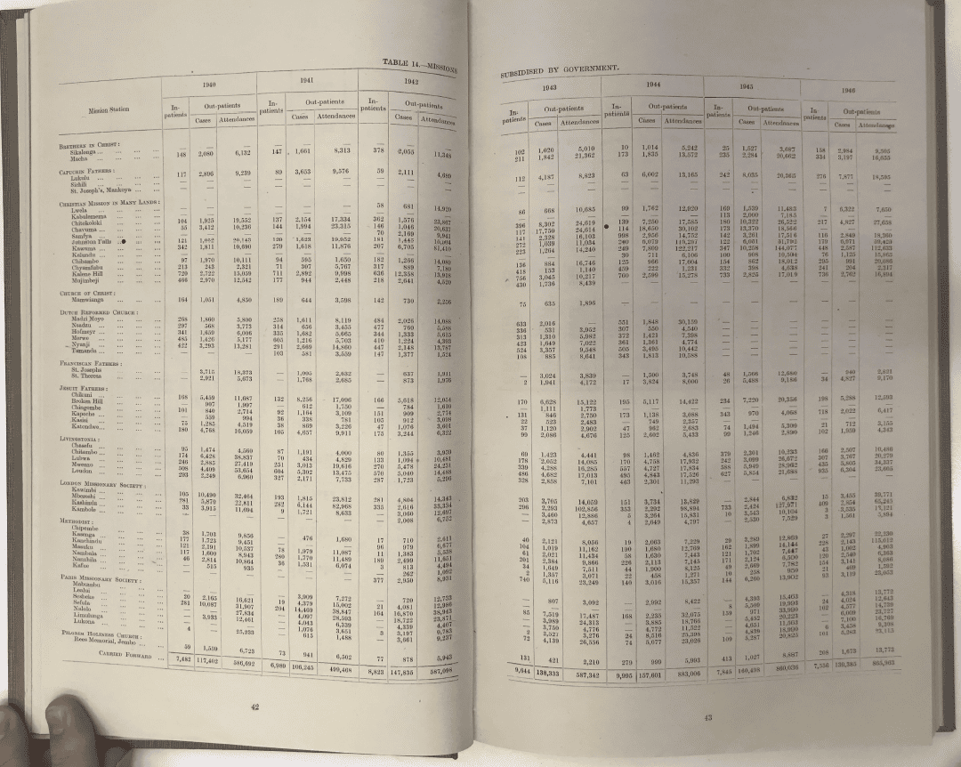
Data (1): a facility-level map of mission medicine
76 to 91%
of missions are missing from commonly used atlases (Jedwab, Meier zu Selhausen and Moradi 2022)
Blue Book ecclesiastical returns
Every mission station, by society and year
Colonial Medical Reports
Mission and government hospitals and dispensaries, with annual in- and out-patients
Validation
Against existing mission data and my Zambian benchmark (Cagé and Rueda 2016; Hedde-von Westernhagen and Becker 2022; Brown 2025; Chiseni 2025)
Northern Rhodesia medical report, Table 14: subsidised mission stations, in- and out-patients, 1940 to 1946
Chiseni | The Long Shadow of Mission Medicine | Research seminar
8
Notes:
Most quantitative work on missions uses missionary atlases, which Jedwab and colleagues show omit most missions and over-represent early, prominent stations. I use two administrative sources instead. The Blue Book church returns list every station by society; the Colonial Medical Reports add which stations ran a hospital or dispensary and how many patients they treated each year. This page is from Northern Rhodesia. Joining the two gives presence, type, duration and intensity of medical activity. I validate against existing datasets and release it openly.
Note: the medical reports list subsidised facilities; unsubsidised dispensaries are traced through society archives, and uncertain stations are coded as such.

Slide 9
Data (2): linked to contemporary surveys, facilities and burden maps
Source
What it measures
Level
IPUMS-DHS (Minnesota Population Center 2022)
Antenatal care, facility births, vaccination, care-seeking; refusal of free blood tests; child mortality
Individual; displaced cluster
Afrobarometer Round 9 (2021–23), Round 10 (2024)
Trust in Ministry of Health vs police, courts (R10); respect at clinics, COVID-19 vaccine trust (R9)
Individual; region
IHME Local Burden of Disease
Modelled malaria and child-health burden, 5 × 5 km
Grid cell; district
KEMRI-Wellcome / WHO facilities (Maina et al. 2019)
98,745 public-sector facilities; faith-based ownership where recorded
Facility
Colonial state hospitals (Bolt and Cilliers 2025)
Government hospitals in 12 British colonies
Facility; territory
Fieldwork, four Zambian communities
About 50 interviews and 8 single-sex focus groups
Community
Chiseni | The Long Shadow of Mission Medicine | Research seminar
9
Notes:
The historical map is linked to contemporary data. DHS gives behaviour, a revealed measure of trust in medicine, and measured child mortality, for the same women. Afrobarometer gives stated trust: Round 10 asks about trust in the Ministry of Health, which I compare with trust in the police and courts; Round 9 asks about respect at clinics. IHME maps are a secondary burden measure, because they are modelled partly from DHS. The facility database and Bolt and Cilliers' state hospitals enter as channels and controls.
Check: whether the Round 10 survey-area coordinates are in the public release; otherwise link at region level.

Slide 10
Methodology (1): separating mission medicine from mission placement
The problem
Missions went first to healthier, more accessible, richer places.
Atlas-based mission effects shrink sharply with fuller data and controls.
Jedwab, Meier zu Selhausen and Moradi 2022
Control for placement and state provision
Malaria, railways, cash crops, urban access (Jedwab et al. 2022); colonial state hospitals (Bolt and Cilliers 2025); country fixed effects
1
Medical versus non-medical stations
Same selection into location, different medical exposure (Calvi and Mantovanelli 2018)
2
Societies' medical propensity as an instrument
Leave-one-out share of a society's stations with medical facilities (Calvi and Mantovanelli 2018; Cagé and Rueda 2016)
3
Dose-response, distance decay and robustness
Oster (2019) bounds; plausibly exogenous IV (Conley, Hansen and Rossi 2012); spatial noise (Kelly 2019)
4
A bounded estimate, not a claim of perfect exogeneity
Chiseni | The Long Shadow of Mission Medicine | Research seminar
10
Notes:
The obvious objection is selection. I address it in layers. I control for what drove mission placement and for where the state built hospitals. I compare stations that had medical facilities with stations that did not, since both faced the same choice of location. I use differences between societies in their medical propensity as an instrument, measured leave-one-out. And I check dose-response and distance decay. Because society identity may affect health through doctrine and schooling, I control for denomination and schools and report plausibly exogenous bounds.
Check before citing: Kelly (2019) is a working paper; confirm the current version.

Slide 11
Methodology (2): measuring trust and decomposing the effect
Measuring trust
Revealed: refusal of free DHS blood tests (Lowes and Montero 2021)
Stated: trust in the Ministry of Health against police and courts (Afrobarometer Round 10)
Experienced: respect, bribes and absent staff at clinics (Afrobarometer Rounds 9 and 10)
Lived: fieldwork accounts of using, bypassing or avoiding clinics
Decomposing the effect
The total effect of mission medical exposure is the primary estimand
Controlled direct effect, holding trust and behaviour fixed, by sequential g-estimation (Acharya, Blackwell and Sen 2016)
Sensitivity to confounding between mediator and outcome (Imai, Keele and Tingley 2010)
Individual-level links within the DHS; across surveys at a common geography
Today's facilities and care quality are channels, not controls
Chiseni | The Long Shadow of Mission Medicine | Research seminar
11
Notes:
Trust is measured four ways so that no single survey item carries the argument: revealed trust in medicine in the DHS, stated trust in the Ministry of Health in Afrobarometer compared with other state institutions, experience at clinics, and the fieldwork. The total effect is my main result. The split into trust, behaviour and surviving facilities is a decomposition under stated assumptions, estimated by sequential g-estimation with sensitivity analysis. I don't control for today's facilities or care quality in the main model, because they are partly outcomes of missions.

Slide 12
Methodology (3): telling the channels apart
Channel
What you'd see
Main evidence
Surviving faith-based facilities
Effect concentrated where the mission facility still runs
Facility database; DHS place of delivery
Health-worker norms
Survives closure; clinic care follows the mission's history
Training records; DHS and Afrobarometer care quality
Religious norm
Strongest among members of the mission's church
Religion in DHS and Afrobarometer; church teaching
Coercion
Lower trust in medicine even where care is no worse
Archival coding; health versus police trust; memories
Care quality: better after mainly care, possibly harsher after coercion. Coercion test after Lowes and Montero (2021).
Chiseni | The Long Shadow of Mission Medicine | Research seminar
12
Notes:
Each channel predicts a different pattern, so they can be tested against each other. If the legacy runs through surviving church facilities, it should be concentrated where they still run. If through health workers, it should survive closure and show in how nearby clinics treat patients, in the direction of the mission's history. If through religious norms, it should be strongest among church members. If through coercion, trust in medicine should be lower even where today's care is no worse, and the effect should be specific to medicine, not the police. The fieldwork in four Zambian communities checks whether each channel's steps actually happened.

Slide 13
If the answer is yes: part of Africa's health inequality is historical
For explanation
A historically rooted, demand-side share of within-country health inequality that supply-side explanations miss (cf. Peters et al. 2008; Gilson 2003)
For policy
Where low use reflects a trust deficit, not distance or cost, infrastructure alone will not close the gap. Locally recruited health workers, partnerships with faith-based providers (Olivier et al. 2015) and respectful care matter more.
If the answer is no
The gap is mainly a present-day problem, which is also worth knowing. Either way, the first open, facility-level map of mission medicine in British Africa.
If yes: trust is a lever that infrastructure spending alone will not move
Chiseni | The Long Shadow of Mission Medicine | Research seminar
13
Notes:
If the answer is yes, part of the uneven distribution of disease burden on the continent has historical roots that run through trust, a demand-side component the supply-side literature misses. That matters for policy: where low use reflects a trust deficit rather than distance or cost, building clinics will not close the gap. If the answer is no, that is informative too, and fits the caution from Jedwab and colleagues about mission effects. Either way the open dataset is a resource for others.
I wrote 'part of' rather than 'a significant amount': how large the share is, is what the project estimates.

Slide 14
Where I'd welcome your feedback
Coverage
Which territories and years of the medical reports are complete enough for a core panel?
Identification
Is societies' medical propensity a credible instrument, given doctrinal differences?
Trust
Which measure best captures trust in health systems, and how should they be combined?
Fieldwork
How should the four Zambian sites be chosen to separate the channels?
Michael Chanda Chiseni | [email]
Chiseni | The Long Shadow of Mission Medicine | Research seminar
14
Notes:
Edit these to the questions you most want help with. Seminar audiences engage more when you ask for something specific.

Slide 15
References (1 of 3)
Acharya, A., Blackwell, M. and Sen, M. (2016). Explaining causal findings without bias: detecting and assessing direct effects. American Political Science Review 110(3): 512–529.
Afrobarometer Data, 39 countries, Round 9, 2021–2023; 38 countries, Round 10, 2024. afrobarometer.org.
Anderson, D.M. (2018). Women missionaries and colonial silences in Kenya's female 'circumcision' controversy, 1906–1930. English Historical Review 133(565).
Arakelyan, S. et al. (2021). The role of trust in health-seeking for non-communicable disease services in fragile contexts. Social Science & Medicine 291: 114512.
Bolt, J. and Cilliers, J. (2025). The expansion of colonial state healthcare in twentieth-century British Africa. Medical History 69(1): 119–165.
Brown, G. (2025). The persistent effects of Bible translations in Africa. Working paper, Stellenbosch University.
Cagé, J. and Rueda, V. (2016). The long-term effects of the printing press in sub-Saharan Africa. American Economic Journal: Applied Economics 8(3): 69–99.
Cagé, J. and Rueda, V. (2020). Sex and the mission: the conflicting effects of early Christian missions on HIV in sub-Saharan Africa. Journal of Demographic Economics 86(3): 213–257.
Calvi, R. and Mantovanelli, F.G. (2018). Long-term effects of access to health care: medical missions in colonial India. Journal of Development Economics 135: 285–303.
Chiseni, M.C. (2025). Healing the nation: Christian missionaries, colonial healthcare and disease prevention in Northern Rhodesia 1924–1960. African Studies 84(1–2): 1–27.
Conley, T.G., Hansen, C.B. and Rossi, P.E. (2012). Plausibly exogenous. Review of Economics and Statistics 94(1): 260–272.
Doyle, S., Meier zu Selhausen, F. and Weisdorf, J. (2020). The blessings of medicine? Patient characteristics and health outcomes in a Ugandan mission hospital, 1908–1970. Social History of Medicine 33(3): 946–980.
Ensor, T. and Cooper, S. (2004). Overcoming barriers to health service access: influencing the demand side. Health Policy and Planning 19(2): 69–79.
Chiseni | The Long Shadow of Mission Medicine | Research seminar
15
Notes:
Check before presenting: page ranges for Anderson (2018) and Kalusa (2014) are not given; Okoye (2021) volume and article number, Vongsathorn (2012) journal details, Gilson (2005) and Jedwab et al. (2022) page ranges were not all confirmed online. Kelly (2019) is a working paper. Afrobarometer asks to be cited as data in the form shown.

Slide 16
References (2 of 3)
Gilson, L. (2003). Trust and the development of health care as a social institution. Social Science & Medicine 56(7): 1453–1468.
Gilson, L. (2005). Building trust and value in health systems in low- and middle-income countries. Social Science & Medicine 61(7): 1381–1384.
Hedde-von Westernhagen, C. and Becker, B. (2022). Mapping missions: new data for the study of African history. Research Data Journal for the Humanities and Social Sciences 7: 1–33.
Hokkanen, M. (2019). The government medical service and British missions in colonial Malawi, c.1891–1940. In A. Greenwood (ed.), Beyond the State. Manchester University Press, 39–63.
Imai, K., Keele, L. and Tingley, D. (2010). A general approach to causal mediation analysis. Psychological Methods 15(4): 309–334.
Jedwab, R., Meier zu Selhausen, F. and Moradi, A. (2022). The economics of missionary expansion: evidence from Africa and implications for development. Journal of Economic Growth 27(2): 149–192.
Jennings, M. (2008). 'Healing of bodies, salvation of souls': missionary medicine in colonial Tanganyika, 1870s–1939. Journal of Religion in Africa 38(1): 27–56.
Kalusa, W.T. (2007). Language, medical auxiliaries, and the re-interpretation of missionary medicine in colonial Mwinilunga, Zambia, 1922–51. Journal of Eastern African Studies 1(1): 57–78.
Kalusa, W.T. (2014). Missionaries, African patients, and negotiating missionary medicine at Kalene Hospital, Zambia, 1906–1935. Journal of Southern African Studies 40(2).
Kelly, M. (2019). The standard errors of persistence. Working paper.
Local Burden of Disease Child Growth Failure Collaborators (2020). Mapping child growth failure across low- and middle-income countries. Nature 577: 231–234.
Lowes, S. and Montero, E. (2021). The legacy of colonial medicine in Central Africa. American Economic Review 111(4): 1284–1314.
Maina, J. et al. (2019). A spatial database of health facilities managed by the public health sector in sub-Saharan Africa. Scientific Data 6: 134.
Chiseni | The Long Shadow of Mission Medicine | Research seminar
16
Notes:
Check before presenting: page ranges for Anderson (2018) and Kalusa (2014) are not given; Okoye (2021) volume and article number, Vongsathorn (2012) journal details, Gilson (2005) and Jedwab et al. (2022) page ranges were not all confirmed online. Kelly (2019) is a working paper. Afrobarometer asks to be cited as data in the form shown.

Slide 17
References (3 of 3)
Minnesota Population Center (2022). IPUMS-DHS: Version 8. Minneapolis: IPUMS.
Nunn, N. and Wantchekon, L. (2011). The slave trade and the origins of mistrust in Africa. American Economic Review 101(7): 3221–3252.
Okoye, D. (2021). Things fall apart? Missions, institutions, and interpersonal trust. Journal of Development Economics 148: 102568.
Olivier, J. et al. (2015). Understanding the roles of faith-based health-care providers in Africa. The Lancet 386(10005): 1765–1775.
Oster, E. (2019). Unobservable selection and coefficient stability: theory and evidence. Journal of Business & Economic Statistics 37(2): 187–204.
Østergaard, L.R. (2015). Trust matters: a narrative literature review of the role of trust in health care systems in sub-Saharan Africa. Global Public Health 10(9): 1046–1059.
Peters, D.H. et al. (2008). Poverty and access to health care in developing countries. Annals of the New York Academy of Sciences 1136: 161–171.
Vaughan, M. (1991). Curing Their Ills: Colonial Power and African Illness. Stanford University Press.
Vongsathorn, K. (2012). 'First and foremost the evangelist'? Mission and government priorities for the treatment of leprosy in Uganda, 1927–48. Journal of Eastern African Studies 6(3): 544–560.
Weiss, D.J. et al. (2019). Mapping the global prevalence, incidence, and mortality of Plasmodium falciparum, 2000–17. The Lancet 394(10195): 322–331.
White, L. (1995). Tsetse visions: narratives of blood and bugs in colonial Northern Rhodesia, 1931–9. Journal of African History 36(2): 219–245.
Chiseni | The Long Shadow of Mission Medicine | Research seminar
17
Notes:
Check before presenting: page ranges for Anderson (2018) and Kalusa (2014) are not given; Okoye (2021) volume and article number, Vongsathorn (2012) journal details, Gilson (2005) and Jedwab et al. (2022) page ranges were not all confirmed online. Kelly (2019) is a working paper. Afrobarometer asks to be cited as data in the form shown.

