Slide 1

SOLID Principles

Slide 2
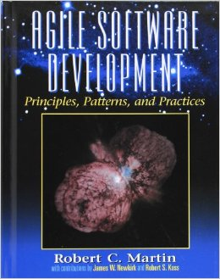
Where it comes from
Introduced by Michael Feathers and Robert C. Martin
C. Martin praises it in his book “Agile Software Development, Principles, Patterns, and Practices”

Slide 3
So what are the principles
Simple responsibility principle
Open/ Close principle
Liskov substitution principle
Interface segregation principle
Dependency inversion principle

Slide 4
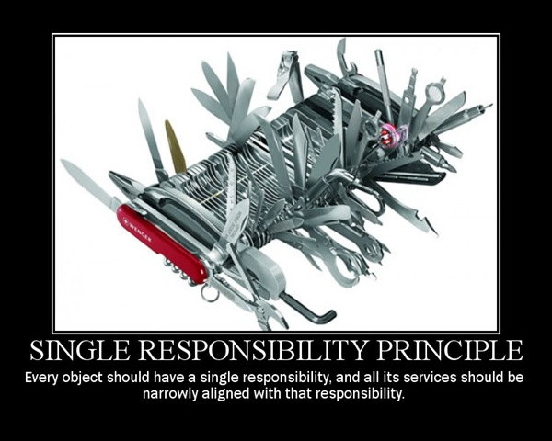

Slide 5
Simple responsibility Principle
In context of SRP, we define a responsibility to be “a reason for change”, so if you can think of more than one motive for changing class than the class has more than one responsibility
And there should never be more than one reason for a class to change
Keep the class simple and focused

Slide 6
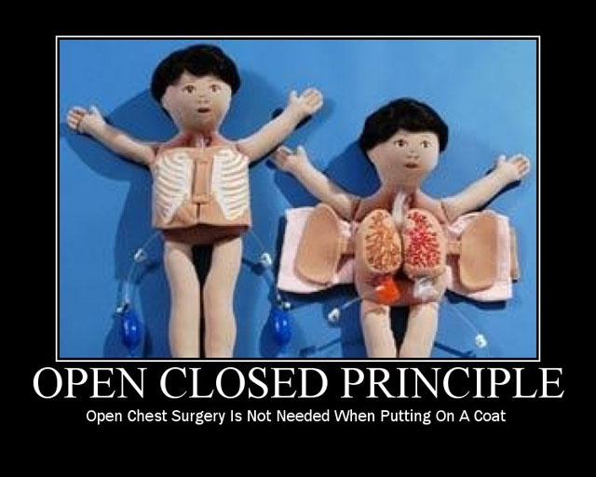

Slide 7
Open/Close Principle
The software Entities ( Classes, Modules, functions, etc.) should be Open for extension but Close for modification
Adding new feature shouldn't cause changing core of class and existing set up

Slide 8
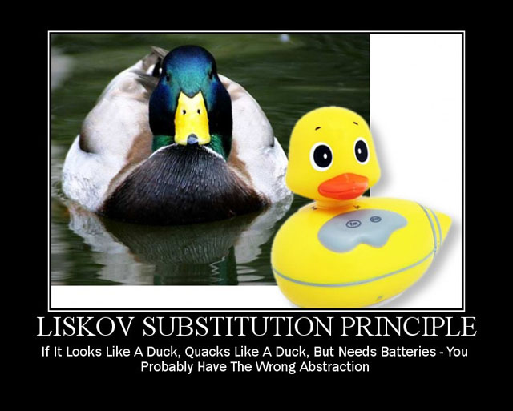

Slide 9
Liskov substitution principle
In a computer Program, if S is a subtype of T, Then objects of type T may be replaced with objects of type S, without altering any of desirable properties of that program, “Barbara Liskov”
Basically Sub Classes shouldn't break their masters behavior

Slide 10
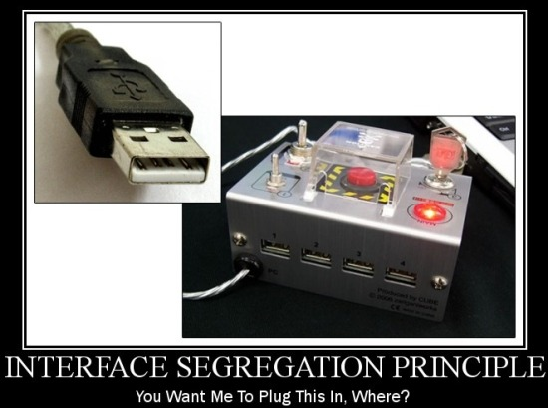

Slide 11
Interface segregation principle
Clients should not be forced to depend upon interfaces that they don’t use
Avoiding Fat interfaces and try to keep interfaces simple and focused

Slide 12
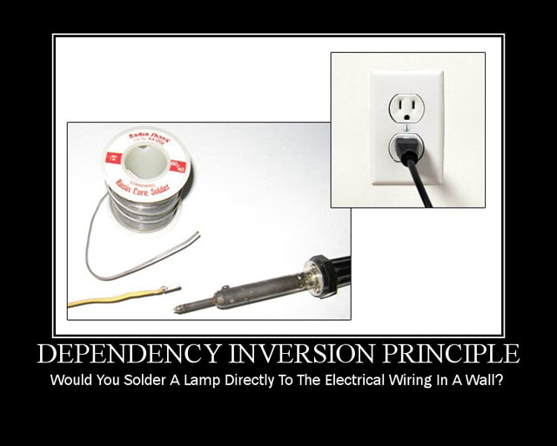

Slide 13
Dependency inversion principle
High level modules should not depend upon low level modules. Both should depend upon abstraction
Abstraction should not depend upon details. Details should depend upon abstraction

Slide 14
http://blog.gauffin.org/2012/05/solid-principles-with-real-world-examples/
http://www.objectmentor.com/resources/articles/ocp.pdf
http://www.objectmentor.com/resources/articles/isp.pdf

