Slide 1



OpenMeasure: Adaptive Flow Measurement & Inference with Online Learning in SDN
ELECTRICAL &
COMPUTER ENGINEERING
Chang Liu
Robust & Ubiquitous Networking Lab
http://www.ece.ucdavis.edu/rubinet

Slide 2
Network Measurement & Inference
Fine-grained traffic size information provides an essential input for many network design and operation tasks.
Capacity planning, network provisionning, load balancing, anomaly detection
Flow size can be measured directly or inferred indirectly from sampled statistics.
Challenge of direct flow measurement: scalability, limited measurement resouces
Estimate TM (traffic matrix) using network inference techniques

Slide 3

SDN based Measurement & Inference
Software-Defined Networking (SDN)
Decouples the network control and forwarding functions
Enables dynamic/re-configurable network control
Provide global view of network
New opportunities
Optimal measurement resource allocation
Dynamically determine what/when/where to measure
Assist network inference with online learning
Dynamically decide what observations to obtain and which missing entries to measure
Controller
Rules/Actions
Secure Channel
Statistics
Flow Table(s)
Rules
Actions
Statistics

Slide 4
OpenMeasure
A network-wide adaptive flow measurement and inference framework with continuous learning capability
Assist network inference with online learning predictions and dynamically update the measurement rules network-wide to track and measure the most informative flows
Leverage the global view of SDN controller to optimally place flow monitoring rules across network

Slide 5
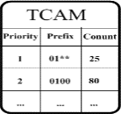
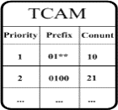
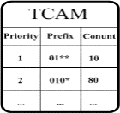
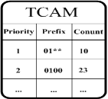
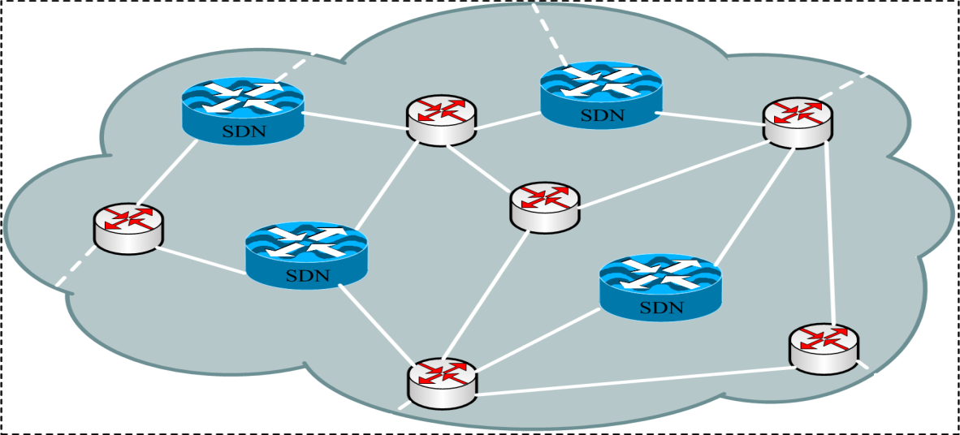
OpenMeasure
Controller
1
4
System model
A centralized controller
Subset of switches are SDN enabled
SDN switches are pre-populated by default routing rules
A handful of TCAMs available for installing new measurement rules
Design Rules
Estimate TM
Install Rules
Collect Statistics
2
3
Flow: <srcIP,dstIP>

Slide 6
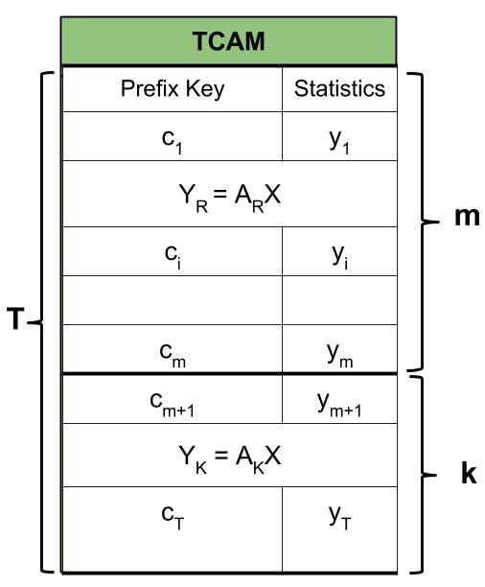
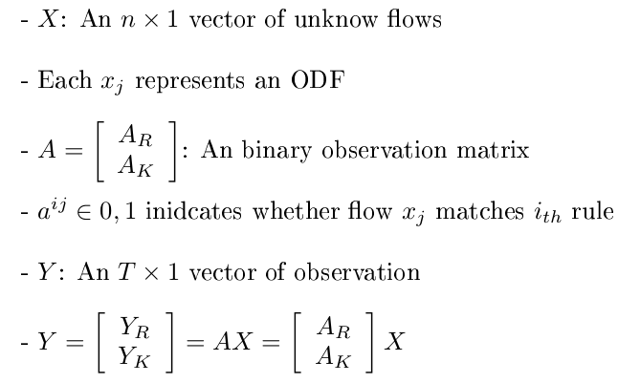
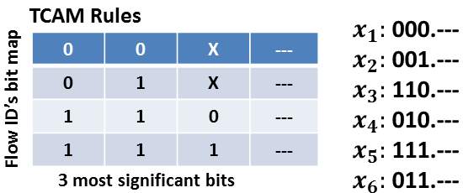
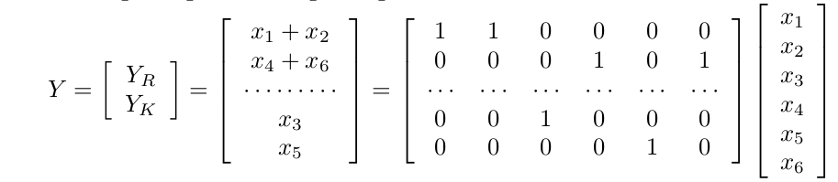
Problem Formulation
Definitions
Example

Slide 7
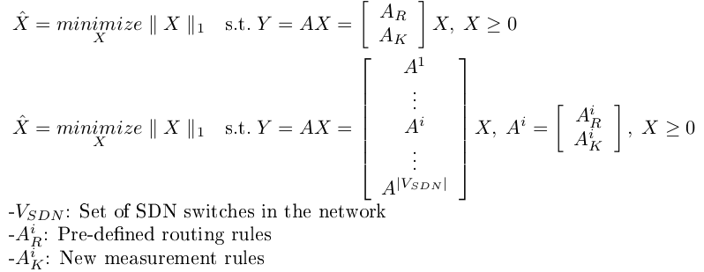
Problem Formulation
Compressive Sensing Estimation*
Single-point
Multi-point
Our approach: Use the K available TCAM entries to sample K most informative flows
[1] M. Malboubi, L. Wang, C. Chuah, and P. Sharma, “Intelligent SDN based traffic (de)aggregation and measurement paradigm (iSTAMP),” IEEE INFOCOM, 2014.

Slide 8
Our approach: OpenMeasure
Key components
Identify the most informative flows from online learning and generate candidate rules to install
Dynamically determine where/what rules are to be installed network-wide using global view
Collect aggregate & flow statistics from switches and perform TM estimation
Controller
1
4
Design Rules
Estimate TM
Install Rules
Collect Statistics
2
3
Flow: <srcIP,dstIP>

Slide 9
Rule Design
Adaptive mechanism with online learning
At each time epoch, update flow tables to track and measure K most informative flows
Measuring the most informative flows is important for improving TM estimation accuracy
Identify large flows with online learning algorithm
Weighted Linear Prediction (WLP)
Modified Upper Confidence Bound (MUCB) Prediction (MUCBP)

Slide 10

Weighted Linear Prediction (WLP)
Maintain a list of n records for each flow
The predicted flow size is a weighted linear sum of history records
Rank flows in decending order of predicted flow sizes and select a set of candidate large flows to track and measure in the next time epoch

Slide 11
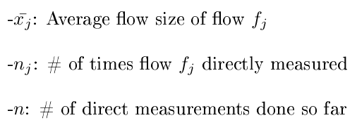

Modified Upper Confidence Bound (MUCB) Prediction
Take flow size of a directly measured flow as sampling reward
Maximize total reward from all available TCAMs over time
Multi-armed bandit (MAB) sequential resource allocation
Balance between exploration and exploitation

Slide 12
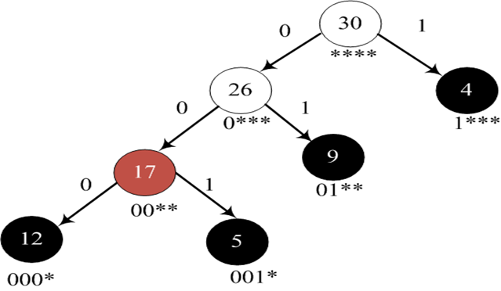
Bootstrap with MLRF
Initial system dynamics
Maximum Load Rule First (MLRF)* strategy to populate the initial measurement rules
The load of a rule is defined as the number of flows matching the rule in an SDN switch
Start from rule w/ maximum load
Generate a new rule with balanced load
Increase the priority of new rule
Old Rule w/ priority p
New Rule w/ priority (p+1)
[2] Y. Gong, X. Wang, M. Malboubi, S. Wang, S. Xu, C.N. Chuah, "Towards Accurate Online Traffic Matrix Estimation in Software-Defined Networks", ACM SIGCOMM SYMPOSIUM ON SDN RESEARCH (SOSR), 2015.

Slide 13
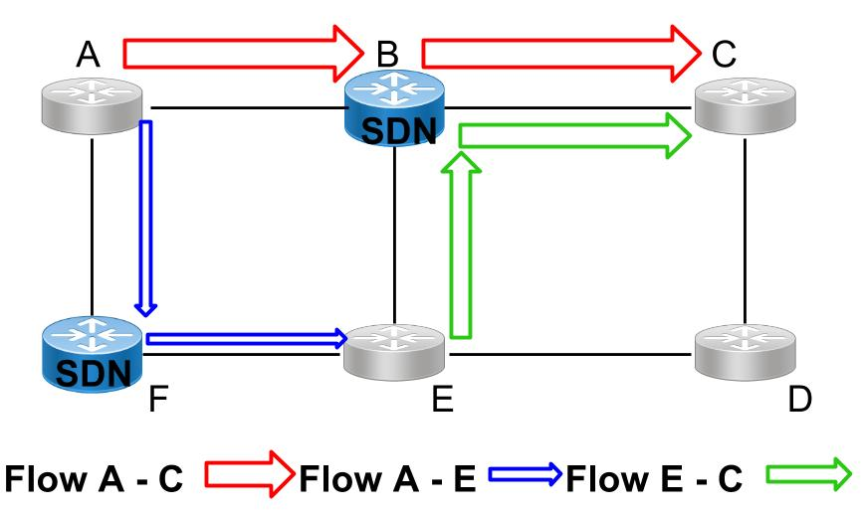
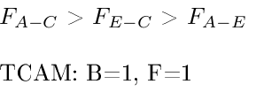
Rule Placement
Determine where (which switch) to directly measure what (which flows)
Optimize rule placement network-wide with the controller’s global view

Slide 14
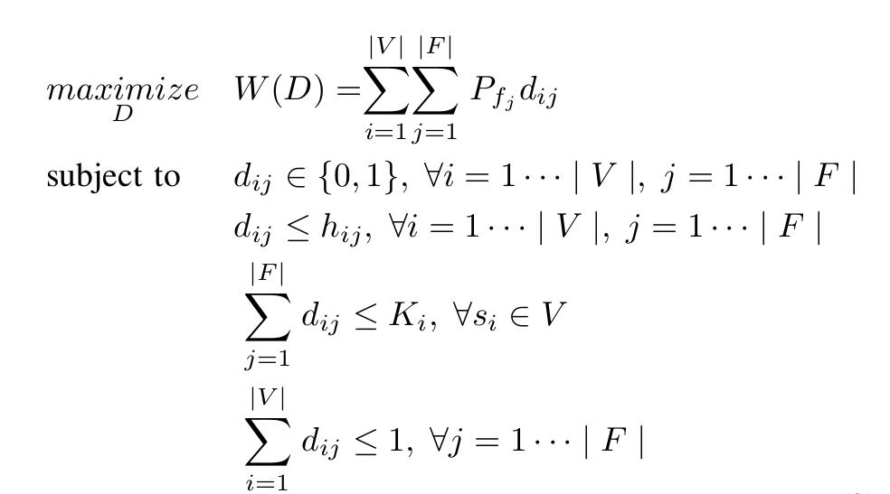
Rule Placement
The problem can be formulated into an integer linear program (ILP)
Computational complexity increases exponentially as the size of the network increases
A flow can only be measured at an SDN switch that it passes in its routing path.

Slide 15
Rule Placement
The problem can be formulated into an integer linear program (ILP)
Computational complexity increases exponentially as the size of the network increases
An SDN switch with Ki available TCAMs can sample Ki flows at most.

Slide 16
Rule Placement
The problem can be formulated into an integer linear program (ILP)
Computational complexity increases exponentially as the size of the network increases
A flow will not be per-flow measured more than once.

Slide 17
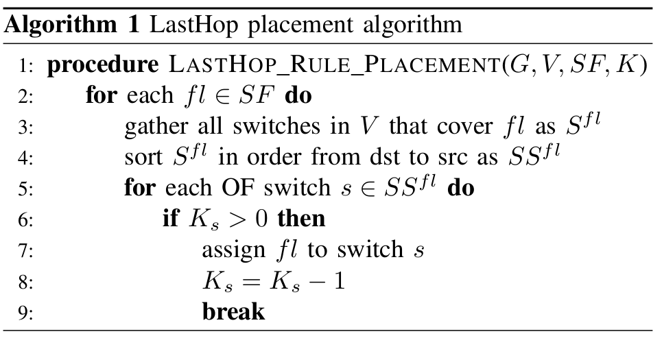
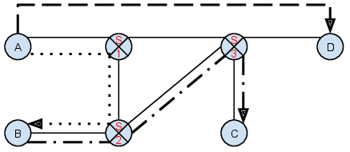
LastHop placement algorithm

Slide 18

LastHop placement algorithm
$$×$$

Slide 19
LastHop placement algorithm

Slide 20
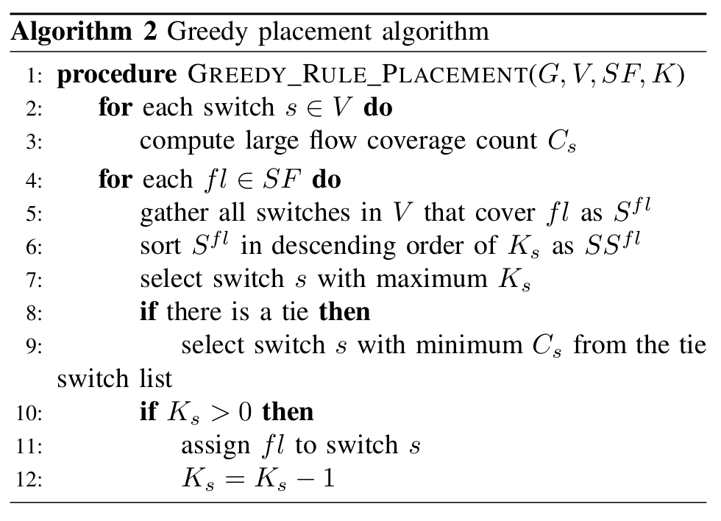
Greedy placement algorithm
3
2

Slide 21
Greedy placement algorithm
3

Slide 22
Performance Study
Network Topologies
Geant (23 nodes & 37 links)
A hybrid SDN-network with 6/23 nodes set to be OF switches
Routing entries are generated based on shortest-path routing
Data Sets
Real traffic traces from Geant are used
Randomly assign a number of IP prefixes to each node to get fine-grained traffic matrices
Performance Metrics
Accuracy for TM estimation: Normalized Mean Square Error (NMSE)
Performance for HHH identification: Recall & Precision

Slide 23

Accuracy for TM Estimation
Normalized Mean Square Error (NMSE)
Compare OpenMeasure with
Random Scheme (RS): Randomly sample a set of flows
Static Aggregation (SA): Fixed grouping of flows
LFF*: Measure a static set of large flows based on one-shot learning
[2] Y. Gong, X. Wang, M. Malboubi, S. Wang, S. Xu, C.N. Chuah, "Towards Accurate Online Traffic Matrix Estimation in Software-Defined Networks", ACM SIGCOMM SYMPOSIUM ON SDN RESEARCH (SOSR), 2015.

Slide 24
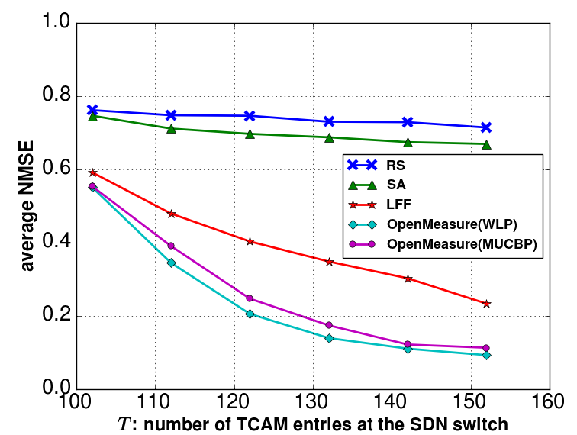
Single-Point: Learning important flows
Accuracy gain from learning
WLP slightly outperforms MUCB
Accuracy gain from continuous learning
OpenMeasure(WLP): Apply WLP learning algorithm in rule design
OpenMeasure(MUCBP): Apply MUCBP learning algorithim in rule design

Slide 25
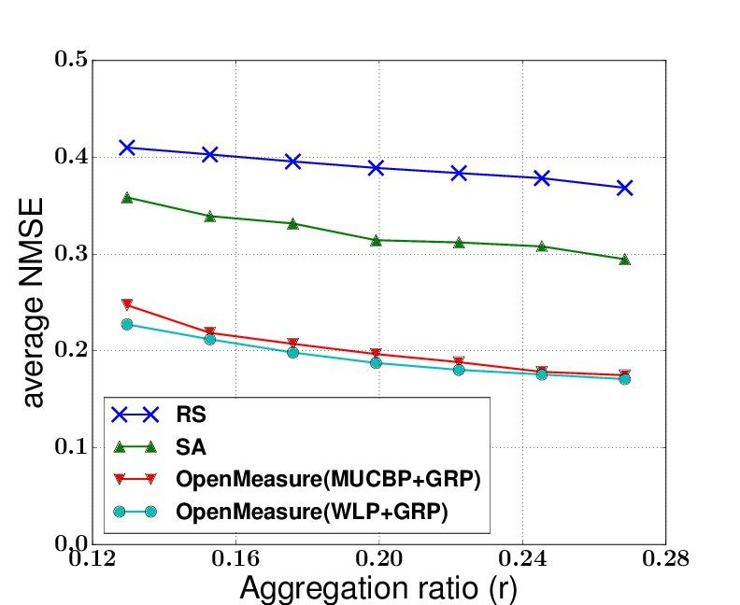
Multi-Point: Accuracy for TM Estimation
r = # of TCAM entries
# of flows
Accuracy gain from adaptive measurement with SDN-enabled online learning
OpenMeasure(WLP/MUCBP+GRP): Apply WLP/MUCBP learning algorithm in rule design and Greedy rule placement (GRP) in rule placement.

Slide 26
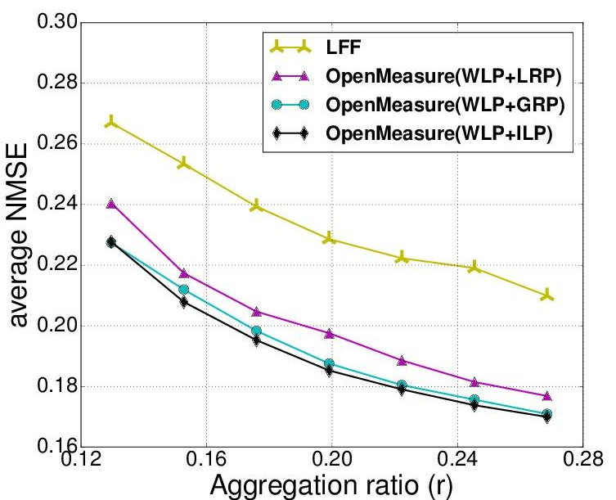
Accuracy for TM Estimation
r = # of TCAM entries
# of flows
Accuracy gain from continuous learning
Two heuristic algorithms achieve estimation accuracy close to that of optimal solution
OpenMeasure(WLP+GRP/LRP): WLP learning algorithm in rule design and Greedy rule placement (GRP)/LastHop rule placement algorithm in rule placement
OpenMeasure(WLP+ILP): WLP learning algorithm in rule design and optimally solve the ILP in rule placement

Slide 27
Hierarchical Heavy Hitter (HHH) Detection
Detecting HHHs is important for security applications
Pinpointing DoS and DDoS attacks, discovering worms and anomalies
Build a prefix tree of source IP addresses for each destination node
HHHs in shaded circles

Slide 28
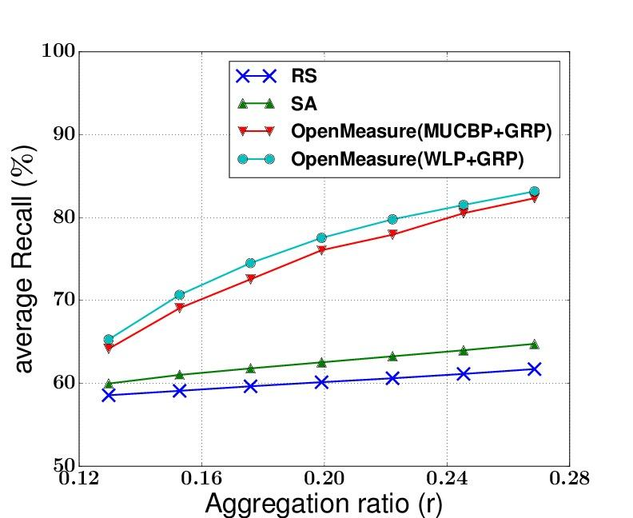
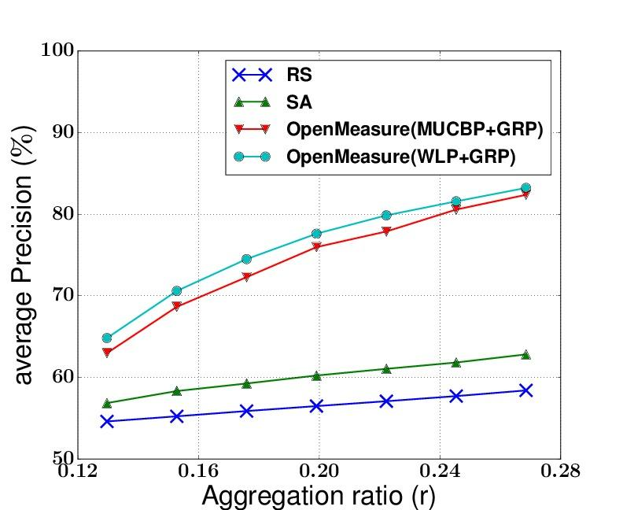
Hierarchical Heavy Hitter (HHH) Detection
Recall: total number of true HHHs detected over real number of HHHs
Precision: total number of true HHHs detected over the total number of HHHs reported
Measurements with SDN-enabled online learning provides the highest precision and recall

Slide 29
Thank you!

