Slide 1

Deloitte Hackathon
Analytics Challenge
April 2017
Notes:
#[TitlePage]

Slide 2
Table of contents
Situation
Our NGO Funding vaccinations around the world
Challenge
Description and deliverables Data sources Hints Presentation Tools Evaluations
Logistics
Team formation Agenda for the day

Slide 3
Situation
NGOs supporting the global immunisation effort face important decisions everyday

Slide 4

Our NGO
Our NGO supports vaccinations that save millions of children’s lives each year – but many more still need immunisations
Context
A non-governmental organisation (NGO) that funds vaccinations for children in lower income regions.
Each year, our NGO spends millions to get vaccinations to where they are needed the most.
Since it launched, our NGO has supported immunisation of more than 580 million children and averted more than 8 million premature deaths.
Maximising the aid effort
Each year, funds have to be allocated across regions, countries, and types of immunisations.

Slide 5
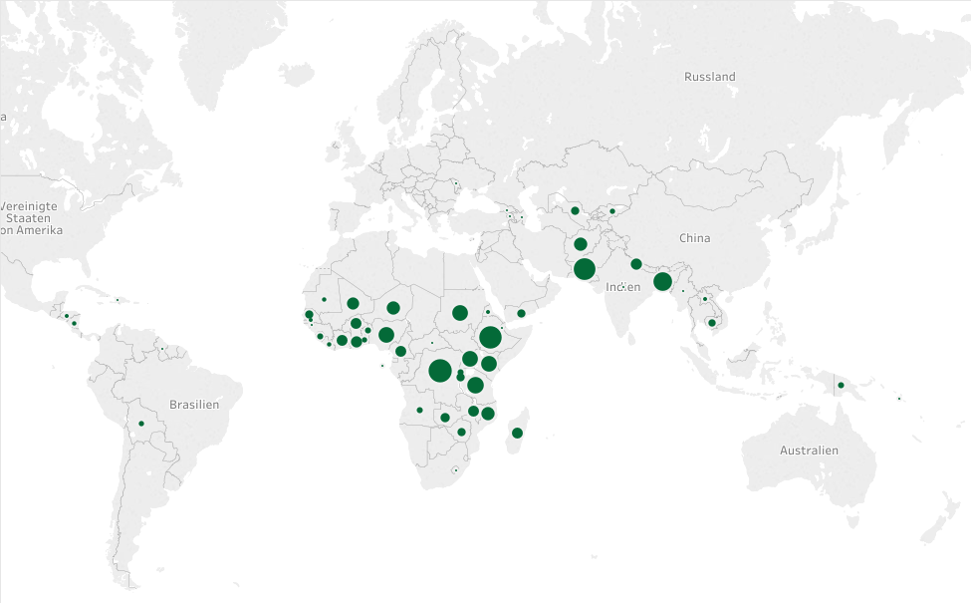
Funding vaccinations around the world
The vaccination strategy has to focus both on short and long term goals - immediately saving lives and pursuing sustainability
Prioritising across countries and immunisations
Immunisation funds are targeted at regions where there would otherwise be an undersupply and lives are at stake.
Immunisations for diseases that pose an immediate risk to children are targeted.
Specific factors play a role: some immunisations require multiple doses at separate times, some diseases are on the brink of eradication.
Country | USD Disbursed
D.R. Congo | $ 57'599'664.00
Ethiopia | $ 53'606'928.00
Pakistan | $ 50'773'773.00
Bangladesh | $ 37'174'576.00
Tanzania | $ 29'218'275.00
Disbursal for pneumococcal immunisations, 2015 (table and graph)

Slide 6
Challenge
Generate data insights to effectively support a worldwide vaccination effort

Slide 7
Description and deliverables
Use cutting-edge analytics to come up with a strategy that ensures funds for vaccinations have maximum impact
Challenge description
Each year, our NGO has to allocate its budget across immunisation types and countries. This allocation of funds plays a crucial role in determining how effective the immunisation initiative is (i.e., how many lives are saved as a result of it).
Our NGO has approached you, a team of independent analytics consultants, to help them plan their investments for the next 5 years. They are looking for a recommendation for how much to invest in what immunisations and what countries. Your model should depend on the following parameters:
Objective: save as many children‘s (< age 10) lives as possible
Budget: USD 1,000,000,000 (1 billion) per year
Time horizon: 5 years
Countries*: all countries where our NGO has previously funded immunisation programs
Immunisations*: all types of immunisations that our NGO has previously funded
What to deliver
Interactive dashboard (or similar) illustrating NGO’s disbursements since 2’000. Depending on your skill and time, this could be a pivot-table-like product and/or a fancy visualisation using a world map.
A final budget allocation recommendation based on generated data insight. This will be presented to the judges and can be supported by a PowerPoint presentation or (ideally) scripts/visualisations/apps that your team built during the Hackathon.
* Data for all past immunisation funding can be found on the Hackathon GIT at
https://github.com/DeloitteHackathon/AnalyticsChallenge/Data

Slide 8
Data sources
You will be relying on data sets that are open to the public – and are you free to add your own data (if openly available)
Data Sources
NGO data:
Detailed information on NGO’s disbursement from 2000 to 2016
World bank data:
Birth rate, death rate, life expectancy, fertility rate, …
Prevalence of obesity, malnourishment, vaccine waste
International migrant numbers, net migration, refugee population by country or territory of origin
GDP, poverty headcount
Air pollution, improved sanitation facilities, water source
WHO data:
Coverage by vaccines for each country 1980-2015
Number of reported cases of cholera, tuberculosis, …
Ideas for supplementary data:
Forecasts of epidemics, forecast of destabilizing elections, GDP growth (meaning country can found own effort), data on innovations for new ways of delivering vaccines in difficult circumstances etc.
All these data sets are available on the hackathon GIT at https://github.com/DeloitteHackathon/AnalyticsChallenge/Data

Slide 9
Hints
Do not get overwhelmed by the data and remember to enjoy yourselves
Hints
Half the work is formalizing the problem. You will have to make assumptions. Make sure you explain why you made them.
You don’t have much time so keep your analysis simple. You will need to discard many of the variables in the various data sets we give you.
We are dealing with a serious topic but after all this is just a hackathon. Try to wow us and your competitors with cool visualisations and solid analysis. (Remember however: the recommendation is the final product of your work ☺)

Slide 10
Presentation
Each team will present their work in front of a group of judges
Presentation Guidelines
Format
10 min pitch
10 min QA
Content
Introduce team
Problem Statement
Presentation of solution
Demo

Slide 11
Tools
Use any of the tools listed below or your own choice, provided the tool is available for free
Tools
Code
All code used must be open sourced. It can be existing code, new code written for the hackathon project, or a combination, but all code must be open sourced and licensed appropriately.
Language (options available)
R – Shiny, Plotly
Python – Pandas, Bokeh
Matlab
SQL – Backend MS SQLServer
Github to download dataset (link)
Slack to bring communication together so that people can share their insights (link)
Data Visualisation (options available)
QlikSense
Tableau (trial available)
GapMinder (link)
PowerBI (link)

Slide 12
Evaluation
A number of clearly defined criteria will be used in the evaluation of your work. Each team’s work will be evaluated as a whole
Analytics
Data indentification and integrity Analysis is relevant and results are easily reproducible Code is well-structured and commented Clearly state hypothesis Sophisticated analysis is used where appropriate
Visualisations
Direct attention to the key message Appropriate chart type Accurate units of measurement Keep it clear Visuals are appealing
Presentation
Provides clear and well-founded recommendations Solves the initial business problem with actionable recommendations Is well-structured Tells a compelling story Is within the time limit

Slide 13
Logistics

Slide 14
Teams
Good collaboration within the team will be key success factor
Team formation
Each participant will be part of a team of 2-4 people
People are free to team up as they wish (we recommend a good mix of skillsets in the same team: technical, business and presentation skills).
We suggest that you look for the following qualities in your team:
Experience building small apps
Experience with data visualisation
Experience with statistics/machine learning
Experiences with business presentations/pitches

Slide 15
Agenda
You will have 24 hours to complete the challenge
Friday
9h – 10h15 Introduction
10h30 – open ended Start of hackathon
11h – 15h Food (ongoing)
19h – 22h Bar opens & Apéro
Saturday
10h – 10h30 Welcome breakfast
10h30 – 12h Presentation of results
12h – 12h30 Wrap up

