Slide 1
Estimating Population Parameters of Fatal Shootings in America
Cholyeon Cho, Emory University, 24C
Advisor:
Professor Adam Glynn, Political Science and Quantitative Methods, Emory University
Notes:
Comfortableness
Feel free to ask Questions

Slide 2
Contributions
Aggregated Dataset
Aggregated dataset of fatal on-duty or off-duty police shootings between years 2015 - 2021
Show Incompleteness
Three current datasets that are primarily referenced are incomplete
Testing Comprehensiveness
By estimating the population parameter of on-duty fatal police shootings in America, tested the comprehensiveness of the aggregated dataset

Slide 3
Table of contents
01
02
03
Datasets
Capture-Recapture
Merged Dataset and Z-Tables

Slide 4
01
Datasets

Slide 5
Datasets
Government Collected Datasets
National Vital Statistics System (NVSS)
Problem
Studies showed that NVSS is missing many observations
Media Sourced Datasets
Fatal Encounters, Mapping Police Violence, Washington Post
Notes:
Specifically, reporting was optional and data was corrupted
Media sources are credible since fatal police shootings are ideally covered in media sources

Slide 6
Common Aspects
1
3
Media Sourced
Location
News reports, other fatal datasets
Longitude, latitude, city, state
2
4
Description Victim
Description Incident
Name, age, gender, race of the victim
Armed status of victim, victim fleeing, mental illness of victim
Notes:
Warning about the city variable

Slide 7
Differences - Variables
1
Fatal Encounters
No information about body cameras
3
Washington Post
2
Did not have links or descriptions about the observation, specific address
Mapping Police Violence
Had many political variables. Political party of prosecutor, congressional representative of area, racial distribution of area etc.
Notes:
Mention the usage of each dataset – MPV

Slide 8
Difference in Definition of Police Violence
1
Fatal Encounters
Broadest definition of police violence. Any death that happened in presence of on-duty or off-duty law enforcement officers
2
Mapping Police Violence
Any on-duty or off-duty law enforcement officer directly inflicting force to lead the victim to death
3
Washington Post
On-duty law enforcement officers fatally shooting the victim to death
Notes:
Mention Usage of dataset FE, WPOST

Slide 9
02
Aggregated Dataset and Z-Tables

Slide 10
Aggregated Dataset
1
Filtering Datasets
Filter datasets to match definition of on-duty or off-duty fatal police shootings
2
Algorithm
Runs through every datapoint in each dataset to check if they are the same observation
3
Manual Checking
Every observation were manually checked and labeled non-fatal, off-duty, obscure

Slide 11
Algorithm
Used thresholding to categorize observations, where an observation would gain scores if certain criteria are met
Threshold and scores were manually tuned and compared to hand annotations
Criteria
Name, Age, Race, Gender, Location, Date

Slide 12
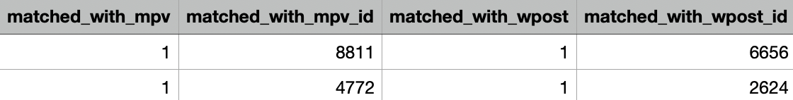
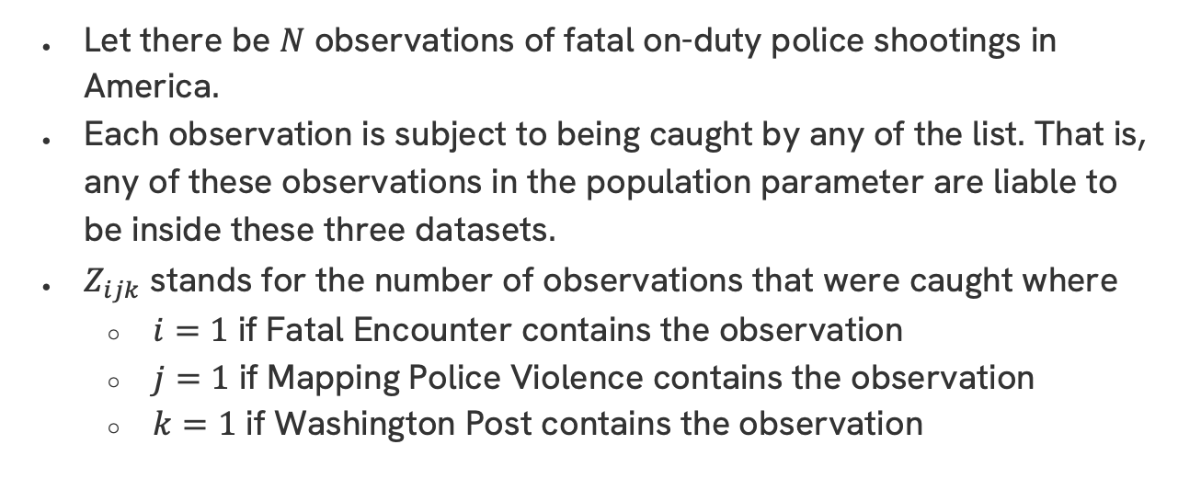
Description of Z-Table
Let there be $N$ observations of fatal on-duty police shootings in America.
Each observation is subject to being caught by any of the list. That is, any of these observations in the population parameter are liable to be inside these three datasets.
$Z_{ijk}$ stands for the number of observations that were caught where
$i=1$ if Fatal Encounter contains the observation
$j=1$ if Mapping Police Violence contains the observation
$k=1$ if Washington Post contains the observation

Slide 13
Matching Police Violence Definitions
Example 1
Example 2
Victim runs towards the police when another group of people were shooting at him. Police shot at the group of people. Victim was shot to death either by police or the group of people.
When the police shot the victim at his own home, the victim barricades himself. There is a standoff for several hours until the police burst into the victim’s home to find him dead.

Slide 14
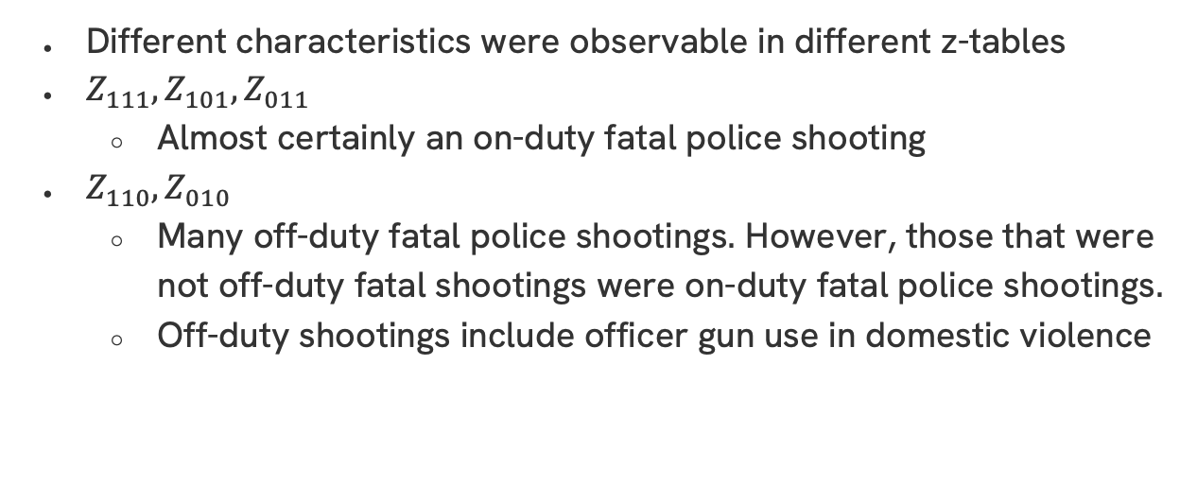
Characteristics of Z-Tables
Different characteristics were observable in different z-tables
$Z_{111},Z_{101},Z_{011}$
Almost certainly an on-duty fatal police shooting
$Z_{110},Z_{010}$
Many off-duty fatal police shootings. However, those that were not off-duty fatal shootings were on-duty fatal police shootings.
Off-duty shootings include officer gun use in domestic violence

Slide 15
Characteristics of $Z_{100}$
The approach of Fatal Encounters is distinctively aggressive
Many observations were not fatal or were more obscure
Herman King Myers Jr., a murder suspect exchanged shots with the police while barricading himself inside his home. He was later found dead with uncertain cause of death

Slide 16
Characteristics of $Z_{001}$
The quality of Washington Post was noticeably poor compared to other datasets
Many observations were initially miscategorized due to missing variables or not fatal police shootings
Dewayne Taylor shot at police in a parking lot and police shot Dewayne Taylor. Although he was injured, he was waiting a hearing

Slide 17

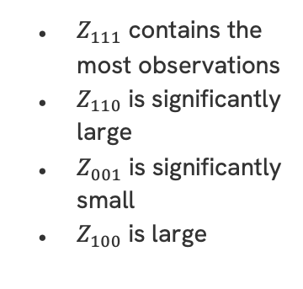
Z-Table Observations
Noticeable Trends
$Z_{111}$ contains the most observations
$Z_{110}$ is significantly large
$Z_{001}$ is significantly small
$Z_{100}$ is large

Slide 18
03
Capture-Recapture

Slide 19
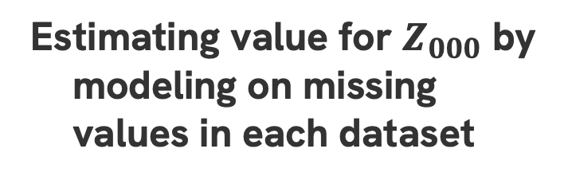
How to check comprehensiveness of the aggregated dataset?
Estimating value for $Z_{000}$ by modeling on missing values in each dataset

Slide 20

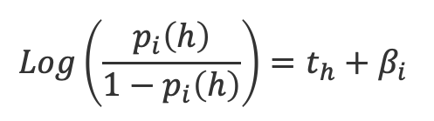



Rcapture Package
$$Log\left(\frac{p_{i}\left(h\right)}{1−p_{i}\left(h\right)}\right)=t_{h}+β_{i}$$
Assumes uniform probability of capture and catchability
$$M_{0}$$
Assumes different catchability but uniform capture probabilities
$$M_{t}$$
Log-Linear Models
Assumes different capture probabilities but same catchabilities
$$M_{h}$$
Assumes different capture probabilities and different catchabilities
$$M_{th}$$

Slide 21
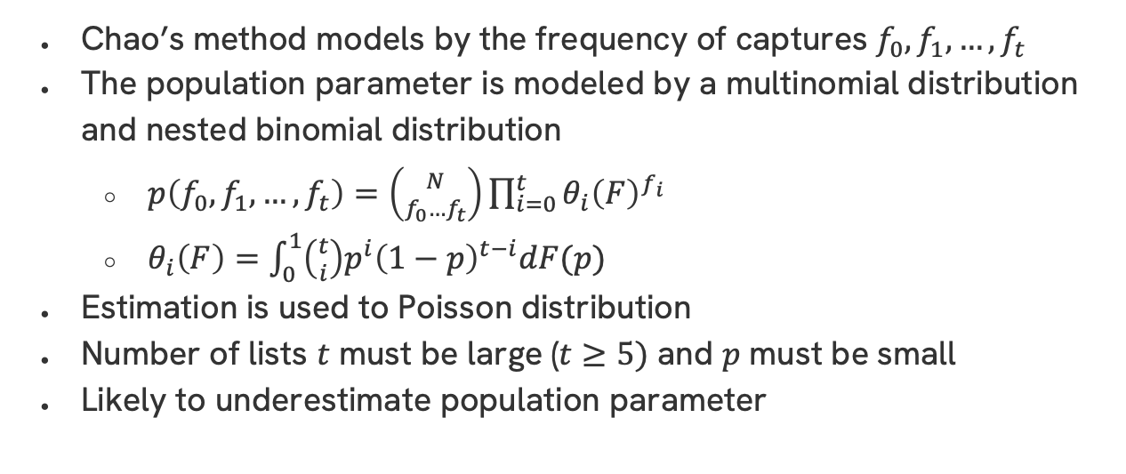
Chao’s Lower Bound
Chao’s method models by the frequency of captures $f_{0},f_{1},…,f_{t}$
The population parameter is modeled by a multinomial distribution and nested binomial distribution
$p\left(f_{0},f_{1},…,f_{t}\right)=\left({N \atop f_{0}…f_{t}}\right)\prod_{i=0}^{t}{θ_{i}{\left(F\right)}^{f_{i}}}$
$θ_{i}\left(F\right)=\int_{0}^{1}{\left({t \atop i}\right)p^{i}{\left(1−p\right)}^{t−i}dF(p)}$
Estimation is used to Poisson distribution
Number of lists $t$ must be large ($t≥5)$ and $p$ must be small
Likely to underestimate population parameter

Slide 22
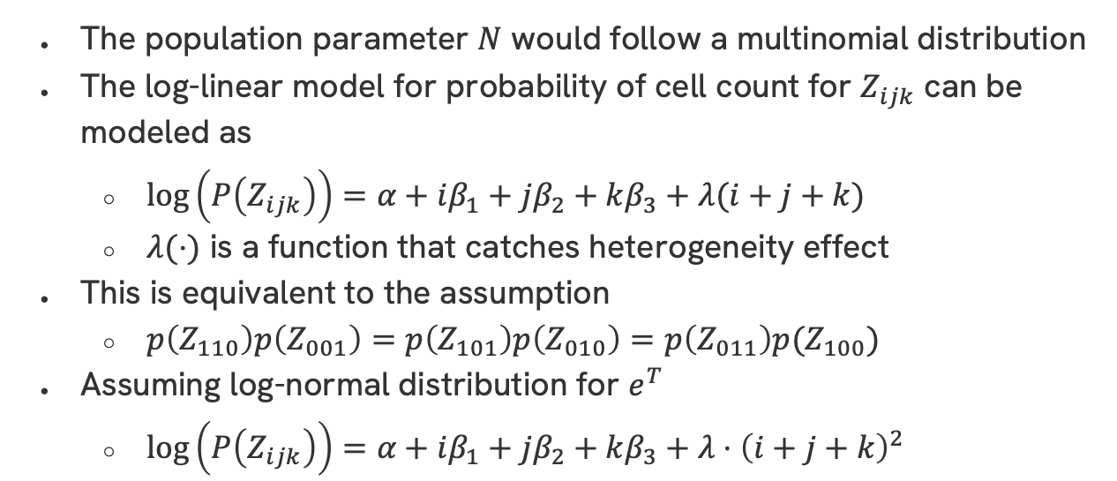
Darroch’s Method – Same Heterogeneity
The population parameter $N$ would follow a multinomial distribution
The log-linear model for probability of cell count for $Z_{ijk}$ can be modeled as
$\log\left(P\left(Z_{ijk}\right)\right)=α+iβ_{1}+jβ_{2}+kβ_{3}+λ(i+j+k)$
$λ(⋅)$ is a function that catches heterogeneity effect
This is equivalent to the assumption
$p\left(Z_{110}\right)p\left(Z_{001}\right)=p\left(Z_{101}\right)p\left(Z_{010}\right)=p\left(Z_{011}\right)p(Z_{100})$
Assuming log-normal distribution for $e^{T}$
$\log\left(P\left(Z_{ijk}\right)\right)=α+iβ_{1}+jβ_{2}+kβ_{3}+λ⋅{\left(i+j+k\right)}^{2}$

Slide 23
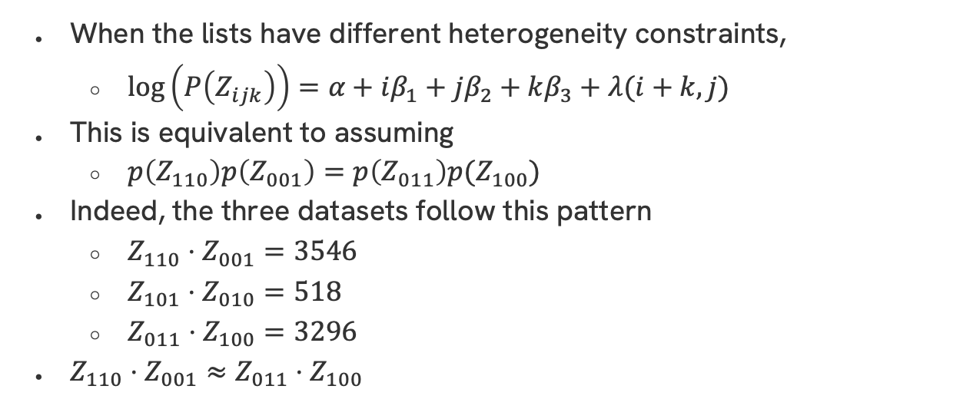
Darroch’s Method – Different Heterogeneity
When the lists have different heterogeneity constraints,
$\log\left(P\left(Z_{ijk}\right)\right)=α+iβ_{1}+jβ_{2}+kβ_{3}+λ(i+k, j)$
This is equivalent to assuming
$p\left(Z_{110}\right)p\left(Z_{001}\right)=p\left(Z_{011}\right)p(Z_{100})$
Indeed, the three datasets follow this pattern
$Z_{110}⋅Z_{001}=3546$
$Z_{101}⋅Z_{010}=518$
$Z_{011}⋅Z_{100}=3296$
$Z_{110}⋅Z_{001}≈$ $Z_{011}⋅Z_{100}$

Slide 24
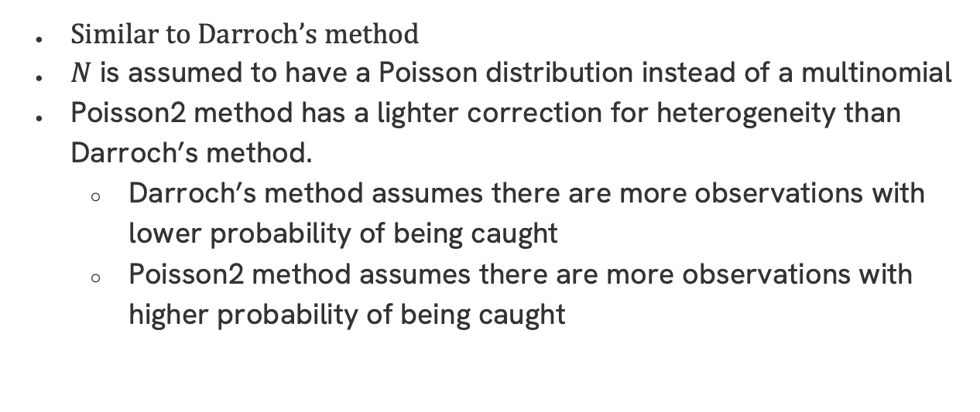
Poisson2 Method
Similar to Darroch’s method
$N$ is assumed to have a Poisson distribution instead of a multinomial
Poisson2 method has a lighter correction for heterogeneity than Darroch’s method.
Darroch’s method assumes there are more observations with lower probability of being caught
Poisson2 method assumes there are more observations with higher probability of being caught

Slide 25
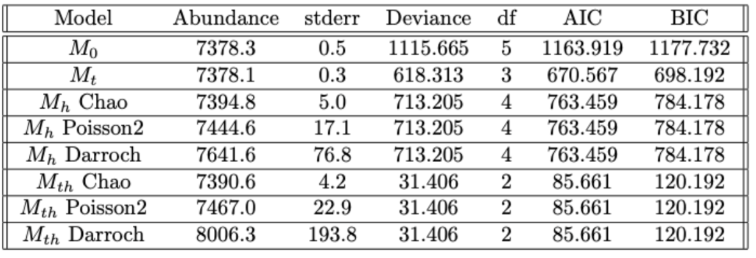
Model Estimations – Same Heterogeneity

Slide 26
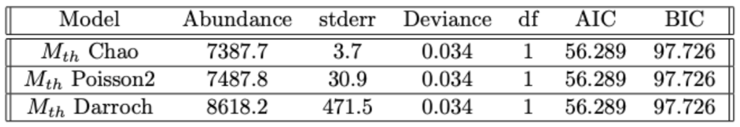
Model Estimations - Different Heterogeneity

Slide 27
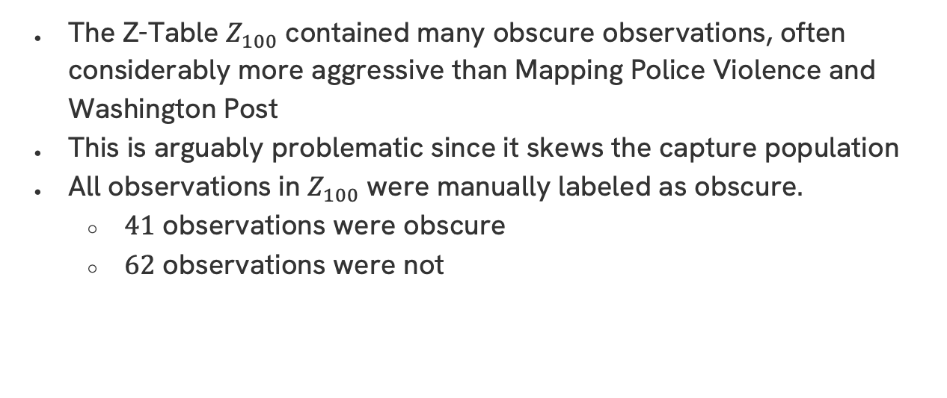
Controlling for Potential Measurement Errors
The Z-Table $Z_{100}$ contained many obscure observations, often considerably more aggressive than Mapping Police Violence and Washington Post
This is arguably problematic since it skews the capture population
All observations in $Z_{100}$ were manually labeled as obscure.
$41$ observations were obscure
$62$ observations were not

Slide 28
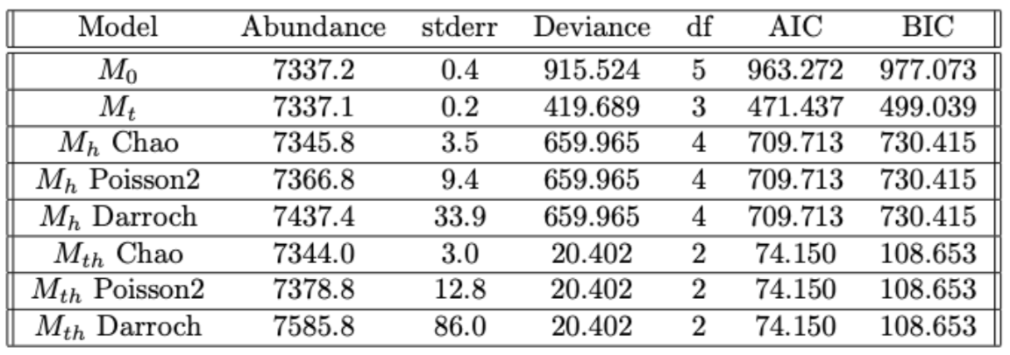
Model Estimations – Same Heterogeneity

Slide 29
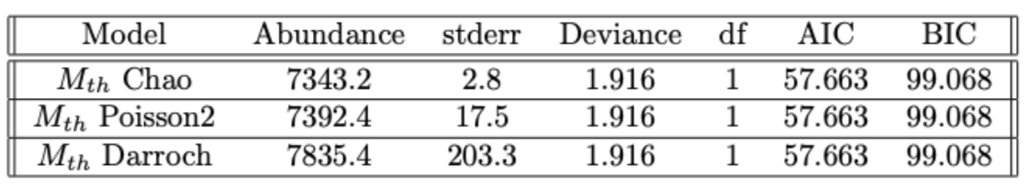

Model Estimations – Different Heterogeneity
Heterogeneity Check
$Z_{110}⋅Z_{001}=3546$
$Z_{101}⋅Z_{010}=518$
$Z_{011}⋅Z_{100}=1984$

Slide 30

Summary of Estimations
1
Poisson2 $M_{th}$ - Different heterogeneity
109 observations missing from aggregated dataset
55 observations missing from aggregated dataset
2
Darroch $M_{th}$- Different heterogeneity
1240 observations missing from aggregated dataset
498 observations missing from aggregated dataset

Slide 31
Conclusions
1
Aggregated Dataset
A comprehensive dataset that is expected to miss no more than 1300 observations of fatal police shootings throughout 7 years in America
2
Show Incompleteness of Other Datasets
Significant improvement of 500 observations from Washington Post dataset. Cleaning observations in the dataset, additional labeling, thorough checking

Slide 32
Acknowledgements

Slide 33
Bibliographical references
The Lancet 398.10307 (Oct. 2021), pp. 1239–1255. doi: 10 . 1016 / s0140-6736(21)01609-3.
Emmanuella Ngozi Asabor et al. “A mixed-methods assessment of off-duty police shootings in a media-curated database”. In: Health Services Research 58.S2 (June 2023), pp. 207–217. doi: 10 . 1111 / 1475 - 6773 . 14170.
Sophie Baillargeon and Louis-Paul Rivest. “The rcapture package: Loglinear models for capture-recapture in r”. In: Journal of Statistical Software 19.5 (2007). doi: 10.18637/jss.v019.i05.
Anne Chao. “Estimating the population size for capture-recapture data with unequal catchability”. In: Biometrics 43.4 (Dec. 1987). doi: 10.2307/2531532.
Benjamin P. Comer and Jason R. Ingram. “Comparing fatal encounters,mapping police violence, and washington post fatal police shooting data from 2015–2019: A research note”. In: Criminal Justice Review 48.2 (Jan. 2022), pp. 249–261. doi: 10.1177/07340168211071014.
John N. Darroch et al. “A three-sample multiple-recapture approach to census population estimation with heterogeneous catchability”. In: Journal of the American Statistical Association 88.423 (Sept. 1993), p. 1137.doi: 10.2307/2290811
Fatal Encounters. url: https://fatalencounters.org/.
David Hemenway et al. “Variation in rates of fatal police shootings across US states: The role of Firearm availability”. In: Journal of Urban Health 96.1 (Oct. 2018), pp. 63–73. doi: 10.1007/s11524-018-0313-z.
How the Washington Post examines fatal police shootings - the ... url: https : / / www . washingtonpost . com / investigations / 2022 / 12 / 05 /washington-post-fatal-police-shootings methodology/.
Mapping Police Violence. url: https://mappingpoliceviolence.us/.
Louis-Paul Rivest and Sophie Baillargeon. “Applications and extensions of Chao’s moment estimator for the size of a closed population”. In: Biometrics 63.4 (Apr. 2007), pp. 999–1006. doi: 10.1111/j.1541- 0420.2007.00779.x.
John A. Shjarback and Justin Nix. “Considering violence against police by citizen race/ethnicity to contextualize representation in officer-involved shootings”. In: Journal of Criminal Justice 66 (Jan. 2020), p. 101653. doi: 10.1016/j.jcrimjus.2019.101653.
The Guardian. Jan. 2023. url: https : / / www . theguardian . com / usnews/2023/jan/06/us-police-killings-record-number-2022.
Bo Zhang and Dylan S. Small. “Number of healthcare workers who have died of covid-19”. In: Epidemiology 31.6 (June 2020), pp. 891–921. doi:10.1097/ede.0000000000001229

Slide 34
Thanks!

