Slide 1
Networks and the Internet
Computer networks
The development of the Internet
The World Wide Web
A protocol hierarchy
Encryption and privacy

Slide 2
Computer Networks
Collection of Computers
Telecommunications equipment
We call the computers nodes on the network
We call the links between them edges.

Slide 3
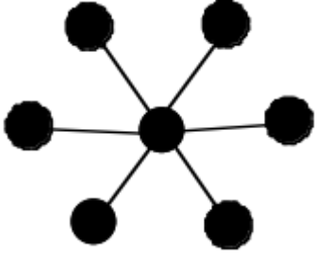
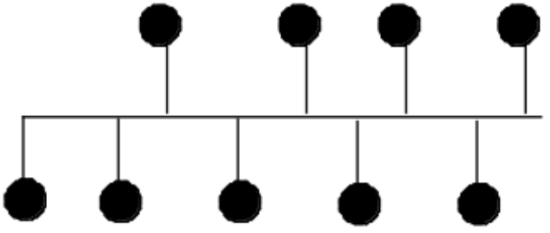
Common Network Topologies
LAN, MAN, and WAN
Star
Bus

Slide 4
How do computers communicate over a network?
Physics
Communications protocols
Standards
  Example: Ethernet
  CSMA/CD Protocol
Protocol hierarchies (Stack)

Slide 5
The Internet
An internet is simply a network of networks
The Internet is an example of an internet that spans the globe and is enormously popular
ARPA (now DARPA) provided funding for the development of ARPANET beginning during the 1960s

Slide 6
The Internet
ARPANET grew into the global network we call the Internet.
The key new concept of the 1960s was to use “packets” to transmit information.
Many of the first design principles for the internet were developed independently and in parallel at MIT, RAND, and NPL

Slide 7
Internet Structure
Today we can roughly organize the Internet into a hierarchy of networks
  Tier 1 ISPs
  Tier 2 ISPs
  Access ISPs
  End Systems

Slide 8
Internet Standards
The network hardware has successfully been privatized.
Communication protocols, development, and standardization falls on the ISOC (1992). There are many other bodies that operate under the auspices of the ISOC
ICANN is a separate body responsible for domain names
W3C is responsible for WWW standards

Slide 9
The World Wide Web
Developed at CERN beginning in the 1980s
1990 first browser and the term World Wide Web is coined.
1994 W3C is founded to provide standards that ensure interoperability on the WWW

Slide 10
How do computers communicate over the Internet?
Goal: Networks that communicate in a variety of ways must all be able to communicate together in the same way.
Answer: Use of protocol hierarchy (stack)
This divide and conquer approach is a wonderful example of the use of abstraction to solve large scale technical problems

Slide 11
Protocol Hierarchy
Applications
Transport
Network
Data Link
Physical

Slide 12
Physical Layer
Problems solved:
  Engineering
  How will bits be represented
  What will connectors look like
  What kind of different mediums will be used to transport information

Slide 13
Data Link Layer
Building on the Physical Layer
  Whose turn to speak?
  Cleaning things up
  Framing
  Error correction

Slide 14
Network layer
How do we get from here to there?
  IP addresses
  Path finding

Slide 15
Transport Layer
Ports for different applications
  Port numbers are like apartment numbers
Global error checking
  Data link on a global level
Breaking things down
  Making long messages into packets

Slide 16
Application Layer
What should we say?
HTTP
SFTP
SMTP
SSH
And more! These are the protocols you use every day.

Slide 17
Privacy
How encryption works
  An example: flipping a coin over the phone
Legal issues with encryption technology
Much remains to be done.

