Slide 1

PPSuite
The last IDE you’ll ever need.
Kevin He, Chris Choy, Dawson Whitehead, April Wang
Uncommon Hacks 2019

Slide 2
Background
Realization: PowerPoint is Turing Complete. In 2017, Tom Wildenhain built a PowerPoint Turing Machine (aka PPTXTM).
Problem: You need punch cards to operate it. Punch cards were phased out in the 1960s…
Idea: What if you could write C code that runs in PowerPoint?
Realization: We need a PowerPoint Compiler & Executor! obviously…

Slide 3
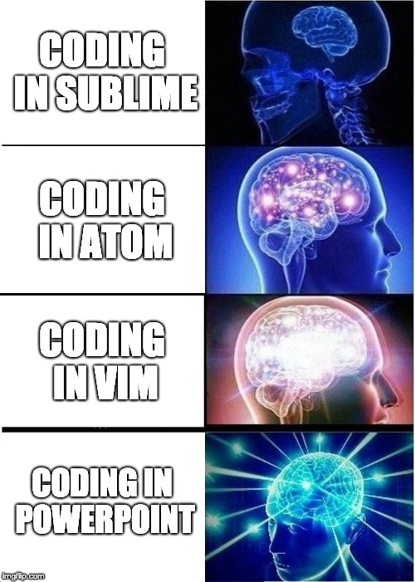
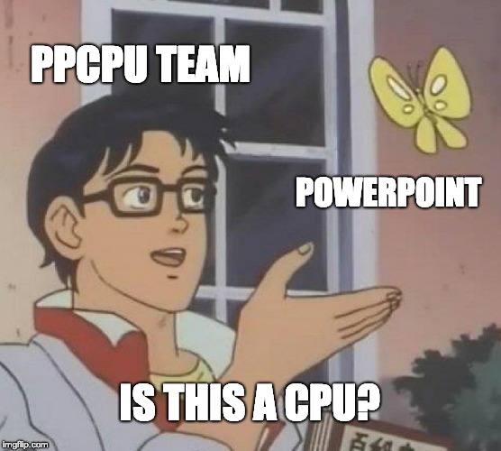
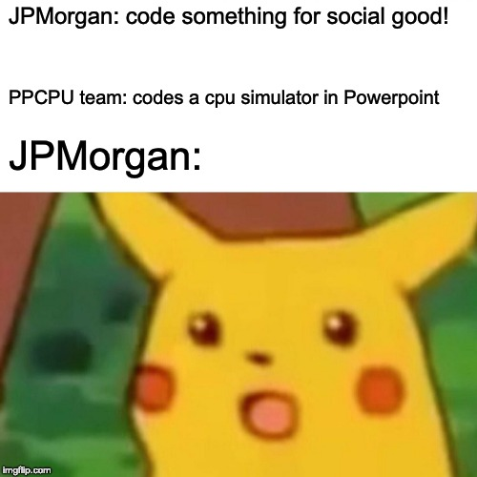
But y tho?
“Is writing code TOO easy?”
“Frustrated by computers being TOO fast?”
By the time someone tried to stop us… it was too late.

Slide 4
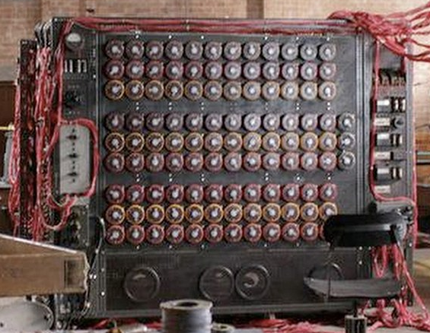
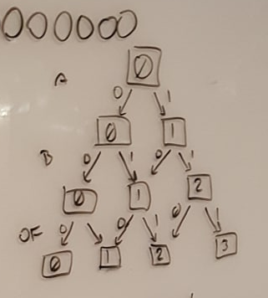
Challenges
None of us knew how Turing Machines or Punch Cards worked.
Going from a PL to TM Language is theoretically possible but neither proven nor implemented before.
PPTXTM’s tape only provides 8 cells/states/bits. Turing Machines assume an “infinite” tape.

Slide 5
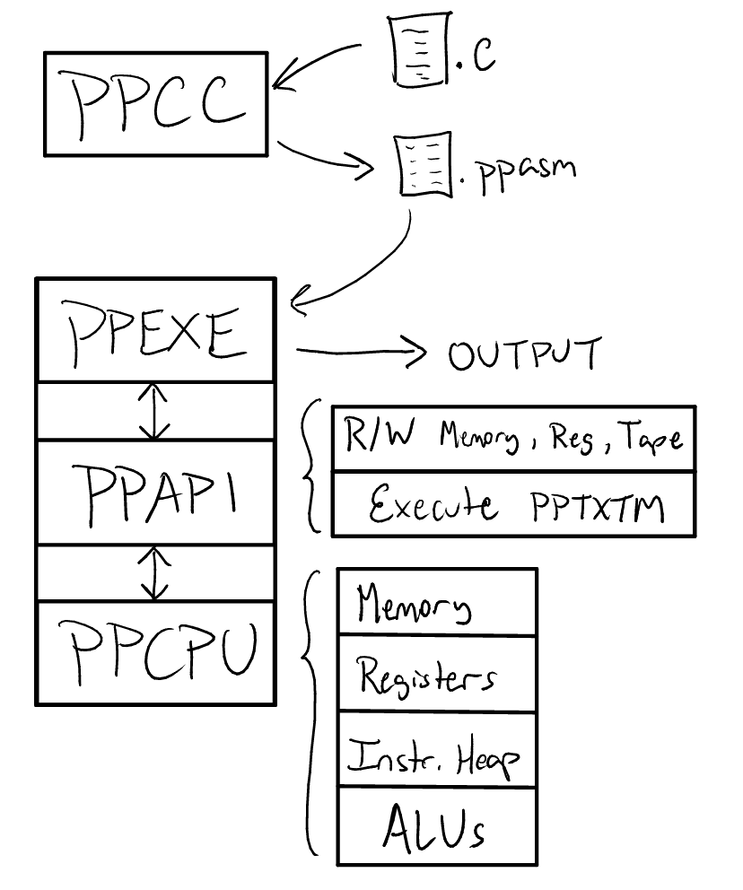
Presenting… the PPSuite!
PPCC.py – compiler that converts .c to .ppasm, our own ASM format via ELVM
PPEXE.py – executor that loads, decodes, and executes ppasm instructions on the ppcpu
PPAPI.py – interface between executor and the ppcpu.
PPCPU.pptx – cpu built to function entirely in Powerpoint. This includes 256 bytes of memory, 8 registers, an instruction code heap, and several Arithmetic Logic Units implemented on Turing Machines.

Slide 6
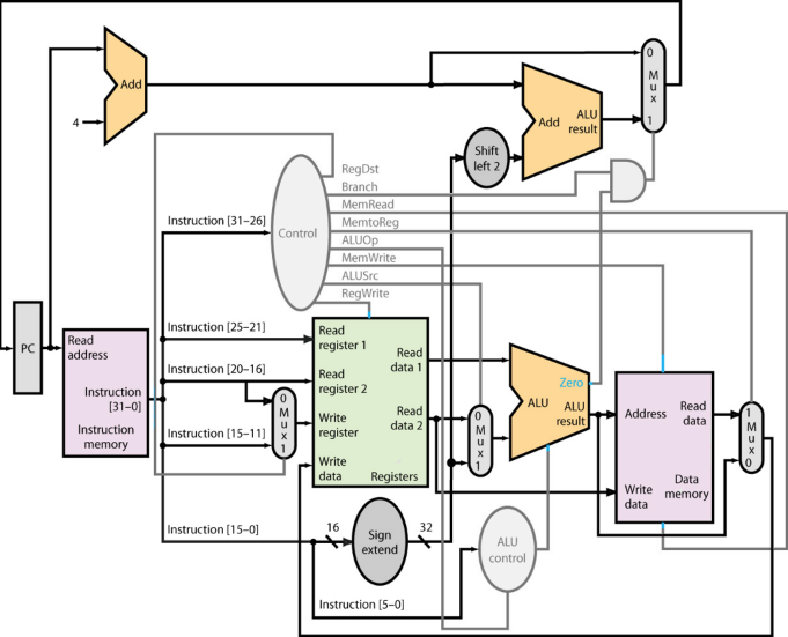
DEMO
Write foo.c
$ python3 ppcc.py foo.c >> foo.ppasm
$ python3 ppexe.py foo.ppasm
Initialize memory in ppcpu
Load instructions to ppcpu
Execute instructions

Slide 7
Dependencies
PowerPoint – yes. surprisingly.
ELVM (esoteric language virtual machine) – used a modified library of this to help us bridge the gap between C and PPASM languages.
AutoHotKey – performs auto-clicking for PPTXTM cycles so a human doesn’t have to. Required a LOT of coordinates.
win32COM – provides PowerPoint interfacing capabilities
Python3.7 – needed purely for control flow. Most CPUs would have wiring to support this.
1920 x 1080 resolution

Slide 8
Some Numbers
1 cycle = around 1 sec = 1-2 Hz
ADD = O(5n), where n=#bits
SUB = O(6n), where n=#bits
Push/Pop = 1 operation
Animations per Cell = O(n²+m²)
8 cells = 1600 animations. 16 cells = 6400 animations.
Memory = 256 bytes of storage
Registers = 8 bits
ALU = 8 bits

Slide 9
Key Contributions
C to PPASM compiler
Modular Turing Machine ALUs in PowerPoint
Code for loading and executing ppasm on pptxtm
Automatic Cycle Executor
Paginated Memory using PowerPoint slides
We executed C code in PowerPoint.

Slide 10
Future Work (bc we only had 24 hrs and a dream)
A larger tape & Multi-tape
Comprehensive Test Suite (This thing is slow)
Writing to stdout
Cross platform/Cross screen resolution support
Performance optimizations

Slide 11
The End. Finally.
https://github.com/cchoy96/ppcc/
Some Memorable Quotes from the past 24 hours:
“What are they doing?” “idk. some PowerPoint shit”
“Look at this wiring! Python is doing nothing.”
“Why Tom?! What did you see?”
“We’re reinventing the wheel, but worse.”
“What have we created? Oh no…”
“It um… It does some shit. Yeah.”
“Some things shouldn’t work… but they do.”

