Slide 1
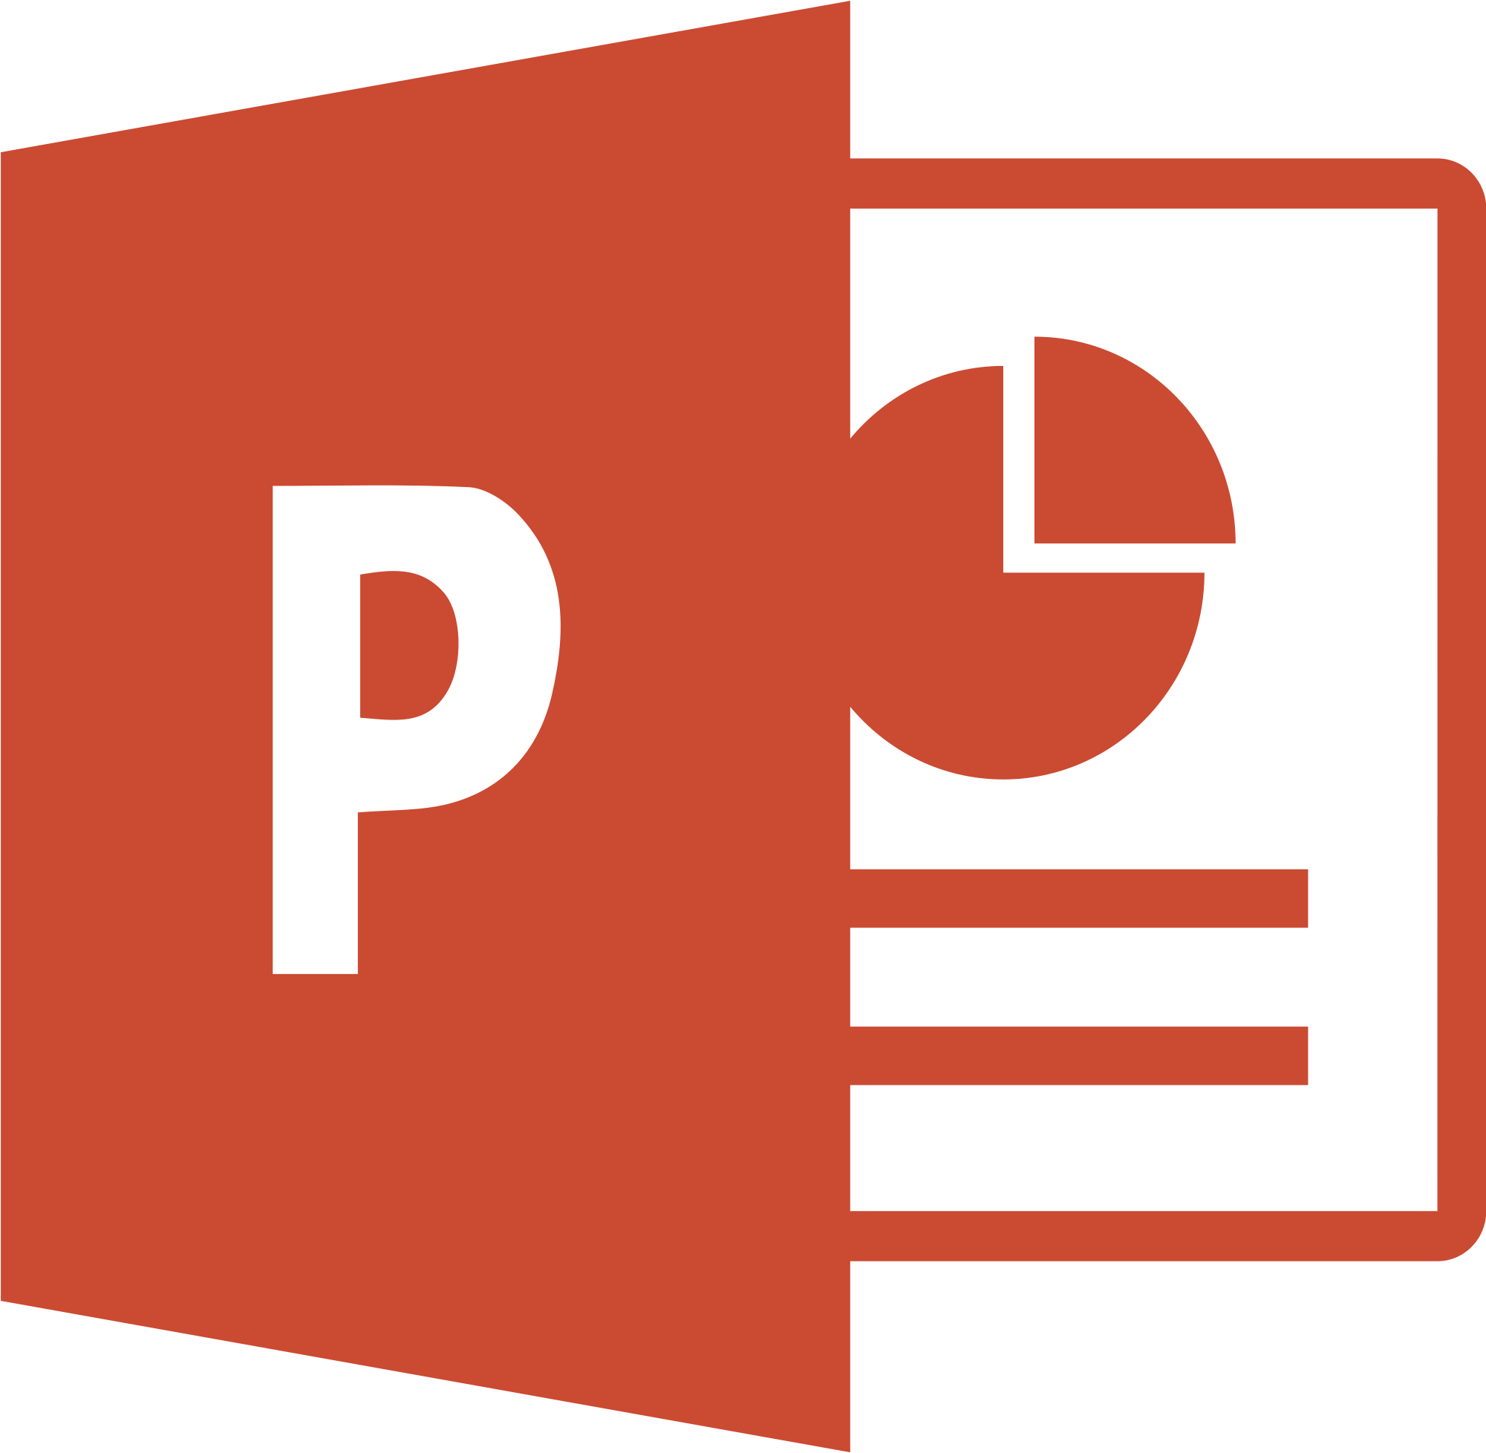
PPSuite
The last IDE you’ll ever need.
Kevin He, Chris Choy, Dawson Whitehead, April Wang
Uncommon Hacks 2019

Slide 2
Background
Realization: PowerPoint is Turing Complete. In 2017, Tom Wildenhain built a PowerPoint Turing Machine (aka PPTXTM).
Problem: You need punch cards to operate it. Punch cards were phased out in the 1960s…
Idea: What if you could write C code that runs in PowerPoint?
Realization: We need a PowerPoint Compiler & Executor. obviously.

Slide 3
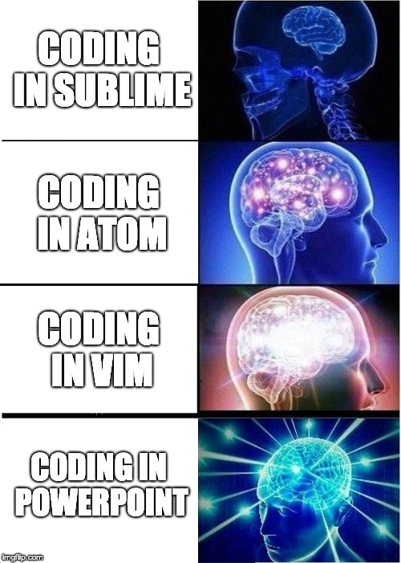
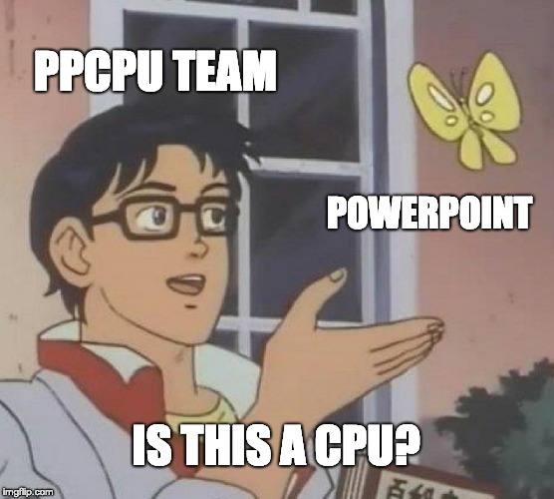
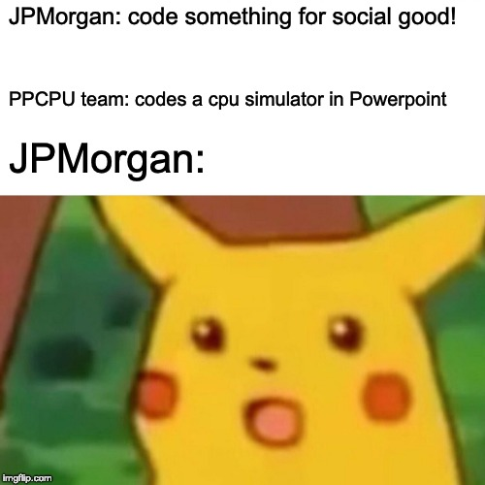
But y tho?
By the time someone tried to stop us… it was too late.
Did it for the memes.

Slide 4
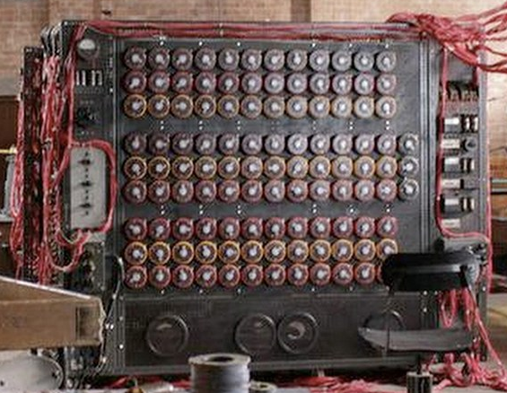
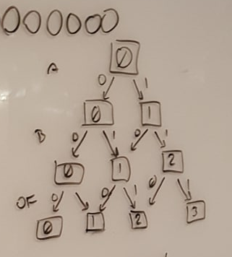
Challenges
None of us knew how Turing Machines or Punch Cards worked.
Going from a PL to TM Language is theoretically possible but neither proven nor implemented before.
PPTXTM’s tape only provides 8 cells/states/bits. Turing Machines assume an “infinite” tape.

Slide 5
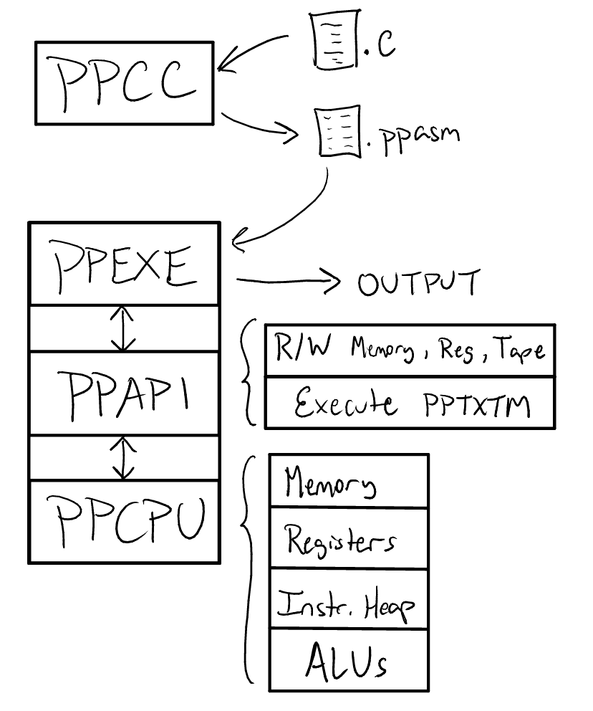
Presenting… the PPSuite!
PPCC.py – compiler that converts .c to .ppasm, our own ASM format
PPEXE.py – executor that loads, decodes, and executes ppasm instructions on the ppcpu
PPAPI.py – interface between executor and the ppcpu.
PPCPU.pptx – cpu built to function entirely in Powerpoint. This includes 256 bytes of memory, 8 registers, an instruction code heap, and several Arithmetic Logic Units implemented on Turing Machines.

Slide 6
Dependencies
ELVM (esoteric language virtual machine) – used a modified library of this to help us bridge the gap between C and PPASM languages.
AutoHotKey – performs auto-clicking for PPTXTM cycles so a human doesn’t have to. Required a LOT of coordinates.
win32COM – provides PowerPoint interfacing capabilities
Python3.7 - because our tape is small and we only had 24hours.

Slide 7
DEMO
Succ
Add 3 + 5

Slide 8
The End. Thank God.
https://github.com/cchoy96/ppcc/
Some Memorable Quotes from the past 24 hours:
“What are they doing?” “idk. some PowerPoint shit”
“Look at this wiring! Python is doing nothing.”
“Why Tom?! What did you see?”
“We’re reinventing the wheel, but worse.”
“What have we created? Oh no…"

