Slide 1
Recommending a neighbourhood to open Italian Restaurant in New York City
IBM Data Science - Capstone
CHRISTODOULOS CHRISTODOULOU

Slide 2
Introduction
Italian cuisine is very popular
Selecting a location for the opening of a new restaurant is very important
Find a neighbourhood with not many similar options can increase the customers and the income
Help aspiring restaurant owners to select a place for their new investment

Slide 3
Data
New York City neighbourhoods from NYU Spatial Data Repository
Coordinates from Geocoder package
Venues for each neighbourhood from Foursquare API

Slide 4

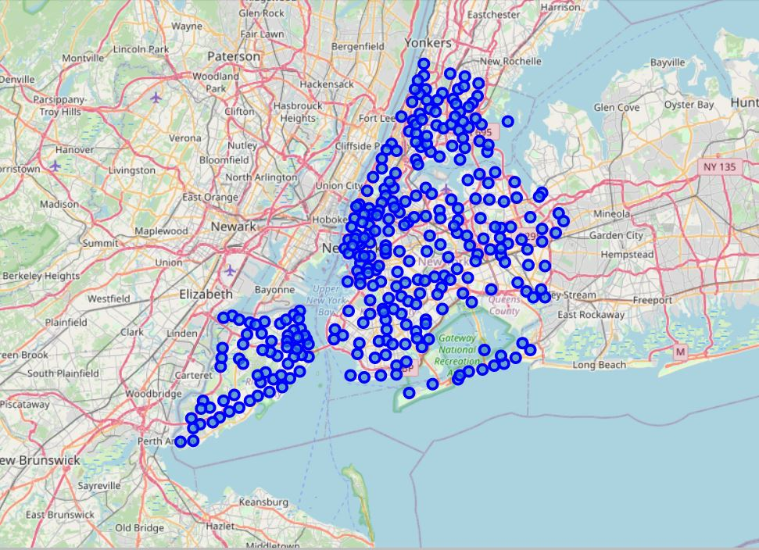
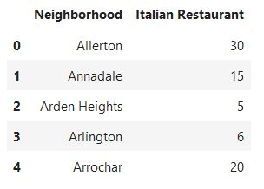
Methodology
Collect names and locations of the neighborhoods
Explore venues for each neighbourhood
Perform data cleaning to create a data frame including the neighbourhoods and the number of existed Italian restaurnts
Apply K-Means algorithm to classify neighborhouds with respect to the presence of Italian restaurants

Slide 5
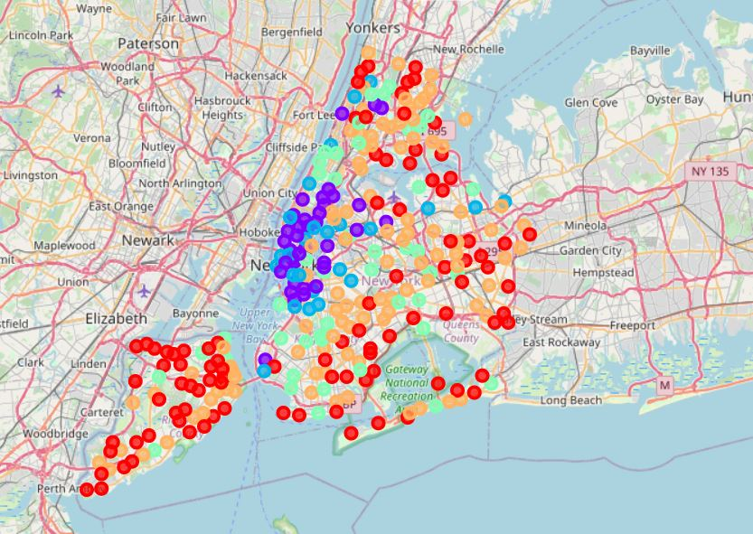
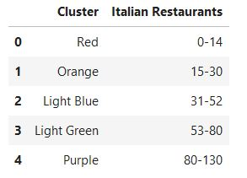
Results

Slide 6
Discussion
Neighbourhoods away from centre (Manhattan) have less existed restaurants
Choice should be done in red cluster but to be close enough to the centre where other venues are present too
Astoria Height neighbourhood is a good recommendation based the above criteria

Slide 7
Conclusion
A methodology to select location for opening a new Italian restaurant was presented using machine learning
Recommendation based on number of other similar options to the neighbourhood and distance from the centre
Further improvement is to make the classification of neighbourhoods by taking into account the average rating of Italian restaurants on each neighbourhood too

