Slide 1
LearnNow Interactive Learning Webpage
Christian Green
Computer Science (B.S.)
Prof. Henderson

Slide 2
Purpose
Learning websites are important because people always have a desire to learn but sometimes the learning environment is dull, and this dims the person’s desire to continue.
The goal of my website is to keep the learning environment interactive and competitive. This will make it entertaining and create an environment where the users want to continue to develop and learn.
I hope to assist students in learning and motivate students to practice what they learned outside of school

Slide 3
Research and Background
Previous programming assignments to create front end website interface using HTML and CSS for styles
Previous programming assignments to create MySQL database and retrieve information to display on front end using PHP code
Research into existing and relevant libraries and APIs to use to accomplish my goals
Research how React library works to render html page and how it updates
Research how to use javascript to create server and APIs that could connect it to react front end
Research how to use unity development environment with C# to create a game

Slide 4

Project Languages
Javascript used for the server and Node JS which is used to set up the React project environment
HTML for developing the webpage content and structure
CSS for styling the webpage with Tailwind CSS v4
C# for developing the game in Unity
React library using Vite library for development of components and webpages

Slide 5
Project Requirements
Login & Sign-Up page
Progress and Levels
Customized Learning
Learning Modes
Saved User Scores & Question Difficulty
Game
Chat between users
Security

Slide 6
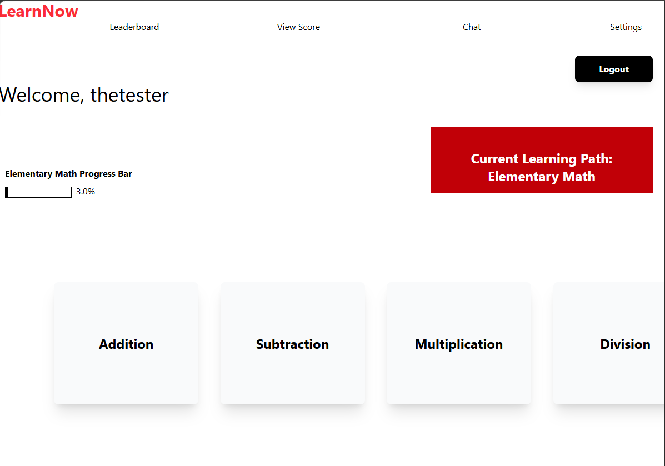
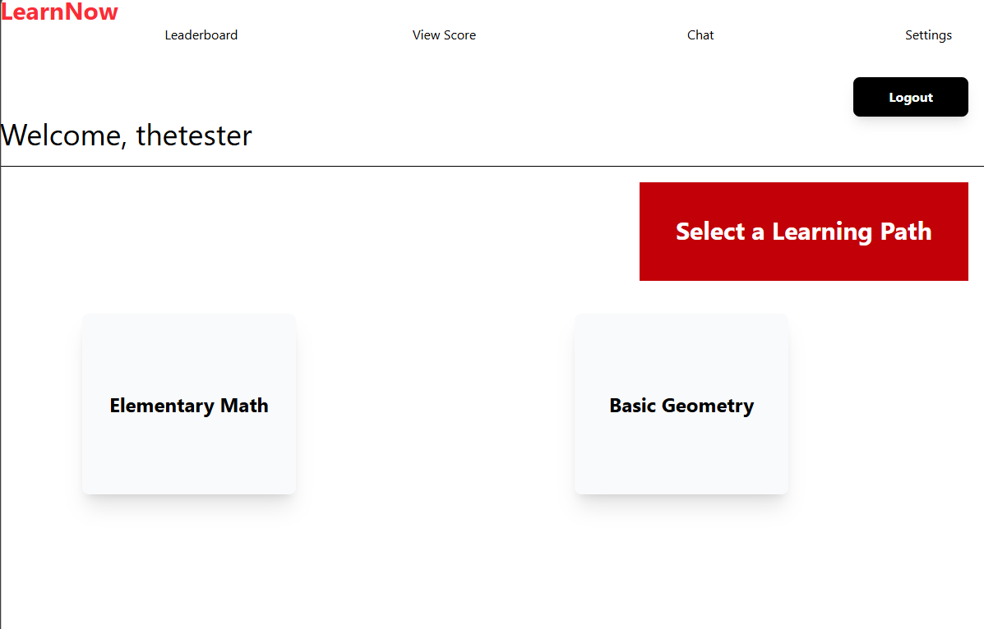
Project Implementation Description
The website has a simple design with links to leaderboard, score, chat, and settings up top
The website displays the user’s username after they logged in as well as a logout button
They will see the learning paths available displayed in cards and can select one and then a subject before starting a lesson
cchristian01/senior-project at master

Slide 7
Test Plan
Test all features of website with students in elementary school
Have the students give their honest feedback on the websites usability and how likely they would be to use it for both entertainment and to practice what they learned
Ask students to give honest feedback on how engaging the game is and is it effective and helping them practice what they learned in school
Ask a variety of questions, open-ended, yes or no, and quantitative questions to get informative feedback
Questions
Is this website easy to use and move around on?
What is one thing you would change or add to make this website better?
Do you think the game is fun and helps you practice what you learned in school ?
Do you think this website can help you practice what you learned in school? If not, how can it be better?
Do you like seeing your score right away and seeing other people’s scores?
Do you like being able to chat with other users and change the screen from light to dark?
On a scale from 1 to 10, how likely are you to use this website on your own for learning or fun?
On a scale from 1 to 10, how likely are you to use this website if your friends were using it too?

Slide 8
Test Results
6 6th graders at my former elementary school tested the website
The results were very positive
Yes Or No Feedback
5/6 students said the website was easy to move around on (83%)
6/6 students said the game was fun and helps students practice what they learned in school (100%)
6/6 students said they enjoyed being able to see their scores and other user’s scores immediately (100%)

Slide 9
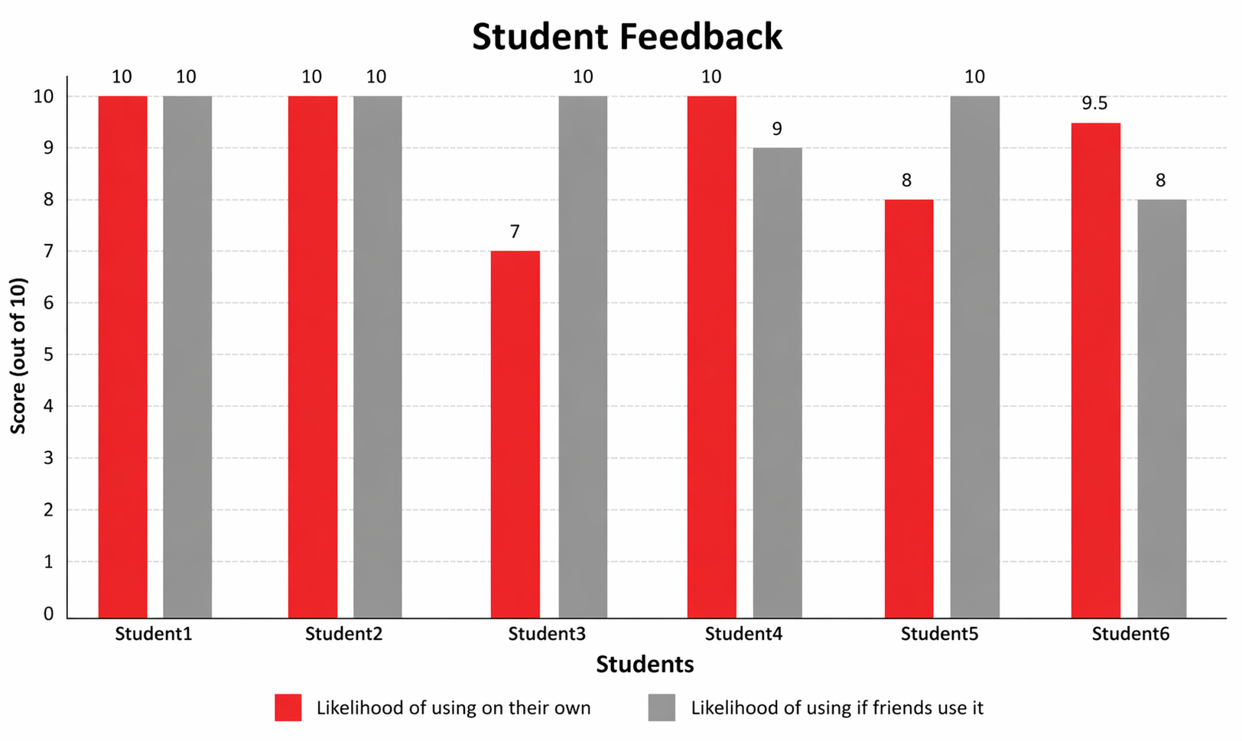
Test Results
Quantitative Feedback From Students

Slide 10

Test Results
Open Ended Feedback from Students
Add more games
Change the button to jump in the game
Add more fun designs
Add more subjects to existing learning paths
Add music and add more learning paths like middle school

Slide 11

Challenges Overcome
Time Constraints
Balancing schoolwork, having a job, and developing project
Debugging issues with React website rendering and server
Developing Dark Mode feature
Fixing the chat
Learning how React works to better identify problems
Integrating the game onto the website

Slide 12

Future Enhancements
Add more games
Add more learning paths
Add designs to website
Make each subject’s lesson more interactive by adding animations and videos; Should also use AI to assist in generating new random examples to further explain topic instead of just plain text
Allow users to have saved chats where they can delete messages and send other media besides text

