Slide 1
Identifying Heart Conditions from Audio Recordings
Constantine Chrysostomou
04-26-17

Slide 2
Problem Set
Challenge from Bentley et al – applying machine learning techniques to segment and classify real-world heart audio
Ideally, would be able to apply results towards developing methods that detect signs of heart disease without require significant/costly medical testing
Goal:
Challenge 1: Given a set of audio recordings from a digital stethoscope or home recordings, identify the “heartbeat” signals in the recording
Challenge 2: Once recordings can be segmented and classified into lub/dub recordings, identify heartbeat signatures that are abnormal/indications of heart disease
http://www.peterjbentley.com/heartchallenge/

Slide 3
Background of Terminology
Heartbeat: A heartbeat is classified as two consecutive heart beat sounds generated by closing of heart valves
Systole (LUB/S1): valves closing when ventricles contract
Diastole (DUB/S2): valves closing when filling ventricles
Heart conditions
Normal: normal heart beat
Lub...dub…..lub…..dub
Murmur: extra noise created by turbulent fluid.
Lub...dub..noise..lub…dub..noise..
Extra heart sound: Additional sounds associated with beat (not just lub/dub)
...lub.lub…….dub…...lub.lub…..dub
Extrasystole: Unexpected additional sounds associated with a normal beat
….lub…….dub…….lub…...dub…..lub.lub….dub

Slide 4
Datasets
Data format: Data is provided from recordings of heartbeats. Data is in .wav format.
Total of 832 .wav files
351 are audio recordings from normal samples
111 files show the time/positions of S1/S2 events in recordings
239 remaining files require classification of S1/S2 events
247 files require classification of heart conditions
Provides an evaluation script for evaluating precision

Slide 5
Processing data and classifying S1/S2 events
.WAV file
Read into python
Dataframe:
Rows -> file, col-> time
Filter background noise
High frequency
noise filtered
High frequency
noise filtered
High frequency
noise filtered
High frequency
noise filtered
Isolate frequencies
Loading training
information
Feature 1?
Frequency of S1/S2
Confirm frequencies
associate with S1/S2
S1 vs S2 vs Other?
Map S1/S2 positions
Bin (rolling window) together information from nearby timepoints
Feature 2?
Binned amplitudes
Binned noise data
Feature 3?
Isolate local “bin”
frequencies

Slide 6
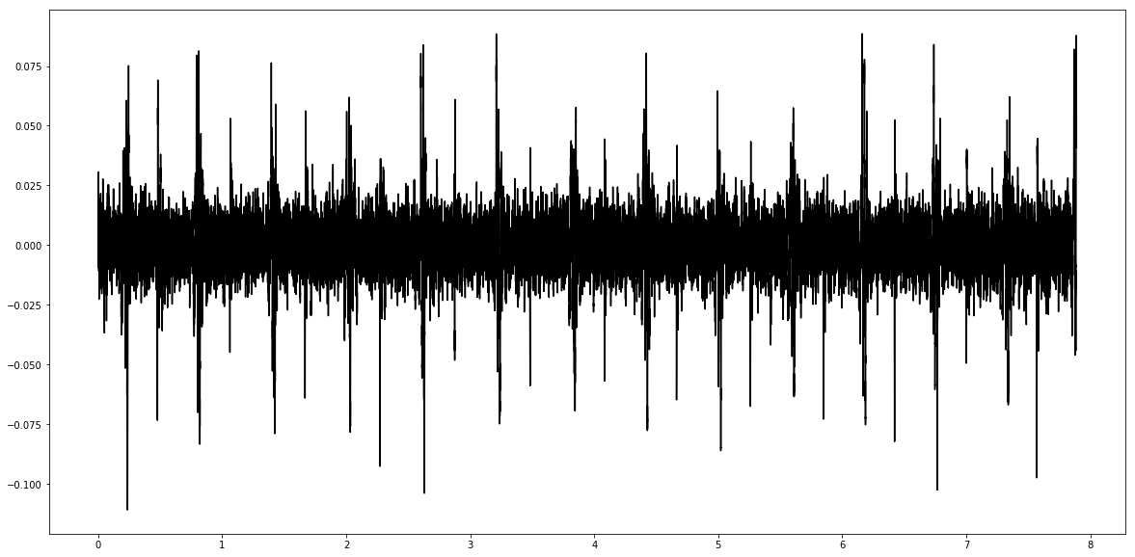
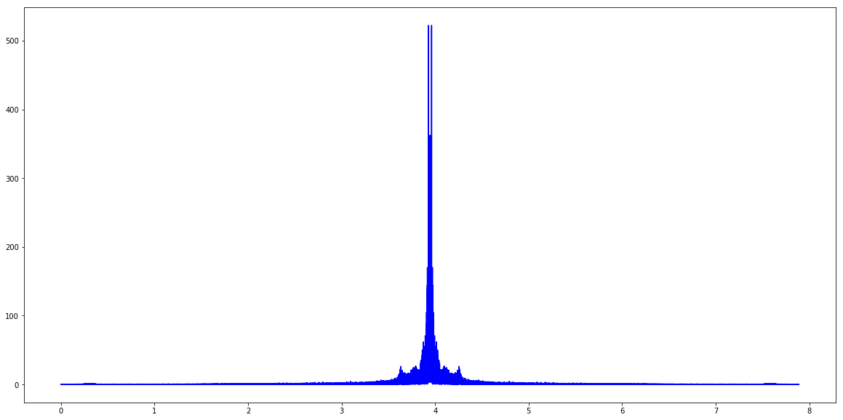
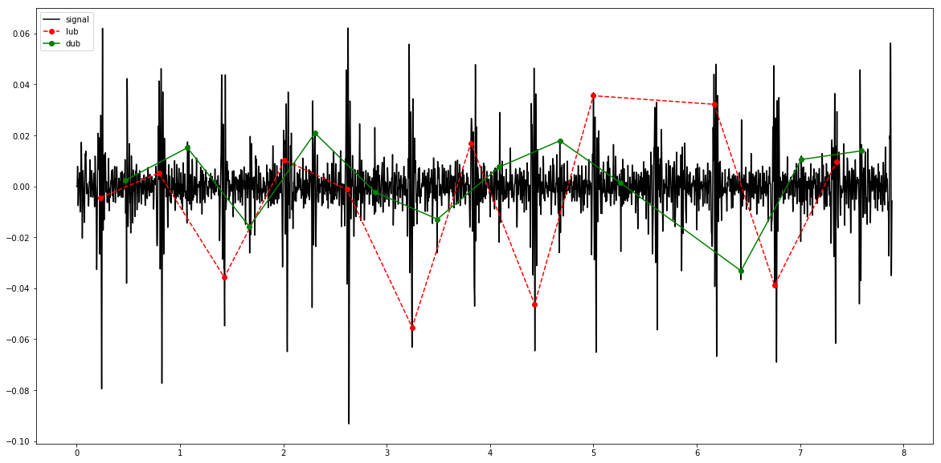
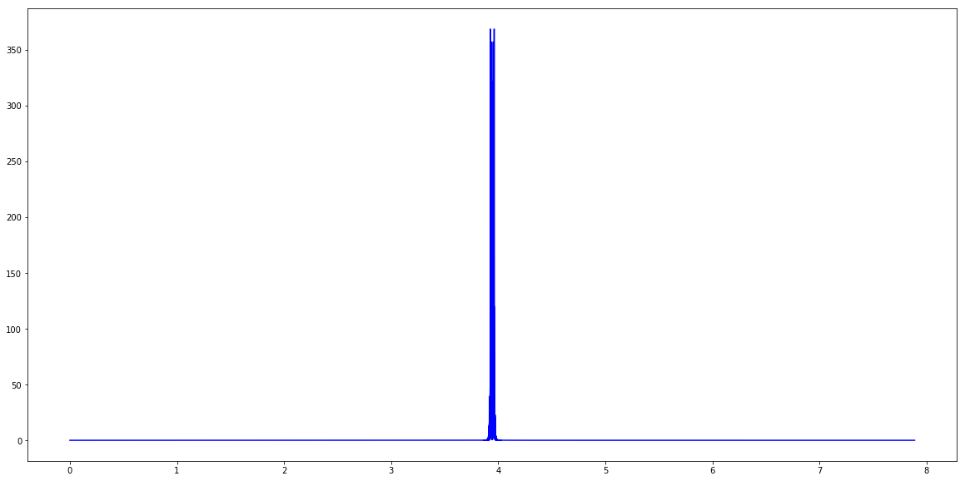
Audio data quick look: Example from single .wav file
Time
Frequency
Filter background noise
Map S1/S2
positions

Slide 7
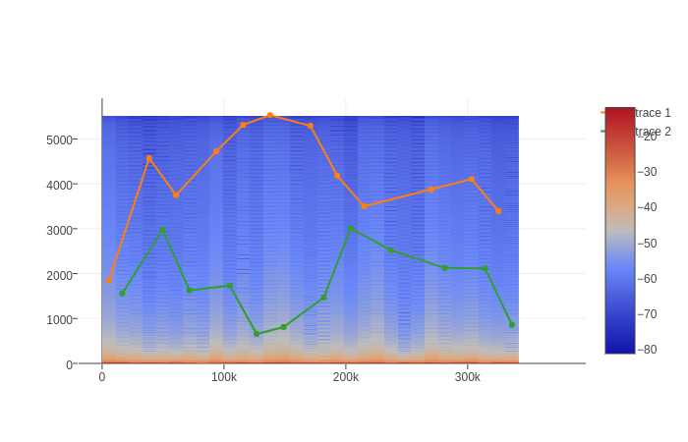
Audio data quick look: Example from single .wav file
Bin data
Isolate frequencies
in bin
Frequency
Windows

Slide 8
Current issues/next steps
Noise is difficult:
hard to classify on non-labeled S1/S2 events (i.e. are they just not labeled or are the not actually heartbeat sounds)
The events reported do not occur at the “amplitude peaks”
Window sizes (i.e. heartbeat rate) change for each file
Current methods for differentiating S1/S2 signals have not been super fruitful:
Features attempted: Mean amplitude in bins and amplitudes of most common frequencies in a signal
Decision tree attempts, KNN, and/or logistic regression: ~0.55-0.65 accuracy via train-test-split
Next steps:
Adjust window sizes
Attempt to fit data to curves such that lub/dub occur at equal frequency but with an offset (i.e. assume distance between lub → dub is constant)

Slide 9
Questions

Slide 10
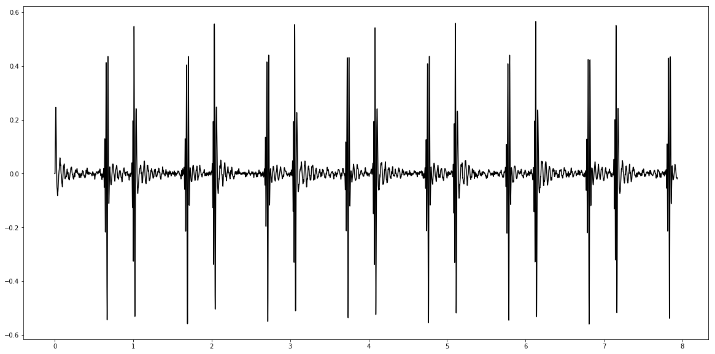
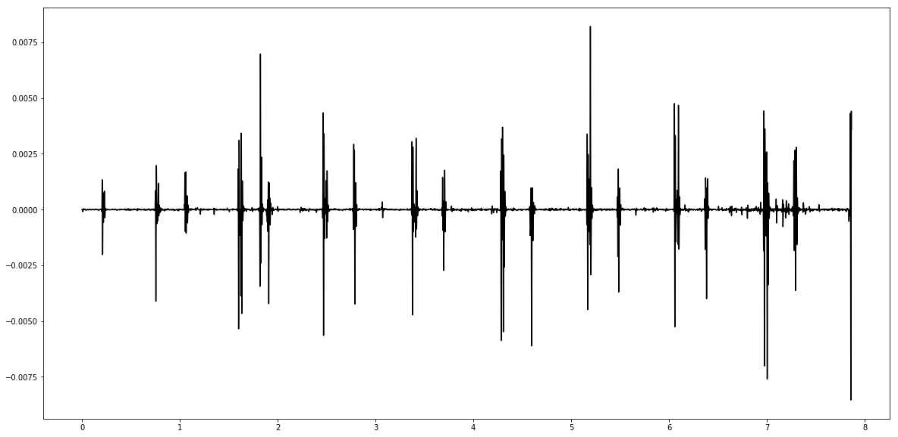
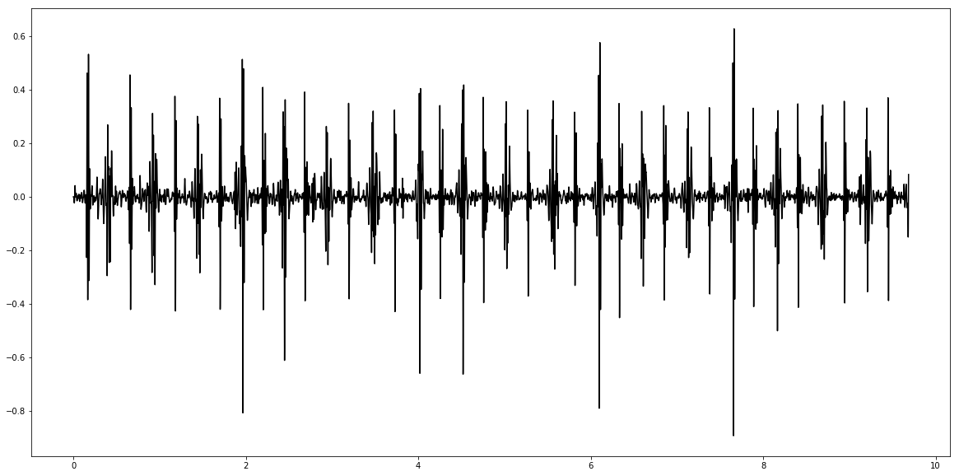
Abnormal Heartbeats
Murmur
Extra heart sound
Extrasystole

