Slide 1
Identifying Heart Conditions from Audio Recordings
Constantine Chrysostomou
04-26-17

Slide 2
Problem Set
Challenge from Bentley et al – applying machine learning techniques to segment and classify real-world heart audio
Ideally, would be able to apply results towards developing methods that detect signs of heart disease without require significant/costly medical testing
Goal:
Challenge 1: Given a set of audio recordings from a digital stethoscope or home recordings, identify the “heartbeat” signals in the recording
Challenge 2: Once recordings can be segmented and classified into lub/dub recordings, identify heartbeat signatures that are abnormal/indications of heart disease
http://www.peterjbentley.com/heartchallenge/

Slide 3
Background of Terminology
Heartbeat: A heartbeat is classified as two consecutive heart beat sounds generated by closing of heart valves
Systole (LUB/S1): valves closing when ventricles contract
Diastole (DUB/S2): valves closing when filling ventricles
Heart conditions
Normal: normal heart beat
Lub...dub…..lub…..dub
Murmur: extra noise created by turbulent fluid.
Lub...dub..noise..lub…dub..noise..
Extra heart sound: Additional sounds associated with beat (not just lub/dub)
...lub.lub…….dub…...lub.lub…..dub
Extrasystole: Unexpected additional sounds associated with a normal beat
….lub…….dub…….lub…...dub…..lub.lub….dub

Slide 4
Datasets
Data format: Data is provided from recordings of heartbeats. Data is in .wav format.
Total of 832 .wav files
351 are audio recordings from normal samples
111 files show the time/positions of S1/S2 events in recordings
239 remaining files require classification of S1/S2 events
247 files require classification of heart conditions
Provides an evaluation script for evaluating precision

Slide 5
Processing data and classifying S1/S2 events
.WAV file
Read into python
Dataframe:
Rows -> file, col-> time
Filter background noise
High frequency
noise filtered
High frequency
noise filtered
High frequency
noise filtered
High frequency
noise filtered
Isolate frequencies
Loading training
information
Feature 1?
Frequency of S1/S2
Confirm frequencies
associate with S1/S2
S1 vs S2 vs Other?
Map S1/S2 positions
Bin (rolling window) together information from nearby timepoints
Feature 2?
Binned amplitudes
Binned noise data
Feature 3?
Isolate local “bin”
frequencies

Slide 6
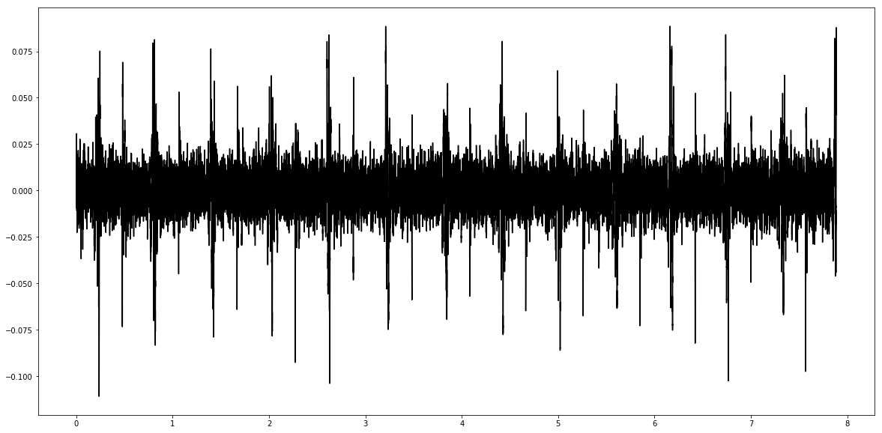
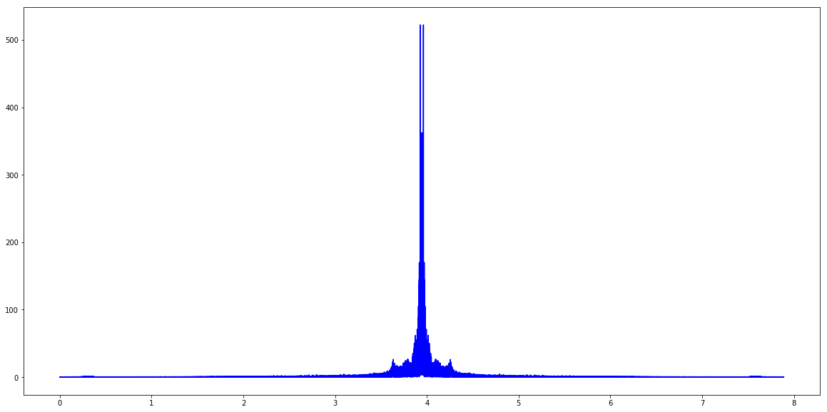
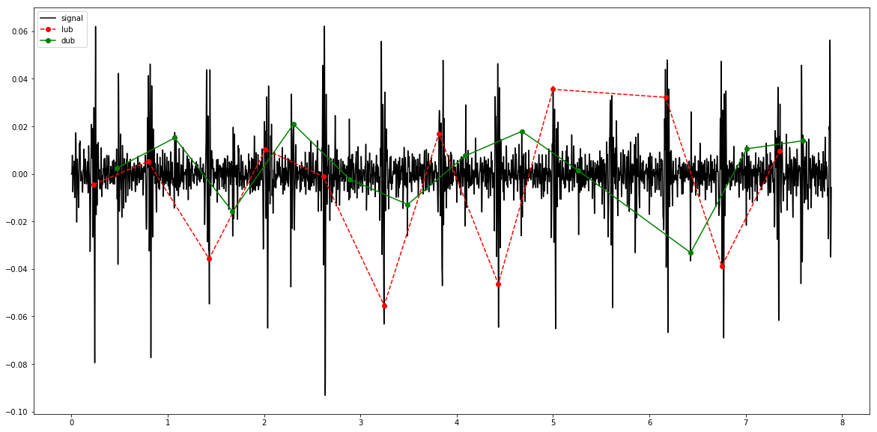
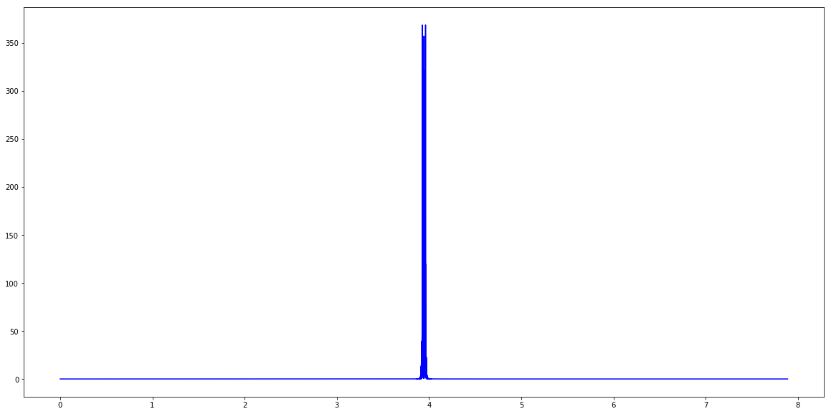
Audio data quick look: Example from single .wav file
Time
Frequency
Filter background noise
Map S1/S2
positions

Slide 7
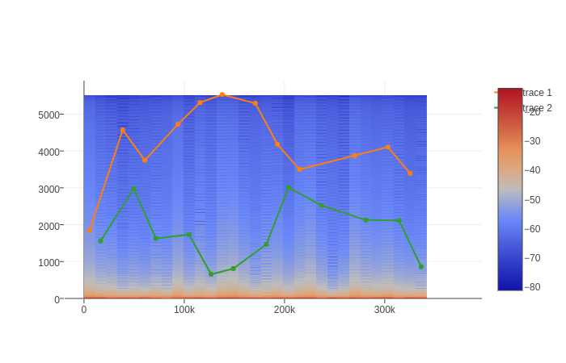
Audio data quick look: Example from single .wav file
Bin data
Isolate frequencies
in bin
Frequency
Window

Slide 8
Current issues/next steps
Noise is difficult: hard to classify on non-labeled S1/S2 events (i.e. are they just not labeled or are the not actually heartbeat sounds)
Current methods for differentiating S1/S2 signals have not been super fruitful:
Features attempted: Mean amplitude in bins and amplitudes of most common frequencies in a signal
Decision tree attempts or logistic regression: ~0.55-0.65 accuracy via train-test-split
Next steps:
Adjust window sizes
Attempt to fit data to curves such that lub/dub occur at equal frequency but with an offset (i.e. assume distance between lub → dub is constant)

Slide 9
Questions

Slide 10
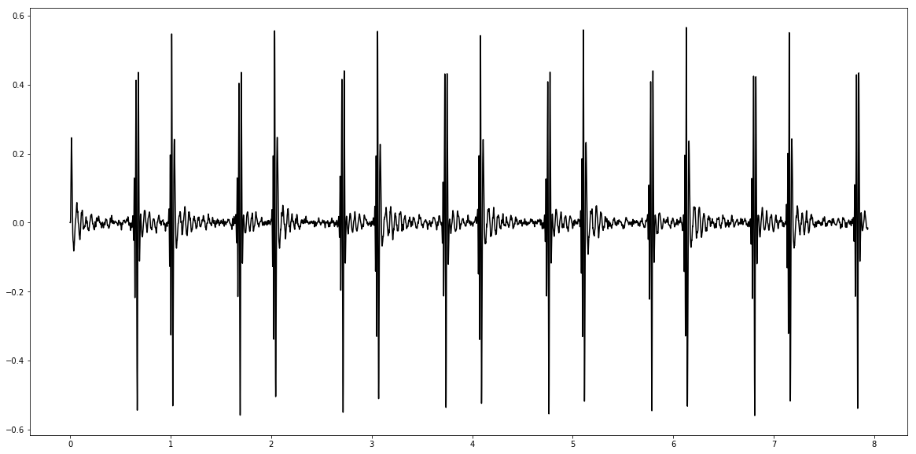
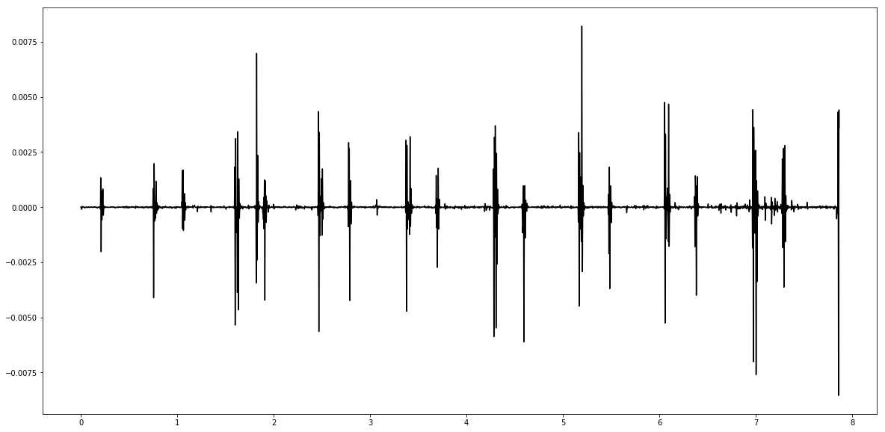
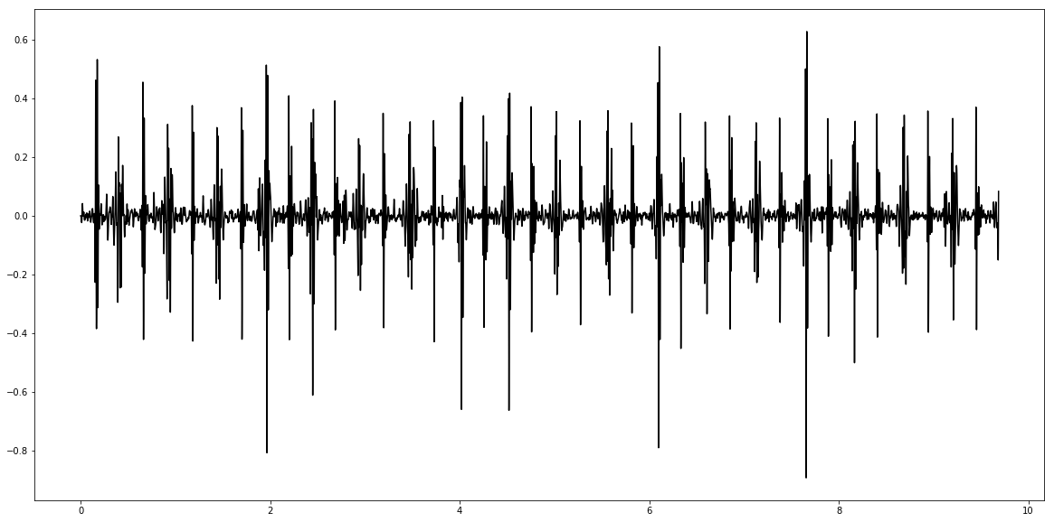
Abnormal Heartbeats
Murmur
Extra heart sound
Extrasystole

