Slide 1
WOA7015 ADVANCED MACHINE LEARNING Alternative Assessment Academic Session 2022/2023: Semester 1 Jan 2023 Project Proposal
No | Team Members | Matric Number
1 | Chong Chia Hsing | S2159070/1
2 | Darkhan Baibulat | S2172558/1
3 | Xue Ying Kung | S2149135/1

Slide 2
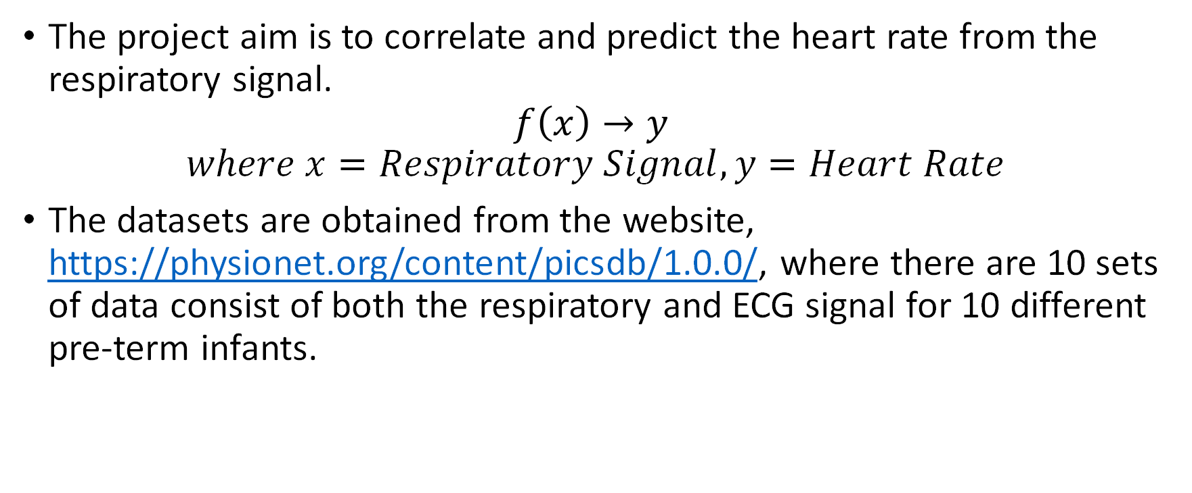
Introduction
The project aim is to correlate and predict the heart rate from the respiratory signal.
$$f\left(x\right)→y$$
$$where x=Respiratory Signal, y=Heart Rate$$
The datasets are obtained from the website, https://physionet.org/content/picsdb/1.0.0/, where there are 10 sets of data consist of both the respiratory and ECG signal for 10 different pre-term infants.

Slide 3
How to obtain the heart rate (target variable)?
For obtaining the Heart Rate, we use the function wfdb.processing.compute_hr(sig_len, qrs_inds, fs) to calculate it, using the numpy and wdfb libraries.
Sig_len is size of the signal
Qrs_inds is Using file .qrsc
Fs is the frequency
Web Link: https://github.com/MIT-LCP/wfdb-python/blob/main/wfdb/processing/hr.py

Slide 4
How to handle the data (Pre-processing / Preparation)?
Visually inspect both the ECG and respiratory data and split the data into bin of 1 hour time range based on the signal quality.
Within the 1-hour bin data, split the data into training and test data sets at 70% ratio.
Perform heart rate calculation on the ECG data sets.
Perform some correlation test to investigate the correlation for the time base data using the covariance matrix, Pearson’s correlation (linear), and Spearman’s correlation (polynomial).
Perform Fourier Transform on Heart Rate and Respiratory Signal to obtain a frequency-based data.
Repeat the correlation test on frequency-based data.

Slide 5
What algorithm is used or built (model architecture)?
Support Vector Machine (SVM) is used
Used in Classification and Regression
Basic idea of SVM: find a hyperplane that best divides a dataset into two classes
Support Vector Regression (SVR)
Idea: find the best fit line, which is the hyperplane that has the maximum number of points

Slide 6
Why can the stated algorithm solve the problem?
Problem: predict heartbeat rate based on respiratory rate
Regression problem
Strengths of using SVM in regression:
L2 regularization feature to prevent overfitting
Good in handling outliers
Perform better when there is limited training data

Slide 7
What are the baseline models or benchmarks?
The baseline models are the simplest regression and data exploration technique used to do some initial inspection and testing on the dataset.
Basic linear regression and polynomial regression will be used as the baseline models for the project to inspect the correlation of the 2 variables: ECG signal and respiratory signal.
Sklearn modules | Description
linear_model.LinearRegression(*[, ...]) | Ordinary least squares Linear Regression.
preprocessing.PolynomialFeatures([degree, ...]) | Generate polynomial and interaction features.

Slide 8
What are the performance metrics?
There are 3 error or performance metrics that will be applied for the regression model:
Mean Squared Error (MSE)
Root Mean Squared Error (RMSE)
Mean Absolute Error (MAE)
Sklearn modules | Description
metrics.mean_absolute_error(y_true, y_pred, *) | Mean absolute error regression loss.
metrics.mean_squared_error(y_true, y_pred, *) | Mean squared error regression loss.

