Slide 1

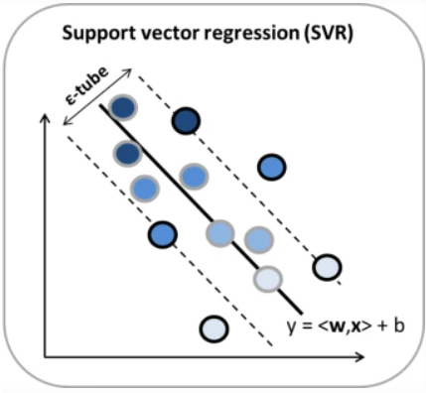
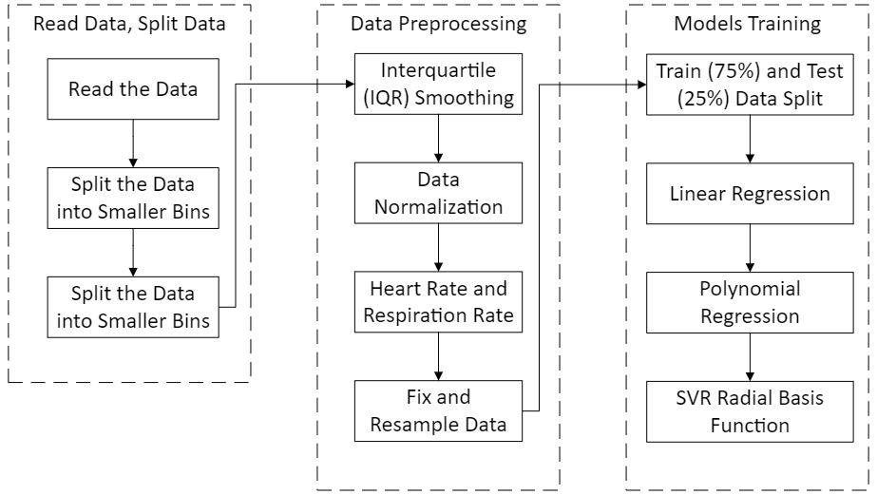
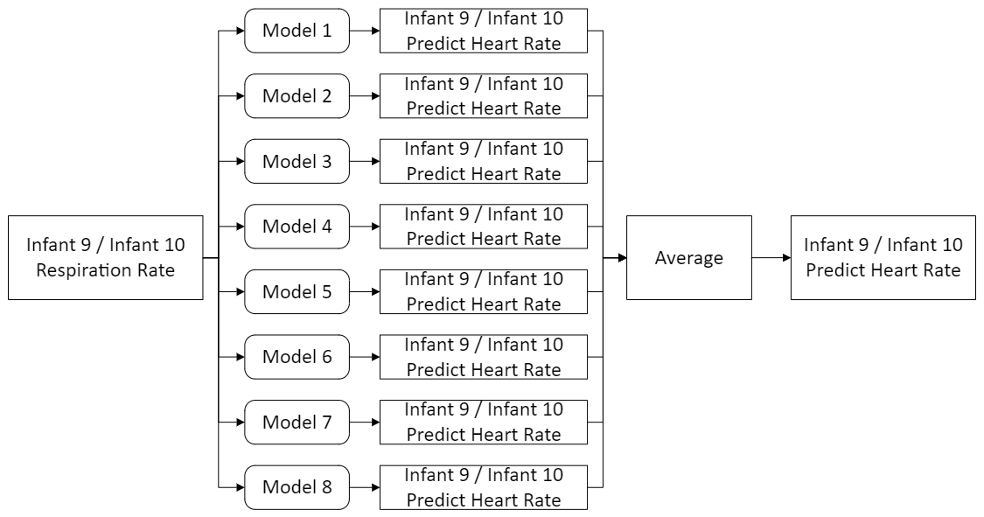
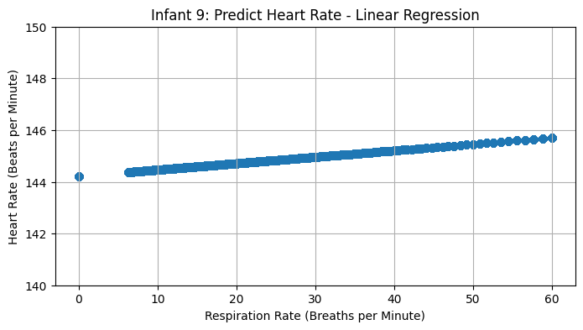
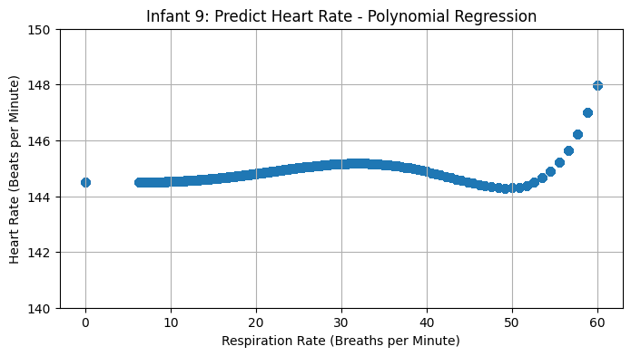

Prediction of Heart Rate based on Respiratory Rate for Neonates using Machine Learning Models
Chia Hsing Chong¹, Xue Ying Kung¹ , Darkhan Baibulat¹
Faculty of Computer Science and Information Technology, Universiti Malaya, Malaysia.
Introduction
Relevant Literature
Neonates refers to children in the first 4 weeks of their lives. At this early age, vitals such as their heart and respiratory rates are important clinical indicators to monitor their health conditions.
There are different ways to measure heart rates, including electrocardiography (ECG) and pulse oximetry. However, both involve attaching many devices to the neonates and are not suitable for them.
In this project, we will investigate the possibility of estimating heart rate directly from the respiratory signal. We will use ECG and respiratory data from 10 different infants to train a machine learning model, then predict the heart rate based on the respiratory signal of an infant.
Heart Rate:
Displays the balance of the cardiovascular system
Evaluates the rhythm and frequency, the large square method is used at R-R intervals.
For newborns, the average heart rate is 110-150 bpm
Respiration Rate:
Assumption is made that the consecutive peak represent 1 breath.
Similar calculation can be as heart rate for respiration in breath per minute.
Strengths of using SVM in regression:
L2 regularization feature to prevent overfitting
Good in handling outliers
Perform better when there is limited training
data
𝑓(𝑥)→𝑦
𝑤ℎ𝑒𝑟𝑒 𝑥=𝑅𝑒𝑠𝑝𝑖𝑟𝑎𝑡𝑜𝑟𝑦 𝑆𝑖𝑔𝑛𝑎𝑙, 𝑦=𝐻𝑒𝑎𝑟𝑡 𝑅𝑎𝑡𝑒
Research Methodology
Results
Infant 9: Linear Regression
Model | MAE | MSE | RMSE
1 | 10.71 | 512.33 | 22.63
2 | 21.35 | 897.26 | 29.95
3 | 20.59 | 862.98 | 29.38
4 | 20.71 | 848.51 | 29.13
5 | 14.32 | 604.16 | 24.58
6 | 17.42 | 743.76 | 27.27
7 | 14.50 | 610.13 | 24.70
8 | 17.57 | 747.98 | 27.35
Average | 9.85 | 513.59 | 22.66
Infant 9: Polynomial Regression
Model | MAE | MSE | RMSE
1 | 10.75 | 512.93 | 22.65
2 | 21.44 | 898.72 | 29.98
3 | 20.67 | 865.38 | 29.42
4 | 20.69 | 847.56 | 29.11
5 | 14.15 | 600.03 | 24.50
6 | 17.83 | 756.45 | 27.50
7 | 14.58 | 612.49 | 24.75
8 | 17.85 | 756.79 | 27.51
Average | 9.86 | 514.04 | 22.67
Infant 9: Support Vector Regression
Model | MAE | MSE | RMSE
1 | 10.75 | 512.93 | 22.65
2 | 21.44 | 898.72 | 29.98
3 | 20.67 | 865.38 | 29.42
4 | 20.69 | 847.56 | 29.11
5 | 14.15 | 600.03 | 24.50
6 | 17.83 | 756.45 | 27.50
7 | 14.58 | 612.49 | 24.75
8 | 17.85 | 756.79 | 27.51
Average | 9.86 | 514.04 | 22.67
Infant 10: Linear Regression
Model | MAE | MSE | RMSE
1 | 13.91 | 501.52 | 22.39
2 | 28.69 | 1152.01 | 33.94
3 | 27.68 | 1091.23 | 33.03
4 | 17.69 | 668.22 | 25.85
5 | 14.36 | 519.22 | 22.79
6 | 24.80 | 943.45 | 30.72
7 | 14.51 | 526.26 | 22.94
8 | 24.80 | 942.13 | 30.69
Average | 15.97 | 576.64 | 24.01
Infant 10: Polynomial Regression
Model | MAE | MSE | RMSE
1 | 13.85 | 499.59 | 22.35
2 | 28.37 | 1128.55 | 33.59
3 | 27.44 | 1072.41 | 32.75
4 | 17.64 | 666.82 | 25.82
5 | 14.34 | 517.75 | 22.75
6 | 24.95 | 946.56 | 30.77
7 | 14.70 | 532.37 | 23.07
8 | 24.68 | 929.23 | 30.48
Average | 15.91 | 574.21 | 23.96
Infant 10: Support Vector Regression
Model | MAE | MSE | RMSE
1 | 13.85 | 499.59 | 22.35
2 | 28.37 | 1128.55 | 33.59
3 | 27.44 | 1072.41 | 32.75
4 | 17.64 | 666.82 | 25.82
5 | 14.34 | 517.75 | 22.75
6 | 24.95 | 946.56 | 30.77
7 | 14.70 | 532.37 | 23.07
8 | 24.68 | 929.23 | 30.48
Average | 15.91 | 574.21 | 23.96
Discussion
There are a total 24 models trained with each infant 1 to infant 8 trained with linear regression, polynomial regression, and SVR RBF model.
There are no obvious improvement of the prediction accuracy from the metrics generated from the predicted value for infant 10 and infant 9. It is most obvious with the identical metrics value for polynomial regression and SVR.
The phenomenon might be due to the outlier and noises which are not properly filtered from the data. Furthermore, hyperparameters tuning is not performed thus, the performance improvement would not be obvious.
Future step for the study is to implement frequency-based filter (band-pass, low-pass, high-pass) to improve the ECG and RESP signal. In addition, the hyperparameters tuning would be implemented.
Conclusions
The data pipeline is built with 3 sections from reading the data, data preprocessing, to model training. The results shows the models has a performance of 22 to 24 RMSE value for the 3 tested regression models. The contribution from this study is to setup a foundation for further exploration.

