Slide 1
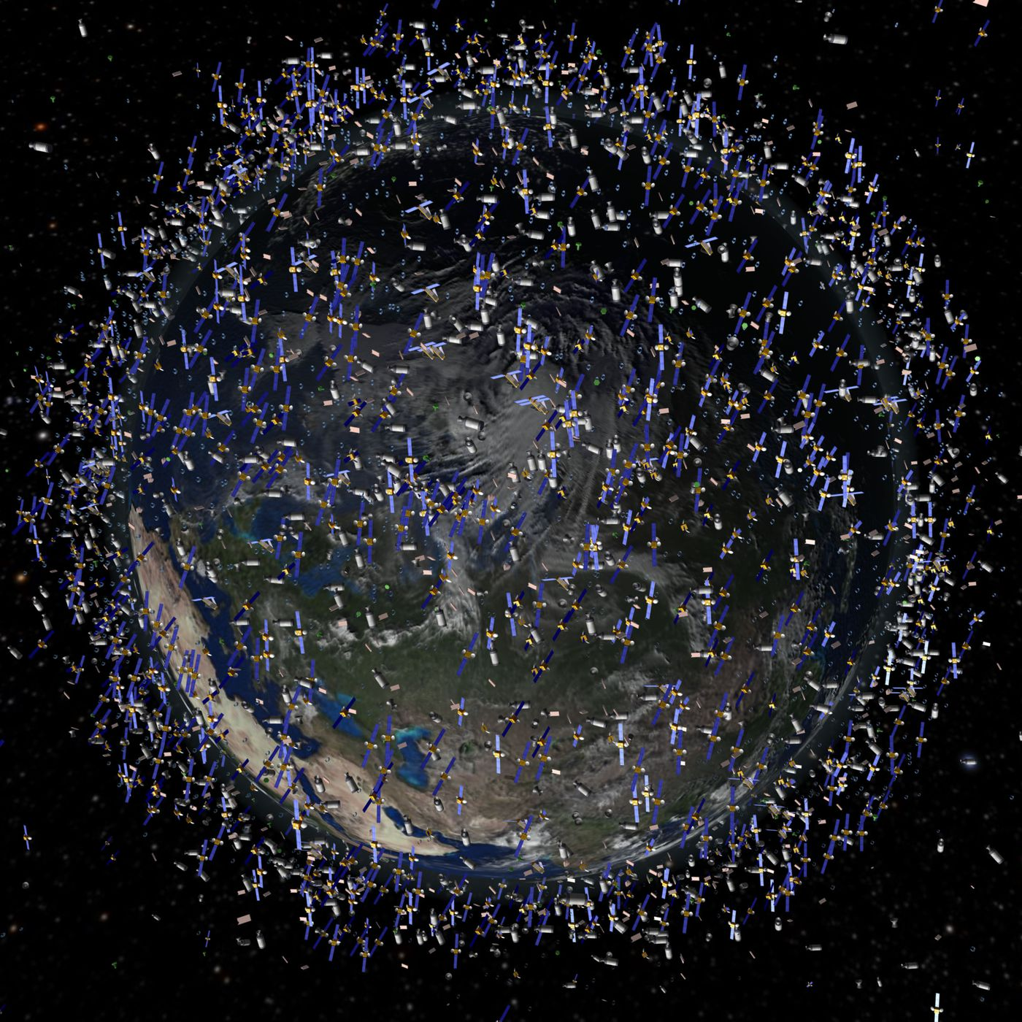
Cybersecurity & Satellites: Analyzing a Growing Trend
Carson Chubbuck

Slide 2
0_symp051uM_n3

Slide 3
Critical Infrastructure & Cybersecurity
Critical infrastructure can be defined as:
Collection of systems, networks, and public works that are essential (DHS)
Maintains normalcy in daily life (DHS)
Essential to safety and functionality in a society
“Considered so vital to the United States that their incapacitation or destruction would have a debilitating effect on security, national economic security, national public health or safety, or any combination thereof.” (CISA)

Slide 4
Satellites & Critical Infrastructure
Defense Industrial Base Sector
Satellites used in US military campaigns
68% of U.S. munitions relied on satellites in the U.S. invasion of Iraq in 2003
Communications Sector/Emergency Services Sector
GPS necessary for “functionality in society”
GPS/Wireless Internet/Cell Towers
Other
Weather Forecasting

Slide 5
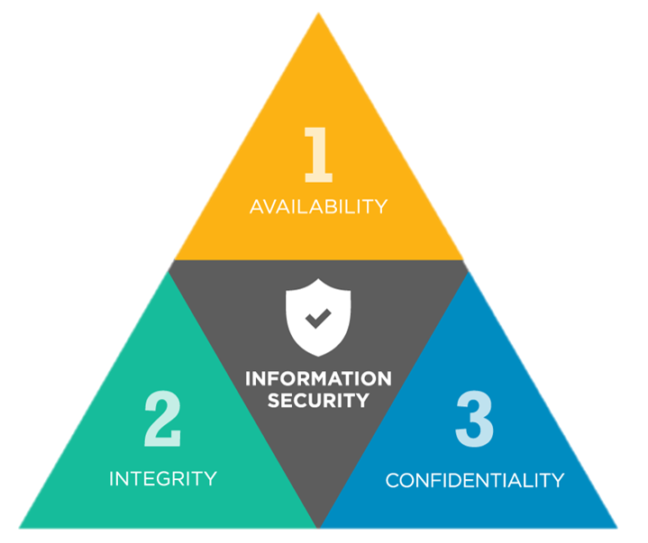

Slide 6

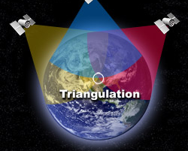
Global Positioning System (GPS)
“Space-based signals are low-power and unencrypted, making them susceptible to both intentional and unintentional disruption.”* DHS
*Military GPS is encrypted

Slide 7

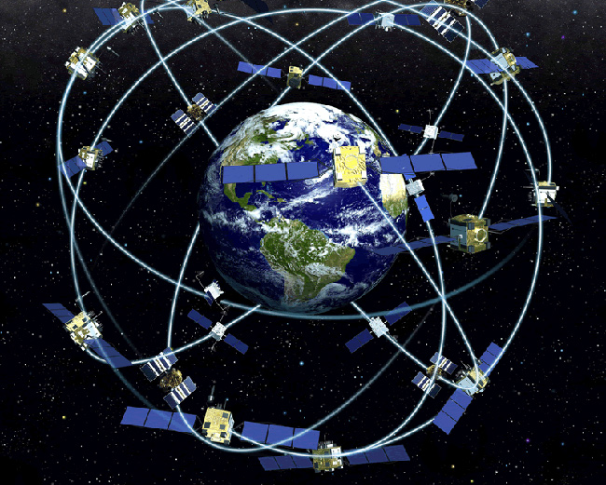
GPS & Cybersecurity
Ability to receive location and time are essential
Satellites are equipped with multiple atomic clocks
Denial of Service and Spoofing attacks are most common

Slide 8

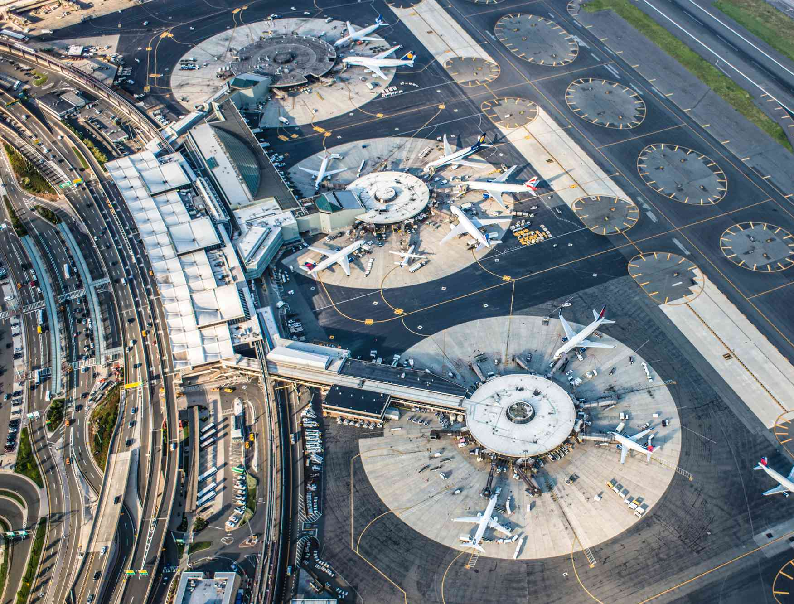
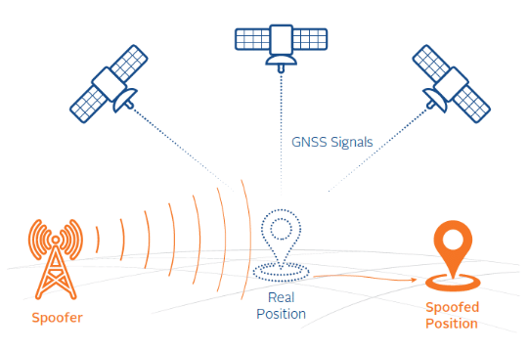
Storytime
2012 Newark Airport Incident: GPS Jammer blocked air traffic control GPS reception
November 2023: GPS spoofing in the Middle East

Slide 9
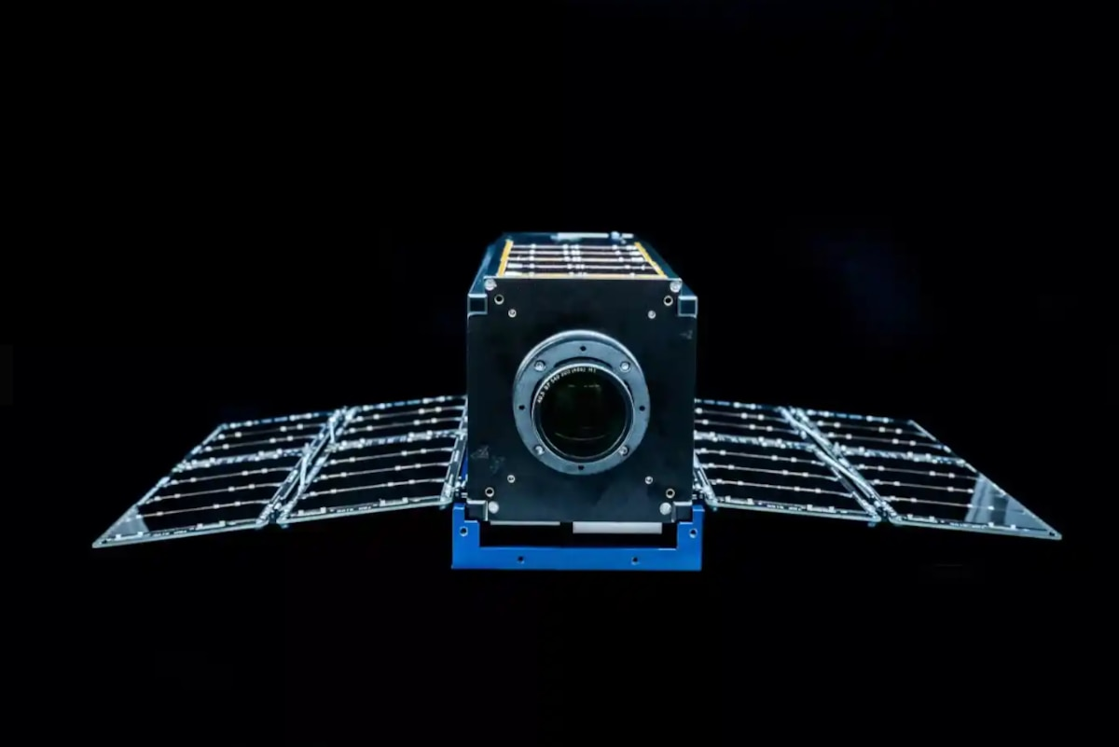
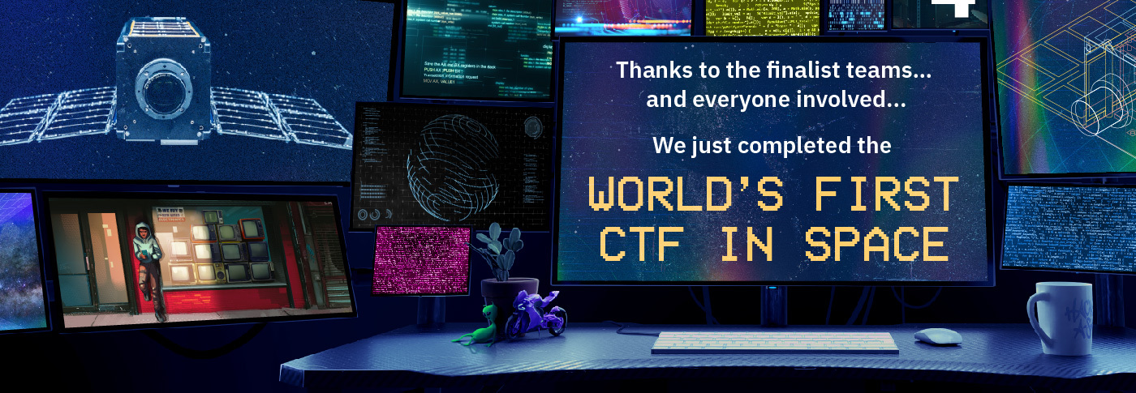
Hack-A-Sat 4
“Hack-A-Sat is a Capture the Flag (CTF) competition designed to inspire the world’s top cybersecurity talent to develop the skills necessary to help reduce vulnerabilities and build more secure space systems”

Slide 10
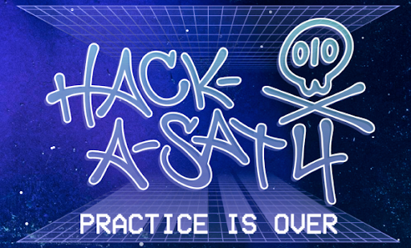
Hack-A-Sat 4
SpaceX, NASA, and Space Force launched a satellite for DEFCON 2023 CTF participants
Participants from multiple backgrounds
Challenges involved pwning a satellite
Uploading scripts to a satellite
Changing its orbit (50 degrees to 80 degrees)
Remove safeguards and take pictures
Changing the orbit to photograph certain targets

Slide 11
Real-World Implications
Photographing Real-World Targets
Violation of Privacy
Photography of sensitive locations
Modification of Orbit
Denies service to regions
Kessler Syndrome

Slide 12
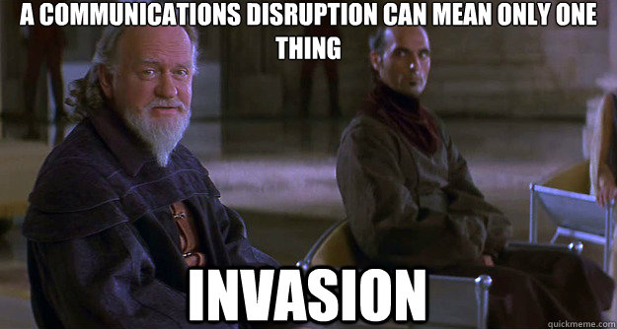
Disruption of ISP Ground Stations

Slide 13
Satellites & Warfare
Hacking Satellites to disrupt communication has been used in the Russo-Ukrainian War
Viasat (ISP) attacked on the evening before Russia’s invasion of Ukraine
Attacked satellite modems, obscuring data transmissions
Killnet attacked Starlink, distributed denial of service
Attacked ground modems

Slide 14
Issues Facing Satellite Cybersecurity
Ground Stations becoming more affordable/accessible
Increasing number of satellites
Internet Service Providers
More developers, more interested people
Security by Obscurity is no longer valid
Critical Infrastructure
Automatically a target
Can only contact a satellite above you

Slide 15
Who? Why?
Foreign Nations
Disrupt Communications
Isolate areas
Denial of Service
Those with equipment to contact satellites
It is possible to contact satellites with simple ham radio equipment
Access transmitted information
Malicious Data Interaction

Slide 16
Solutions
S.3511 - Satellite Cybersecurity Act (Introduced)
CISA takes action to protect commercial satellites from cyber attacks
Implement good security practices
Role-based access control
Least privilege
Secure ALL endpoints
Secure ground stations
Encrypt & Authenticate

Slide 17
Sources
https://www.cisa.gov/topics/critical-infrastructure-security-and-resilience/critical-infrastructure-sectors
https://www.cisa.gov/topics/critical-infrastructure-security-and-resilience/critical-infrastructure-sectors
https://hackasat.com/
https://www.congress.gov/bill/117th-congress/senate-bill/3511
https://cyberscoop.com/viasat-ka-sat-hack-black-hat/

