Slide 1
Web Science:
Intro to InfoVis with R and Python
(Part 1 - InfoVis Principles)
CS 432/532
Old Dominion University
Many slides courtesy Tamara Munzner, VAD minicourse, June 2014
Based on Tamara Munzner, Visualization Analysis and Design, AK Peters / CRC Press, Oct 2014
This work is licensed under a Creative Commons Attribution-NonCommercial-ShareAlike 3.0 Unported License

Slide 2
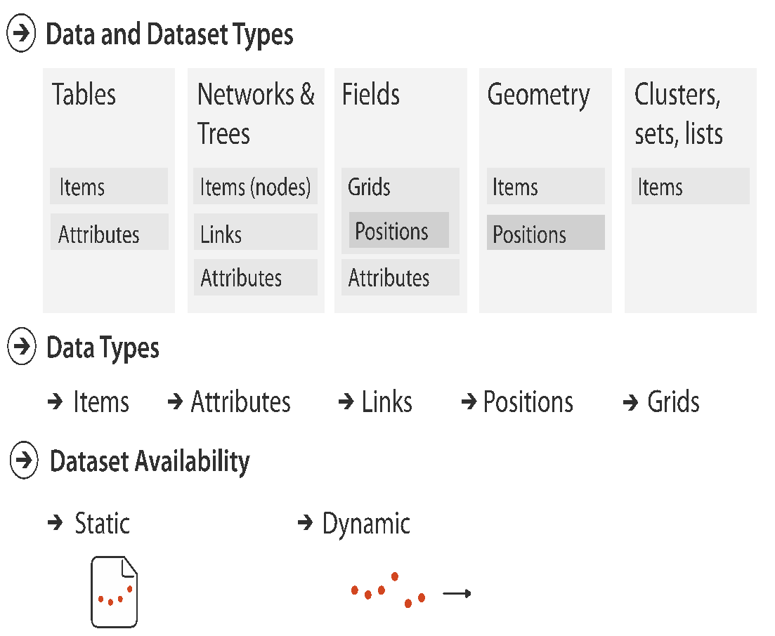
Dataset and data types

Slide 3
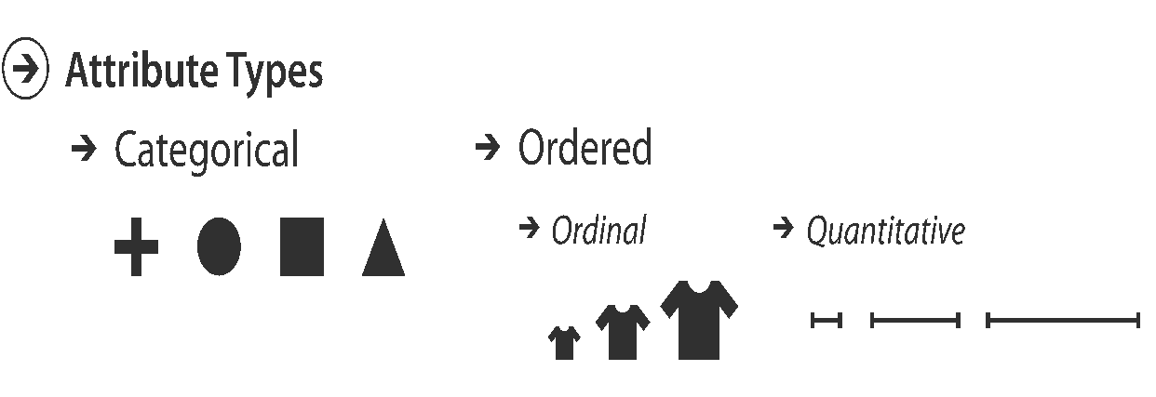
Attribute types

Slide 4
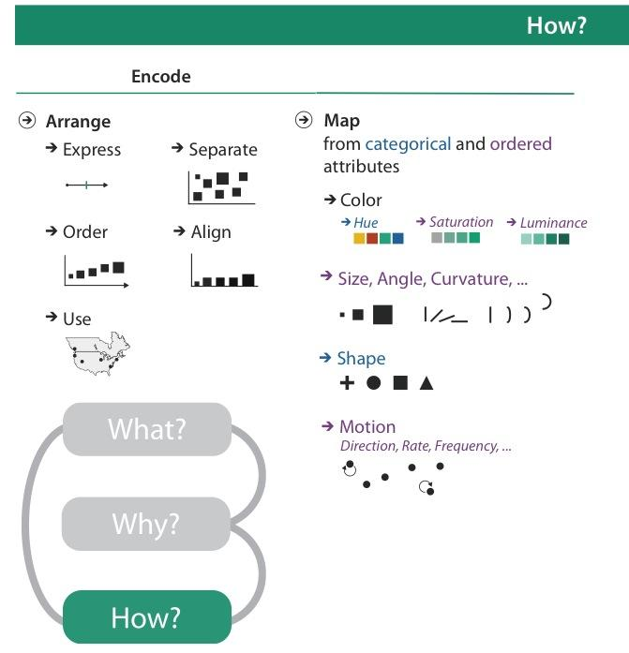

Slide 5
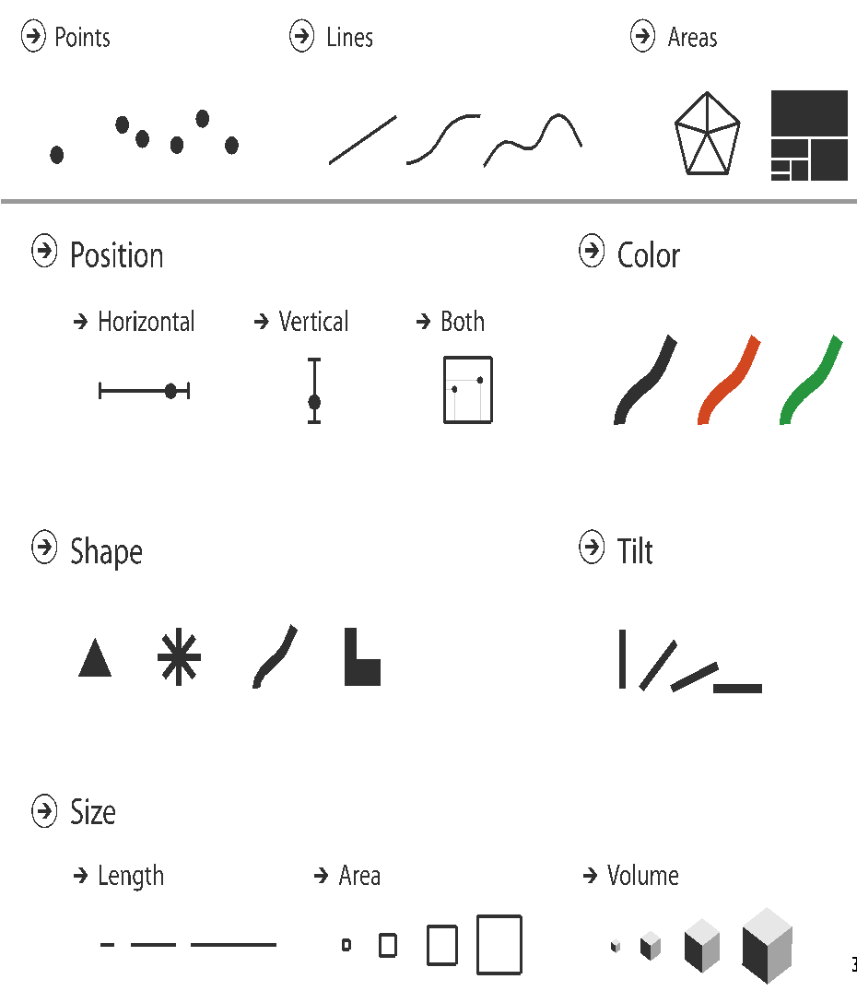
Definitions: Marks and channels
marks
geometric primitives
channels
control appearance of marks
can redundantly code with multiple channels
interactions
point marks only convey position; no area constraints
can be size and shape coded
line marks convey position and length
can only be size coded in 1D (width)
area marks fully constrained
cannot be size or shape coded

Slide 6
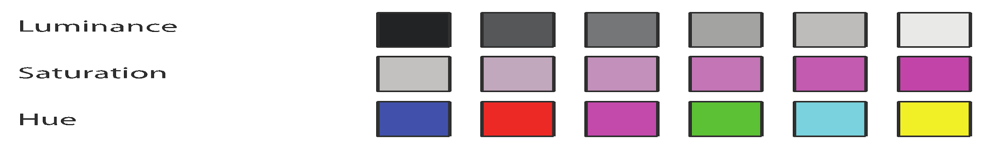

Color: Luminance, saturation, hue
3 channels
identity channel for categorical
hue
magnitude channels for ordered
luminance
saturation

Slide 7
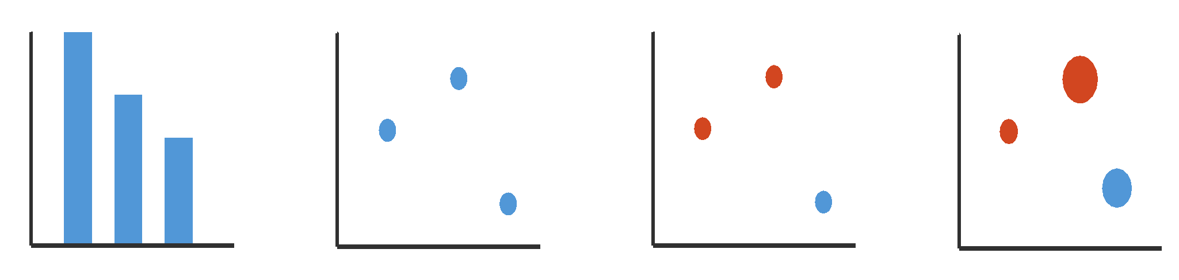
Visual encoding
1: vertical position
2: vertical position
horizontal position
3: vertical position
horizontal position
color hue
4: vertical position
horizontal position
color hue
size (area)
mark: line
mark: point
mark: point
mark: point

Slide 8
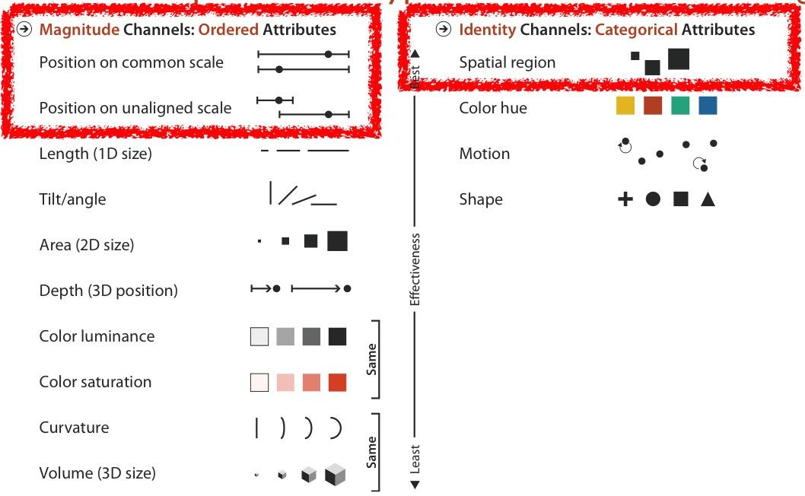
Channels: Expressiveness types and effectiveness rankings

Slide 9
Effectiveness and expressiveness principles
effectiveness principle
encode most important attributes with highest ranked channels
expressiveness principle
match channel and data characteristics

Slide 10
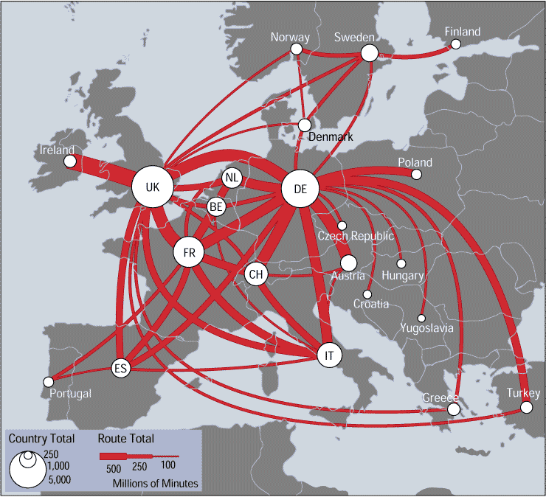
Discriminability: How many usable steps?
linewidth: only a few
source: Telecommunications Traffic Flow Map

Slide 11
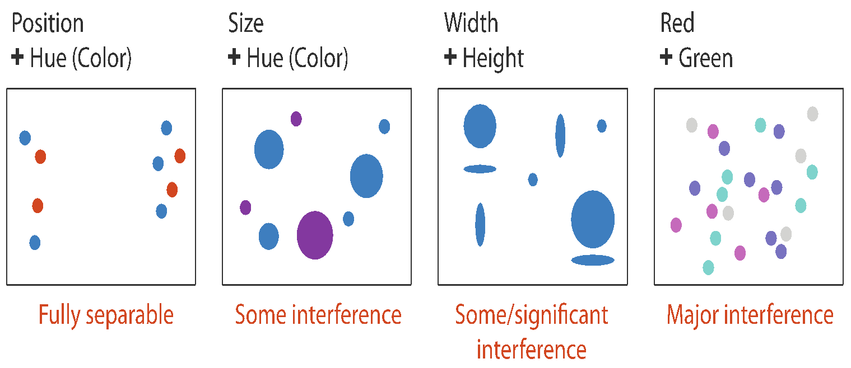
Separability vs. Integrality
2 groups each
2 groups each
3 groups total:
integral area
4 groups total:
integral hue

Slide 12
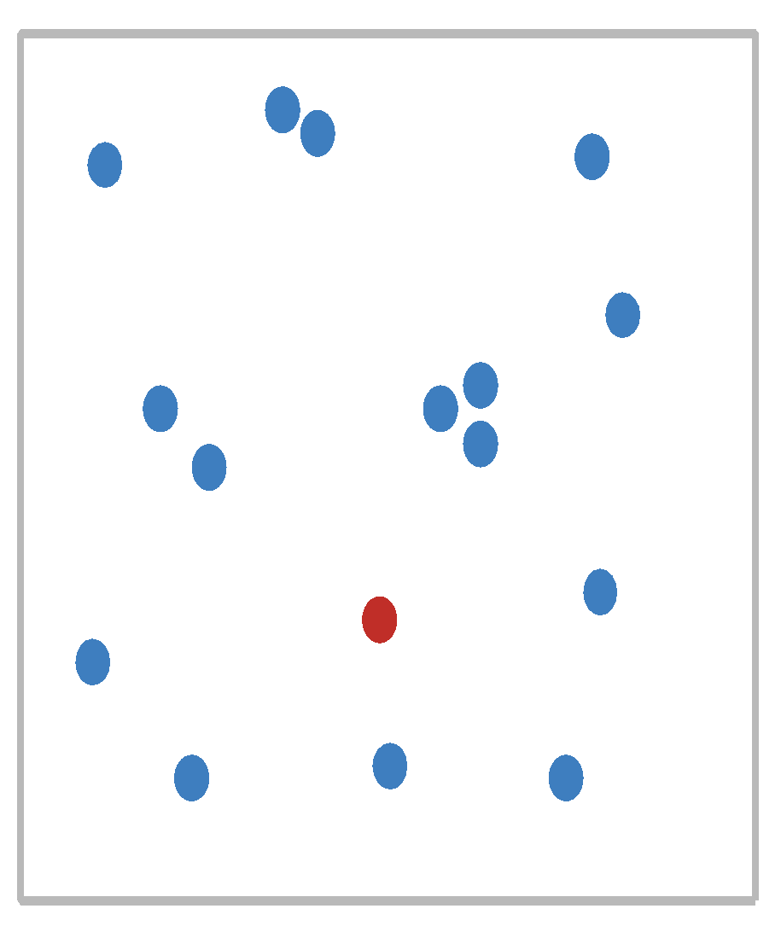
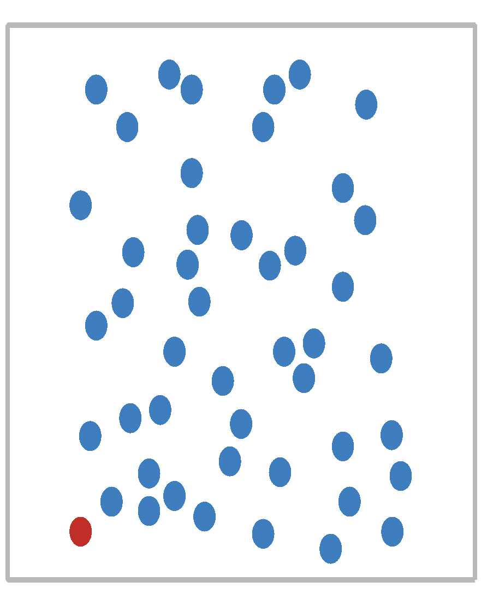
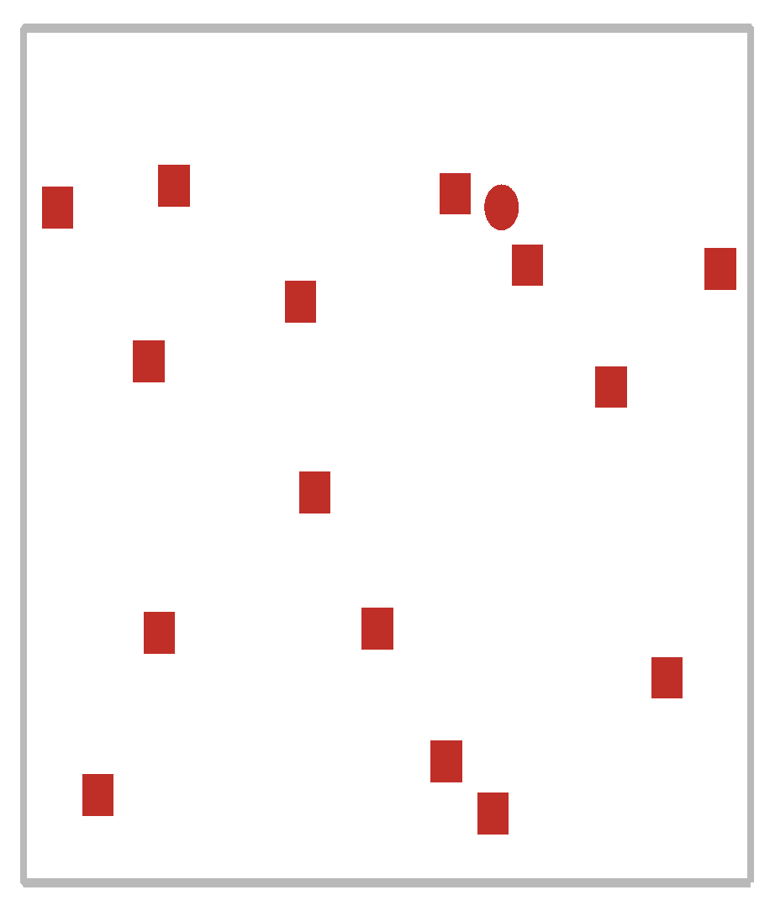
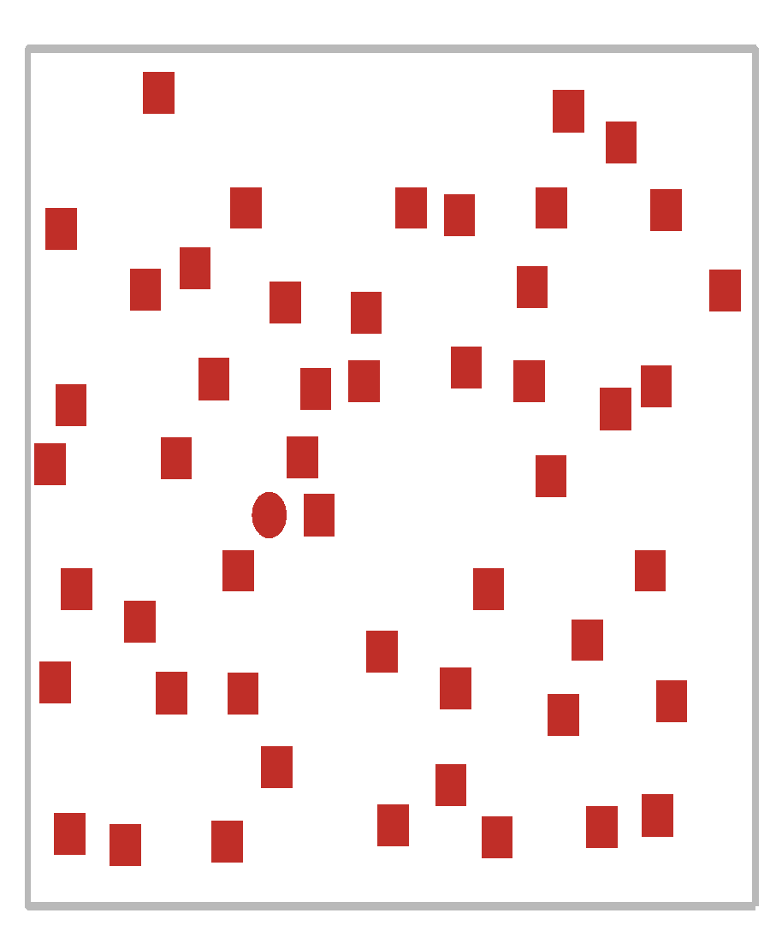
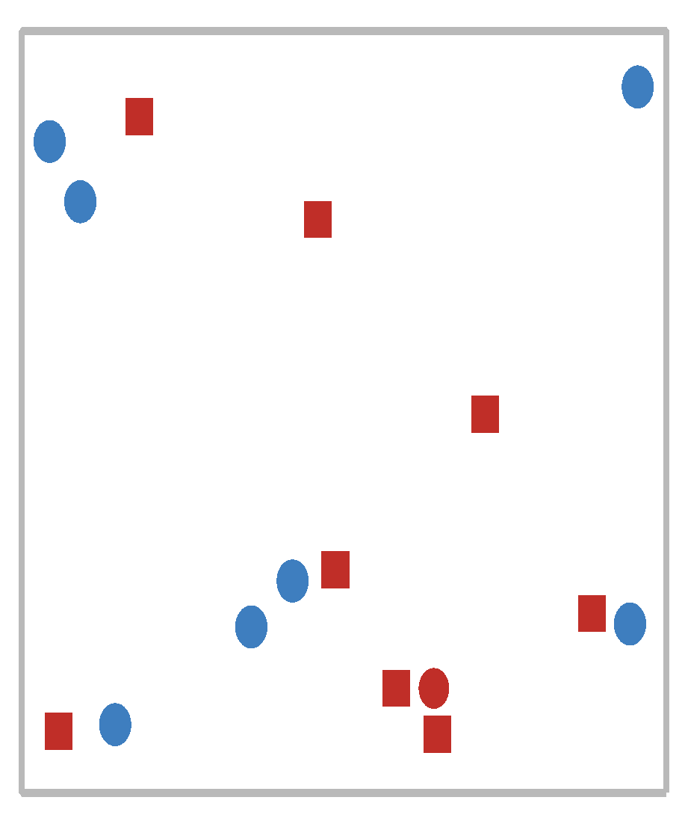
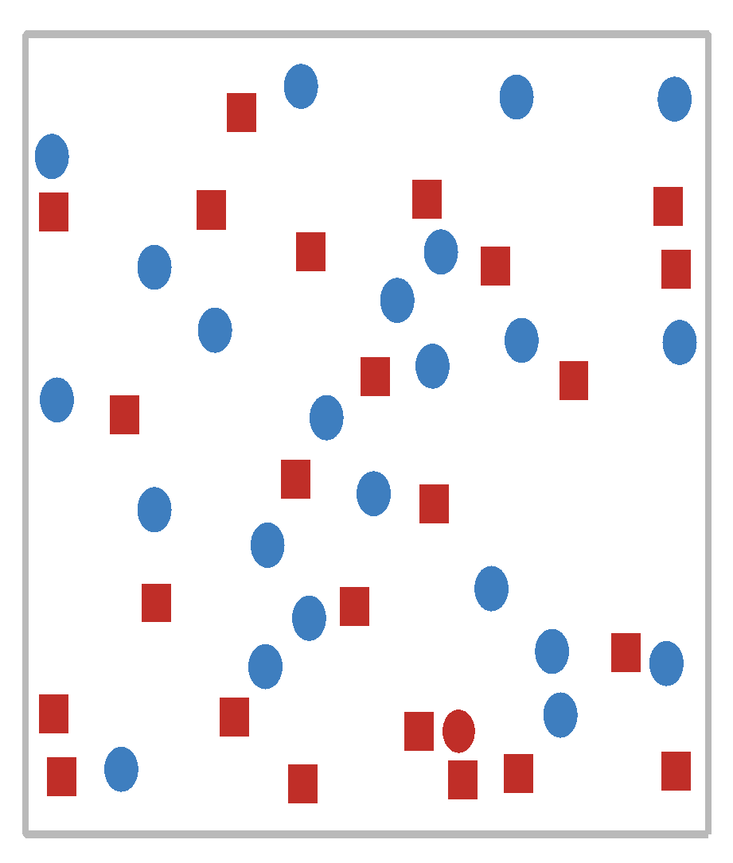
Popout
find the red dot
how long does it take?
parallel processing on many individual channels
speed independent of distractor count
speed depends on channel and amount of difference from distractors
serial search for (almost all) combinations
speed depends on number of distractors

Slide 14
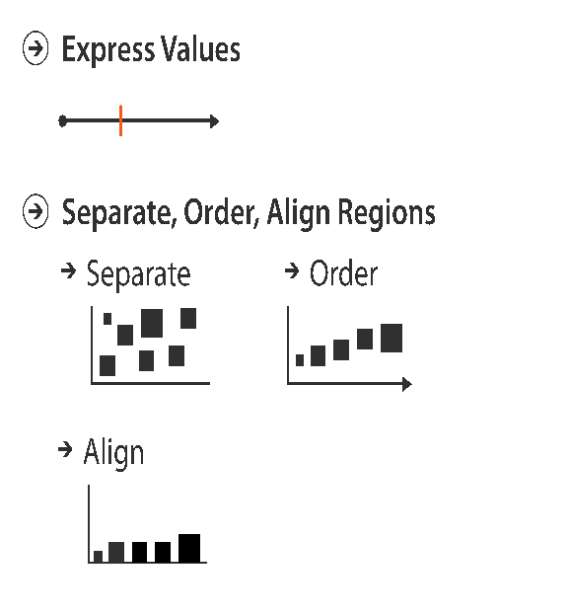
Arrange tables

Slide 15
Web Science:
Intro to InfoVis with R and Python
(Part 2 - Visualization Idioms)
CS 432/532
Old Dominion University
Many slides courtesy Tamara Munzner, VAD minicourse, June 2014
Based on Tamara Munzner, Visualization Analysis and Design, AK Peters / CRC Press, Oct 2014
This work is licensed under a Creative Commons Attribution-NonCommercial-ShareAlike 3.0 Unported License

Slide 16
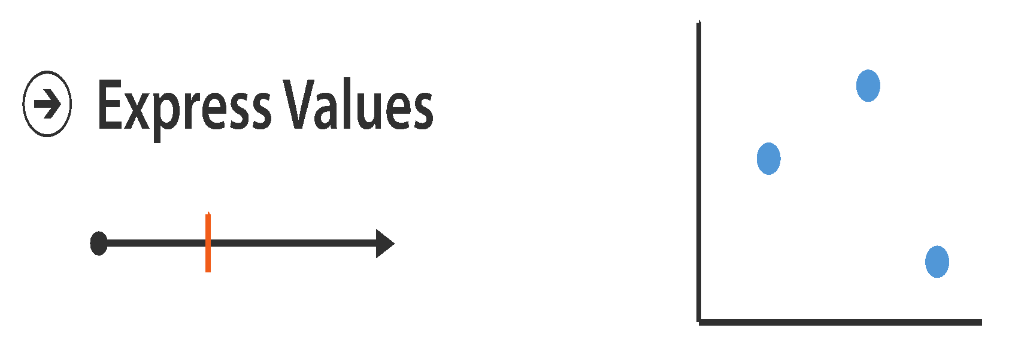
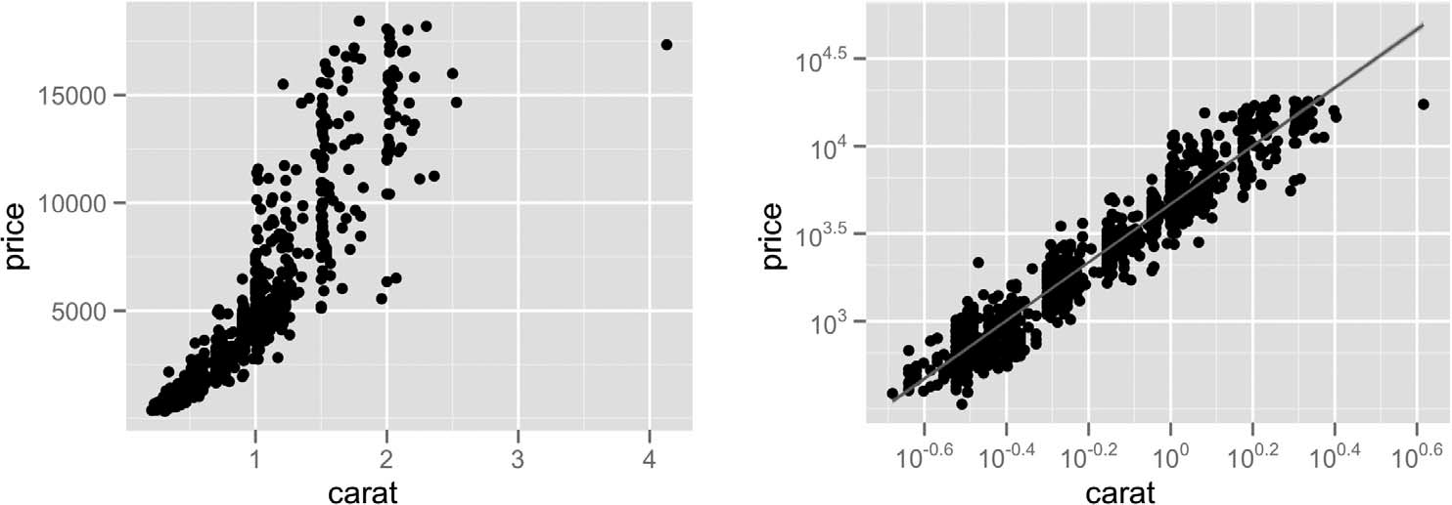
Idiom: scatterplot
express values
quantitative attributes
no keys, only values
data
2 quant attribs
mark: points
channels
horiz + vert position
tasks
find trends, outliers, distribution, correlation, clusters
scalability
hundreds of items
source: [A layered grammar of graphics. Wickham. Journ. Computational and Graphical Statistics 19:1 (2010), 3–28.]

Slide 17
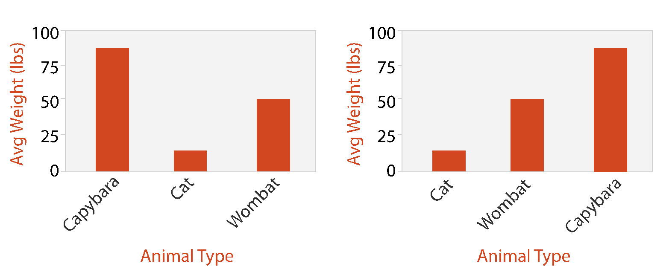
Idiom: bar chart
one key, one value
data
1 categ attrib, 1 quant attrib
mark: lines
channels: length to express quant value
spatial regions: one per mark
separated horizontally, aligned vertically
ordered by quant attrib
by label (alphabetical), by length attrib (data-driven)
task
compare, lookup values
scalability
dozens to hundreds of levels for key attrib

Slide 18
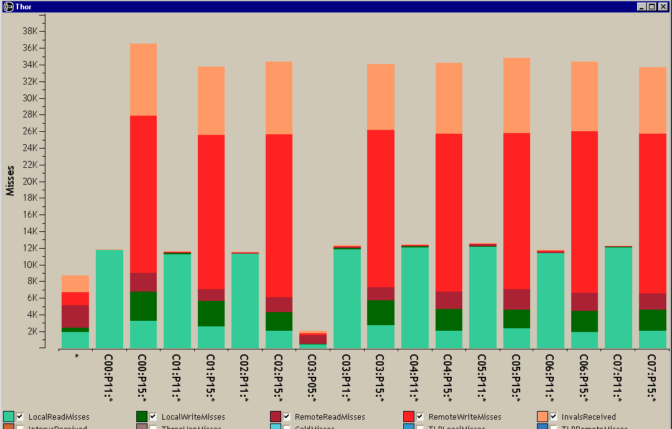
Idiom: stacked bar chart
one more key
data
2 categ attrib, 1 quant attrib
mark: vertical stack of line marks
glyph: composite object, internal structure from multiple marks
channels
length and color hue
spatial regions: one per glyph
aligned: full glyph, lowest bar component
unaligned: other bar components
task
part-to-whole relationship
scalability
several to one dozen levels for stacked attrib
source: [Using Visualization to Understand the Behavior of Computer Systems. Bosch. Ph.D. thesis, Stanford Computer Science, 2001.]

Slide 19
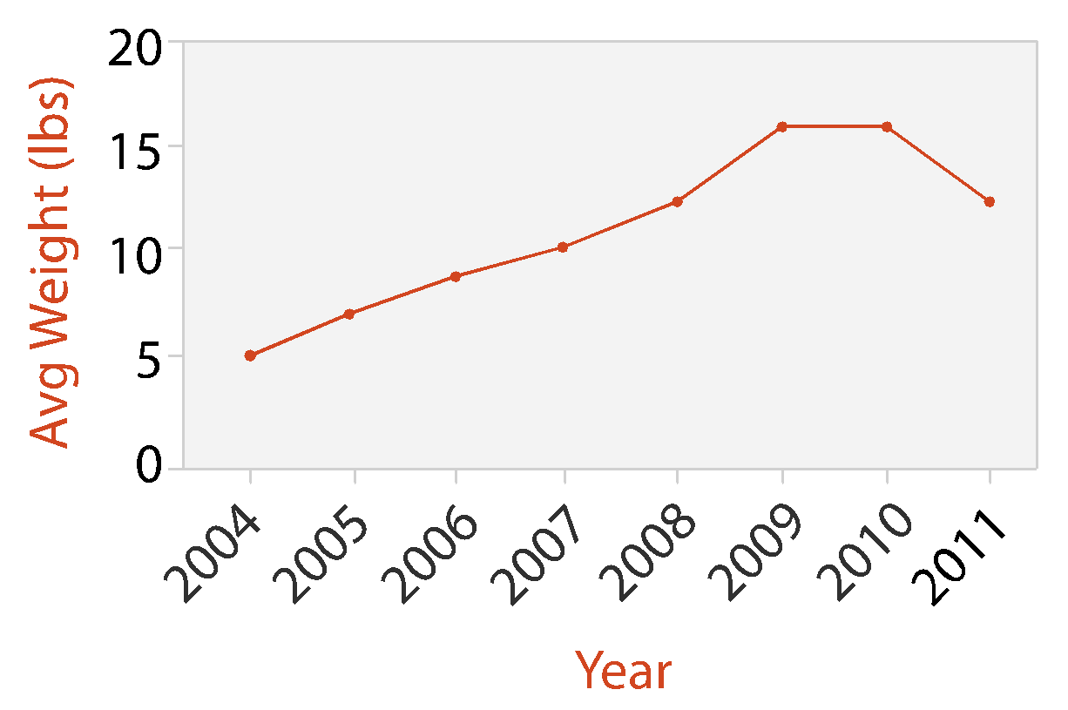
Idiom: line chart
one key, one value
data
1 quant attrib, 1 ordered attrib
mark: points
line connection marks between them
channels
aligned vertical position
separated and ordered by key attrib into horizontal regions
task
find trend
connection marks emphasize ordering of items along key axis by explicitly showing relationship between one item and the next
Notes:
Fig 5.10
fonts are fine

Slide 20
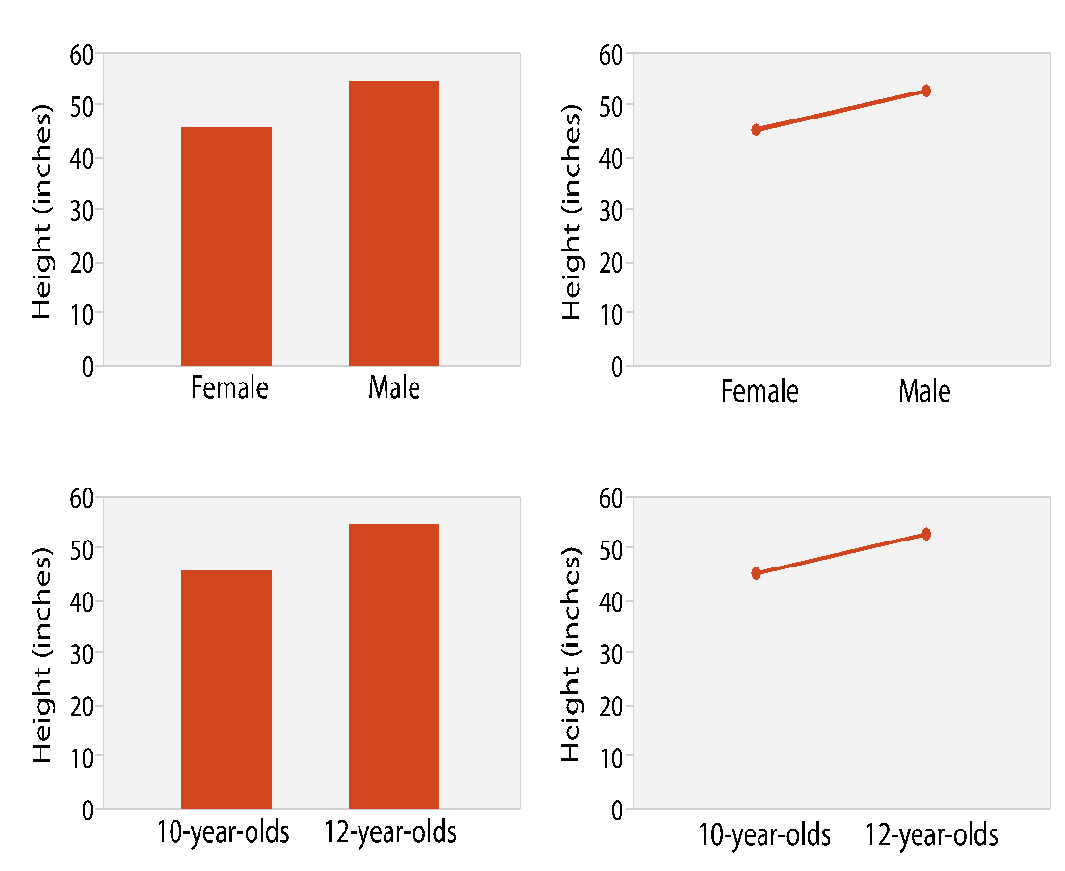
Choosing bar vs line charts
depends on type of key attrib
bar charts if categorical
line charts if ordered
do not use line charts for categorical key attribs
violates expressiveness principle
implication of trend so strong that it overrides semantics!
“The more male a person is, the taller he/she is”
source: [Bars and Lines: A Study of Graphic Communication. Zacks and Tversky. Memory and Cognition 27:6 (1999), 1073–1079.]

Slide 21
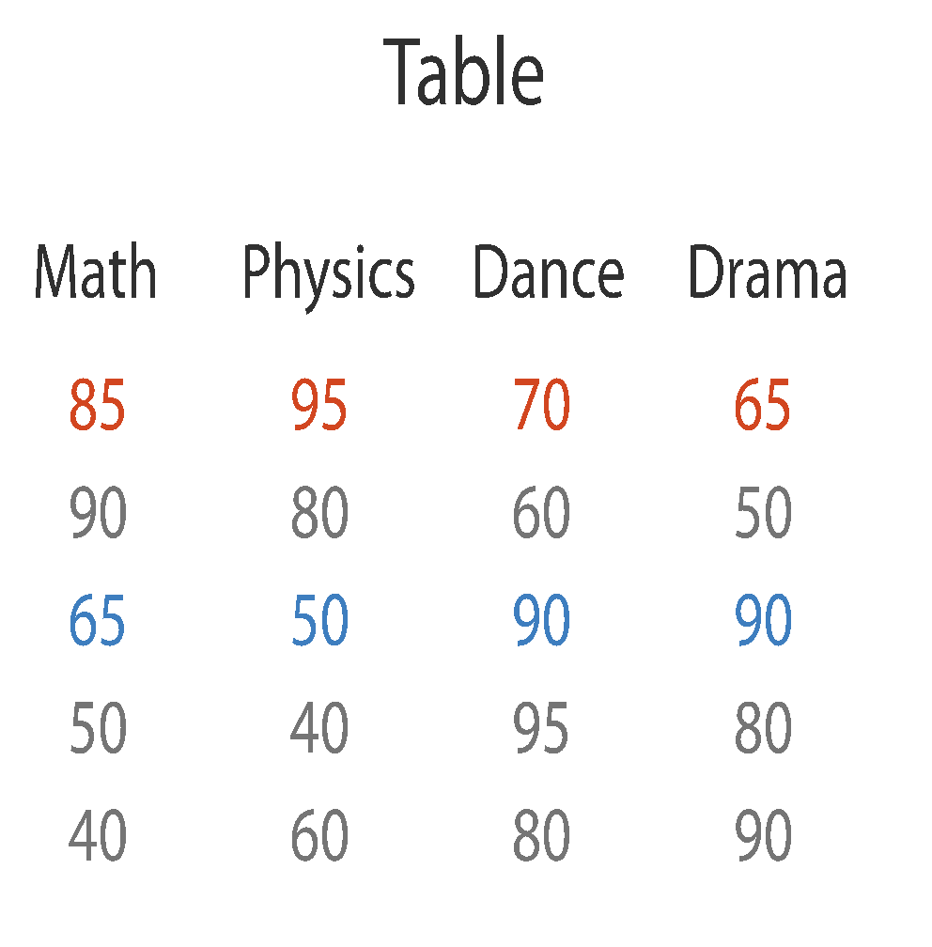
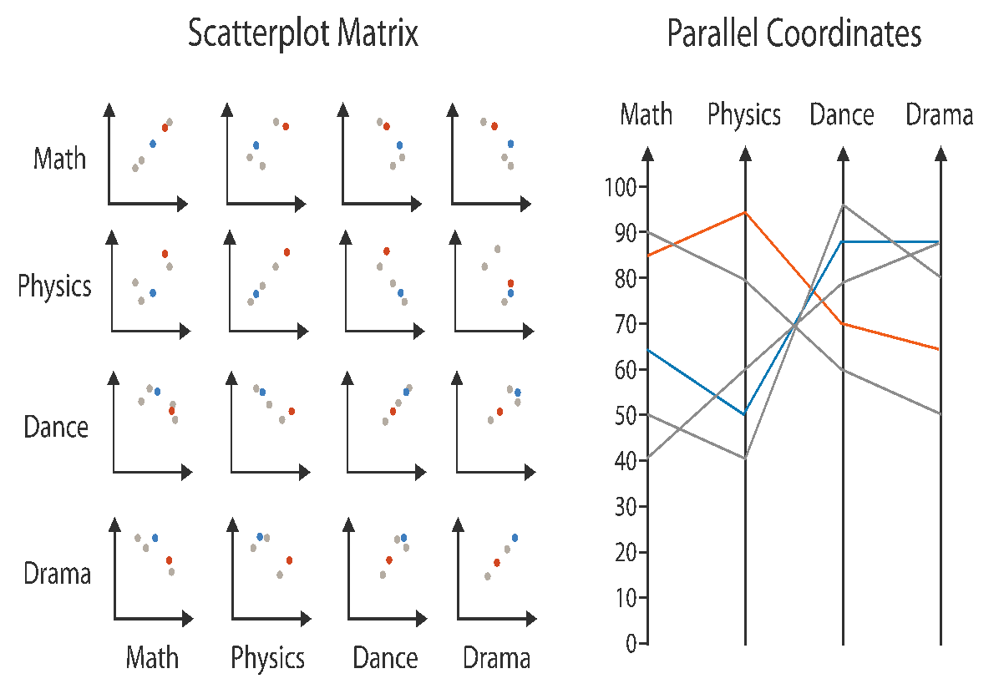
Idiom: scatterplot matrix
scatterplot matrix (SPLOM)
rectilinear axes, point mark
all possible pairs of axes
scalability
one dozen attribs
dozens to hundreds of items
task: correlation
positive correlation: diagonal low-to-high
negative correlation: diagonal high-to-low
uncorrelated
source: [Visualization Course Figures. McGuffin, 2014]

Slide 22
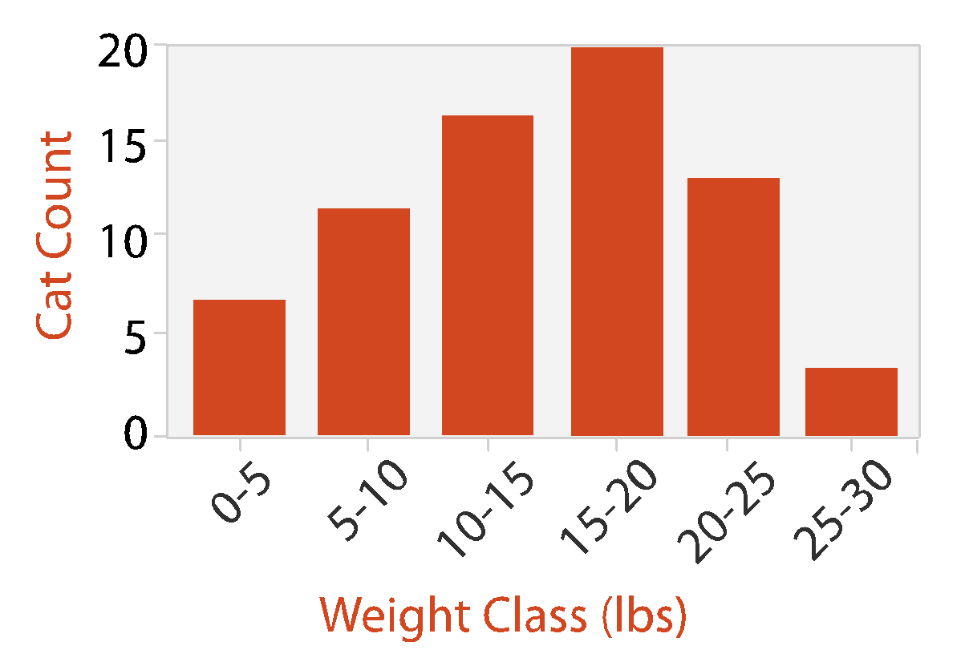
Idiom: histogram
histogram
static item aggregation
task: find distribution
data: table
derived data
new table: keys are bins, values are counts
bin size crucial
pattern can change dramatically depending on discretization (bin size)
bar chart

Slide 23
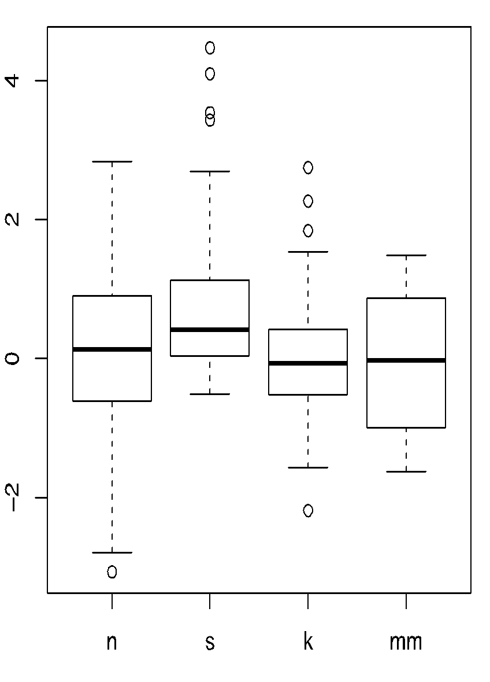
Idiom: boxplot
static item aggregation
task: find distribution
data: table
derived data
5 quant attribs
median: central line
lower and upper quartile: boxes
lower upper fences: whiskers
values beyond which items are outliers
outliers beyond fence cutoffs explicitly shown
source: [40 years of boxplots. Wickham and Stryjewski. 2012]

Slide 24
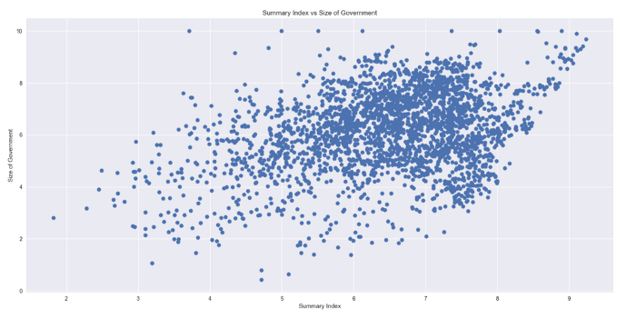
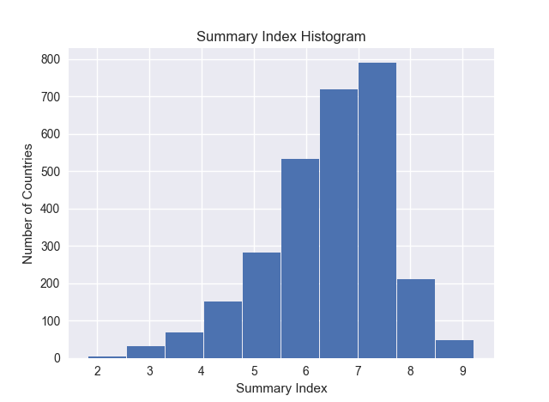
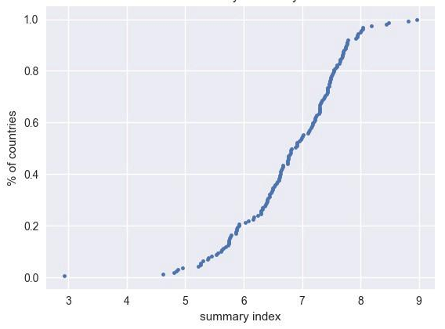
Empirical CDF (ECDF)
histogram
scatterplot
Expresses percentage of values <= x
Never decreases
Easy to spot median, quantiles
ECDF
90th percentile
75th percentile (3rd quartile)
50th percentile (median)
25th percentile (1st quartile)
source: What, Why, and How to Read Empirical CDF

Slide 25
Interested in learning more?
Watch Tamara Munzner's D3 Unconference Keynote, Nov 2015 (55 min)
Still interested?
Take CS 625 - Data Visualization
covers most of Munzner’s textbook
Still interested?
Take CS 725/825 - Information Visualization and Visual Analytics
more advanced visualizations, research-based, assumes knowledge of all material from CS 625

Slide 26
Web Science:
Intro to InfoVis with R and Python
(Part 3 - Charts with R)
CS 432/532
Old Dominion University
This work is licensed under a Creative Commons Attribution-NonCommercial-ShareAlike 3.0 Unported License

Slide 27
What is R?
Software for statistical computing and graphics
Free (GNU General Public Licence) implementation of the S programming language
Based on a command line interface (various GUIs are available)
Extensible through loadable libraries
Available for multiple platforms including Linux, MacOS, Windows
Well-documented with its own documentation format, similar to UNIX man pages
available at The R Project for Statistical Computing
popular GUI: RStudio
ref: "An Incomplete R Tutorial", Martin Klein

Slide 28
R Resources
The R Project - main R website
R Documentation
RStudio - most popular GUI for R
Connect RStudio to Git and GitHub
RStudio and R for Beginners
R for Data Science - tutorials from O'Reilly book
R TidyVerse packages - helper packages for Data Science (used in "R for Data Science")
"An Incomplete R Tutorial", by Martin Klein

Slide 29
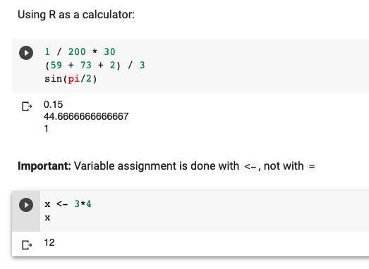
R and Google Colab
Note: There's no menu option to create an R notebook, so you have to create a notebook with certain options in the URL (see link below)
Create new Google Colab R notebook (https://colab.research.google.com/notebook#create=true&language=r)

Slide 30
ggplot2
How to make any plot in ggplot2? | ggplot2 Tutorial
basic getting started guide
The Complete ggplot2 Tutorial - Part1 | Introduction To ggplot2 (Full R code)
simple syntax explanation
scatterplot
Top 50 ggplot2 Visualizations - The Master List (With Full R Code)
code for 50 different types of charts
Data Visualization Cheat Sheet
A ggplot2 Tutorial for Beautiful Plotting in R and Beautiful plotting in R: A ggplot2 cheatsheet
examples on how to change a ton of options for customizing the look

Slide 31
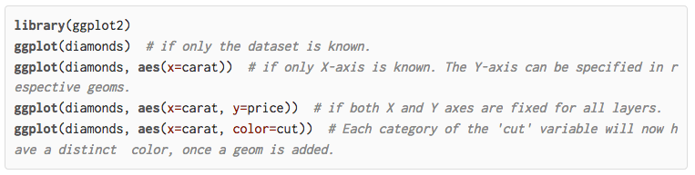
ggplot2 Intro
ref: How to make any plot in ggplot2?

Slide 32
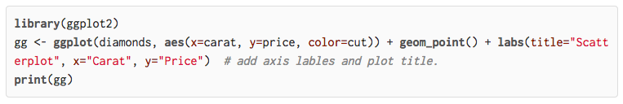
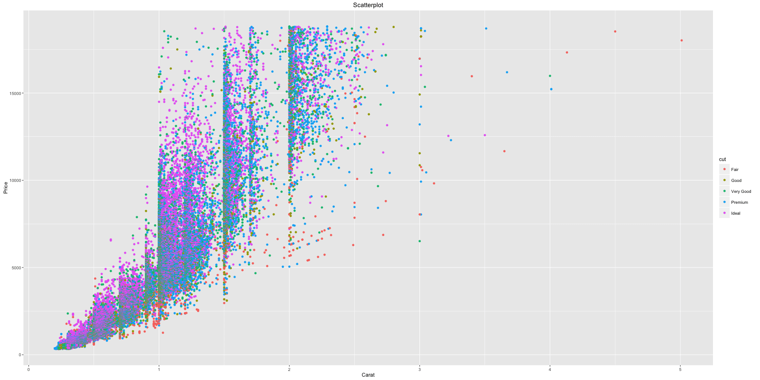
ggplot2 Intro
ref: How to make any plot in ggplot2?

Slide 33
Web Science:
Intro to InfoVis with R and Python
(Part 4 - Charts with Python)
CS 432/532
Old Dominion University
This work is licensed under a Creative Commons Attribution-NonCommercial-ShareAlike 3.0 Unported License

Slide 34
Ways to Plot Data in Python
Matplotlib
most popular Python plotting library, similar to Matplot
Seaborn
high-level interface to Matplotlib
Plotly
interactive, open-source, and browser-based graphing library, built on top of D3
Bokeh
interactive visualization library for modern web browsers, outputs plots as HTML files
Altair
declarative statistical visualization library for Python, based on Vega and Vega-Lite
Pygal
focus on visual appearance, produces SVG plots
Pandas
popular data science library for Python, visualization is wrapper around Matplotlib
ref: The 7 most popular ways to plot data in Python

Slide 35
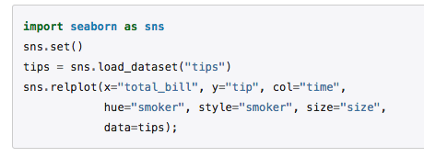
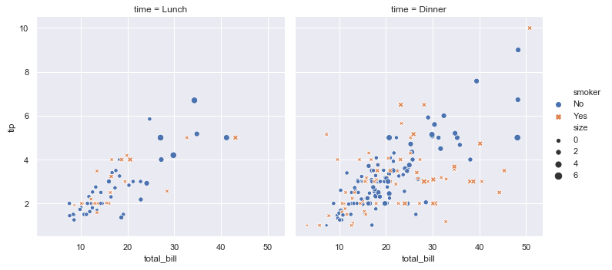
Seaborn
Note: A couple updates to the Google Colab notebook have been made since the lecture video was recorded:
distplot() is deprecated, so that has been replaced with histplot()
Seaborn has added the ecdfplot() function, so I've added an example using that.

Slide 36
Objectives
Distinguish between categorical and ordered attributes.
Explain how marks and channels are related.
Distinguish between the identity channel type and the magnitude channel type and indicate which channels belong to each type.
Distinguish between the principles of expressiveness and effectiveness in visual encoding.
List the channels for ordered attributes in order from most effective to least effective.
Explain how the concepts of express, separate, order, and align all relate to arranging tabular data.
Differentiate between line charts and bar charts and explain when each is appropriate.
Explain how the boxplot idiom can characterize a distribution.
Use R to create a bar chart, line chart, and scatterplot.
Use Python charting libraries to create a bar chart, line chart, and scatterplot.

