Slide 1
Web Science:
Measuring the Web
(Part 1 - How Big Is the Web and How Can We Tell?)
CS 432/532
Old Dominion University
Permission has been granted to use these slides from Frank McCown, Michael L. Nelson, Alexander Nwala, Michele C. Weigle
This work is licensed under a Creative Commons Attribution-NonCommercial-ShareAlike 3.0 Unported License

Slide 2
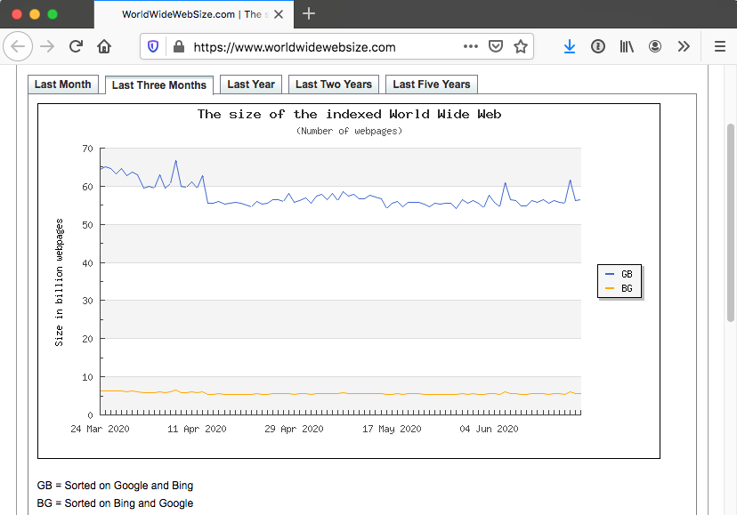
How Big Is the Web? (2020-06-22)
June 2020:
at least
5.56 B pages
source: World Wide Web Size

Slide 3
Measuring the Web - Initial Studies
MIT Study (1993-1995)
How fast is the Web growing?
W3C Characterization (1998-1999)
How many web pages are there? How fast is the Web growing?
OCLC (1998-2002)
Analyzed Web samples annually to look for trends
Baeza-Yates et al. (2000-2005)
Examined languages, file sizes, pages per site, link structure, etc. of national domains

Slide 4
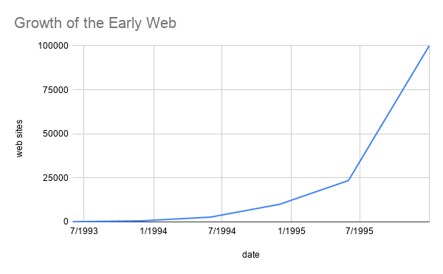
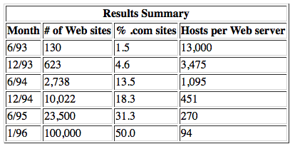
MIT Study (1993-1995)
Crawled the web June 1993 to June 1995
Used World Wide Web Wanderer, the first automated Web agent or "spider"
“The growth of the Web has been remarkable even compared to the Internet at large”
ref: "Measuring the Growth of the Web"

Slide 5
W3C Characterization Activity (1998-1999)
Provided definitions for common Web terms like resource, link, proxy, server, etc., some of which are now dated (Web Characterization Terminology & Definitions)
Attempted to answer questions like: How many web pages are there? How fast is the Web growing?
Summary: Pitkow, Summary of WWW Characterizations, Journal of the World Wide Web, 1999

Slide 6
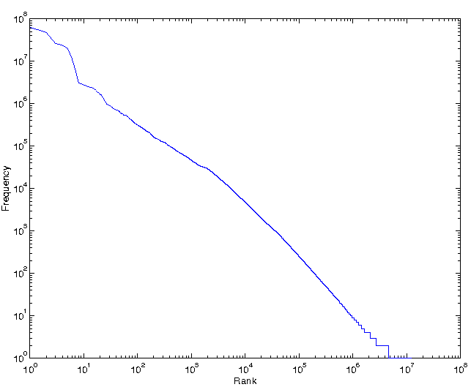
Web Page Popularity
Page hits
100 M
10 M
1 M
100,000
10,000
1000
100
10
1
Power law distributions - tell-tale is linear distribution on a log-log scale
The Zipf distribution of number of page hits versus rank for five days of AOL December 1997 data
Summary of WWW Characterizations

Slide 7
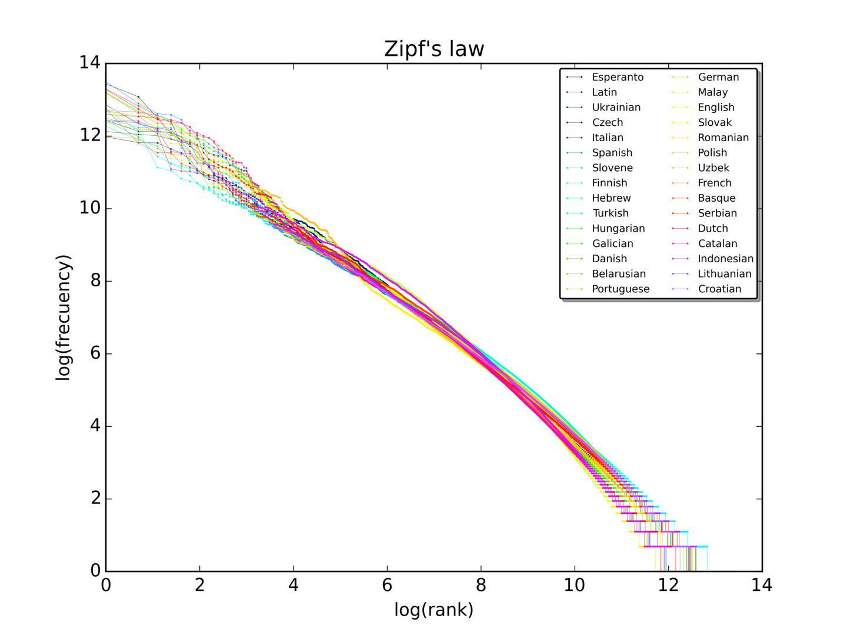
Zipf’s Law
Originally formulated in study of linguistics
The frequency of any word is inversely proportional to its rank in the frequency table
A plot of the rank versus frequency for the first 10 million words in 30 Wikipedias (dumps from October 2015) in a log-log scale.
Image credit: By SergioJimenez - Own work, CC BY-SA 4.0, https://commons.wikimedia.org/w/index.php?curid=45516736
Zipf's Law (wikipedia)

Slide 8
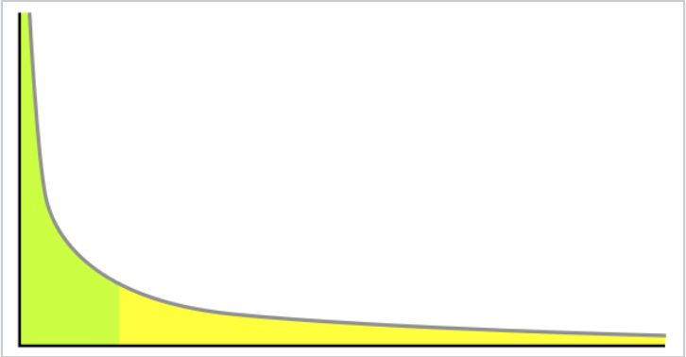
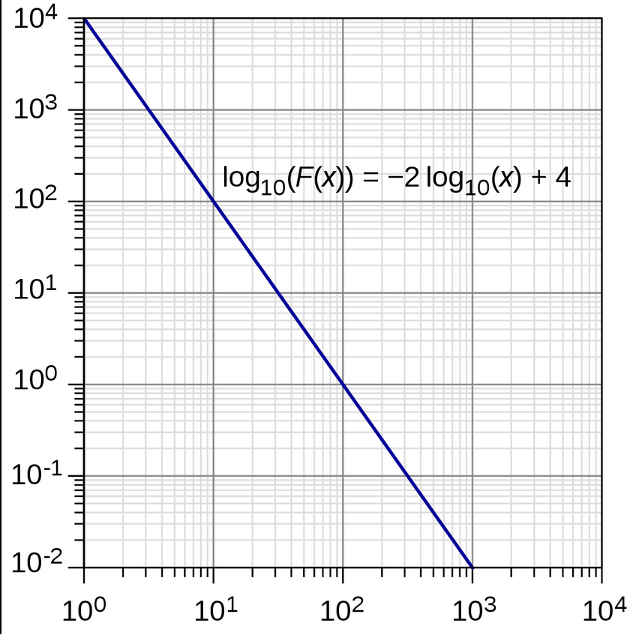
Power Law
Relative change in one quantity results in a proportional change in the other quantity.
One quantity varies as a power of another
An example power-law graph that demonstrates ranking of popularity. To the right is the long tail, and to the left are the few that dominate (also known as the 80–20 rule).
Image credit: By User:Husky - Own work, Public Domain, https://commons.wikimedia.org/w/index.php?curid=1449504
Power Law (wikipedia)
A small number of items is clustered at the top of a distribution (or at the bottom), taking up 95% of the resources.
A straight line on a log–log plot is necessary but insufficient evidence for power-laws.
Image credit: By M. W. Toews - Own work, CC BY 4.0, https://commons.wikimedia.org/w/index.php?curid=63281920

Slide 9
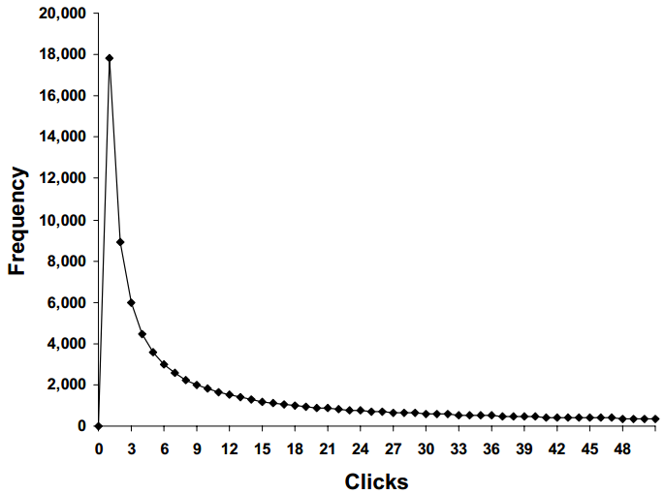
Web Page Popularity
Average: 8 clicks per site
Typical: 1 click per site
Summary of WWW Characterizations
The number of clicks per user at the Xerox WWW Site during May 1998.
The curve follows an inverse Gaussian Distribution, which has a heavy right tail.

Slide 10
OCLC Characterization Research (1998-2002)
Work by Online Computer Library Center (OCLC)
Analyzed Web samples annually to look for trends
Sample obtained by randomly sampling IP addresses and connecting to port 80
Today this method would miss a large number of websites that use virtual hosting – multiple domain names hosted on same computer using one IP address (remember the "Host:" request header?)
Findings: O'Neill et al., Trends in the Evolution of the Public Web, D-Lib Magazine, Apr 2003

Slide 11
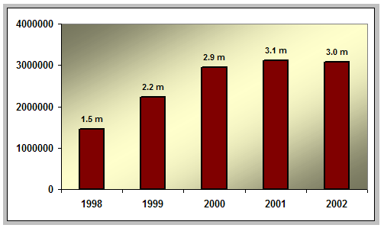
Number of Public Websites Doubled in Five Years
O'Neill et al., Trends in the Evolution of the Public Web, D-Lib Magazine, Apr 2003

Slide 12
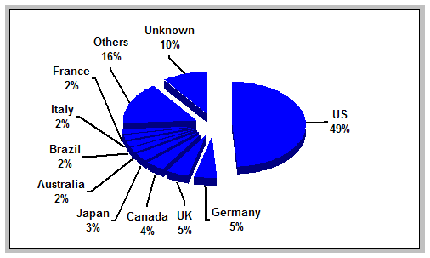
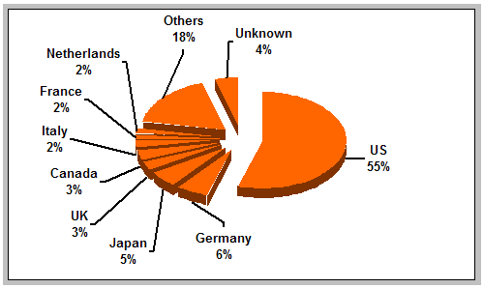
Distribution of Websites by Country (this is why you don’t use pie charts!)
1999
2002
O'Neill et al., Trends in the Evolution of the Public Web, D-Lib Magazine, Apr 2003

Slide 13

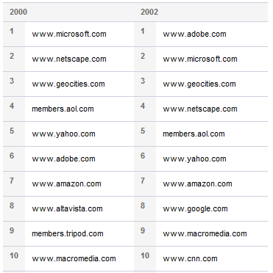
Popular Websites by In-Links
Most Linked-To Websites
(Jan 2013)²
OCLC Most Linked-To Websites¹
(Jan 2020)³
facebook.com
twitter.com
google.com
youtube.com
adobe.com
wordpress.org
blogspot.com
wikipedia.org
godaddy.com
wordpress.com
google.com
apple.com
youtube.com
microsoft.com
play.google.com
support.google.com
blogger.com
docs.google.com
adobe.com
plus.google.com
²Moz Top 500 Websites (archived Jan 2013)
³ Moz Top 500 Most Popular Websites
¹OCLC Top 50 most frequently linked-to sites (archived 2013)

Slide 14
Popular Websites by Visits
Alexa's Top Websites (Jan 2013)¹
Most Linked-To Websites (Jan 2013)²
facebook.com
google.com
youtube.com
yahoo.com
baidu.com
wikipedia.org
live.com
amazon.com
qq.com
twitter.com
facebook.com
twitter.com
google.com
youtube.com
adobe.com
wordpress.org
blogspot.com
wikipedia.org
godaddy.com
wordpress.com
lots of links,
but when is
the last time
you went here?
¹ Alexa Top 500 sites (archived 2013) ²SEOMoz Top 500 domains (archived 2013)
see also: "What is Alexa Traffic Rank?", "How are Alexa traffic rankings determined?"

Slide 15
Characterizing National Web Domains
A large-scale study by Baeza-Yates et al.¹ analyzed web collections from 10 national domains and multinational Web spaces of African and Indochinese Web sites
Indochina - Cambodia (KH), Laos (LA), Myanmar (MM), Thailand (TH) and Vietnam (VN)
Examined languages, file sizes, pages per site, link structure, etc.
¹Baeza-Yates et al., Characterization of national Web domains, ACM Trans. Internet Technol., May 2007

Slide 16
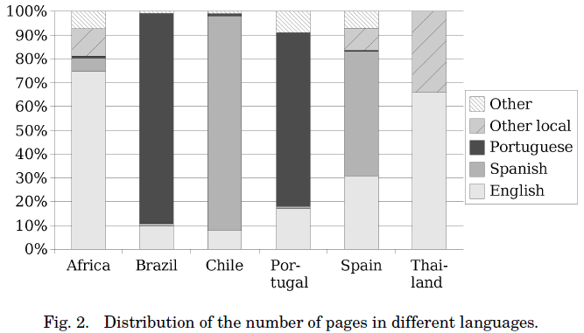
Distribution of Web Page Languages (English vs. Local Language)
Baeza-Yates et al., Characterization of national Web domains, ACM Trans. Internet Technol., May 2007

Slide 17
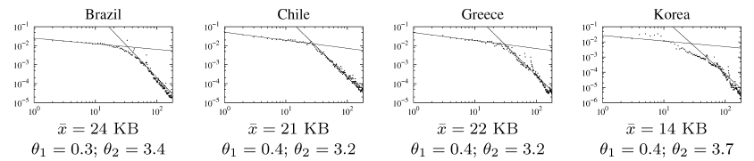
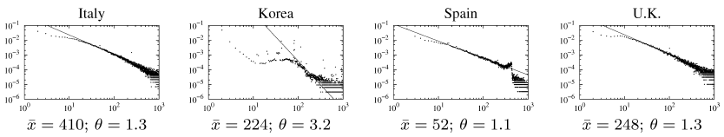
Some Power-law Distributions
File sizes for small and large files
Pages per site
Baeza-Yates et al., Characterization of national Web domains, ACM Trans. Internet Technol., May 2007

Slide 18
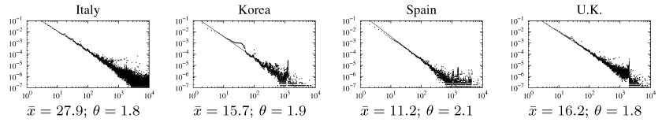
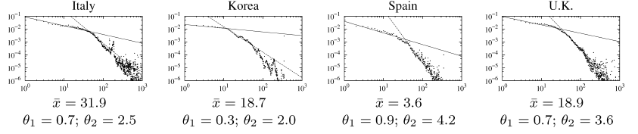
In and Out Degree of Web Pages
In-degree of web pages
Out-degree of web pages for few and many outlinks
Baeza-Yates et al., Characterization of national Web domains, ACM Trans. Internet Technol., May 2007

Slide 19
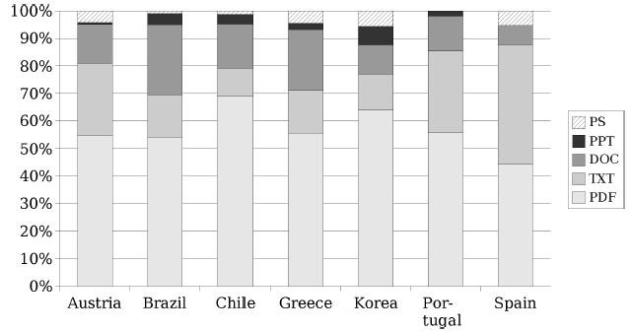
Non-HTML File Content
More than 95% of content was HTML
Baeza-Yates et al., Characterization of national Web domains, ACM Trans. Internet Technol., May 2007

Slide 20
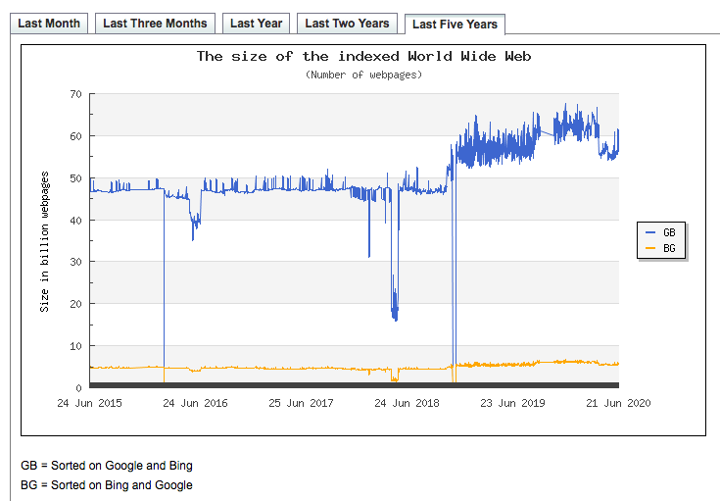
How Has the Web Grown?
ref: World Wide Web Size

Slide 21
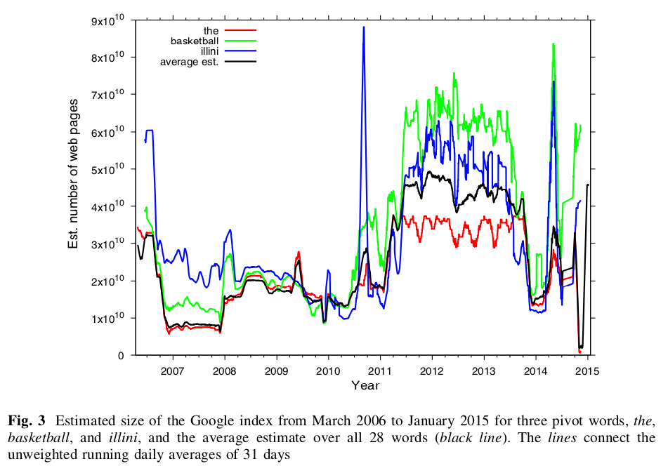
Estimating the Size of the Web
ref: World Wide Web Size
van den Bosch et al., “Estimating search engine index size variability: a 9-year longitudinal study”, Scientometrics, 2016

Slide 22
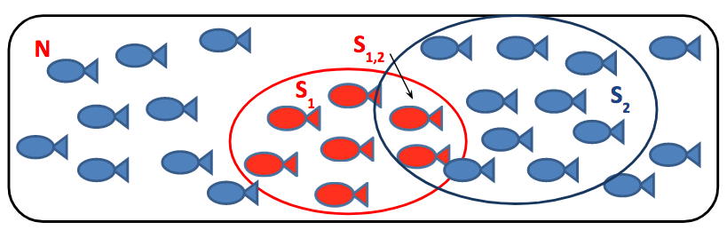
Estimate Web Population
Lawrence and Giles (1998) used capture-recapture method to estimate web page population
Submitted 575 queries to sets of 2 search engines
S1 = All pages returned by SE1
S2 = All pages returned by SE2
S1,2 = All pages returned by both SE1 and SE2
Size of indexable Web (N) = S₁ × S₂/S_{1,2}
Estimated size of indexable Web in 1998 = 320 million pages
Lawrence & Giles, Searching the World Wide Web, Science, 1998

Slide 23
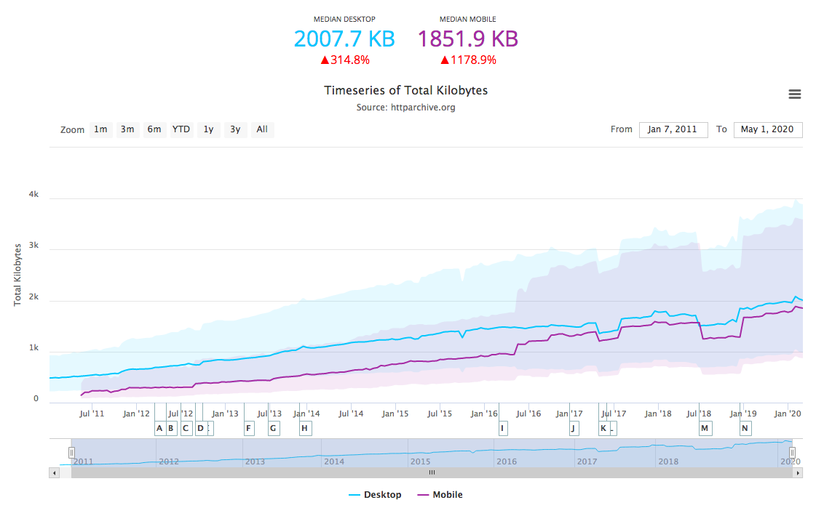
HTTPArchive State of the Web
refs: HTTPArchive's State of the Web, HTTPArchive FAQ

Slide 24
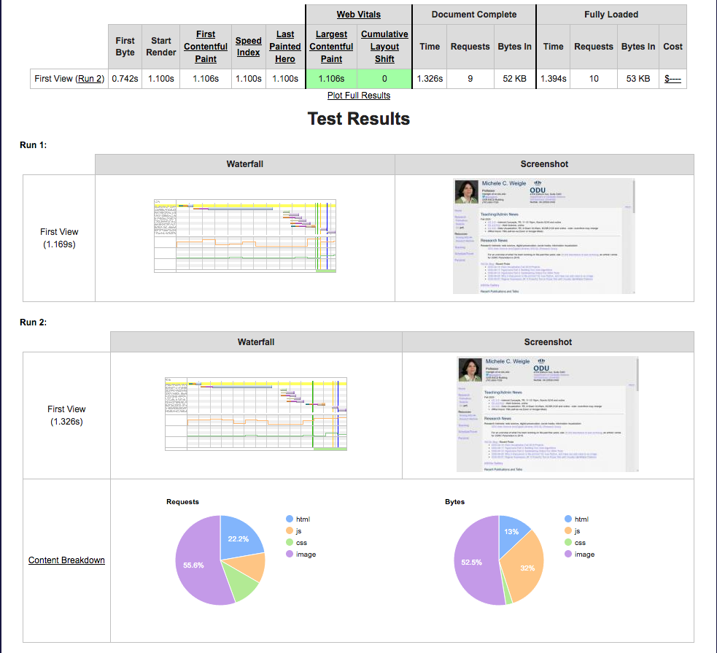
WebPageTest
source: WebPageTest

Slide 25
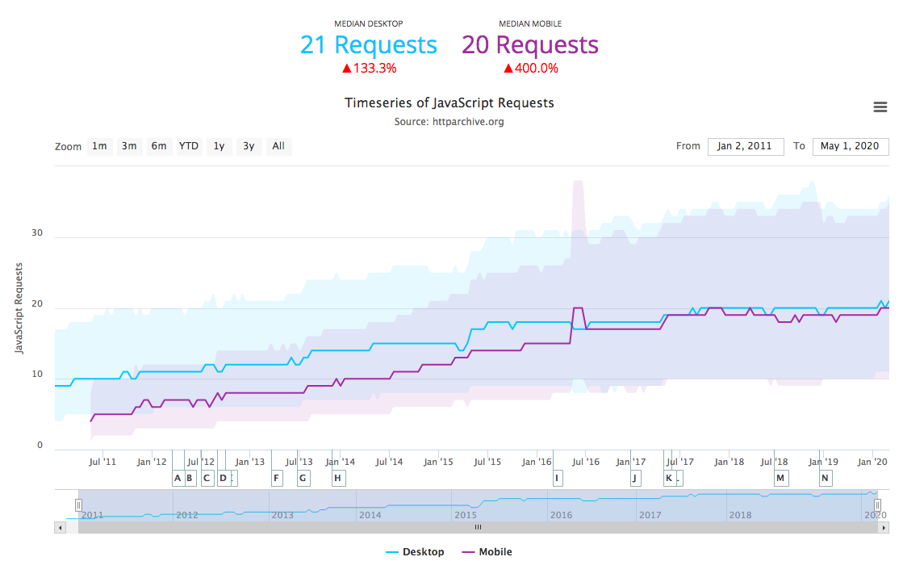
HTTPArchive State of JavaScript
ref: HTTPArchive's State of JavaScript

Slide 26
Web Science:
Measuring the Web
(Part 2 - How Dynamic Is the Web?)
CS 432/532
Old Dominion University
Permission has been granted to use these slides from Frank McCown, Michael L. Nelson, Alexander Nwala, Michele C. Weigle
This work is licensed under a Creative Commons Attribution-NonCommercial-ShareAlike 3.0 Unported License

Slide 27
How dynamic is the Web?
How often are pages added to the Web?
How often are pages are removed from the Web?
How often do pages change?
What kinds of changes do pages typically exhibit?
How does the link structure change over time?

Slide 28
How dynamic is the Web?
We focus on two studies that attempt to answer these questions:
2004 study (Fetterly et al.¹) of 150 million web pages over 11 weeks analyzed weekly snapshots
2004 study (Ntoulas et al.²) of 150 websites over one year analyzed weekly snapshots
What follows are some selected highlights
¹Fetterly et al., A large-scale study of the evolution of Web pages, Software Practice & Experience, 2004 ²Ntoulas et al., What's new on the web?: the evolution of the web from a search engine perspective, Proc WWW 2004

Slide 29
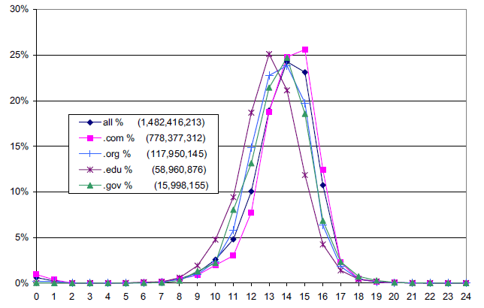
Document Length
2^{n} bytes
Figure 2: Distribution of documents lengths overall and for selected top-level domains.
Fetterly et al., 2004

Slide 30
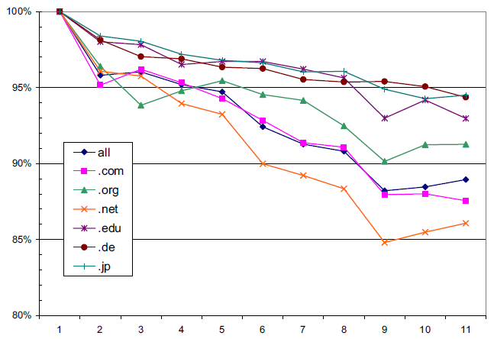
Successful Downloads
Weeks
Figure 5: Distribution of successful downloads over crawl generations, broken down by selected top-level domains.
Fetterly et al., 2004

Slide 31
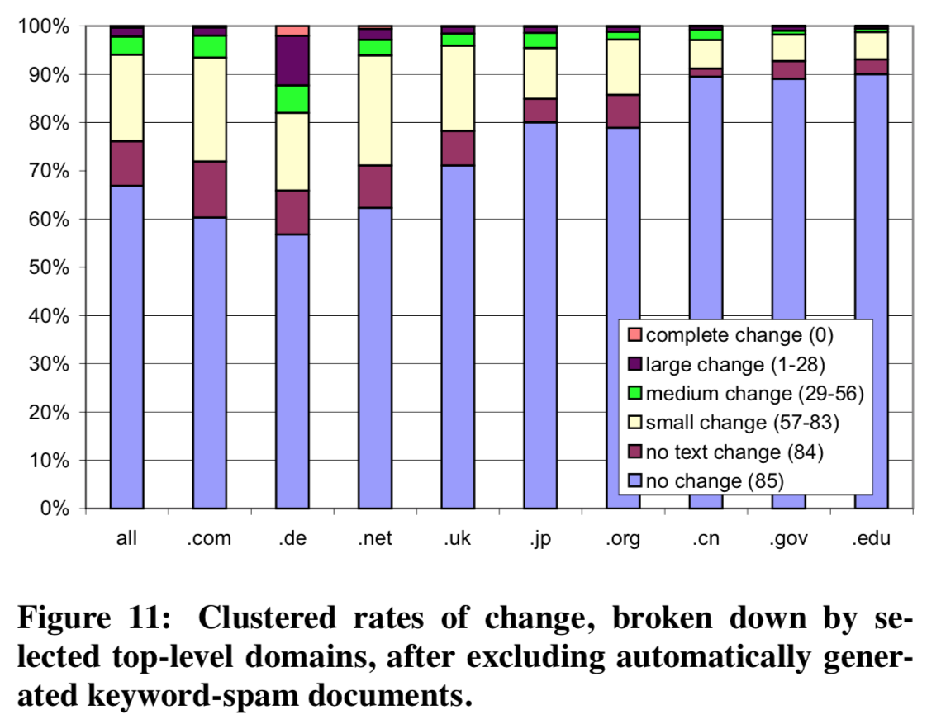
Rates of Change by TLD
Fetterly et al., 2004

Slide 32
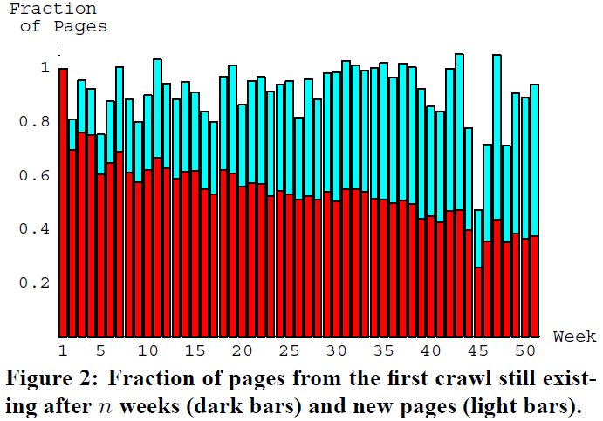
New Pages
Ntoulas et al. , 2004

Slide 33
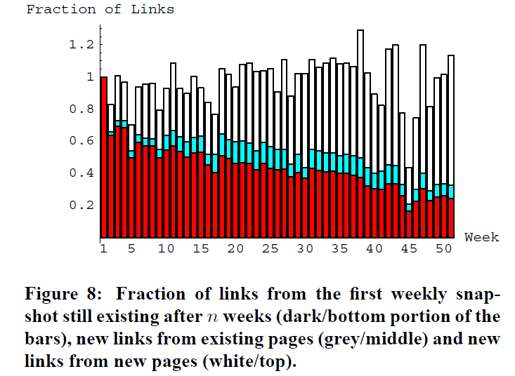
Link Evolution
Ntoulas et al. , 2004

Slide 34
Summary of Findings
Fetterly et al., 2004
Ntoulas et al., 2004
When pages change, they change in trivial ways or just their markup
Strong relationship between TLD and rate of change but not degree of change
The larger the document, the more likely it is to be changed more frequently and significantly
Past frequency of changes to a page is good predictor of future page changes
Web page changes are usually minor
New pages are created at rate of 8% per week
Only 20% of pages today will be accessible in a year
Large number of pages borrow content from existing pages
Every week, 25% new links are created, and after 1 year, 80% of links are replaced with new ones
Past degree of change to web page is good predictor of future degree of change

Slide 35
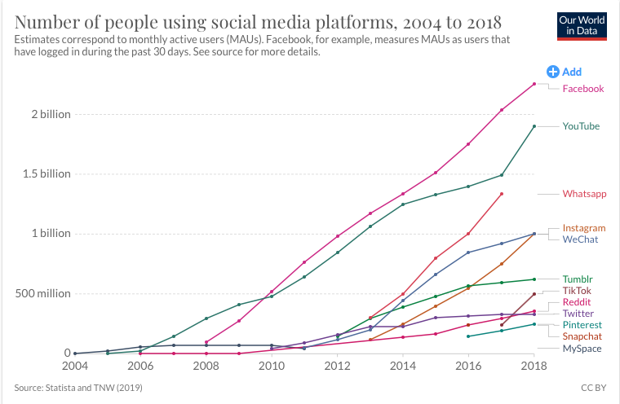
Rise of Social Media
ref: Internet stats from Our World in Data

Slide 36
Today, we add lots of content, mainly through social media
Every day
Facebook: more than 300 million photos uploaded
Instagram: 95 million photos and videos shared
Every minute of the day
Snapchat users: share 527,760 photos
Twitter: 456,000 tweets are sent
Instagram users: post 46,740 photos
Facebook: 510,000 comments posted
Wikipedia: 600 new page edits
"How Much Data Do We Create Every Day? The Mind-Blowing Stats Everyone Should Read" (stats from 2017-2019)

Slide 37
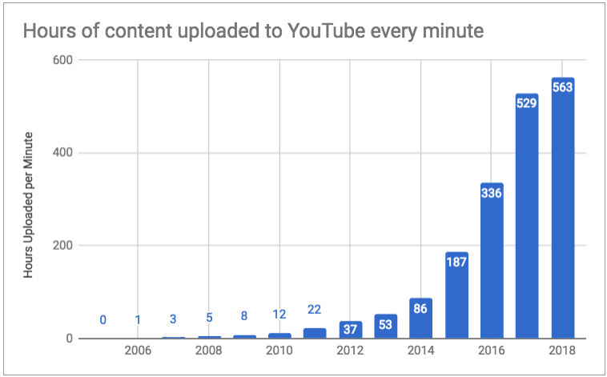
YouTube
ref: State of the YouTube Address — an overview of YouTube usage and growth

Slide 38
Links and Pages Can Still Disappear
Link Rot
Kahle ('97) - Average page lifetime is 44 days
Koehler ('99, '04) - 67% URLs lost in 4 years
Lawrence et al. ('01) - 23%-53% URLs in CiteSeer papers invalid over 5 year span (3% of invalid URLs "unfindable")
Spinellis ('03) - 27% URLs in CACM/Computer papers gone in 5 years
Fetterly et al. ('03) – about 0.5% of web pages disappeared per week
Ntoulas et al. ('04) – predicted only 20% of pages today will be accessible in a year
McCown et al. ('05) - 10 year half-life for URLs in D-Lib Magazine articles
SalahEldeen & Nelson ('12) – 11% of URLs from Tweets disappear after 1 year

Slide 39
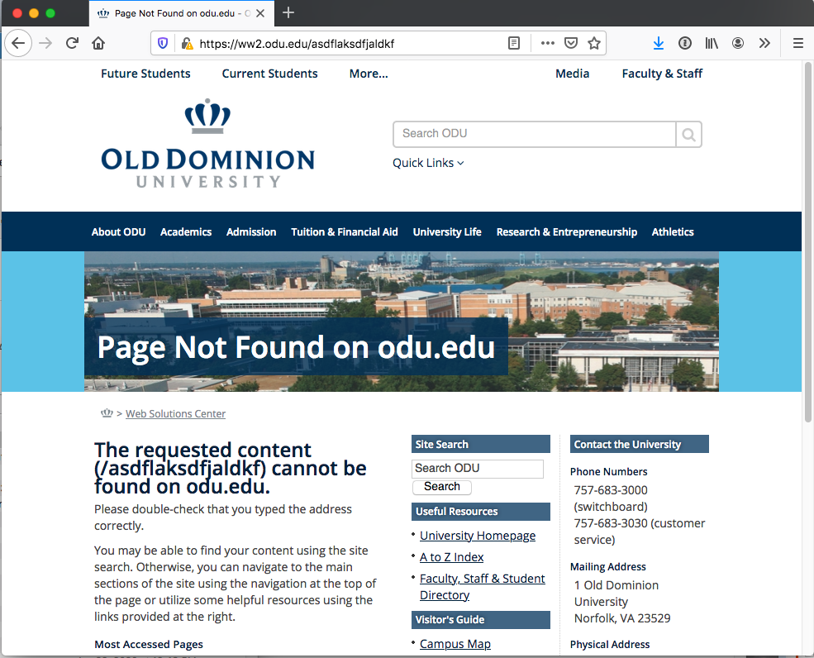
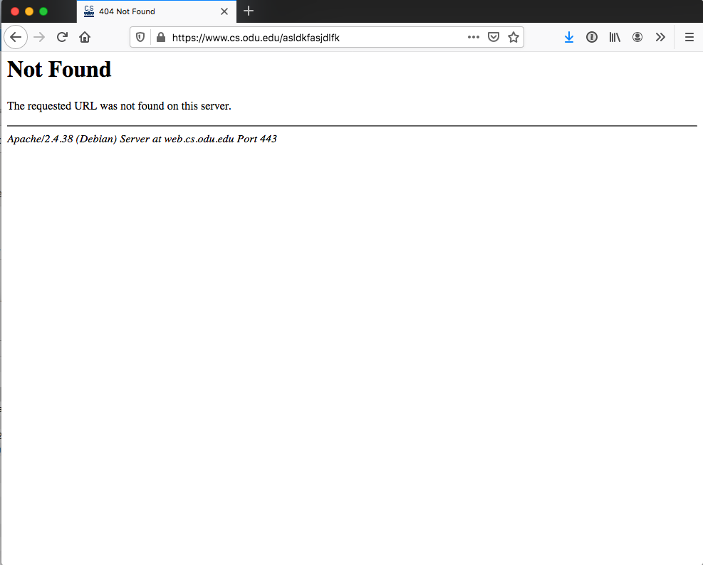
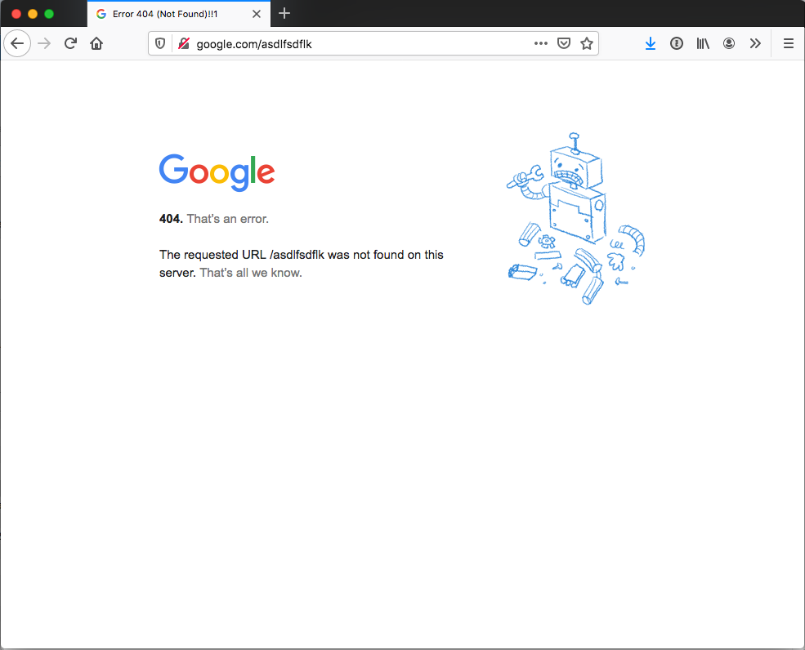
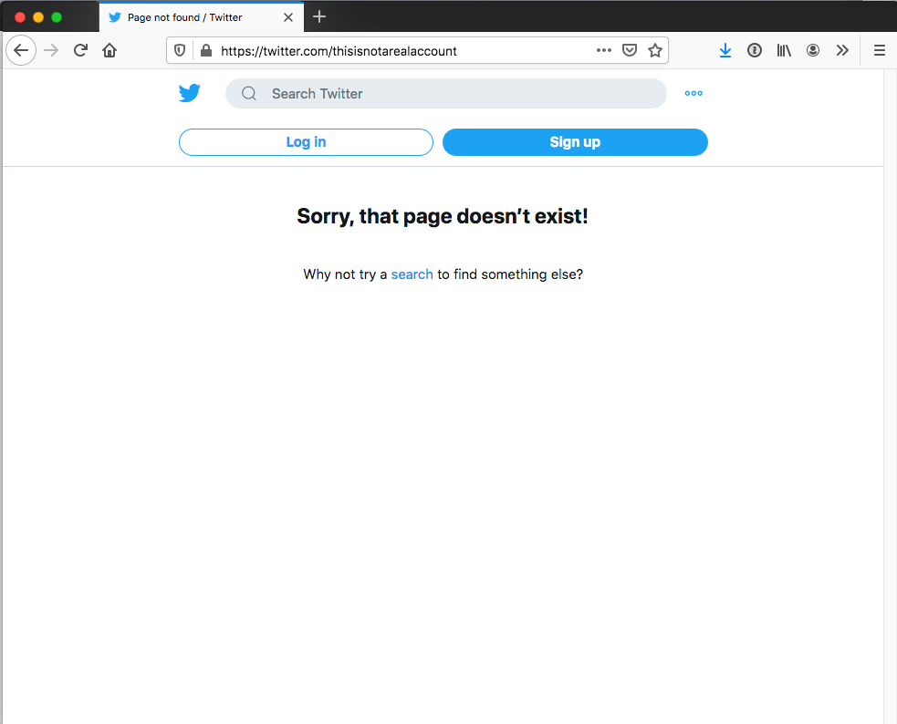

Slide 40
% curl -Ik https://ww2.odu.edu/asdflaksdfjaldkf
HTTP/1.1 404 Not Found
Date: Mon, 29 Jun 2020 17:54:43 GMT
Server: Apache
Vary: Accept-Encoding,User-Agent
X-XSS-Protection: 1; mode=block
Content-Type: text/html
% curl -Ik https://www.cs.odu.edu/asldkfasjdlfk
HTTP/1.1 404 Not Found
Server: nginx
Date: Mon, 29 Jun 2020 17:54:48 GMT
Content-Type: text/html; charset=iso-8859-1
Connection: keep-alive
curl -I https://twitter.com/thisisnotarealaccount
HTTP/2 200
content-type: text/html; charset=utf-8
date: Mon, 29 Jun 2020 17:54:13 GMT
expiry: Tue, 31 Mar 1981 05:00:00 GMT
last-modified: Mon, 29 Jun 2020 17:54:13 GMT
pragma: no-cache
server: tsa_b
strict-transport-security: max-age=631138519
vary: Accept-Encoding
x-content-type-options: nosniff
x-frame-options: DENY
x-powered-by: Express
x-response-time: 48
x-xss-protection: 0
% curl -I http://google.com/asdlfsdflk
HTTP/1.1 404 Not Found
Content-Type: text/html; charset=UTF-8
Referrer-Policy: no-referrer
Content-Length: 1571
Date: Mon, 29 Jun 2020 17:54:04 GMT

Slide 41
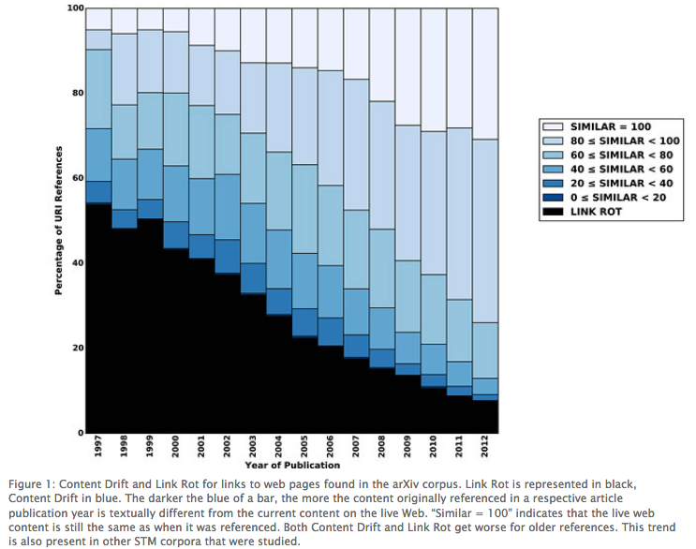
Content Drift
Jones, Van de Sompel, Shankar, Klein, Tobin, Grover (2016) "Scholarly Context Adrift: Three out of Four URI References Lead to Changed Content". PLoS ONE 11(12): e0167475.

Slide 42
Objectives
Characterize the growth of the Web during the 1990s.
Explain what it means that some web characteristics exhibit a power law distribution.
Explain how researchers use search engines to estimate the size of the web.
Differentiate between the concepts of link rot and content drift.

