Slide 1
Web Science:
Selection & Social Influence
(Part 1 - Homophily)
CS 432/532
Old Dominion University
Permission has been granted to use these slides from Frank McCown, Michael L. Nelson, Alexander Nwala, Michele C. Weigle
This work is licensed under a Creative Commons Attribution-NonCommercial-ShareAlike 3.0 Unported License

Slide 2
Most slides based on Ch 4 (“Networks in Their Surrounding Contexts”) of Networks, Crowds and Markets by Easley & Kleinberg (2010)
(abbreviated as EK10)

Slide 3
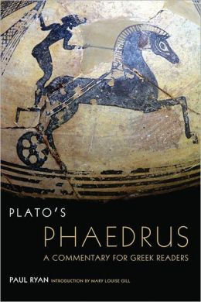
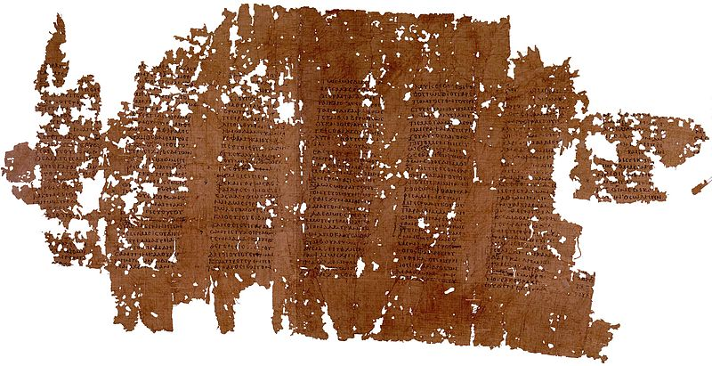
The old proverb says that
"birds of a feather flock together";
I suppose that equality of years inclines
them to the same pleasures, and
similarity begets friendship; …
Phaedrus by Plato
Phaedrus (dialogue) (Wikipedia)
(ca. 370BC)

Slide 4

Homophily
Your friends are more similar to you in age, race, interests, opinions, etc. than a random collection of individuals
Homophily: principle that we tend to be similar to our friends

Slide 5
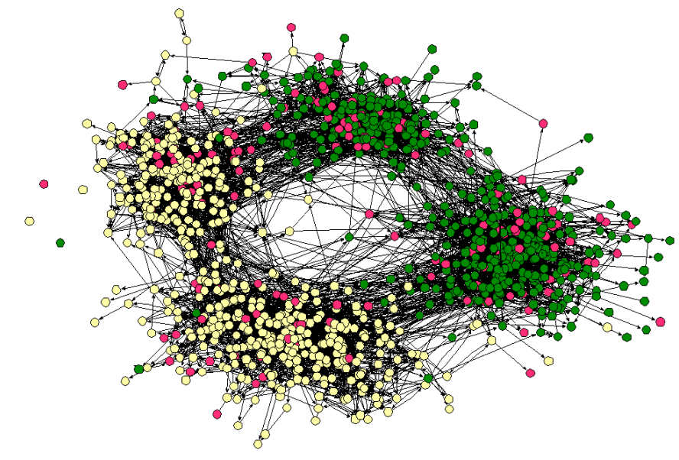
Social network from town's middle and high schools
middle school
high school
Clustering by race
Moody, Race, School Integration, and Friendship Segregation in America (2001)

Slide 6
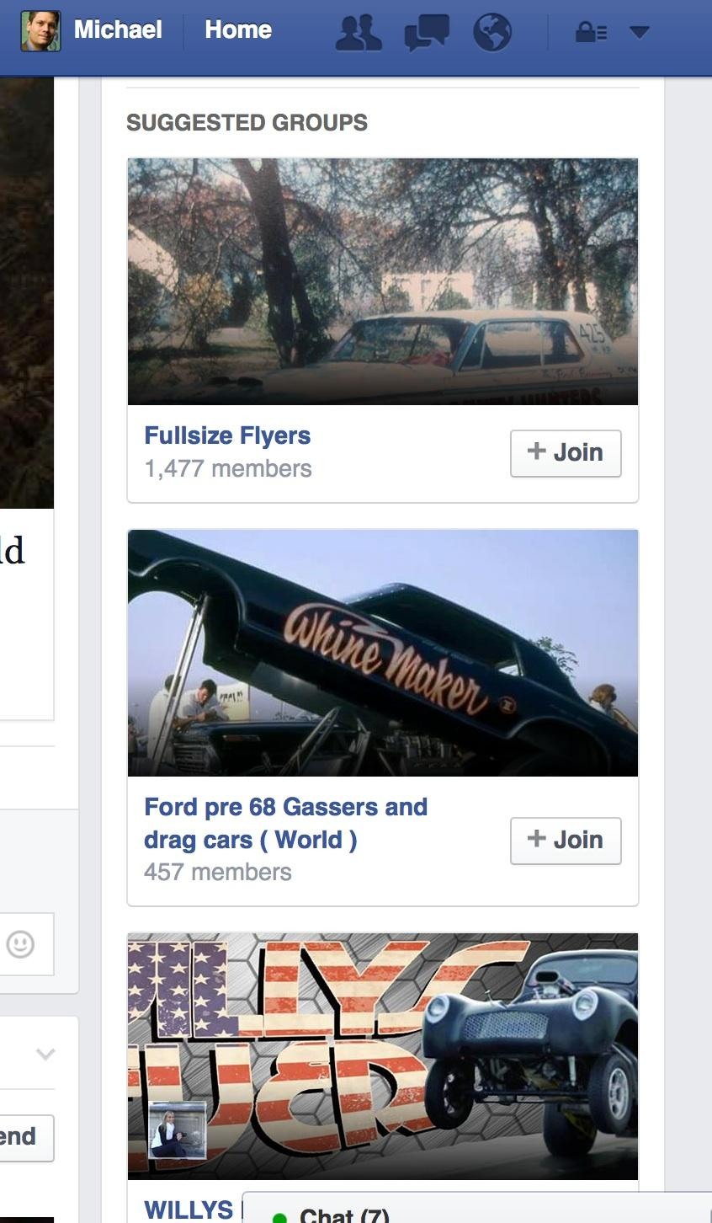
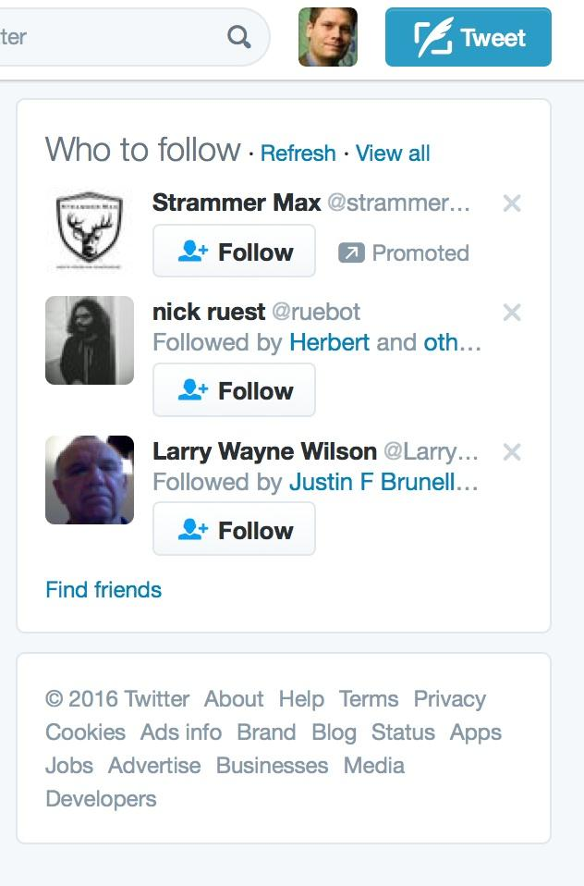
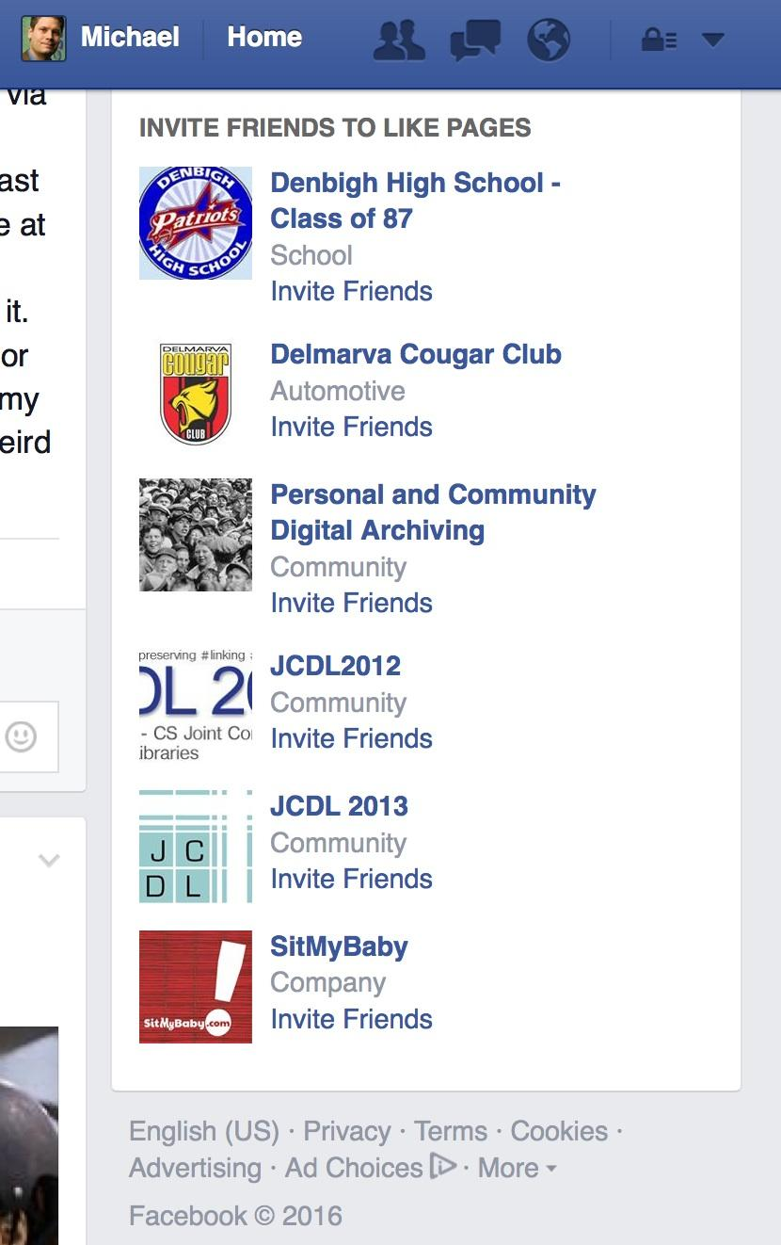
Q: Why Do We Study This? A: Recommending edges in the graph is life blood of social networks
Twitter recommending people
for Dr. Nelson to follow
Facebook recommending to Dr. Nelson groups for him to recommend to his friends
Facebook recommending
groups for Dr. Nelson

Slide 7
Homophily and Triadic Closure
Triadic closure: When two individuals share a common friend, a friendship between the two is more likely to occur
Homophily suggests two individuals are more alike because of common friend, so link may occur even if neither is aware of mutual friend!
Difficult to attribute formation of link to any one factor

Slide 8
Can we develop a simple test for the presence of homophily?

Slide 9
Example Male/Female Network
What would this network look like if it did not exhibit homophily?

Slide 10
Randomly Generated Network
Randomly assigned a gender according to gender balance of real network
Number of cross-gender edges should not change significantly relative to real network
If fraction p are males and q are females:
p² = 0.45
2pq = 0.44
q² = 0.11

Slide 11
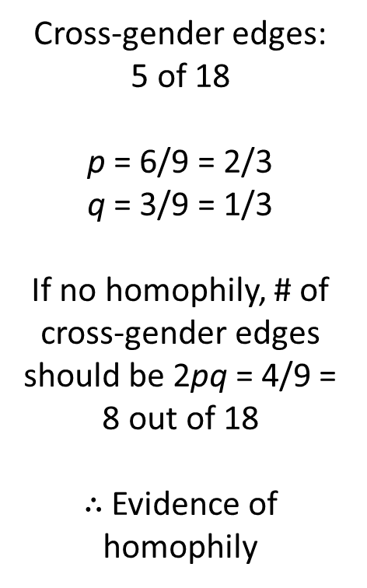
Homophily Test: If the fraction of heterogeneous (cross-gender) edges is significantly less than 2pq then there is evidence for homophily

Slide 12
Notes on Homophily Test
"significantly less than" – How significant? A deviation below the mean is suitable
What if network had significantly more than 2pq cross-gender edges?
Inverse homophily (i.e., "heterophily")
Example: Male-Female dating relationships

Slide 13
Notes on Homophily Test
Homophily test can be used to test any characteristic like race, age, native language, preferences, etc.
For characteristics that have more than 2 values, can perform a general version of the same type of calculation

Slide 14
Web Science:
Selection & Social Influence
(Part 2 - Selection and Social Influence)
CS 432/532
Old Dominion University
Permission has been granted to use these slides from Frank McCown, Michael L. Nelson, Alexander Nwala, Michele C. Weigle
This work is licensed under a Creative Commons Attribution-NonCommercial-ShareAlike 3.0 Unported License

Slide 15
Most slides based on Ch 4 (“Networks in Their Surrounding Contexts”) of Networks, Crowds and Markets by Easley & Kleinberg (2010)
(abbreviated as EK10)

Slide 16
Selection
Why is homophily often present in a social network? Selection
Selection: People tend to choose friends who are like themselves

Slide 17
Selection
Can operate at different scales and levels of intentionality
You actively choose friends that are like yourself among a small group of people
Your school's population is relatively homogeneous compared to overall population, so your environment compels you to choose friends like yourself

Slide 18
Mutable and Immutable Characteristics
Selection operates differently based on type of characteristic
Immutable: Characteristics that don't change (gender, race) or change consistently with the population (age, generation)
Mutable: Characteristics that can change over time (behaviors, beliefs, interests, opinions)

Slide 19
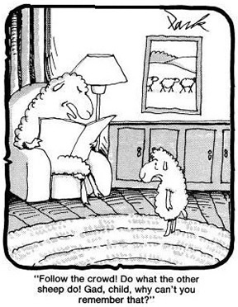
Social Influence
Research has shown that (surprise!) people are susceptible to social influence:
they may change their behaviors to more closely resemble the behaviors of their friends
Cartoon credit: https://www.cartoonstock.com/directory/r/remember_to_follow_the_crowd.asp

Slide 20
Selection and Social Influence
Social influence is reverse of selection
Selection: Individual characteristics drive the formation of links
Social influence: Existing links shape people's mutable characteristics
Selection
Characteristics
Links
Social Influence

Slide 21
Longitudinal Studies
Difficult to tell if selection or social influence at play with a single snapshot of a network
Longitudinal studies tracking social connections and individual behaviors over time can help researchers uncover effect of social influence
Does behavior change after changes to network, or does network change after changes in behavior?

Slide 22
Example: Teenage Drug Use
Is drug use affected more by selection or social influence?
Understanding these effects can be helpful in developing interventions
If drug use displays homophily in a network, targeting social influence (get friends to influence other friends to stop) might work best
But if homophily due to selection, former drug users may choose new friends and drug-using behavior of others is not strongly affected

Slide 23
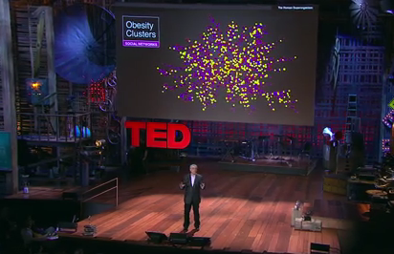
Social Influence of Obesity
Christakis and Fowler tracked obesity status and social network of 12,000 people over 32 years
Found homophily based on obesity status
They wanted to know why
Nicholas Christakis: The hidden influence of social networks | TED Talk
Christakis & Fowler, The Spread of Obesity in a Large Social Network over 32 Years (2007)

Slide 24
Why Obesity Homophily?
Selection effects – people choose to befriend others of similar obesity status?
Confounding effects of homophily – other factors that correlate with obesity status?
Social influence – if friends changed their obesity status, did it influence person's future obesity status?
Discovered significant evidence for hypothesis 3 as well as 1 and 2: Obesity is a type of “contagion” that can spread through social influence!
Christakis & Fowler, The Spread of Obesity in a Large Social Network over 32 Years (2007)

Slide 25
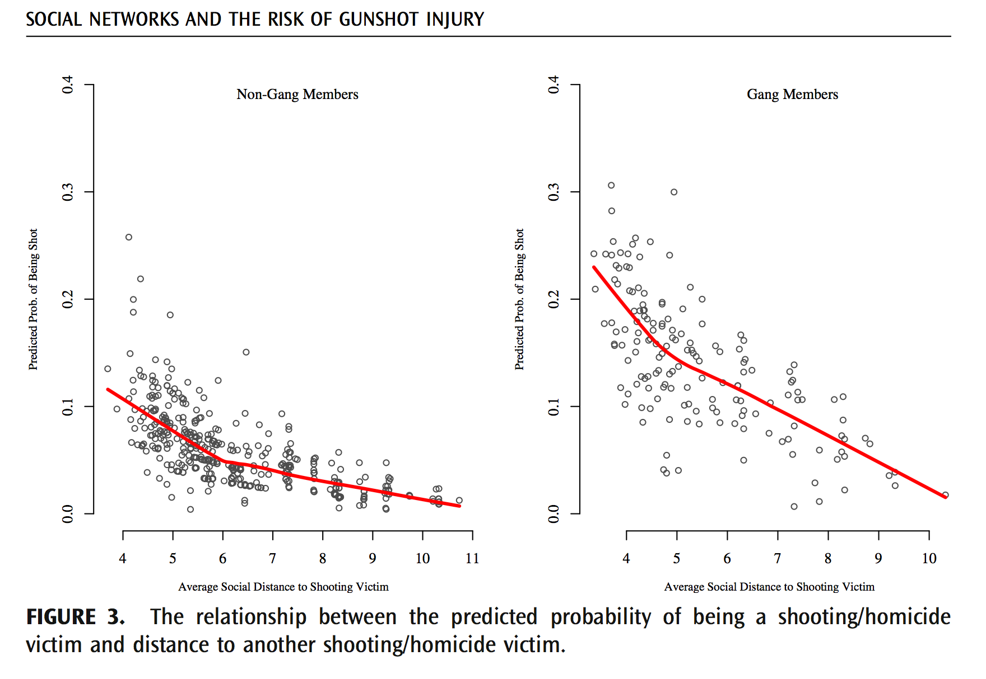
Homicide is Also Contagious
(Boston, link=observed colocation by police)
Papachristos, Braga, Hureau, “Social Networks and the Risk of Gunshot Injury”, 2012,

Slide 26
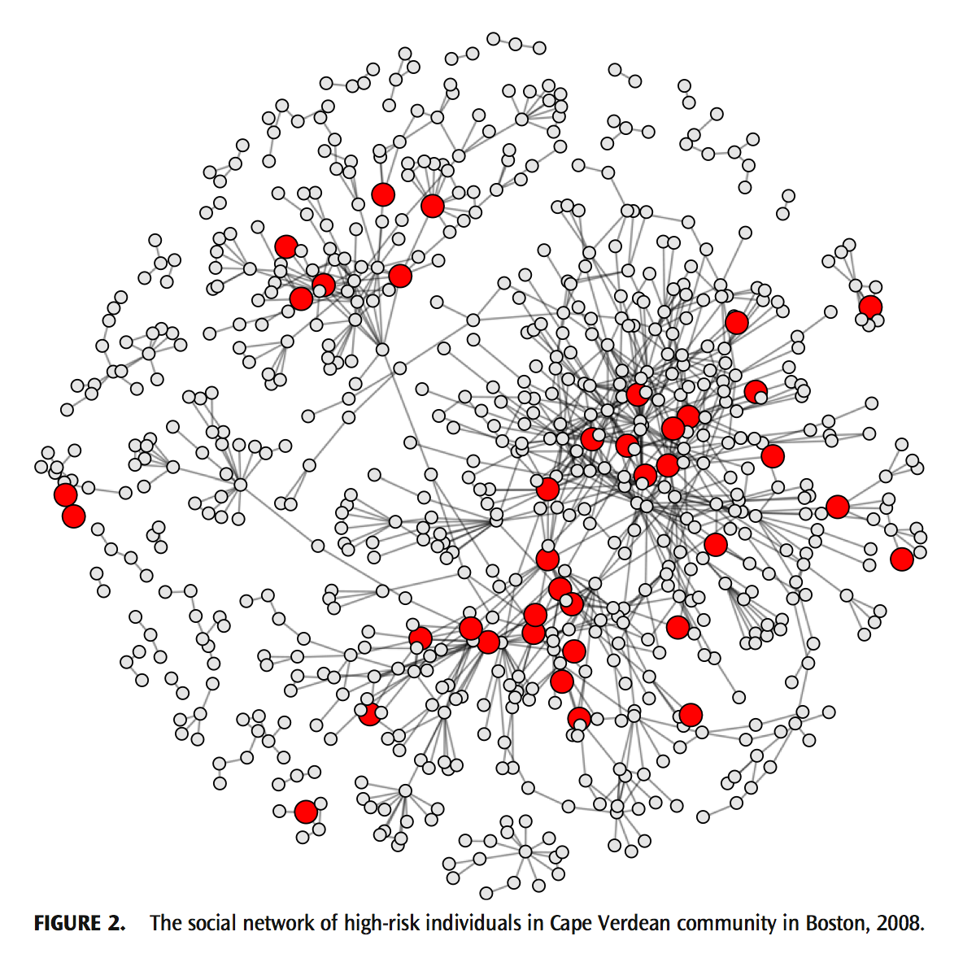
85% of Victims in Giant Component
(Boston, link=observed colocation by police)
Probability of gunshot victimization is related to one’s network distance to other gunshot victims
Papachristos, Braga, Hureau, “Social Networks and the Risk of Gunshot Injury”, 2012,

Slide 27
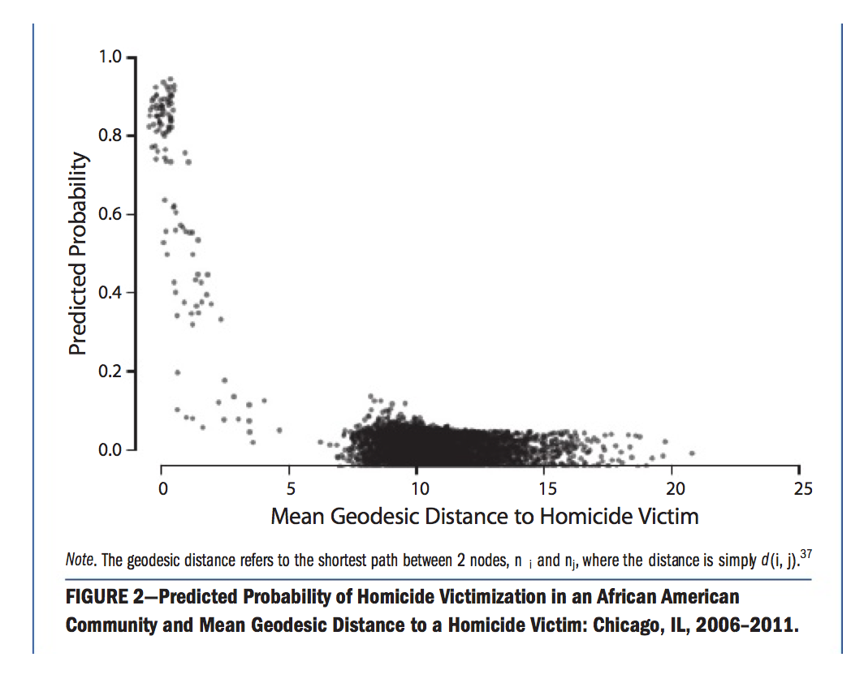
41% of Homicides in 4% of Population
Link=co-offending arrest records
Study: Odds Of Being Murdered Closely Tied To Social Networks, NPR, 2013
Papachristos and Wildeman, “Network Exposure and Homicide Victimization in an African American Community”, 2013

Slide 28
Web Science:
Selection & Social Influence
(Part 3 - Affiliation and Closure)
CS 432/532
Old Dominion University
Permission has been granted to use these slides from Frank McCown, Michael L. Nelson, Alexander Nwala, Michele C. Weigle
This work is licensed under a Creative Commons Attribution-NonCommercial-ShareAlike 3.0 Unported License

Slide 29
Most slides based on Ch 4 (“Networks in Their Surrounding Contexts”) of Networks, Crowds and Markets by Easley & Kleinberg (2010)
(abbreviated as EK10)

Slide 30
Social-Affiliation Network
Putting context into the network by showing connections to activities, companies, organizations, neighborhoods, etc.
Bipartite graph: every edge joins two nodes belonging to different sets (and no edges join nodes that belong to the same set)
Sue
Chess Club
Affiliations, or foci
Bill
Band

Slide 31
Social-Affiliation Network
Two types of edges:
Person to person: Friendship or other social relationship
Person to foci: Participation in the focus
Gary
Sue
Chess Club
Alice
Band
Bill

Slide 32
Closure Processes
Gary
Sue
Triadic closure
Alice
Focal closure: closure due to selection
Band
Sue
Bill
Membership closure: closure due to social influence
Sue
Band
Gary

Slide 33
Research Questions About Closure
Focal closure: What is the probability that two people form a link as a function of the number of foci they are jointly affiliated with?
Membership closure: What is the probability that a person becomes involved in a particular focus as a function of the number of friends who are already involved in it?
Band
Sue
Bill
Ping Pong
Sue
Band
Gary
Jill

Slide 34
Research Questions About Closure
Would Sue be more likely to become friends with Alice if they shared more than one friend?
In other words, is triadic closure dependent on the number of shared friends?
More formally: What is the probability that two people form a link as a function of the number of mutual friends they share?
Gary
Sue
Gary
Sue
Alice
Alice
Moe

Slide 35
Research Methodology: Measuring Triadic Closure
Take two snapshots of network at times t₁ and t₂
For each k, identify all pairs of nodes who have exactly k friends in common at t₁ but who are not directly connected by an edge
Define T(k) to be fraction of these pairs that form an edge by t₂. This is the probability that a link will form between two people with k friends in common
Plot T(k) as function of k to illustrate effect of common friends on link formation
main idea: k=0, we might become friends, but chances (T(0)) are low
k=10, we have a lot of friends in common, so chances (T(10)) are high

Slide 36
Research Methodology: Measuring Triadic Closure
Take two snapshots of network at times t₁ and t₂
t₁
t₂

Slide 37
Research Methodology: Measuring Triadic Closure
2. For each k, identify all pairs of nodes who have exactly k friends in common at t₁ but who are not directly connected by an edge
k = 0
t₁
t₂

Slide 38
Research Methodology: Measuring Triadic Closure
2. For each k, identify all pairs of nodes who have exactly k friends in common at t₁ but who are not directly connected by an edge
k = 0
t₁
t₂

Slide 39
Research Methodology: Measuring Triadic Closure
2. For each k, identify all pairs of nodes who have exactly k friends in common at t₁ but who are not directly connected by an edge
k = 0
t₁
t₂

Slide 40
Research Methodology: Measuring Triadic Closure
2. For each k, identify all pairs of nodes who have exactly k friends in common at t₁ but who are not directly connected by an edge
k = 1
k = 2,
etc.
t₁
t₂

Slide 41
Research Methodology: Measuring Triadic Closure
3. Define T(k) = fraction of pairs that form an edge by t₂. This is the probability that a link will form between two people with k friends in common
T(1) = 1/1
T(0) = 1/11
t₁
t₂

Slide 42
Research Methodology: Measuring Triadic Closure
4. Plot T(k) as function of k to illustrate effect of common friends on link formation
T(k)
Prob of link
formation
k
Friends in common

Slide 43
Web Science:
Selection & Social Influence
(Part 4 - Closure in Real-World Networks)
CS 432/532
Old Dominion University
Permission has been granted to use these slides from Frank McCown, Michael L. Nelson, Alexander Nwala, Michele C. Weigle
This work is licensed under a Creative Commons Attribution-NonCommercial-ShareAlike 3.0 Unported License

Slide 44
Most slides based on Ch 4 (“Networks in Their Surrounding Contexts”) of Networks, Crowds and Markets by Easley & Kleinberg (2010)
(abbreviated as EK10)

Slide 45
Email Social Network
Kossinets and Watts (2006) examined email communication of 22,000 students over one year at a large US university
Made link between two people if an email was sent between the two in the last 60 days
Each snapshot is one day apart
T(k) averaged over multiple pairs of snapshots

Slide 46
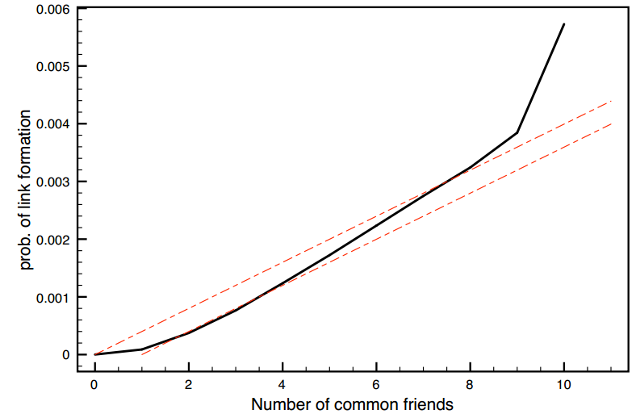
Triadic Closure in Email Data Set
empirical
simple model
Almost no emails exchanged when no friends in common
more conservative simple model
Figure 4.9 from [EK10]

Slide 47
Triadic Closure in Email Data Set
Significant increase but on much smaller subpopulation
Significant increase going from 1 to 2 friends
Figure 4.9 from [EK10]

Slide 48
Triadic Closure in Email Data Set
Baseline model: probability p of forming link when k friends in common T_{base}(k) = 1 – (1 – p)^{k}
p = probability of sending email,
each k relationship is independent
(not completely realistic)
T_{base}(k) = 1 – (1 – p)^{k-1}
Figure 4.9 from [EK10]

Slide 49
Email Social Network
To evaluate focal closure, Kossinets and Watts obtained class schedules for 22,000 students
Created social-affiliation network where classes are foci
Determined probability of link formation as function of number of shared foci
ENG 101
Sue
Bill
HIST 202

Slide 50
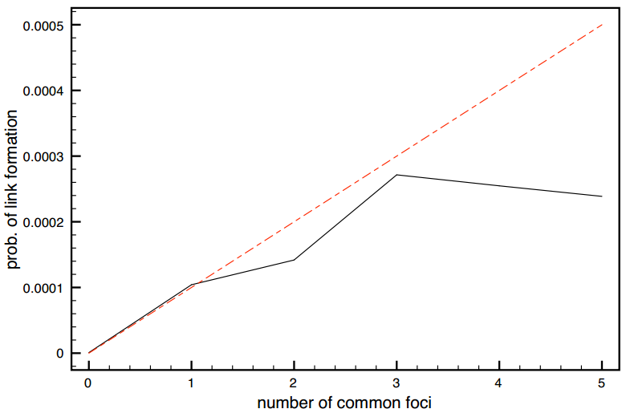
Focal Closure in Email Data Set
T_{base}(k) = 1 – (1 – p)^{k}
Sharing a class has nearly same effect as sharing a friend
Diminishing returns
(if we share 3+ classes and we're still not friends, I just don't like you)
Figure 4.10 from [EK10]

Slide 51
Measuring Membership Closure
Backstrom et al. (2006) created social-affiliation network for LiveJournal
Friendships designated by users in their profile
Foci are membership in user-defined communities
Sue
Jazz Comm
Gary
Jill

Slide 52
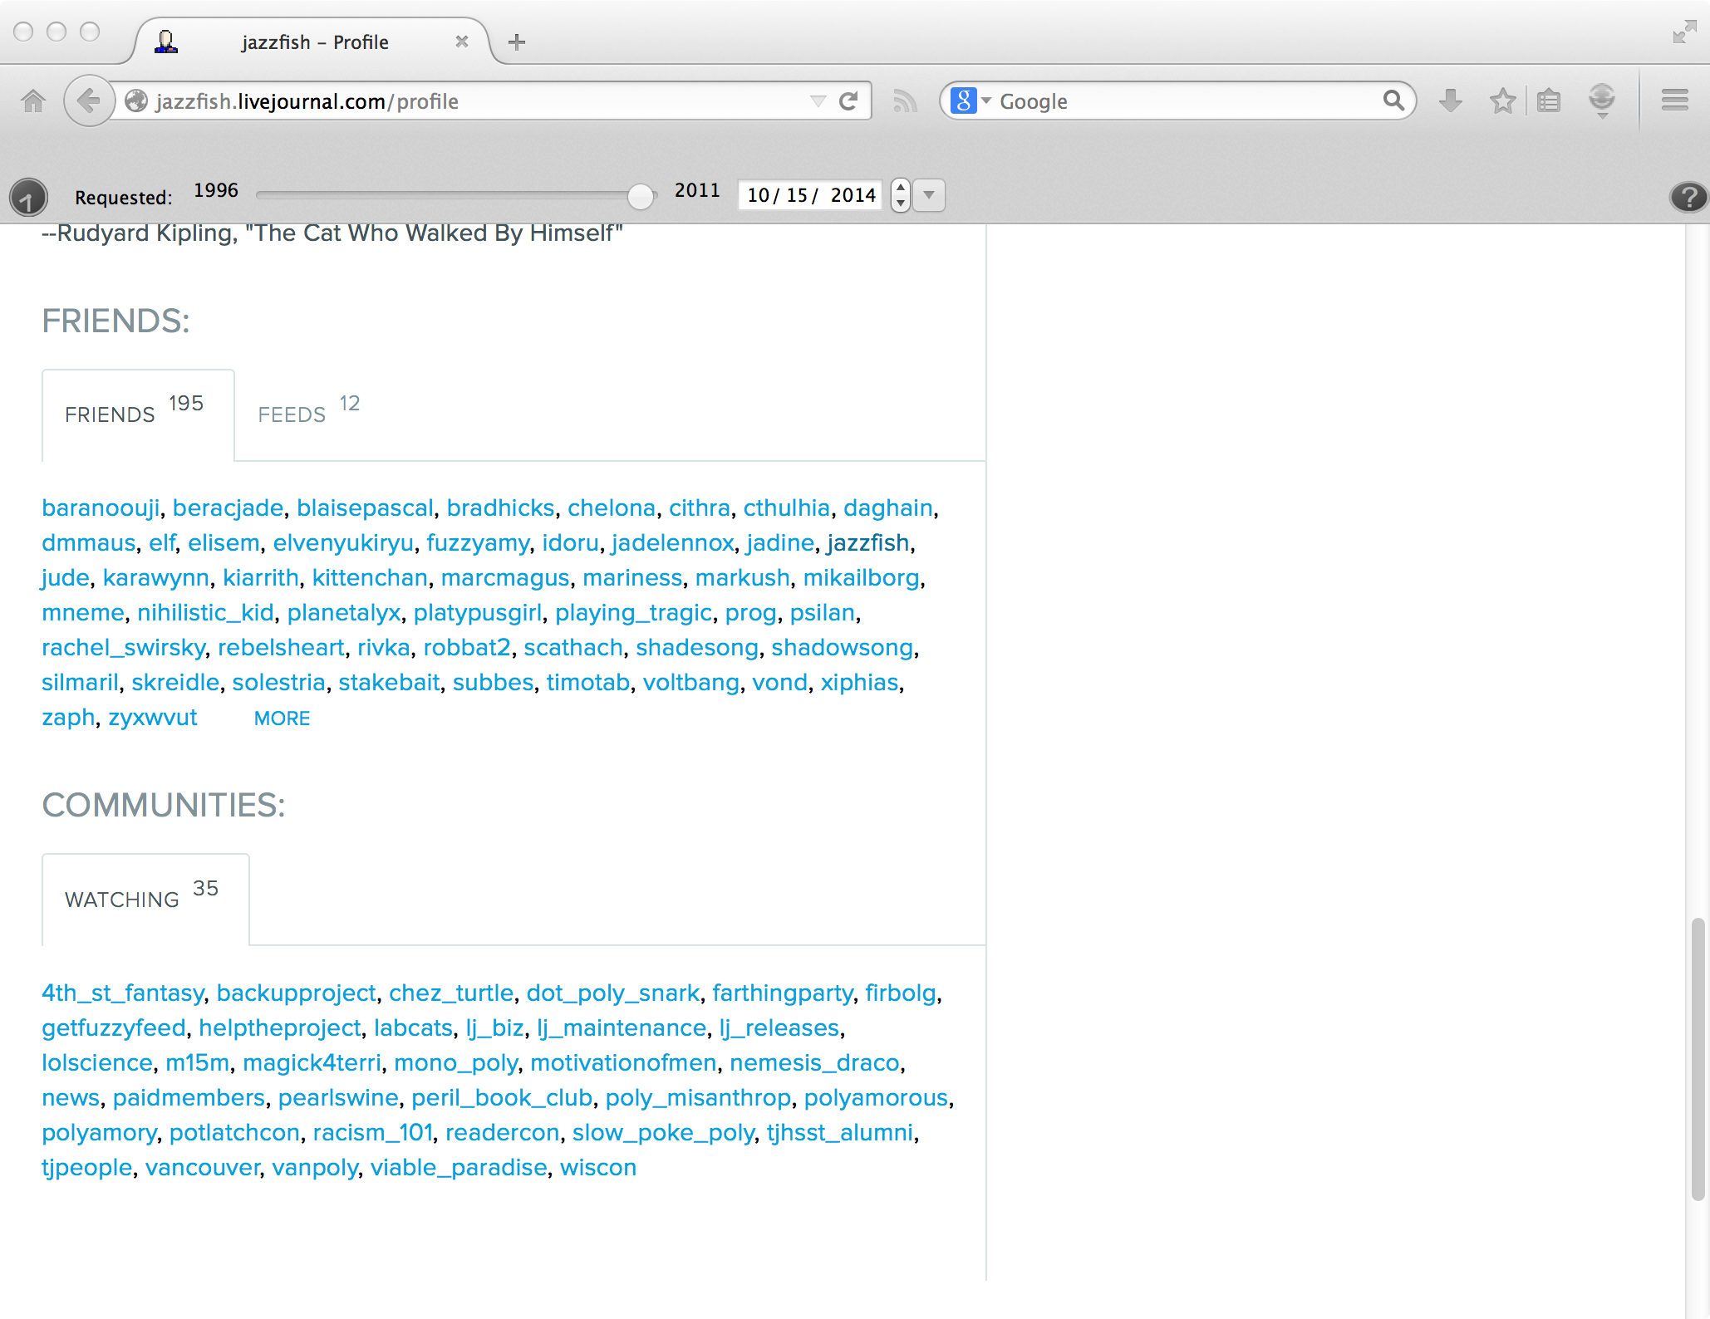
LiveJournal User Profile Example
jazzfish - LiveJournal

Slide 53
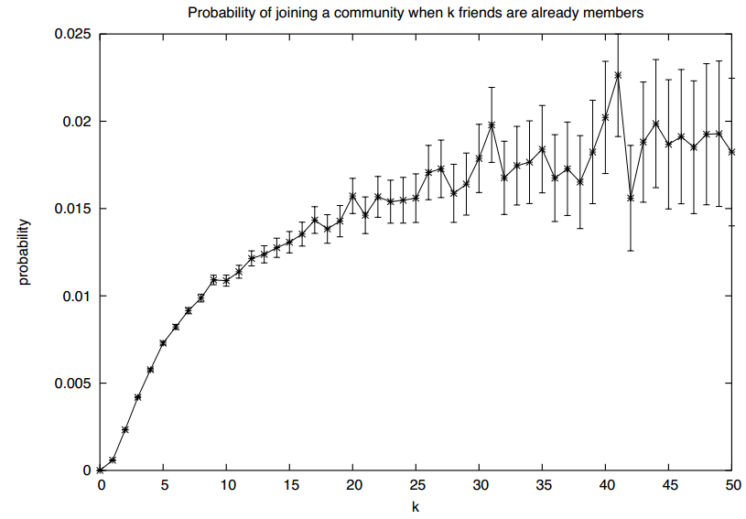
Membership Closure in LiveJournal Data Set
Diminishing returns
Significant increase going from 1 to 2
Figure 4.11 from [EK10]

Slide 54
Measuring Membership Closure
Crandall et al. (2008) created social-affiliation network for Wikipedia
Node for editors maintaining a user talk page
Link if two editors have communicated using talk page(s)
Foci are articles edited by editors
Sue
Jazz Article
Gary
Jill

Slide 55
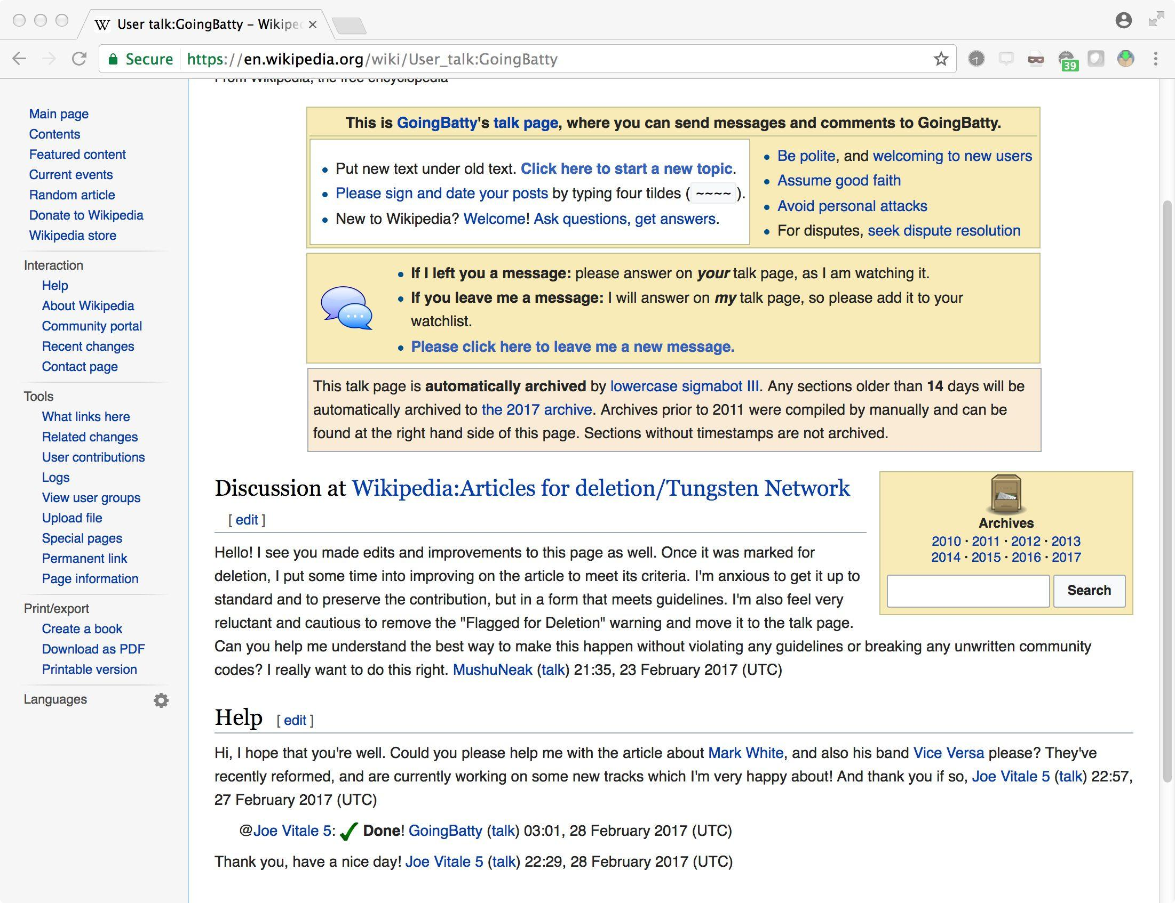
Wikipedia User Talk Pages

Slide 56
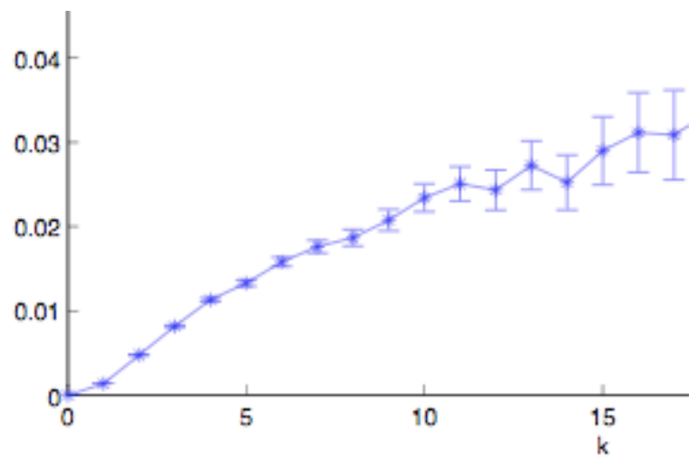
Membership Closure in Wikipedia Data Set
T(k)
Significant increase going from 1 to 2
Diminishing returns
Figure 4.12 from [EK10]

Slide 57
Selection and Social Influence
Further examination of Wikipedia data set to see evidence of homophily produced by selection and social influence
How do we measure similarity of two editors?
number of articles edited by both editors number of articles edited by at least one editor
Similar to neighborhood overlap of two editors in an affiliation network of editors and articles

Slide 58
Selection and Social Influence
Pairs of Wikipedia editors who have communicated are significantly more similar in behavior than editors who have never communicated
Does homophily arise because…
editors are talking with editors who have edited the same article? (selection)
editors are led to the articles by those they talk to? (social influence)

Slide 59
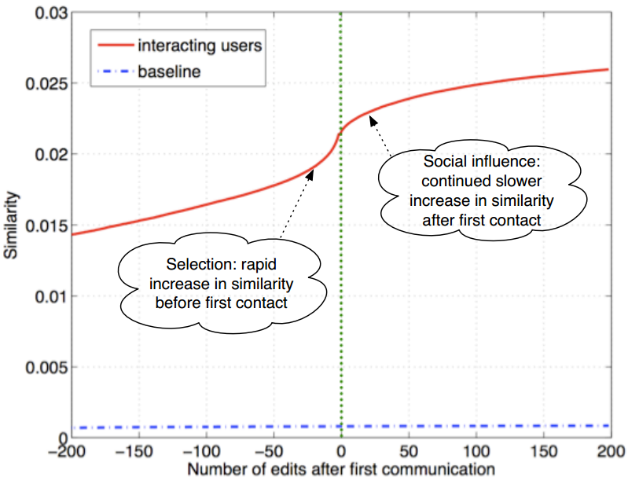
+ = since averaged over many pairs,
tells us more than anecdotes
- = does not inform us re: any single pair
Figure 4.13 from [EK10]

Slide 60
Objectives
Define homophily.
Explain how selection affects homophily.
Explain how social influence affects homophily.
Explain the difference between focal closure and membership closure in a social-affiliation network.
Explain the process/steps for measuring how triadic closure is dependent upon the number of shared friends.

