Slide 1
Web Science:
Clustering Algorithms
(Part 1 - Intro to Clustering and Preparing the Data)
CS 432/532
Old Dominion University
Permission has been granted to use these slides from Frank McCown, Michael L. Nelson, Alexander Nwala, Michele C. Weigle
This work is licensed under a Creative Commons Attribution-NonCommercial-ShareAlike 3.0 Unported License

Slide 2
Main reference:
Ch 3 from Programming Collective Intelligence by Toby Segaran
(abbreviated as PCI)
Ch 3 GitHub repo

Slide 3
From Similarity to Clusters...
Ch 2 - compute similarity between pairs of items
Ch 3 - discover and group (cluster) things that are similar
We want to cluster our information because we want to:
find unknown groups or patterns
visualize our results

Slide 4
Supervised vs. Unsupervised Learning
Clustering is an example of unsupervised learning
we don't know what the correct answer is before we start
Supervised learning is based on first being provided a set of inputs and known outputs
supervised learning examples in later chapters

Slide 5
First Things First…
Items to be clustered need numerical scores that "describe" the items
Some examples:
customers can be described by the amount of purchases they make each month
movies can be described by the ratings given to them by critics
documents (and webpages) can be described by the number of times they use certain words

Slide 6
Finding Similar Webpages
Given N webpages, how would we cluster them?
documents (and webpages) can be described by the number of times they use certain words
Extract terms
break each string by whitespace
convert to lowercase
remove HTML tags (boilerplate removal)
Find frequency of each term in each document
remove common terms (i.e., stop words, high TF) and very unique terms (i.e., high IDF)

Slide 7
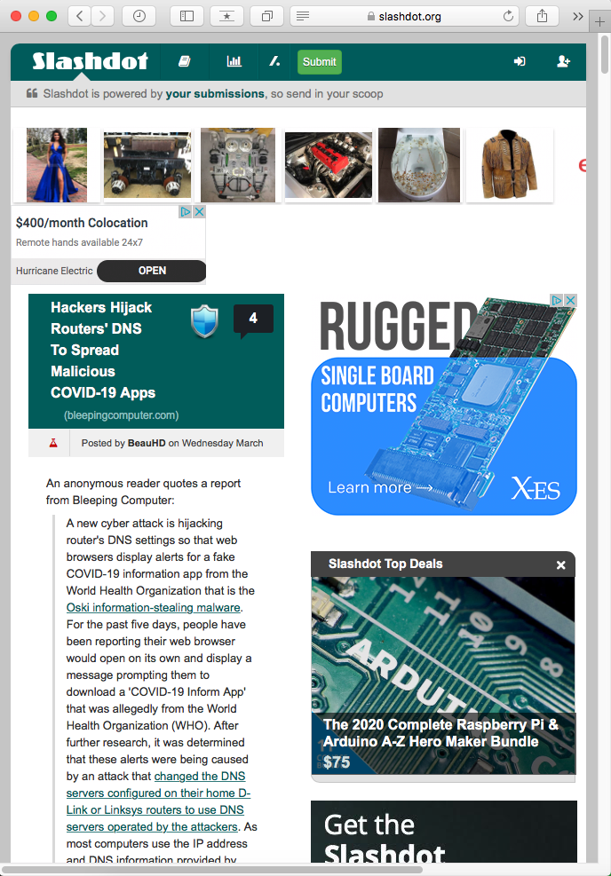
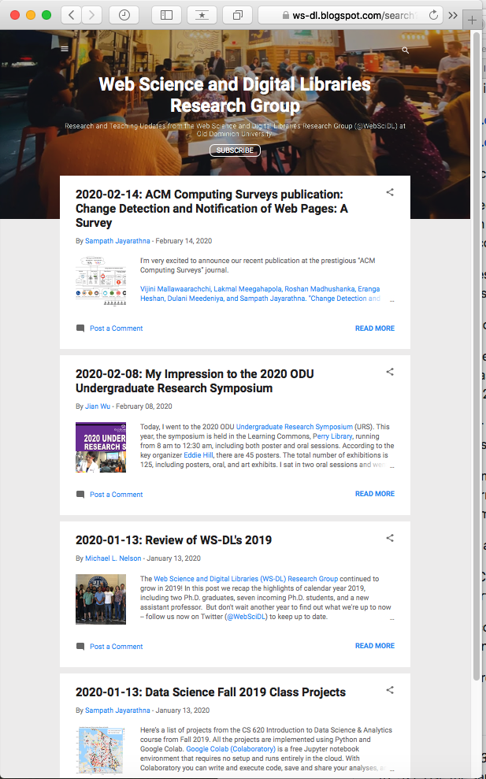
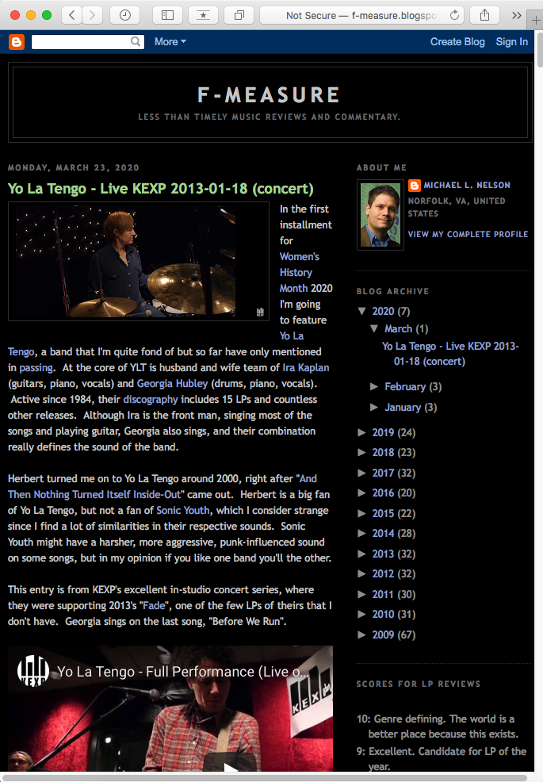
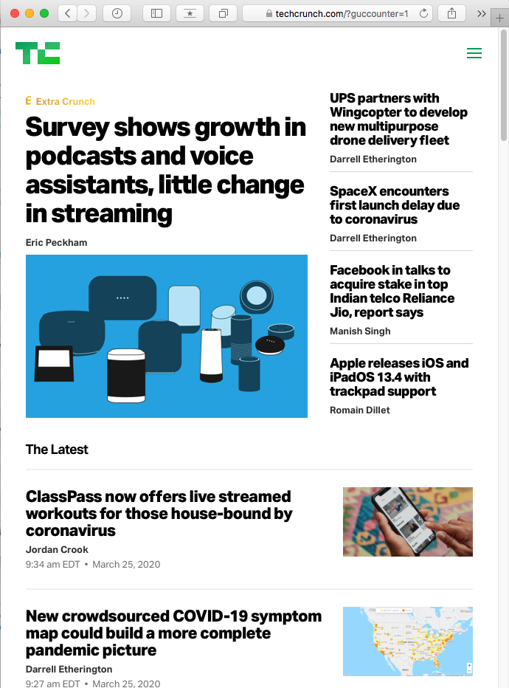
Blogs

Slide 8
Grabbing Blog Feeds
Humans read blogs, newsfeeds, etc. in HTML, but machines read blogs in the XML-based syndication formats RSS or Atom
RSS (Wikipedia)
Atom (Web standard) (Wikipedia)
These feeds contain a number of blog posts and include the blog post title and often the full text of each blog post

Slide 9
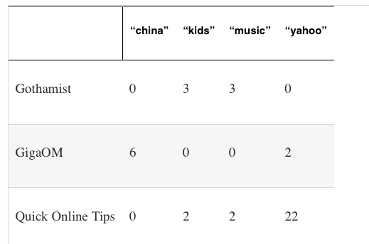
Creating a Blog-Term Matrix
Table 3-1 from PCI - Subset of blog word frequencies

Slide 10
Code for Creating a Blog-Term Matrix
Beginning of generatefeedvector.py
Code on pp. 31-32 for grabbing feeds, getting terms from title and summary (RSS) or description (Atom)
Sample feed URIs in chapter3/feedlist.txt
Sample blog-term matrix in chapter3/blogdata.txt
# Returns title and dictionary of
# word counts for an RSS feed
def getwordcounts(url):
# Parse the feed
d=feedparser.parse(url)
wc={}
# Loop over all the entries
# description==RSS; summary==Atom
for e in d.entries:
if 'summary' in e: summary=e.summary
else: summary=e.description
# Extract a list of words
words=getwords(e.title+' '+summary)
for word in words:
wc.setdefault(word,0)
wc[word]+=1
return d.feed.title,wc
Ch 3 GitHub repo

Slide 11


PCI Code "Fakes" Stopwords, TF-IDF
Stop word (Wikipedia)
Stopwords - most common words in a language
"the", "and", "in", …
Can be approximated with words that have high TF
Very unique words - may only appear in a single blog
Can be approximated with words that have high IDF
low IDF means that it appears in many docs
Intuition
term that appears in many documents will get a low IDF; that term is not what the document is "about"
term that appears in just one or a few documents is a good discriminator and will get a high IDF; if appears in that document a lot, it will also get a high TF and the resulting high TF-IDF means that term captures the "aboutness" of the document

Slide 12
PCI Code "Fakes" Stopwords, TF-IDF
wordlist=[]
for w,bc in apcount.items():
frac=float(bc)/len(feedlist)
if frac>0.1 and frac<0.5:
wordlist.append(w)
apcount is an array that indicates how many blogs each word appears in
w is the word
bc is the blog count
frac is the percentage of blogs that the word appears in
wordlist is the final list of words

Slide 13
Creating a Blog-Term Matrix
Table 3-1 from PCI - Subset of blog word frequencies
blogdata.txt

Slide 14
Web Science:
Clustering Algorithms
(Part 2 - Hierarchical Clustering and Dendrogram)
CS 432/532
Old Dominion University
Permission has been granted to use these slides from Michele C. Weigle
This work is licensed under a Creative Commons Attribution-NonCommercial-ShareAlike 3.0 Unported License

Slide 15
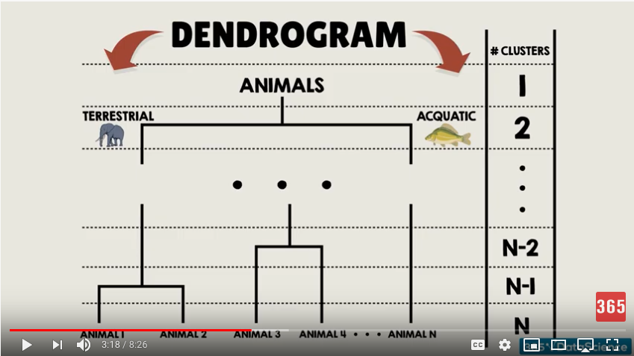
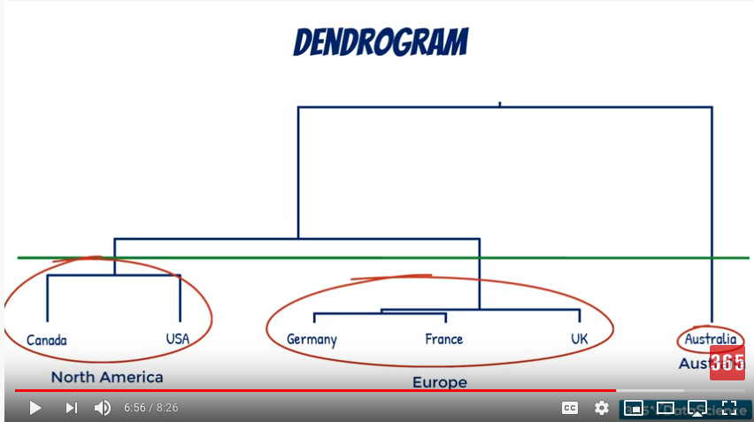
Hierarchical Clustering
These slides assume you have already watched the assigned 365 Data Science video on "Flat and Hierarchical Clustering | The Dendrogram Explained"

Slide 16
Main reference:
Ch 3 from Programming Collective Intelligence by Toby Segaran
(abbreviated as PCI)
Ch 3 GitHub repo

Slide 17
Remember the Blog-Term Matrix
Table 3-1 from PCI - Subset of blog word frequencies
blogdata.txt

Slide 18
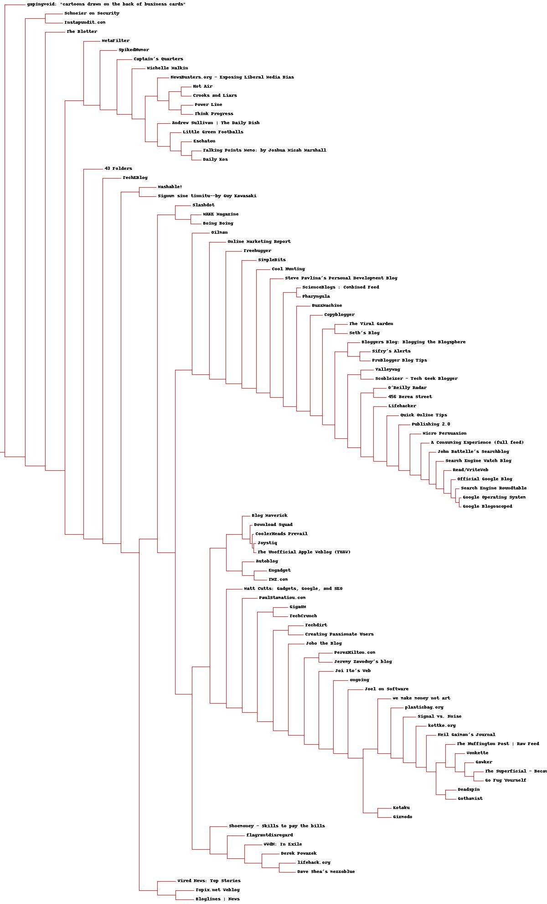
Working Towards a Dendrogram
Political blogs
Andrew Sullivan | The Daily Dish
Little Green Footballs
Eschaton
Talking Points Memo
Daily Kos
Tech blogs
Official Google Blog
Search Engine Roundtable
Google Operating System
Google Blogoscoped

Slide 19
General Functions
required imports
readfile(filename) - returns arrays of rownames, colnames, data
pearson(v1, v2) - returns Pearson correlation between two vectors of numbers
rotatematrix(data) - returns rotated matrix (rows become columns and columns become rows)
Original code: Ch 3 GitHub repo

Slide 20
Hierarchical Clustering
class bicluster - data structure to hold the clustering information
hcluster(rows, distance=pearson) - does the hierarchical clustering, default distance function is pearson()
printclust(clust, labels=None, n=0) - traverses the cluster and prints an ASCII text representation
Original code: Ch 3 GitHub repo

Slide 21
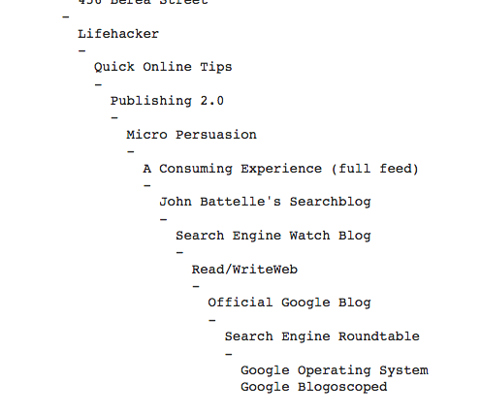
Example 1 (pg. 37)
Generate hierarchical cluster, print ASCII clusters
blognames, words, data = readfile("blogdata.txt")
clust = hcluster(data)
printclust(clust, labels=blognames)
Original code: Ch 3 GitHub repo

Slide 22
Drawing the Dendrogram
getheight(clust) - returns the total height of a given cluster
getdepth(clust) - returns the error depth of the cluster, the maximum possible error from each branch
drawdendrogram(clust, labels, jpeg='clusters.jpg') - creates a dendrogram image with the default name of clusters.jpg
drawnode(draw, clust, x, y, scaling, labels) - takes and cluster and its location, calculates where the child nodes should be, and draws lines to them
Original code: Ch 3 GitHub repo

Slide 23
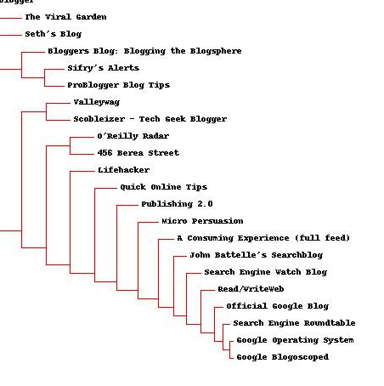
Example 2 (pg. 40)
Draw dendrogram
drawdendrogram(clust, blognames,
jpeg='blogclust.jpg')
Original code: Ch 3 GitHub repo

Slide 24
Generate a Term-Blog Matrix
Rotate the matrix
 | Gothamist | GigaOM | Quick Online Tips
"china" | 0 | 6 | 0
"kids" | 3 | 0 | 2
"music" | 3 | 0 | 2
"yahoo" | 0 | 2 | 22
Original code: Ch 3 GitHub repo

Slide 25
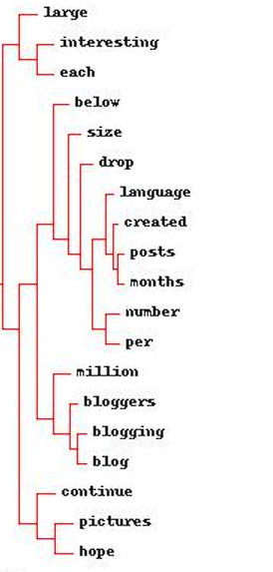
Example 3 (pg. 40)
Rotate the matrix, cluster, draw dendrogram of words
rdata = rotatematrix(data)
wordclust = hcluster(rdata)
drawdendrogram(wordclust, labels=words,
jpeg='wordclust.jpg')
Original code: Ch 3 GitHub repo

Slide 26
Python Libraries for Dendrograms
Plotly - Dendrograms | Python
SciPy - scipy.cluster.hierarchy.dendrogram
SciPy dendrogram tutorial/examples
#400 Basic Dendrogram
#401 Customised dendrogram
SciPy and sklearn - Plot Hierarchical Clustering Dendrogram

Slide 27
Web Science:
Clustering Algorithms
(Part 3 - k-Means Clustering)
CS 432/532
Old Dominion University
Permission has been granted to use these slides from Michele C. Weigle
This work is licensed under a Creative Commons Attribution-NonCommercial-ShareAlike 3.0 Unported License

Slide 28
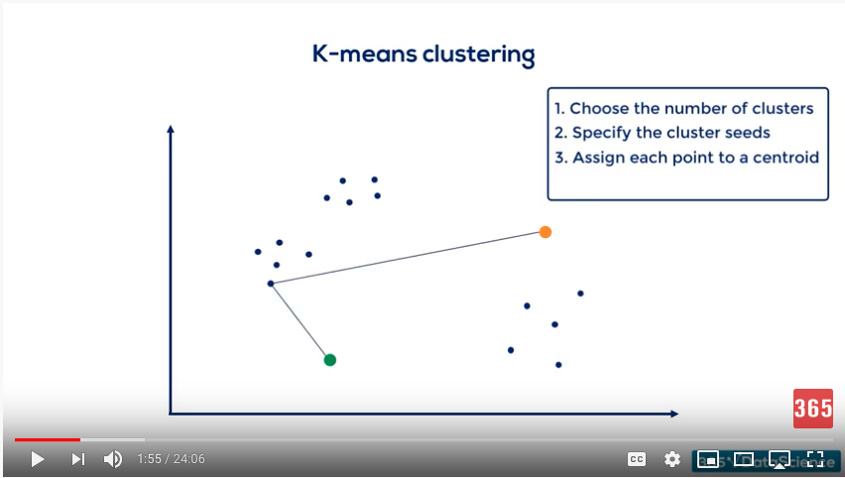
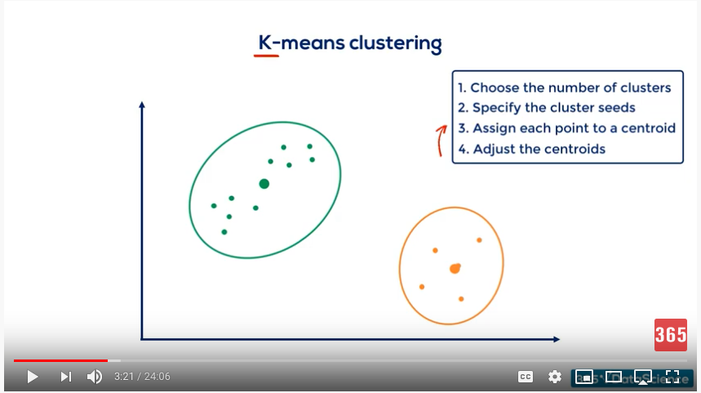
k-Means Clustering
These slides assume you have already watched up to time 4:44 of the assigned 365 Data Science video on "K Means Clustering: Pros and Cons of K Means Clustering"

Slide 29
Main reference:
Ch 3 from Programming Collective Intelligence by Toby Segaran
(abbreviated as PCI)
Ch 3 GitHub repo

Slide 30
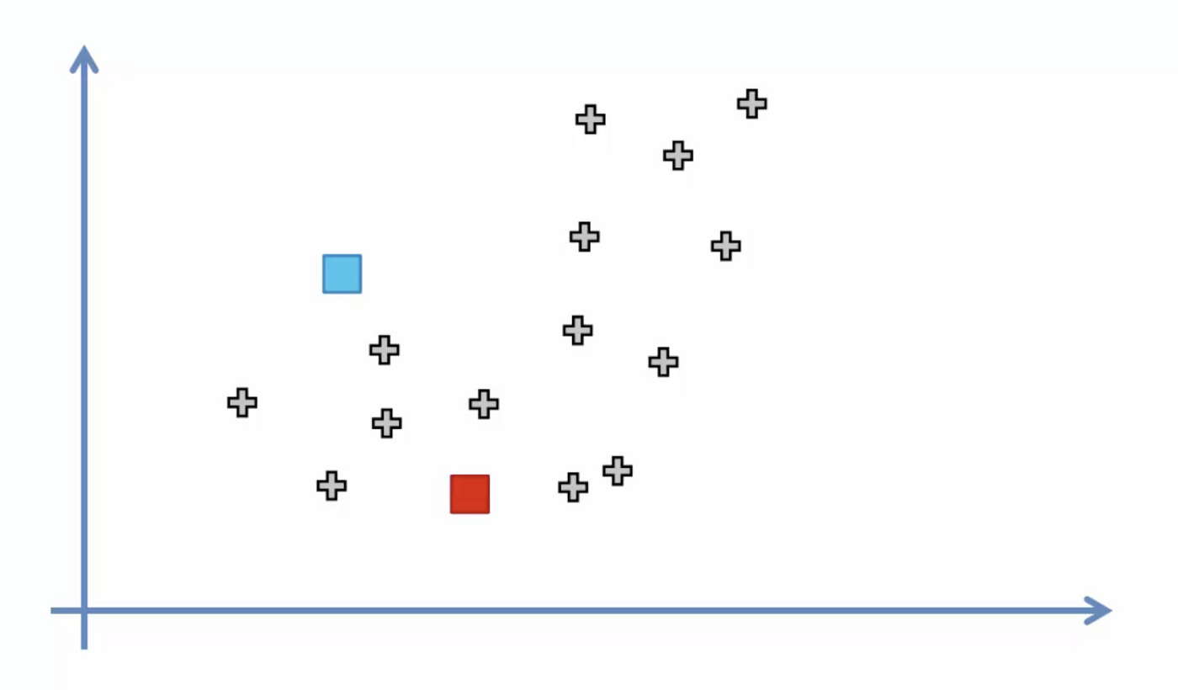
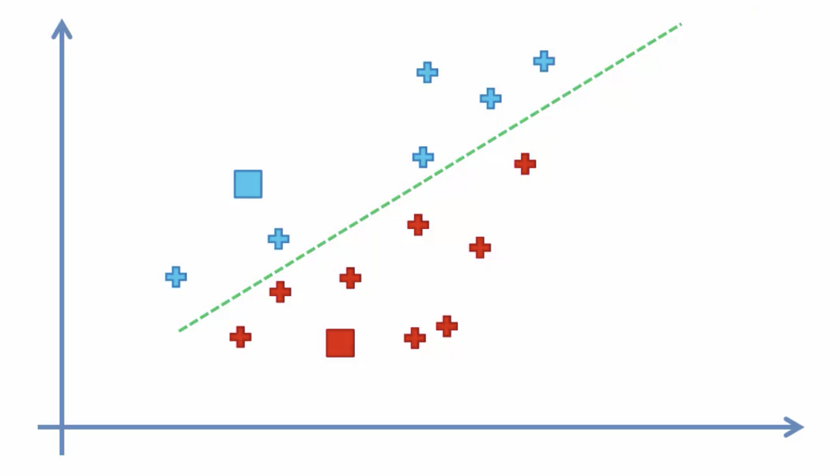
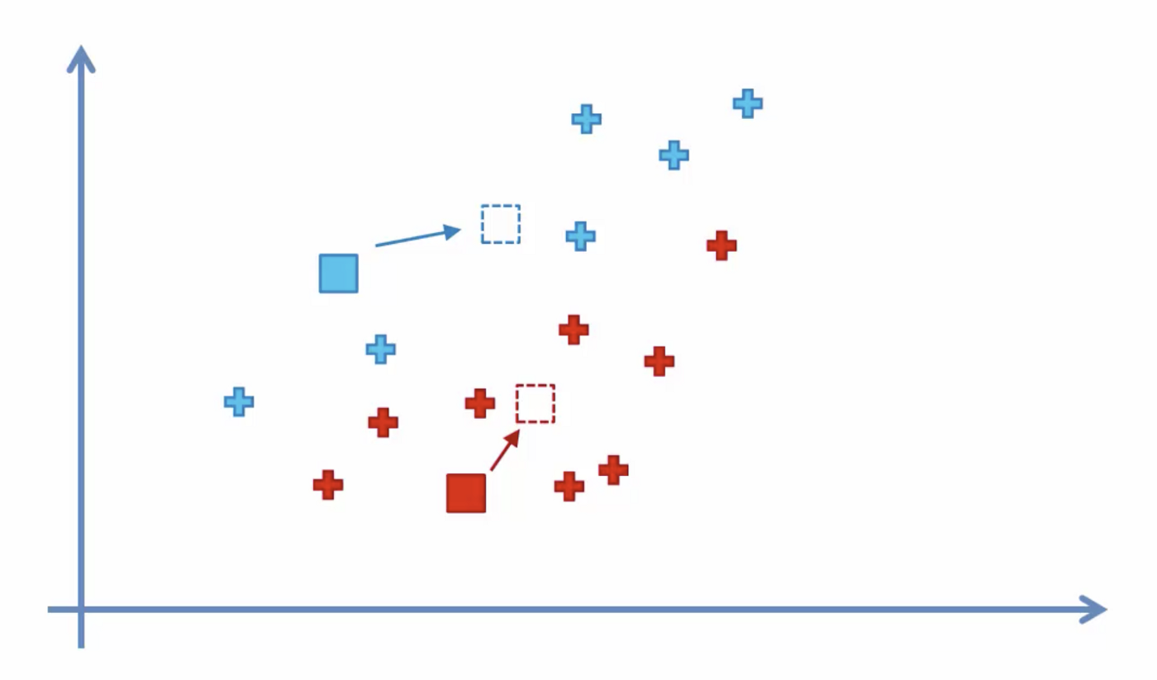
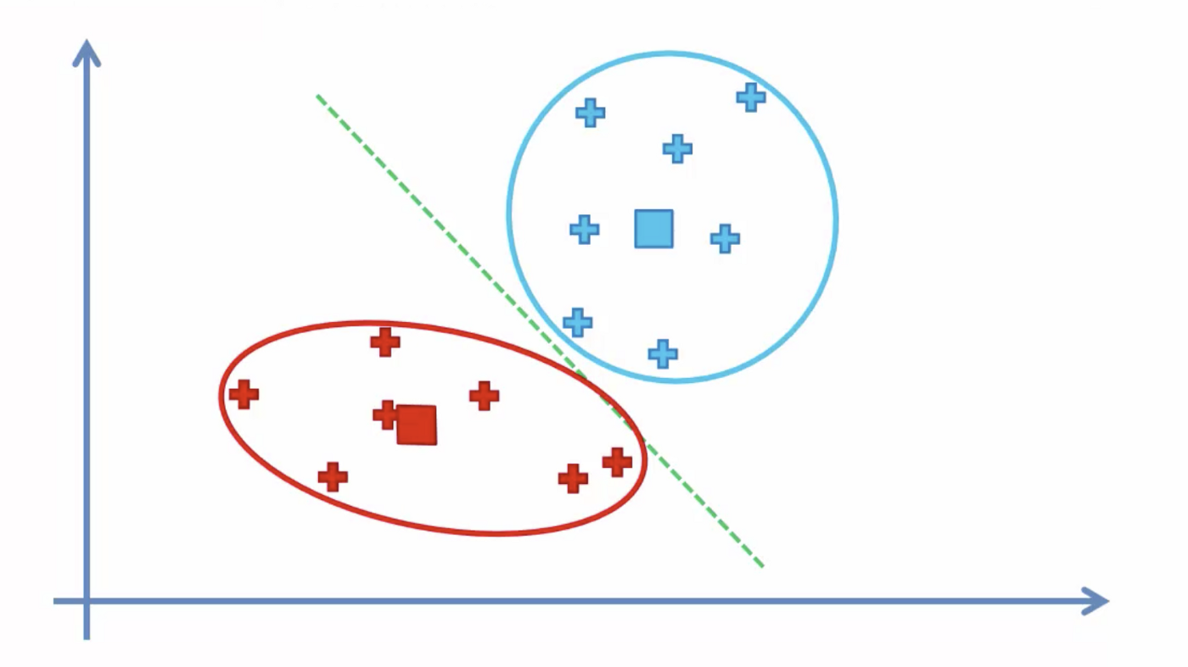
k-Means Review
1
Select k (e.g. 2) random points as cluster centers called centroids
Assign each data point to the closest cluster by calculating its distance with respect to each centroid
Determine the new cluster center by computing the average (mean) of the assigned points
Repeat steps 2 and 3 until none of the cluster assignments change
2
3
4
K-means Clustering Python Example

Slide 31
Remember the Blog-Term Matrix
Table 3-1 from PCI - Subset of blog word frequencies
blogdata.txt

Slide 32
k-Means Clustering
kcluster(rows, distance=pearson, k=4) - does the k-means clustering algorithm, default distance function is pearson(), default k is 4
Original code: Ch 3 GitHub repo

Slide 33
kcluster() - Step 1
1
# Create k randomly placed centroids
clusters = [[random.random() * (ranges[i][1] - ranges[i][0]) + ranges[i][0]
for i in range(len(rows[0]))] for j in range(k)]
i - 0-700 (number of columns in the first row of data, or number of words)
j - 0-3 (assume k=4)
ranges[] - minimum and maximum values for each row
Original code: Ch 3 GitHub repo

Slide 34
kcluster() - Step 2
2
# Find which centroid is the closest for each row
for j in range(len(rows)):
row = rows[j]
bestmatch = 0
for i in range(k):
d = distance(clusters[i], row)
if d < distance(clusters[bestmatch], row):
bestmatch = i
bestmatches[bestmatch].append(j)
j - current row i - current cluster
distance(clusters[bestmatch], row) - distance between centroid and row
bestmatches[i] - list of row ids in cluster i
Original code: Ch 3 GitHub repo

Slide 35
kcluster() - Step 3
3
# Move the centroids to the average of their members
for i in range(k):
avgs = [0.0] * len(rows[0])
if len(bestmatches[i]) > 0:
for rowid in bestmatches[i]:
for m in range(len(rows[rowid])):
avgs[m] += rows[rowid][m]
for j in range(len(avgs)):
avgs[j] /= len(bestmatches[i])
clusters[i] = avgs
j - current row i - current cluster
avgs - average of each column over all rows in the cluster
bestmatches[i] - list of row ids in cluster i
Original code: Ch 3 GitHub repo

Slide 36
kcluster() - Step 4
4
for t in range(100):
print ('Iteration %d' % t)
bestmatches = [[] for i in range(k)]
[...]
# If the results are the same as last time, this is complete
if bestmatches == lastmatches:
break
lastmatches = bestmatches
Original code: Ch 3 GitHub repo

Slide 37
Example (pg. 44)
Run k-means with 10 clusters on blogdata
Iteration 0
Iteration 1
Iteration 2
Iteration 3
Iteration 4
Iteration 5
kclust = kcluster(data, k=10)
Note that because we start with randomly-placed centroids, we may get different clusters each time we run the algorithm.
Original code: Ch 3 GitHub repo

Slide 38
sklearn Python Library for k-Means
Reference
sklearn.cluster.KMeans
Examples
In Depth: k-Means Clustering | Python Data Science Handbook
K-Means Clustering

Slide 39
Web Science:
Clustering Algorithms
(Part 4 - Multidimensional Scaling)
CS 432/532
Old Dominion University
Permission has been granted to use these slides from Frank McCown, Michael L. Nelson, Alexander Nwala, Michele C. Weigle
This work is licensed under a Creative Commons Attribution-NonCommercial-ShareAlike 3.0 Unported License

Slide 40
Main reference:
Ch 3 from Programming Collective Intelligence by Toby Segaran
(abbreviated as PCI)
Ch 3 GitHub repo

Slide 41
Remember the Blog-Term Matrix
Table 3-1 from PCI - Subset of blog word frequencies
blogdata.txt

Slide 42
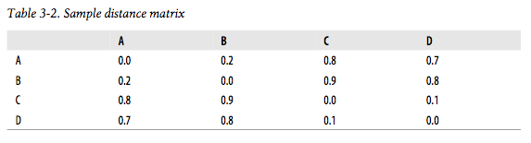
Multidimensional Scaling (MDS)
Allows us to visualize N-dimensional data in 2 or 3 dimensions
Not a perfect representation of data, but allows us to visualize it without our heads exploding
Start with item-item distance matrix (note: 1-similarity)
PCI

Slide 43
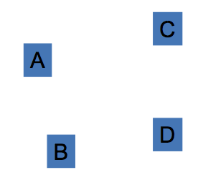
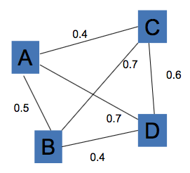
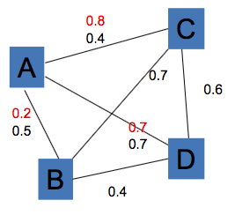
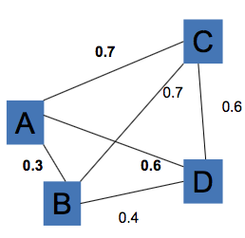
MDS Overview
1
Randomly drop items in 2d graph
Measure all inter-item distances
Compare with actual item-item distance for 1 item
Move item in 2D space (ex. A moves closer to B (good), further from C (good), closer to D (bad))
Repeat steps 2-4 for all items until no more changes can be made without increasing the error
2
3
4

Slide 44
Multidimensional Scaling - Python
scaledown(data, distance=pearson, rate=0.01) - performs the MDS algorithm, returns a vector with the x,y coordinates of each item, learning rate (how much to move items) is default 0.01
draw2d(data, labels, jpeg="mds2d.jpg") - function to display the labels in 2d space
Original code: Ch 3 GitHub repo

Slide 45
scaledown() - Step 1
n = len(data)
# The real distances between every pair of items
realdist = [[distance(data[i], data[j]) for j in range(n)] for i in
range(0, n)]
# Randomly initialize the starting points of the locations in 2D
loc = [[random.random(), random.random()] for i in range(n)]
fakedist = [[0.0 for j in range(n)] for i in range(n)]
n - number of rows
realdist - compute actual distance (with pearson) between every pair of items
loc - will hold the 2d x,y locations, initialize to random points
fakedist - will hold chart distance between every pair of items
Original code: Ch 3 GitHub repo

Slide 46
scaledown() - Step 2
# Find projected distances
for i in range(n):
for j in range(n):
fakedist[i][j] = sqrt(sum([pow(loc[i][x] - loc[j][x], 2)
for x in range(len(loc[i]))]))
fakedist[i][j] - Euclidean distance between position of row i and position of row j on the graph
Original code: Ch 3 GitHub repo

Slide 47
scaledown() - Step 3
for k in range(n):
for j in range(n):
if j == k:
continue
# The error is percent difference between the distances
errorterm = (fakedist[j][k] - realdist[j][k]) / realdist[j][k]
[...]
# Keep track of the total error
totalerror += abs(errorterm)
errorterm - percent difference between the distances (real distance and graph distance)
Original code: Ch 3 GitHub repo

Slide 48
scaledown() - Step 4
# Each point needs to be moved away from or towards the other
# point in proportion to how much error it has
grad[k][0] += (loc[k][0] - loc[j][0]) / fakedist[j][k] * errorterm
grad[k][1] += (loc[k][1] - loc[j][1]) / fakedist[j][k] * errorterm
[...]
# Move each of the points by the learning rate times the gradient
for k in range(n):
loc[k][0] -= rate * grad[k][0]
loc[k][1] -= rate * grad[k][1]
Original code: Ch 3 GitHub repo

Slide 49
scaledown() - Step 5
# If the answer got worse by moving the points, we are done
if lasterror and lasterror < totalerror:
break
lasterror = totalerror
Original code: Ch 3 GitHub repo

Slide 50
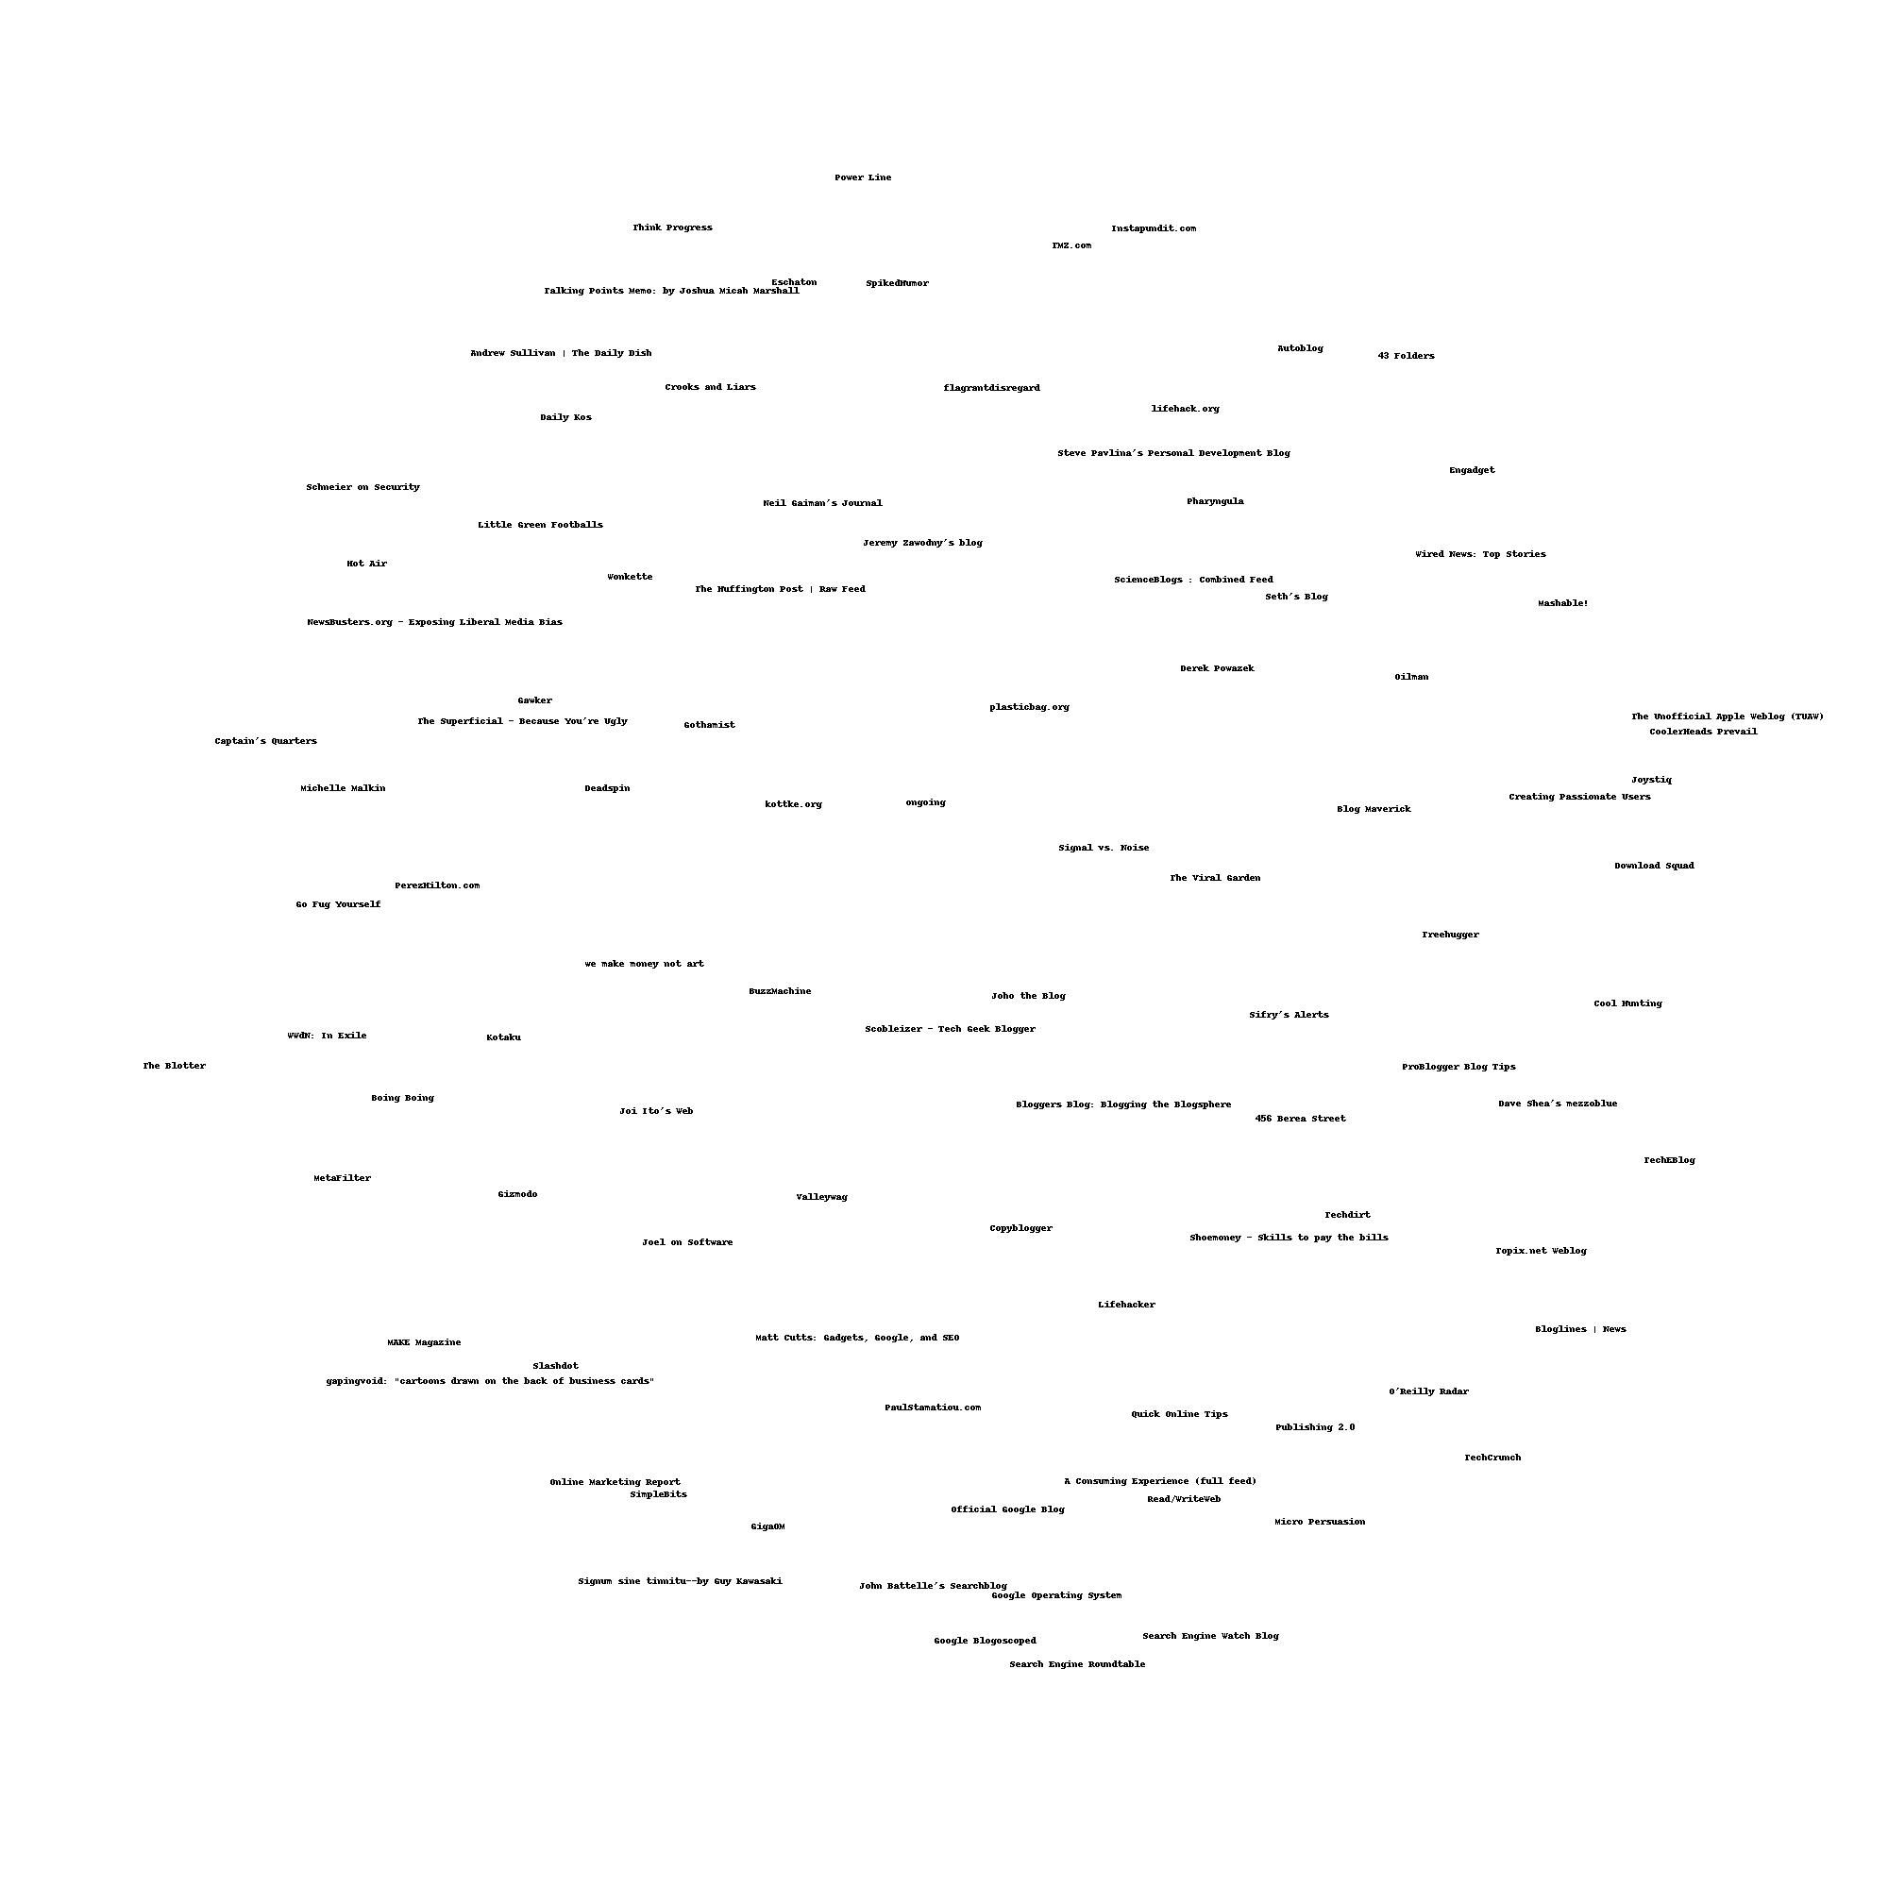
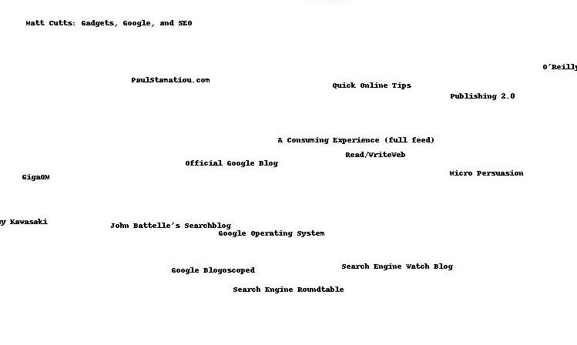
Example (pg. 52)
Run MDS on blogdata
coords = scaledown(data)
draw2d(coords, blognames, jpeg='blogs2d.jpg')
Original code: Ch 3 GitHub repo

Slide 51
Objectives
Distinguish between unsupervised learning and supervised learning.
Differentiate between agglomerative and divisive clustering.
Explain how a dendrogram is constructed.
Explain the main steps in k-means clustering.
Describe the purpose of multidimensional scaling (MDS).
Explain the steps of multidimensional scaling.

