Slide 1
Web Science:
Document Filtering
(Part 1 - Intro to Classifiers)
CS 432/532
Old Dominion University
Permission has been granted to use these slides from Frank McCown, Michael L. Nelson, Alexander Nwala, Michele C. Weigle
This work is licensed under a Creative Commons Attribution-NonCommercial-ShareAlike 3.0 Unported License

Slide 2
Main references:
Ch 6 from Programming Collective Intelligence by Toby Segaran
(abbreviated as PCI)
Ch 9 from Search Engines: Information Retrieval in Practice by Croft, Metzler, and Strohman
(abbreviated as SEIRP)

Slide 3
Clustering vs. Classification
Clustering
grouping related items together
clusters may not correspond to a meaningful concept
uses unsupervised learning techniques
Classification
task of automatically applying predefined labels to data
uses supervised learning techniques
SEIRP, Ch 9

Slide 4


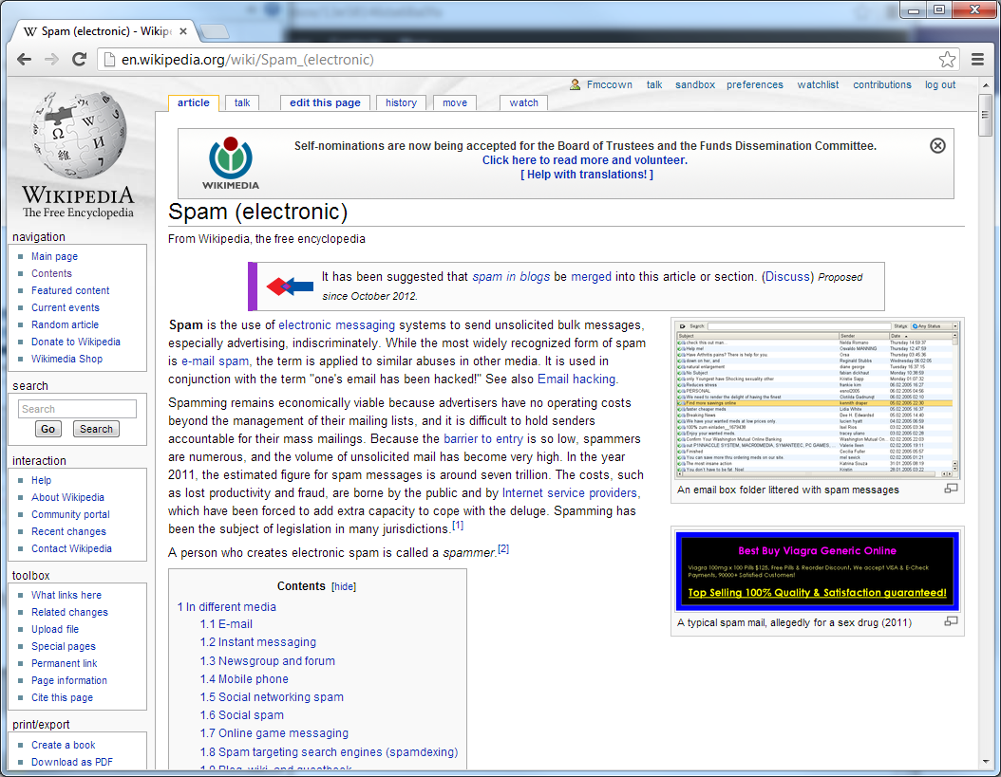
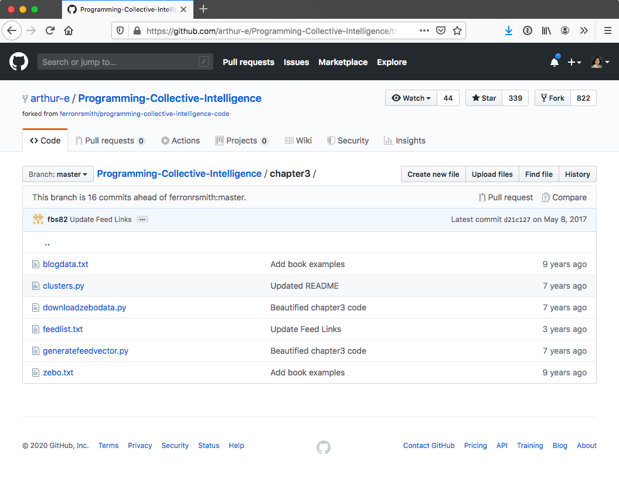

Can we classify these documents?
Science, Leisure, Programming, etc.

Slide 5
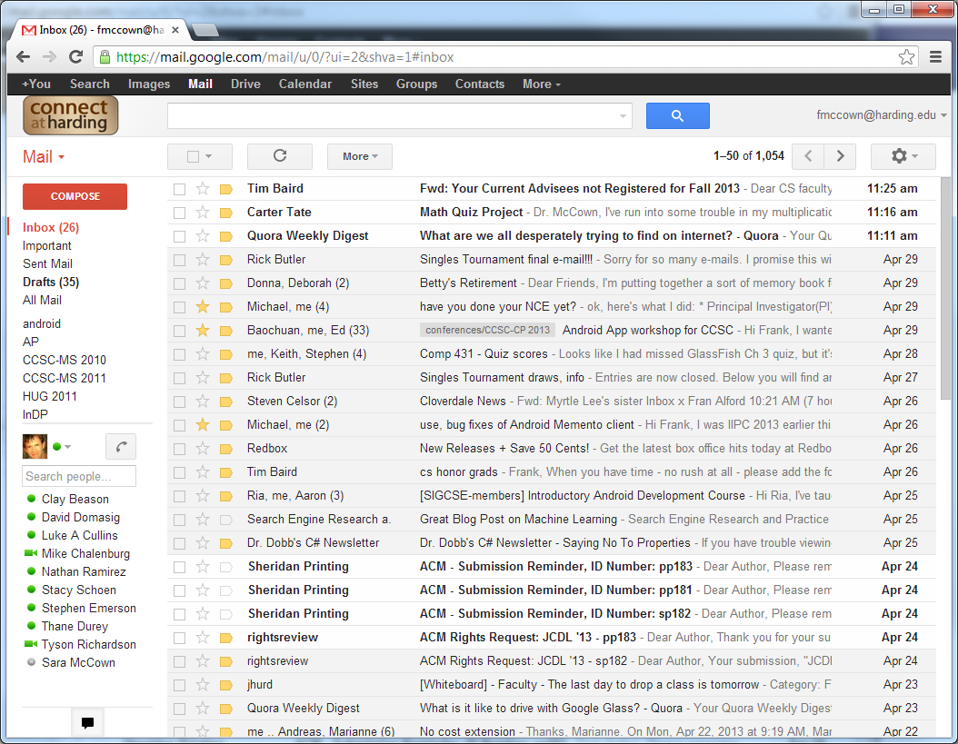
Can we classify these documents?
Important, Work, Personal, Spam, etc.

Slide 6
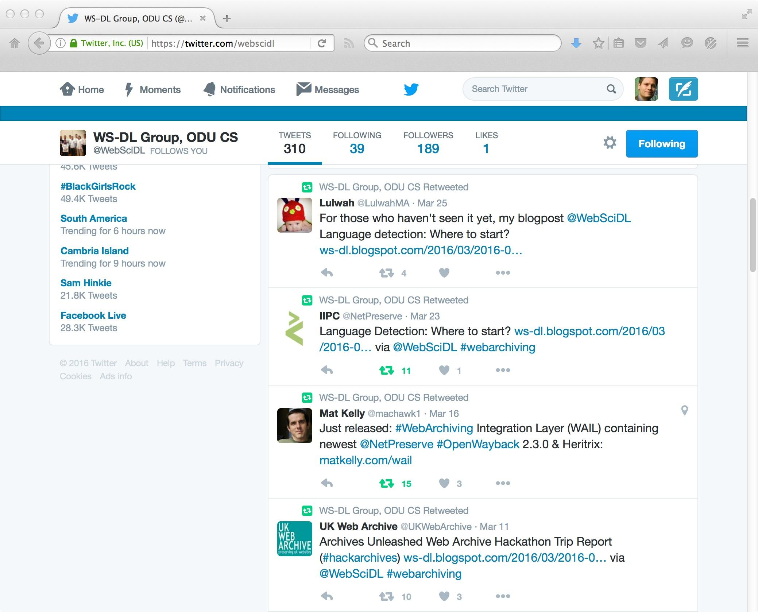
How about very small documents?

Slide 7
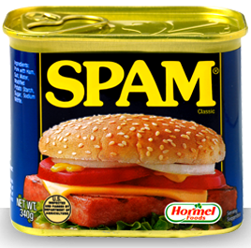

We’re Going to Look at Spam Email

Slide 8
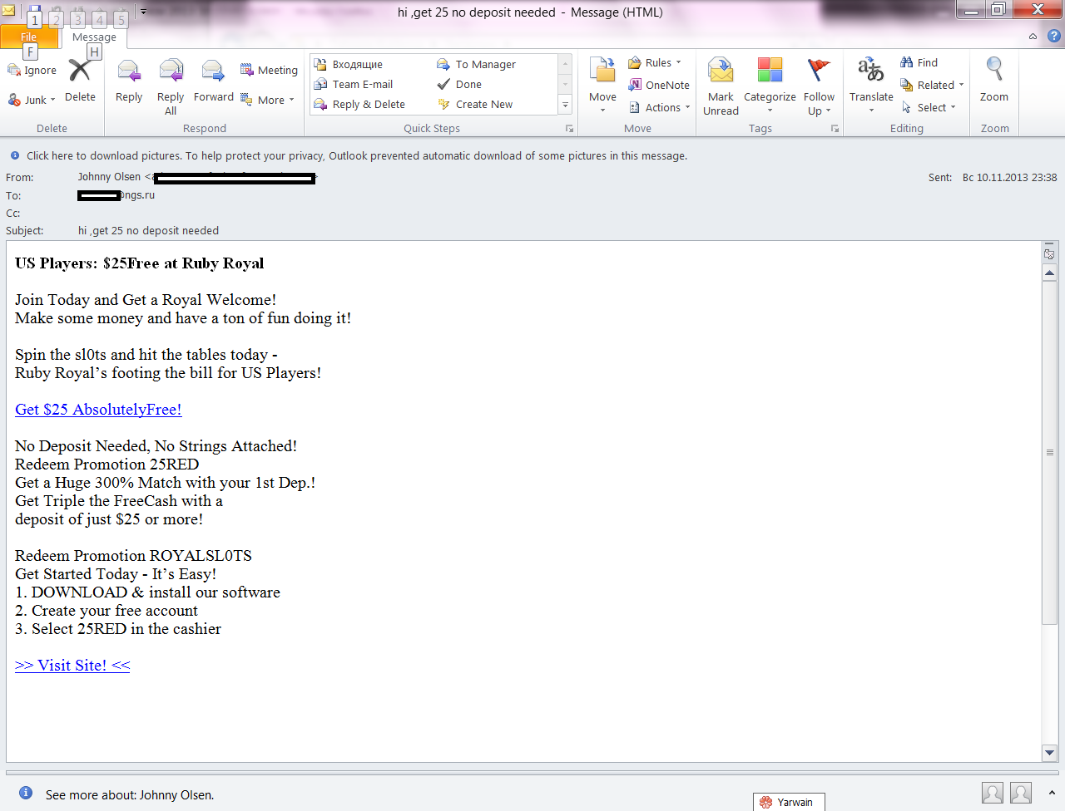
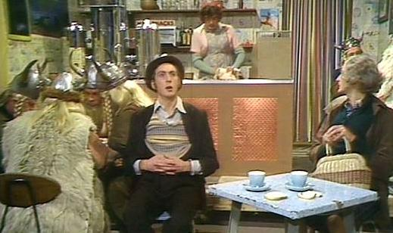
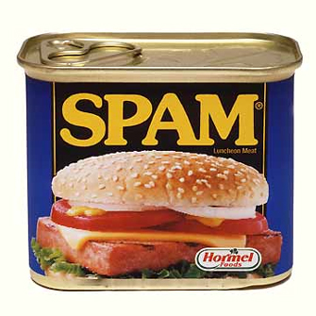
Rule-Based Classifiers Are Inadequate
If my email has the word "spam", is the message about...
Spam - Monty Python's Flying Circus
Spam (Monty Python) (Wikipedia)
Why is it called Python?
Rule-based classifiers don't consider context

Slide 9
How Do Humans Classify Things?
We identify a number of important features that distinguish between possible categories.
We extract these features from each item.
We then combine evidence from the extracted features in some way.
Finally, we classify the item using some decision mechanism based on the combined evidence.
SEIRP, Ch 9

Slide 10
Supervised Learning
Classification is a supervised learning problem.
Training set
set of fully labeled items (items and their classification) used to build the model
Testing set
set of unlabeled items given to the model for automatic classification
SEIRP, Ch 9

Slide 11
Classifying with Supervised Learning
We "teach" the program to learn the difference between spam as unsolicited bulk email, luncheon meat, and comedy troupes by providing examples of each classification
Spam - Monty Python's Flying Circus
Spam (Monty Python) (Wikipedia)
Why is it called Python?

Slide 12
Classifiers
Need features for classifying documents
Feature is anything you can determine that is present or absent in the item
Best features are common enough to appear frequently but not all the time (cf. stopwords)
Words in document are a useful feature
For spam detection, certain words like casino appear more often in spam than not spam

Slide 13
Features for Spam Classification
Many external features can be used depending on type of document
Links pointing in? Links pointing out?
Recipient list? Sender's email and IP address?
Many internal features
Use of certain words or phrases
Color and sizes of words
Document length
Grammar analysis
We will focus on internal features to build a classifier

Slide 14
Classifying with Supervised Learning
We use an item's features for classification
item = document
feature = word
classification = {good|bad}
"the quick brown fox jumps over the lazy dog", "good"
"make quick money in the online casino", "bad"
"buy pharmaceuticals now", "bad"
"the quick rabbit jumps fences", "good"

Slide 15
Web Science:
Document Filtering
(Part 2 - Classifiers and Probabilities)
CS 432/532
Old Dominion University
Permission has been granted to use these slides from Frank McCown, Michael L. Nelson, Alexander Nwala, Michele C. Weigle
This work is licensed under a Creative Commons Attribution-NonCommercial-ShareAlike 3.0 Unported License

Slide 16
Main references:
Ch 6 from Programming Collective Intelligence by Toby Segaran
(abbreviated as PCI)
Ch 9 from Search Engines: Information Retrieval in Practice by Croft, Metzler, and Strohman
(abbreviated as SEIRP)

Slide 17
From Counts to Probabilities
"Nobody owns the water.", "good"
"the quick brown fox jumps over the lazy dog", "good"
"make quick money in the online casino", "bad"
"buy pharmaceuticals now", "bad"
"the quick rabbit jumps fences", "good"
Count the number of times a word falls into a category {good|bad}
"quick": {bad: 1, good: 2}
Want the probability that a word is in a particular category
probability that "quick" is "good"

Slide 18
Events and Probabilities
Independent: this means each event is not affected by other events
example: two separate coin tosses
Mutually Exclusive: this means events cannot happen at the same time
Dependent (aka Conditional): this means an event is affected by other events
Adapted from: Conditional Probability, mathisfun

Slide 19
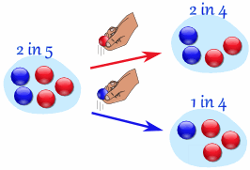
Conditional Probabilities
Example: Marbles in a Bag
What are the chances of getting a blue marble?
Adapted from: Conditional Probability, mathisfun

Slide 20
Conditional Probabilities
Example: Marbles in a Bag
What are the chances of getting a blue marble?
if a red marble was picked before, then the chance of picking a blue marble next is 2 in 4
if a blue marble before, then the chance of a blue marble next is 1 in 4
Adapted from: Conditional Probability, mathisfun

Slide 21
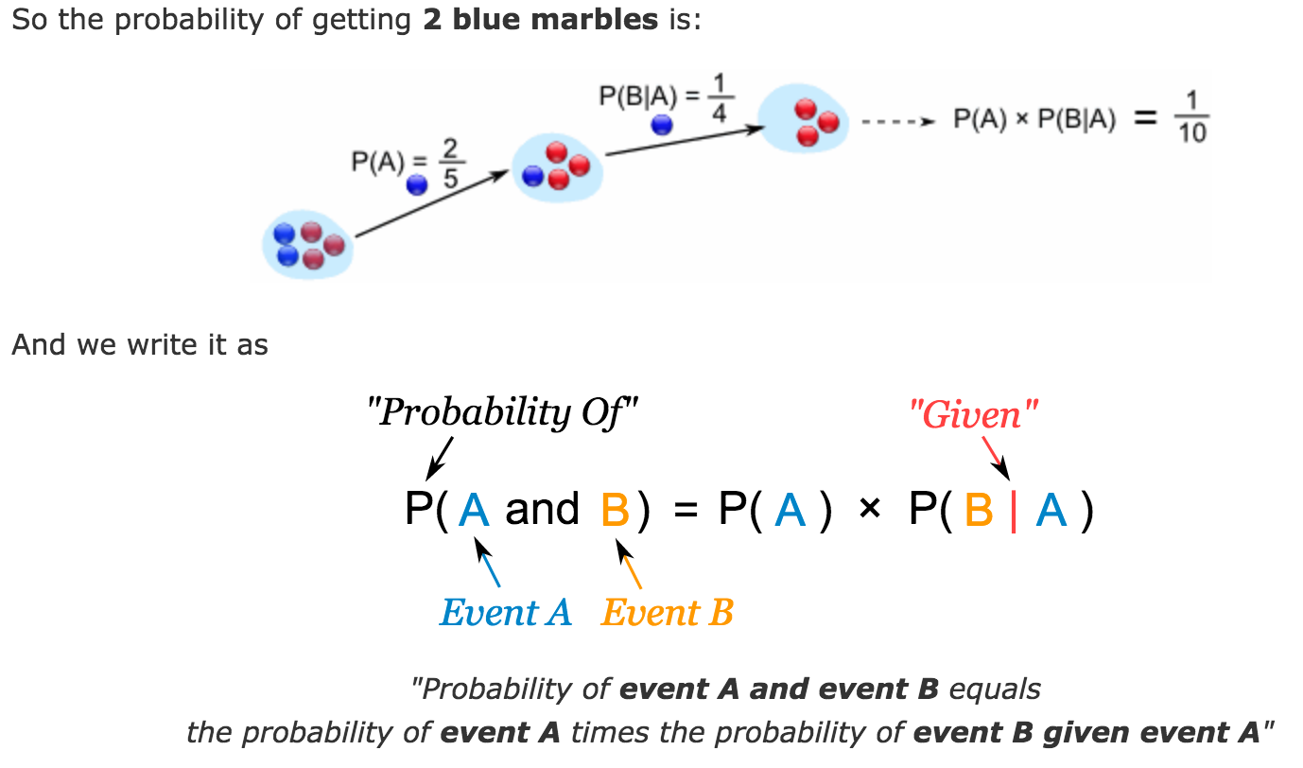
Conditional Probabilities: notation
P(A) means "Probability of Event A"
P(B|A) means "Event B given Event A"
P(A) = 2/5 = 0.4
P(B|A) = 1/4 = 0.25
P(A and B) = 1/10 = 0.1
Adapted from: Conditional Probability, mathisfun

Slide 22
From Counts to Probabilities
"Nobody owns the water.", "good"
"the quick brown fox jumps over the lazy dog", "good"
"make quick money in the online casino", "bad"
"buy pharmaceuticals now", "bad"
"the quick rabbit jumps fences", "good"
Count the number of times a word falls into a category {good|bad}
"quick": {bad: 1, good: 2}
Want the probability that a word is in a particular category
probability that "quick" is "good"

Slide 23
Pr(word|category)
"Nobody owns the water.", "good"
"the quick brown fox jumps over the lazy dog", "good"
"make quick money in the online casino", "bad"
"buy pharmaceuticals now", "bad"
"the quick rabbit jumps fences", "good"
Pr(word|category) - for a given category, the probability that the word appears

Slide 24
Pr(word|category)
Pr(w|c) = df_{w,c} / N_{c}
df_{w,c} - num docs in c containing w
N_{c} - num docs in c
^{Multiple-Bernoulli model}
PCI book examples use this model
Pr(w|c) = tf_{w,c} / |c|
tf_{w,c} - times w appears in documents in c
|c| - num words in c
^{Multinomial model}
SEIRP, Ch 9, pp. 346-349

Slide 25
Pr(word|category)
"Nobody owns the water.", "good"
"the quick brown fox jumps over the lazy dog", "good"
"make quick money in the online casino", "bad"
"buy pharmaceuticals now", "bad"
"the quick rabbit jumps fences", "good"
Multiple Bernoulli model
Pr("quick"|"good") = num docs in “good” with “quick” / num docs in “good” = 2 / 3 = 0.6667
Multinomial model
Pr("quick"|"good") = num times "quick" appears in "good" / num words in "good" = 2 / 18 = 0.111

Slide 26
Problem of Data Sparseness
"Nobody owns the water.", "good"
"the quick brown fox jumps over the lazy dog", "good"
"make quick money in the online casino", "bad"
"buy pharmaceuticals now", "bad"
"the quick rabbit jumps fences", "good"
Pr("money"|"good") = num docs in "good" with "money" / num docs in "good" = 0 / 3 = 0
data sparseness - not every possible event is observed in the training set
Start all probabilities at some assumed probability

Slide 27
Weighted Probability
Pr(w|c) = ((𝛼 ap) + (cf_{w} Pr*(w|c)) / (𝛼 + cf_{w} )
𝛼 - weight (1)
ap - assumed probability (0.5)
cf_{w} - times w appears in training set
Pr*(w|c) = df_{w,c} / N_{c}
df_{w,c} - num docs in c containing w
N_{c} - num docs in c
original Multiple Bernoulli probability
PCI, pp. 122-123 (weightedprob())

Slide 28
Weighted Probability: Pr(“money”, “good”)
"Nobody owns the water.", "good"
"the quick brown fox jumps over the lazy dog", "good"
"make quick money in the online casino", "bad"
"buy pharmaceuticals now", "bad"
"the quick rabbit jumps fences", "good"
Pr(w|c) = ((𝛼 ap) + (cf_{w} Pr*(w|c)) / (𝛼 + cf_{w} )
Pr*("money"|"good") = 0
Pr("money", "good") =
(1 * 0.5) + (1 * 0) / (1 + 1) = 0.5 / 2 = 0.25

Slide 29
Web Science:
Document Filtering
(Part 3 - Bayesian Classifiers)
CS 432/532
Old Dominion University
Permission has been granted to use these slides from Frank McCown, Michael L. Nelson, Alexander Nwala, Michele C. Weigle
This work is licensed under a Creative Commons Attribution-NonCommercial-ShareAlike 3.0 Unported License

Slide 30
Main references:
Ch 6 from Programming Collective Intelligence by Toby Segaran
(abbreviated as PCI)
Ch 9 from Search Engines: Information Retrieval in Practice by Croft, Metzler, and Strohman
(abbreviated as SEIRP)

Slide 31
Naïve Bayesian Classifier
Move from terms to documents:
Pr(document) = Pr(term₁) * Pr(term₂) * … * Pr(term_{n})
Naïve because we assume all terms occur independently
we know this is as simplifying assumption; it is naïve to think all terms have equal probability for completing:
"New York _____"
"International Business ______"
Bayesian because we use Bayes' Theorem to invert the conditional probabilities

Slide 32
Probability of Whole Document
Naïve Bayesian classifier determines probability of entire document being given a classification
Pr(Category | Document)
Assume:
Pr(python|bad) = 0.2
Pr(casino|bad) = 0.8
So Pr(python & casino|bad) = 0.2 * 0.8 = 0.16
This is Pr(Document|Category)
How do we calculate Pr(Category|Document)?

Slide 33
Bayes’ Rule
Pr(c|d) = Pr(d|c) Pr(c) / Pr(d)
Pr(c) = N_{c} / N
N_{c} - num docs in c
N - total docs
Pr(d) - we’ll ignore this for now...
SEIRP, Ch 9, pp. 342-344

Slide 34
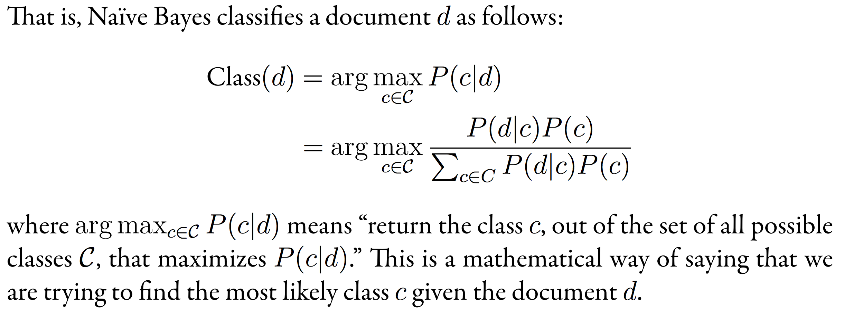
Bayes’ Rule Applied to Documents and Classes
SEIRP, Ch 9, p. 342

Slide 35
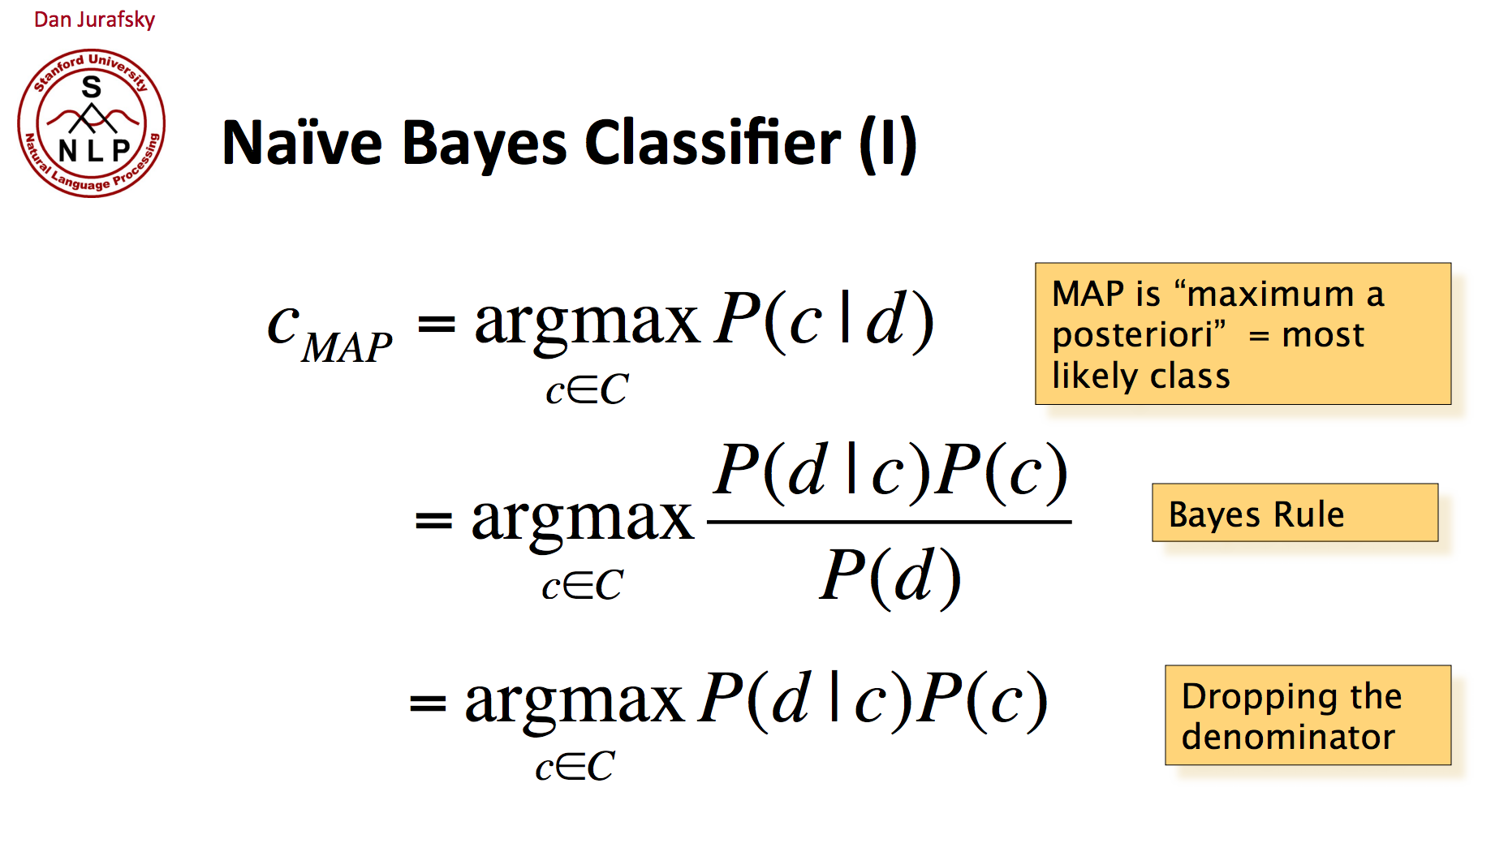
Bayes’ Rule Applied to Documents and Classes
Adapted from Text Classification and Naïve Bayes (stanford.edu), (archived copy)

Slide 36
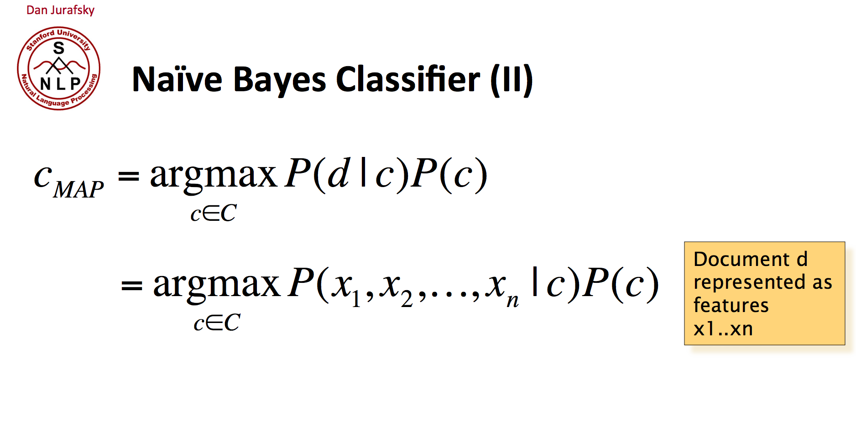
Bayes’ Rule Applied to Documents and Classes
Adapted from Text Classification and Naïve Bayes (stanford.edu), (archived copy)

Slide 37
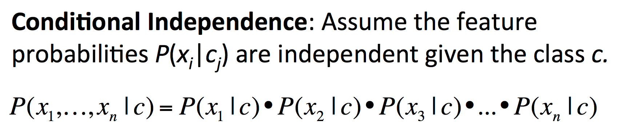
Bayes’ Rule Applied to Documents and Classes
Adapted from Text Classification and Naïve Bayes (stanford.edu), (archived copy)

Slide 38
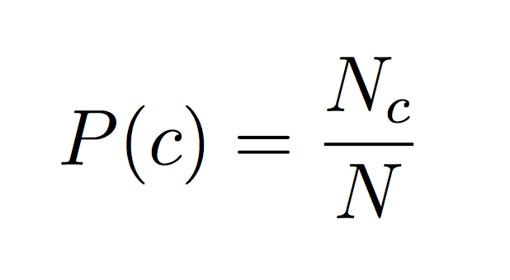
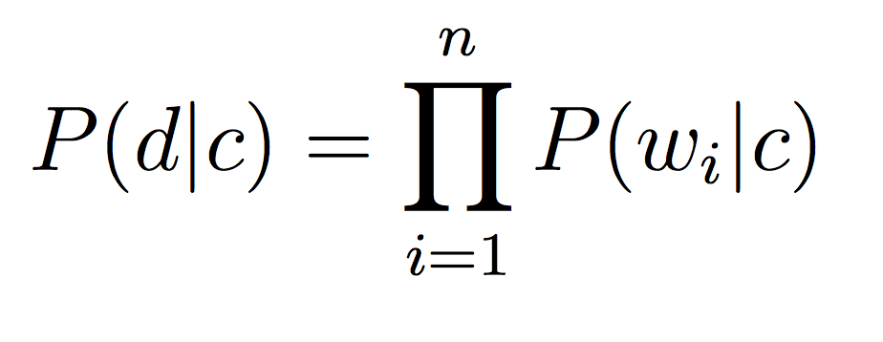
Bayes’ Rule Applied to Documents and Classes
N_{c} - num docs in c
N - total docs
SEIRP, Ch 9, p. 344

Slide 39
Choosing Spam or Not Spam
Should we always choose the category with the highest probability?
what if the difference is really small?
Sometimes the classifier should admit that it doesn’t know the best category
Better to have spam in inbox (false negative) than important messages filtered to spam (false positive)

Slide 40
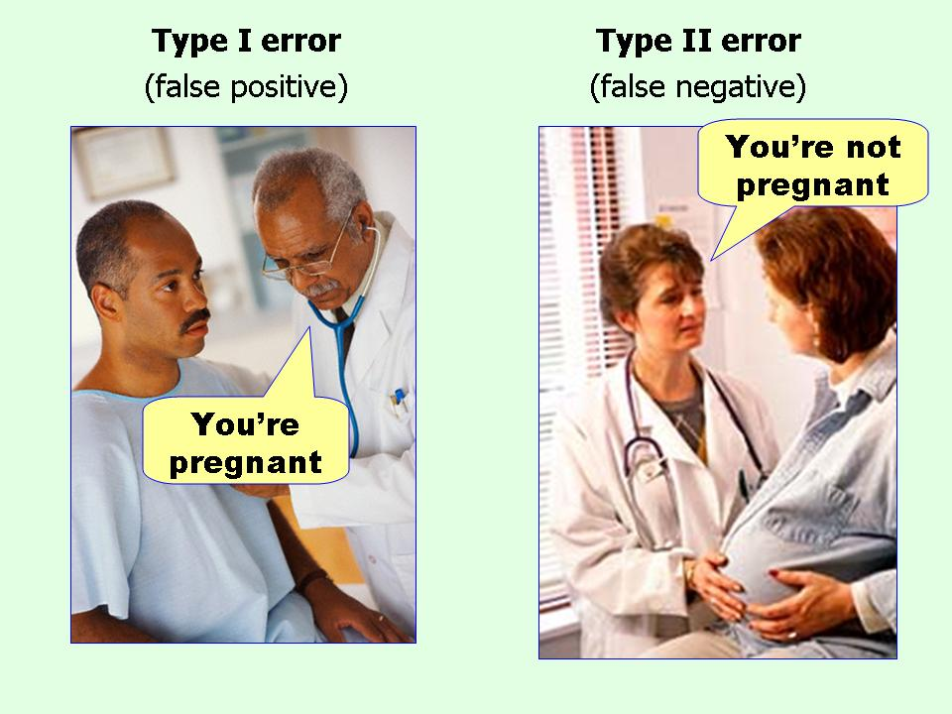
False Positives vs. False Negatives
From: I always get confused about Type I and II errors. Can you show me something to help me remember the difference?

Slide 41
Tuning for False Negatives
Use a threshold for each category
Only classify as spam if probability difference is threshold times higher for spam than for not spam
Can have a different threshold for each category. Examples:
"Spam" threshold = 3
"Not Spam" threshold = 1
If threshold not met, classify as 'unknown'

Slide 42
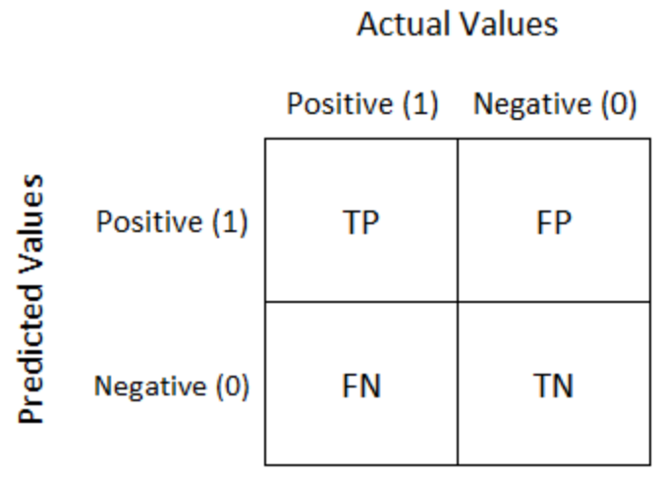
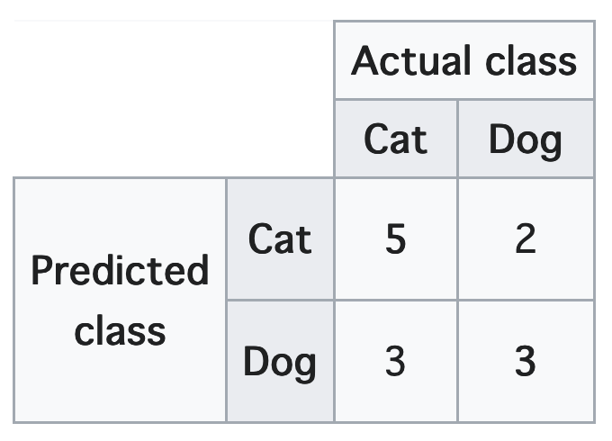
Confusion Matrix
Demonstrates performance of a prediction/classification algorithm
Actual (known) values are on the columns, Predicted (algorithm) values are on the rows
Cells are populated by numbers of true positives (TP), false positives (FP), false negatives (FN), and true negatives (TN)
References: Confusion matrix (Wikipedia),
Understanding Confusion Matrix. When we get the data, after data… | by Sarang Narkhede

Slide 43
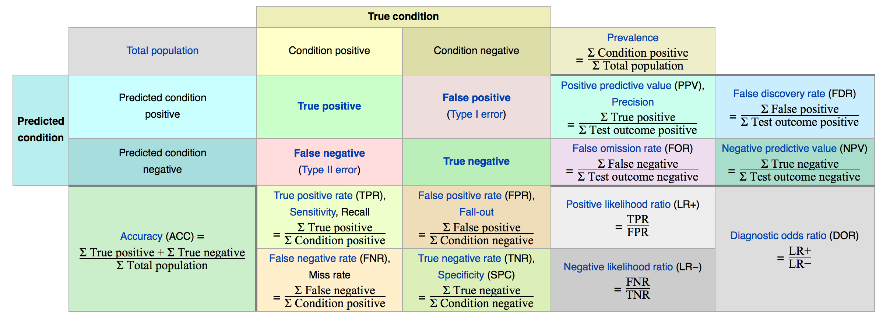
Stats Derived from Confusion Matrix
confusion matrix
Reference: Precision and recall (Wikipedia)

Slide 44
How Do Humans Classify Things?
We identify a number of important features that distinguish between possible categories.
We extract these features from each item.
We then combine evidence from the extracted features in some way.
Finally, we classify the item using some decision mechanism based on the combined evidence.
SEIRP, Ch 9

Slide 45
Objectives
Differentiate between clustering and classification.
Explain the general steps in classification.
Explain the purpose of training sets and testing sets in supervised learning.
Explain how Bayes’ Rule is used in a Naive Bayes Classifier.
Train and test a Naive Bayes Classifier and draw a confusion matrix for the classification results.

