Slide 1
MQTT Sentinel
Distributed MQTT Security Platform

Slide 2
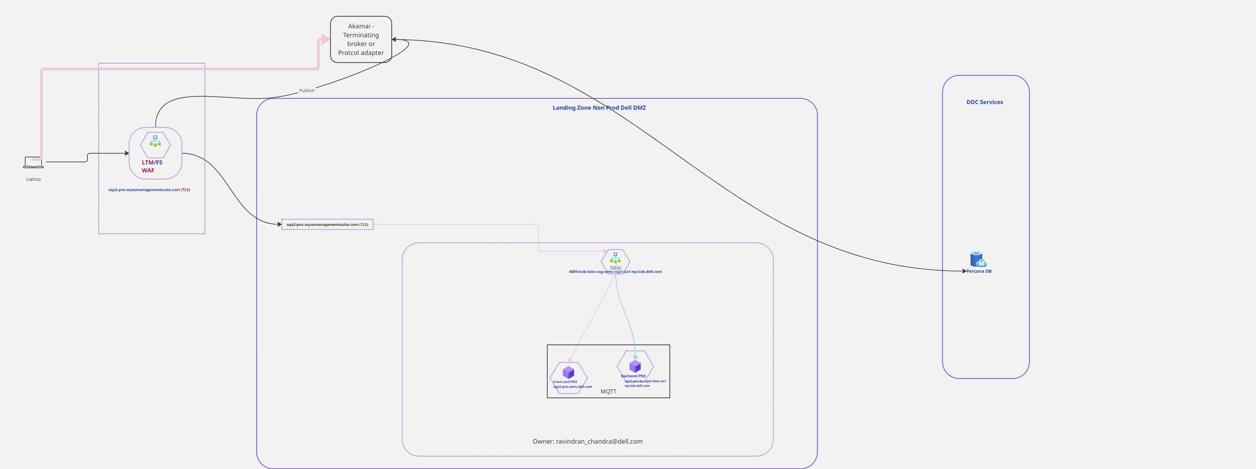
Current Architecture
WMS MQTT deployment — current state

Slide 3
Requirements
Parameter | Value
Protocol | MQTT 3.1.1
Use Case | Server-to-device alert notification (one-way, subscribe-only clients)
Topic Structure | Unique device ID per topic (e.g. wyse3299349539363084573)
Message Pattern | Per-topic delivery only, no broadcast
Message Rate | ~600 msgs/sec aggregate (spike)
Payload | "ALERT" notification (~5 bytes current, up to 100 bytes future)
QoS | Level 1 (at least once delivery)
Retention | 3 days
Concurrency | 1.5 million concurrent connections
Growth | 500K additional connections per year

Slide 4
Problem Statement
1. MQTT is a binary protocol — existing WAF infrastructure (Akamai, F5) cannot inspect it.
2. Origin ingresses are directly exposed to 1.5M+ device connections with no application-layer filtering.
3. No distributed DDoS protection at the MQTT protocol level — rate limiting, auth brute-force prevention, and packet validation do not exist at the edge.
4. No visibility into MQTT-specific security events — connection anomalies, malicious payloads, and auth failures are not surfaced in existing monitoring.
5. Scaling to 1.5M+ connections (growing 500K/year) requires a purpose-built proxy tier, not just broker scaling.

Slide 5
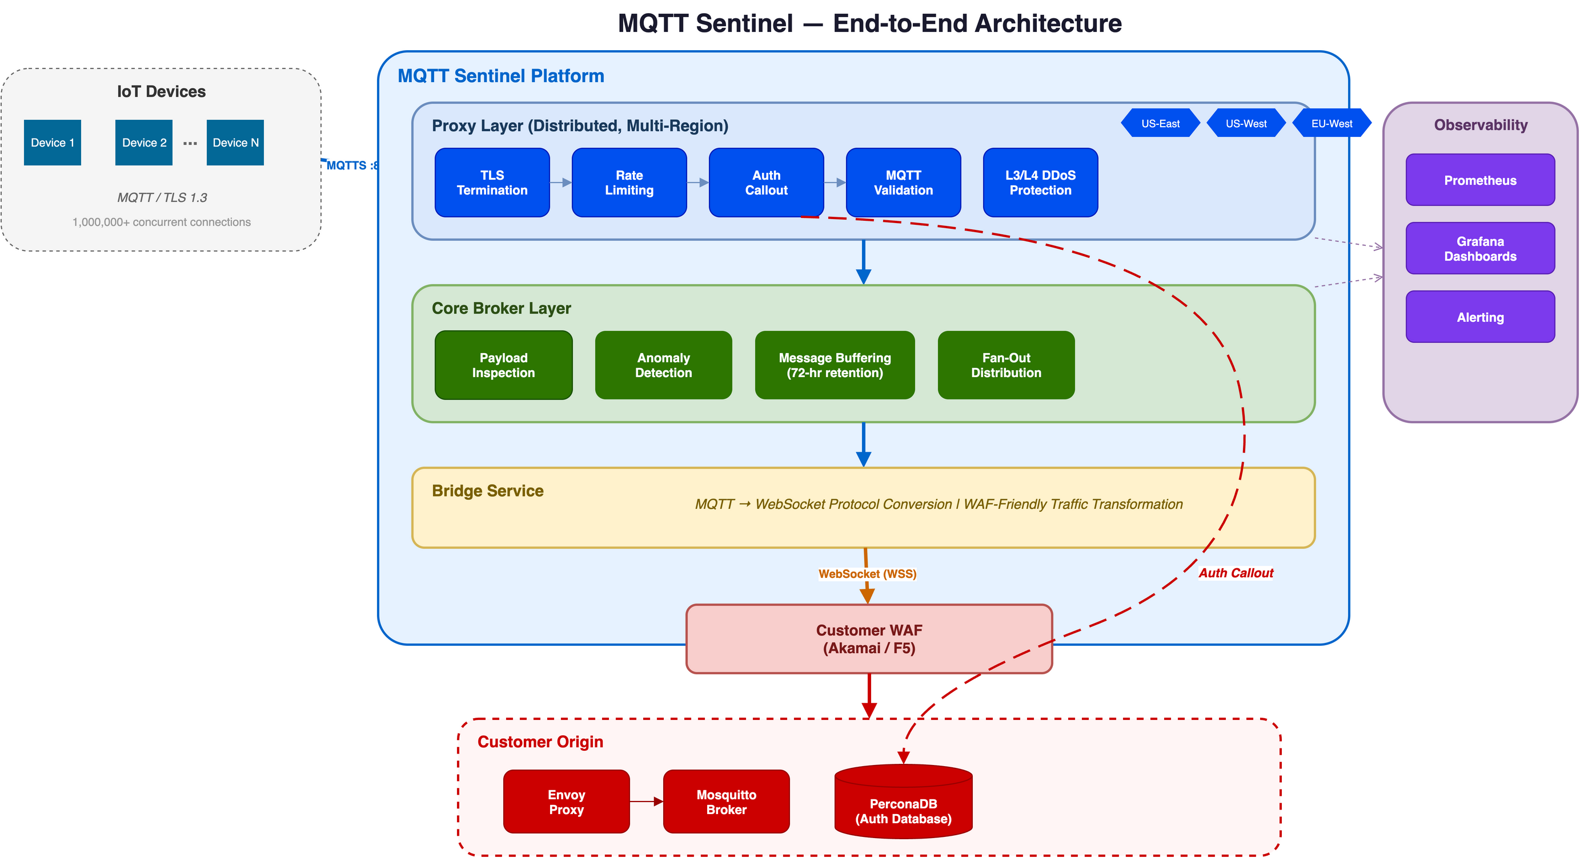
Solution Overview
MQTT Sentinel — layered security architecture

Slide 6
Platform-Level Network Security
Infrastructure protection before traffic reaches MQTT Sentinel
Protection Layer | Detail
Linode Region-Level DDoS | Always-on DDoS mitigation at every Linode region edge. Drops volumetric attacks (UDP/ICMP floods, amplification), protocol attacks (SYN floods), and network anomalies automatically.
Akamai Prolexic Routed On-Demand | Network-layer scrubbing for sustained large-scale attacks. Traffic rerouted to Prolexic scrubbing centers, cleaned, and returned via GRE tunnels. Multi-terabit capacity.
Coverage | All platform IP space used by MQTT Sentinel proxy and broker instances is protected.
Result | Network-layer (L3/L4) volumetric attacks are absorbed at the infrastructure edge before any MQTT Sentinel component processes traffic.

Slide 7
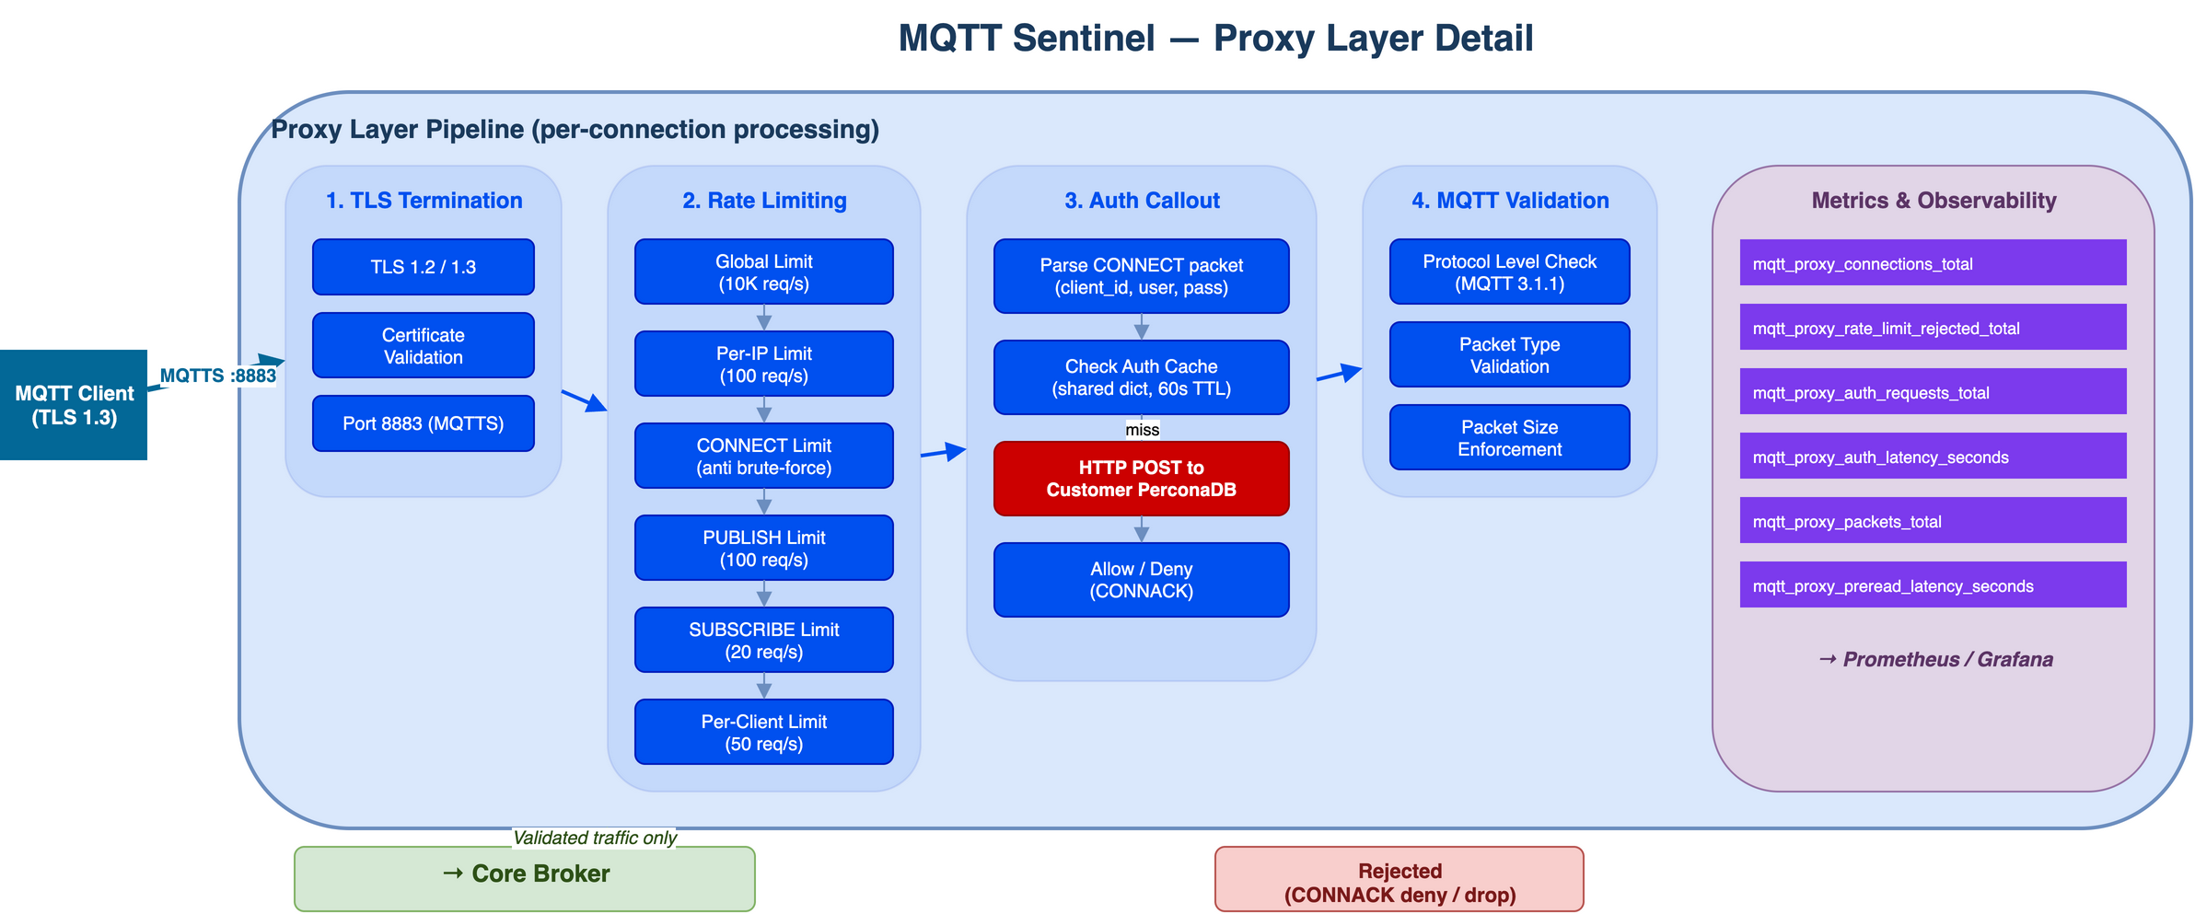
Proxy Layer — Distributed Edge Security

Slide 8
Proxy Layer — Capabilities
Capability | Detail
TLS Termination | TLS 1.2/1.3 offload at the edge, plain MQTT internally
Rate Limiting | 6 tiers: global (10K/s), per-IP (100/s), CONNECT (10/s), PUBLISH (100/s), SUBSCRIBE (20/s), per-client (50/s)
Authentication | Auth callout to customer PerconaDB. Fail-closed. Results cached 60s.
MQTT Validation | MQTT 3.1.1 packet parsing — protocol level, packet type, size enforcement
DDoS Protection | Distributed multi-region fleet absorbs volumetric attacks. Horizontal scaling by adding nodes.
Observability | Prometheus metrics: connections, rate limit events, auth latency, packet counts

Slide 9
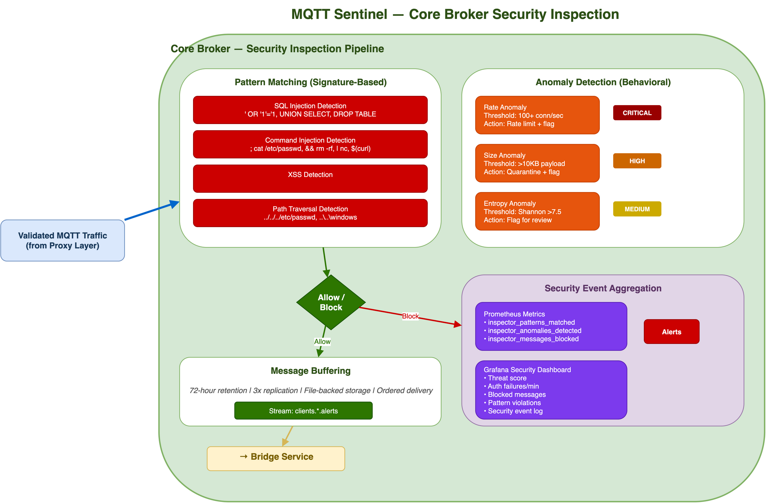
Core Broker — Security Inspection

Slide 10
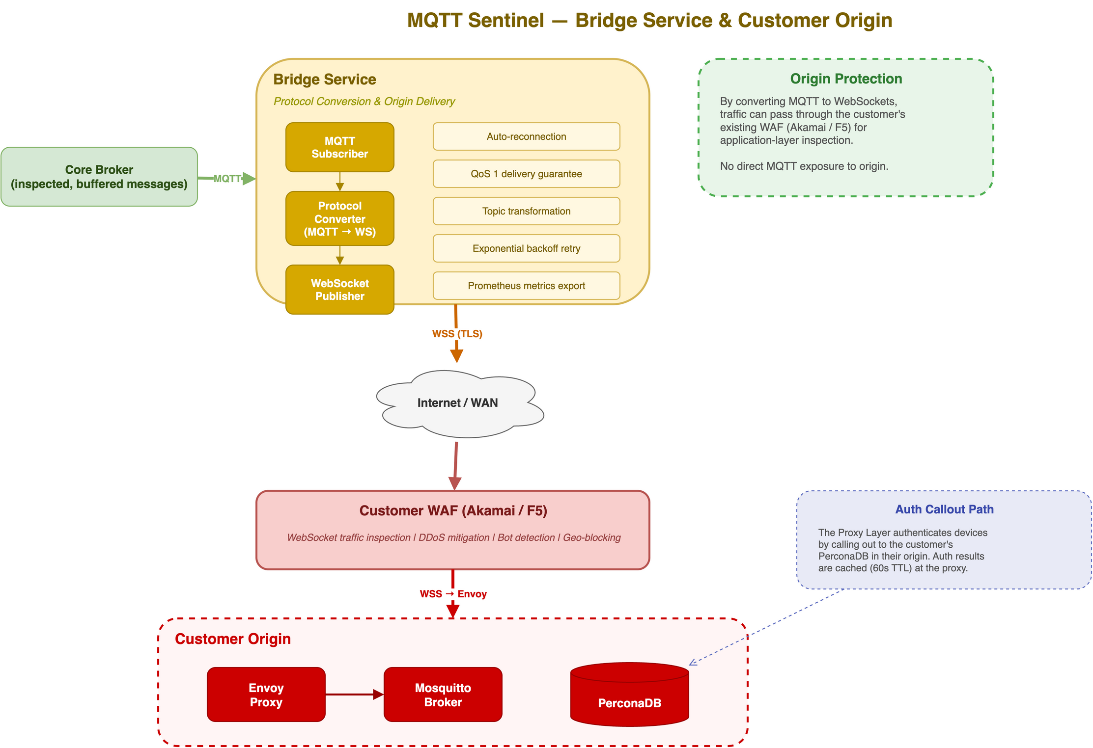
Bridge Service — Origin Protection

Slide 11
Origin Protection — How It Works
1. Bridge Service subscribes to messages on the core broker via MQTT.
2. Messages are converted from MQTT to WebSocket (WSS) frames.
3. WebSocket traffic passes through the customer's existing WAF (Akamai / F5) — the WAF can now inspect what was previously opaque binary MQTT.
4. Clean traffic arrives at customer origin via Envoy, then to Mosquitto.
5. Origin never receives raw MQTT from the internet. All inbound connections terminate at the distributed proxy layer.
Result: existing WAF investment is leveraged for MQTT traffic without protocol changes on the origin.

Slide 12
Scale and Performance
Metric | Target
Concurrent Connections | 1,500,000+ (scaling 500K/year)
Message Throughput | 600+ msgs/sec aggregate
Auth Latency (P99) | < 10ms
Message Delivery (P99) | Regional: < 50ms, Cross-region: < 200ms
Availability | 99.99%
Message Retention | 72 hours (3 days)
QoS | Level 1 (at least once)
Protocol | MQTT 3.1.1

Slide 13
Live Demo
1. Platform health and connection metrics
2. Device authentication (valid + invalid credentials)
3. Rate limiting under burst traffic
4. Security inspection — malicious payload detection
5. Grafana dashboard — real-time security events

