Slide 1


Slide 2
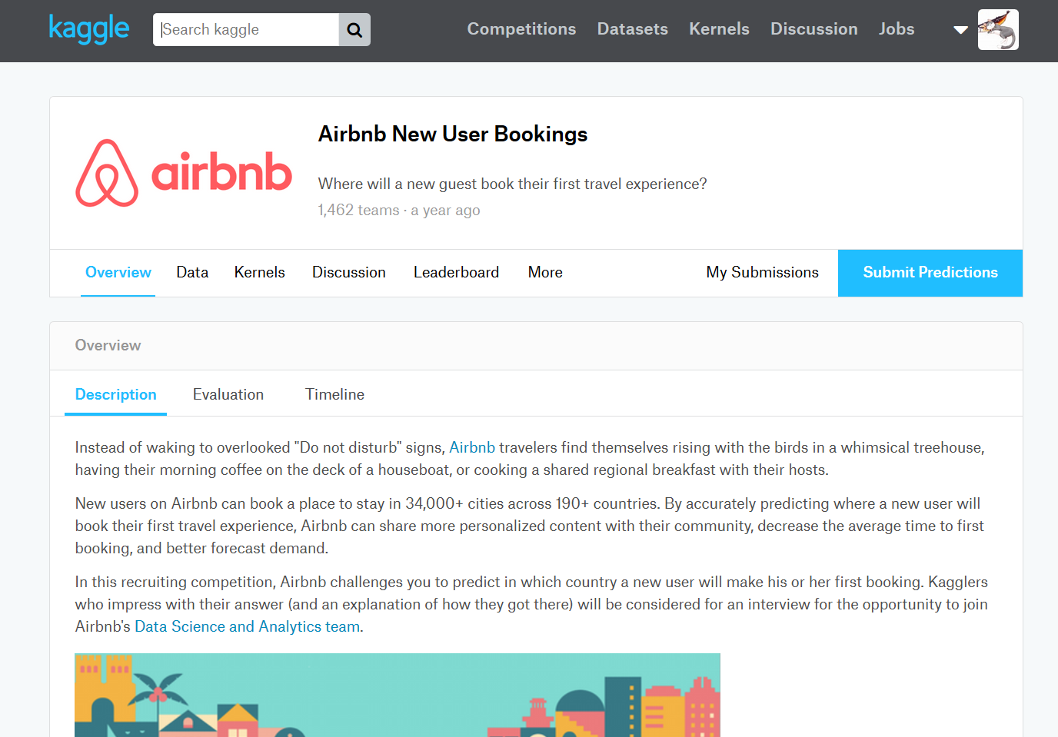
DATA SET

Slide 3
Goal:
1.
Predict which country
a new user’s
first booking destination
will be.
2.
predict the time
between
creating the account and booking
Notes:
1. given a list of users along with their demographics, web session records, and some summary statistics. You are asked to predict which country a new user's first booking destination will be. All the users in this dataset are from the USA.

Slide 4
DATA SET
16 variables, mostly categorical variables
213466 users in the training set
62096 in the test set
train_users.csv: the training set of users
test_users.csv: the test set of users
sessions.csv: web sessions log for users
countries.csv: summary statistics of destination countries in this dataset and their locations
age_gender_bkts.csv : summary statistics of users' age group, gender, country of destination

Slide 5
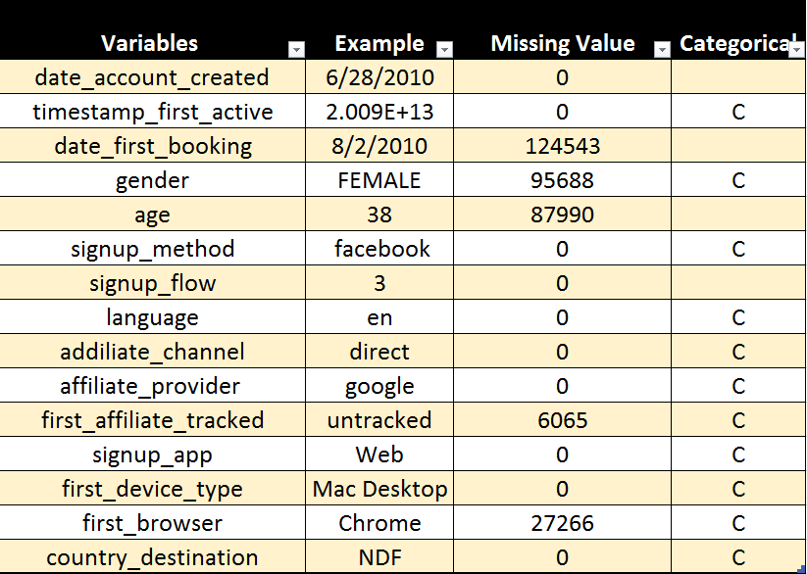
Some Important Variables
Notes:
category: 14 66.67%
datetime64[ns]: 3 14.29%
float64: 2 9.52%
object: 1 4.76% int64: 1 4.76%
category 14 datetime64[ns] 3 float64 2 int64 1 object 1 dtype: int64
WE HAVE 16 VARIABLES. The majority of them are vategorical variables. A total of 213466 users.

Slide 6
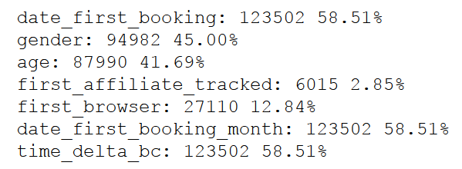
NA
Conditions:
Have sufficient data points, so the model doesn't lose power.
Not to introduce bias (meaning, disproportionate or non-representation of classes).

Slide 7
Cleaning DateTime
change data types to datetime
created, first booking - extract month
time difference in days between created and first booking
first active - extract hour of the day

Slide 8
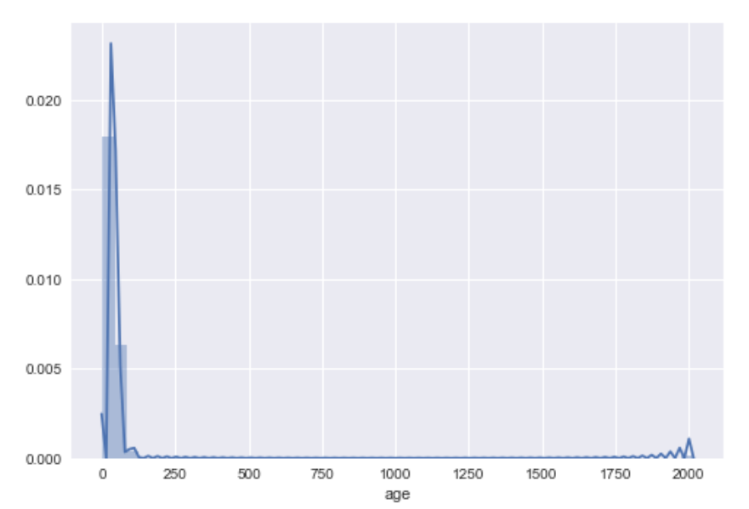
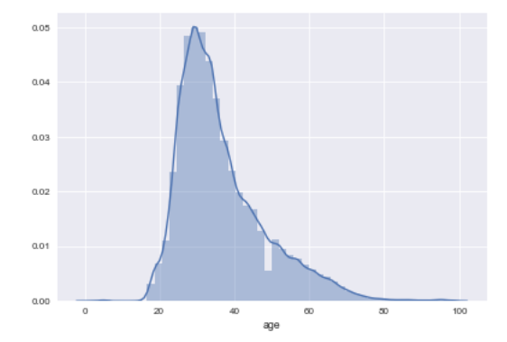
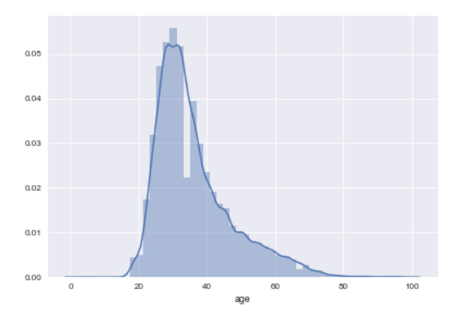
Cleaning age
Original Data
After data cleaning

Slide 9

Exploration
Age
Gender
Signup method
First log in device
Time between creating the account and booking

Slide 10
Question I
Predict
the
time
between
creating the account
and
booking

Slide 11
REGRESION
Linear Regression
Ridge Regression
Lasso Regression
Decision Tree Regressor
Support Vector Machine Regressor

Slide 12
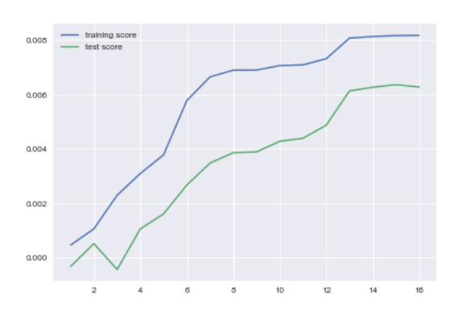
Include date first booking… Linear regression
Notes:
Train Score with all features: 0.818% Test Score with all features: 0.628%

Slide 13
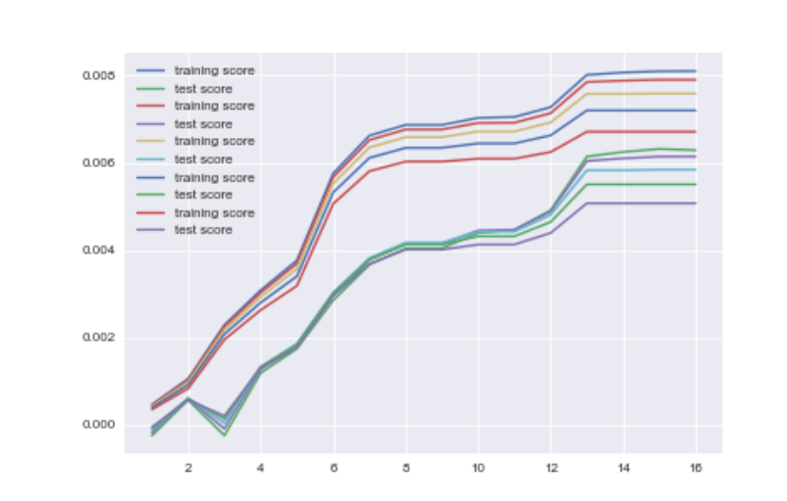
Include date first booking… Lasso regression
Train Score with all features: 0.671%
Test Score with all features: 0.507%

Slide 14
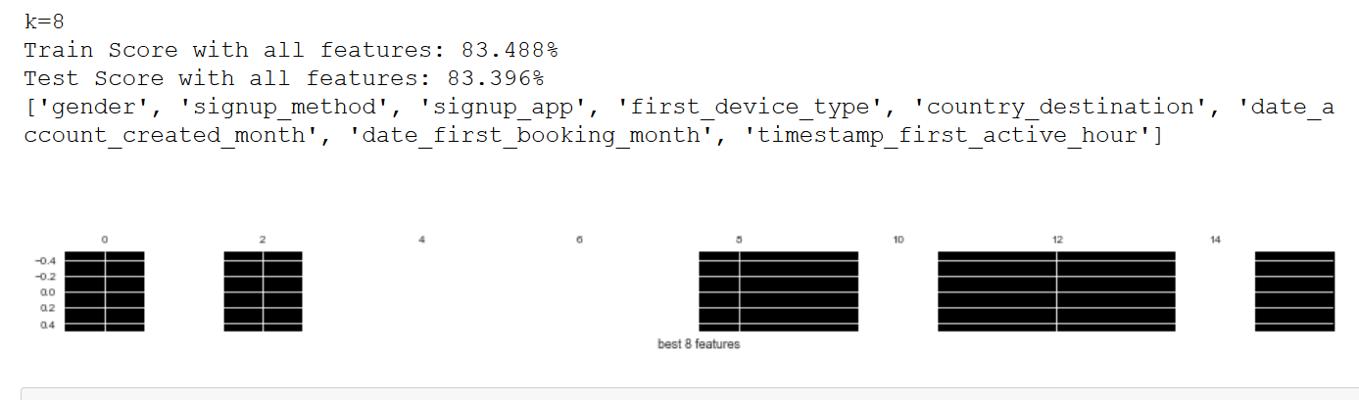
Decision Tree

Slide 15
After removing date_month_first_booking…

Slide 16

Linear Regression:
Train Score with all features: 0.812%
Test Score with all features: 0.622%

Slide 17
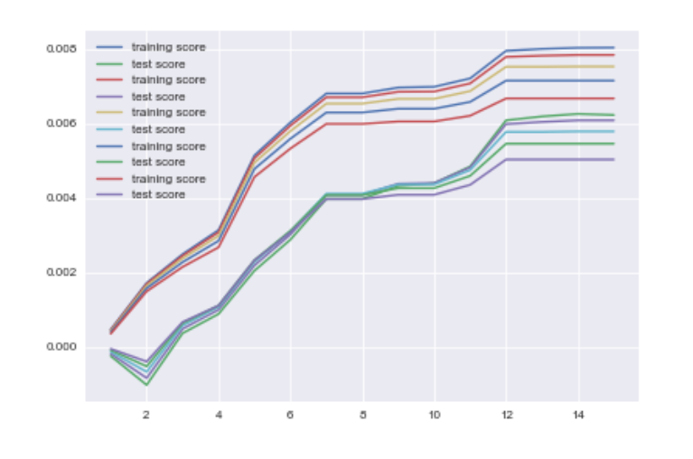
Lasso Regression
k=12, alpha = 0.2
Train Score with all features: 0.795%
Test Score with all features: 0.608%
'gender', 'age', 'signup_method', 'signup_flow', 'affiliate_channel',
'affiliate_provider', 'signup_app', 'first_device_type', 'country_destination',
'date_account_created_month', 'timestamp_first_active_month',
'timestamp_first_active_hour'

Slide 18
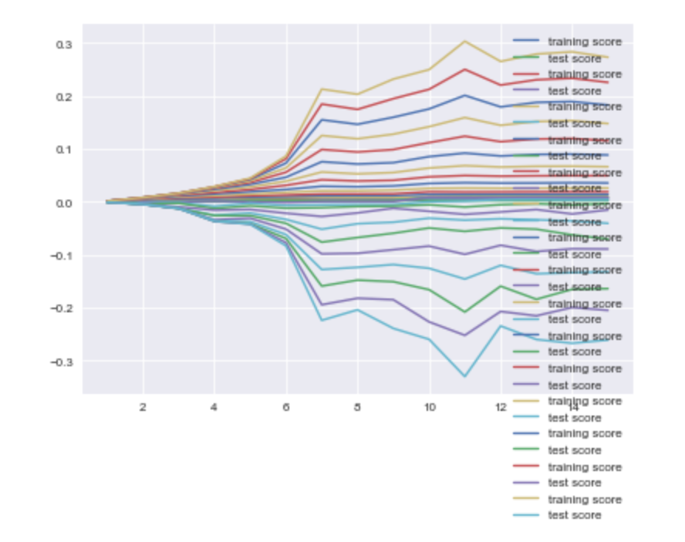

Decision Tree
…

Slide 19
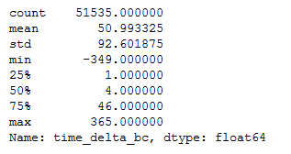
Classification
} 0
} 1
} 2
} 3

Slide 20
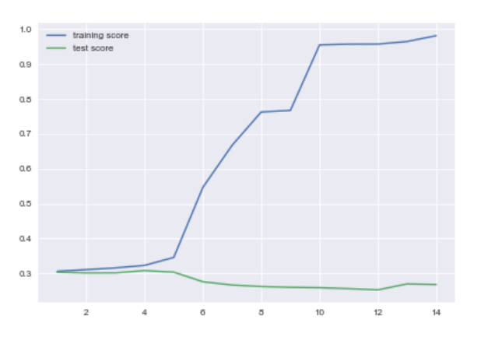
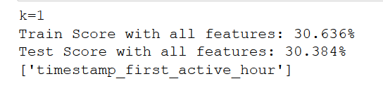
Decision Tree

Slide 21
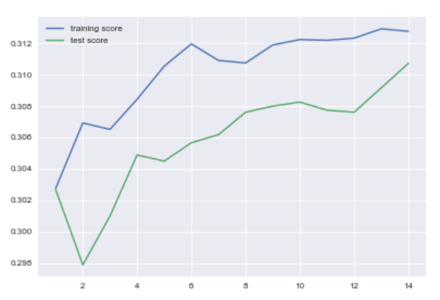
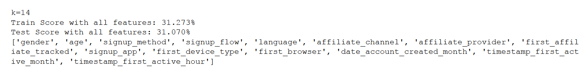
Logistic Regression

Slide 22
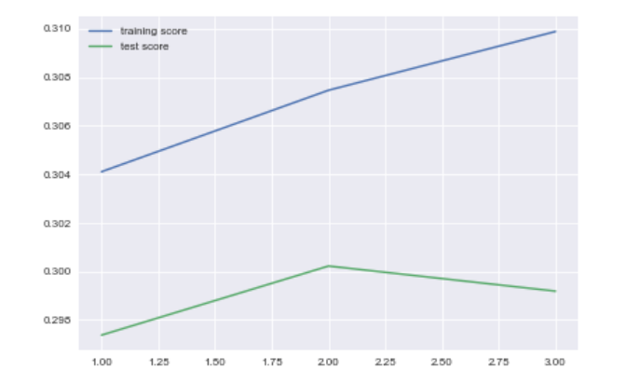
SVM
Notes:
K = 3

Slide 23
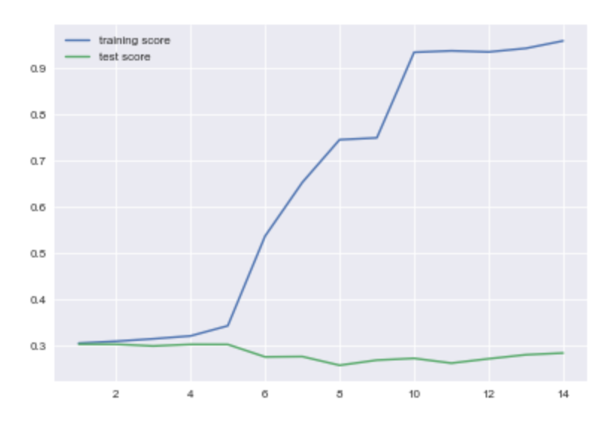
Random Forest

Slide 24
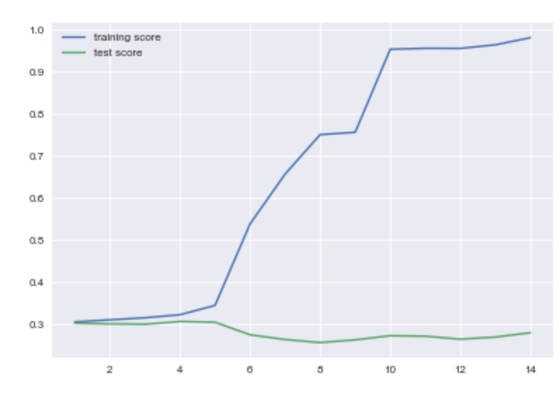
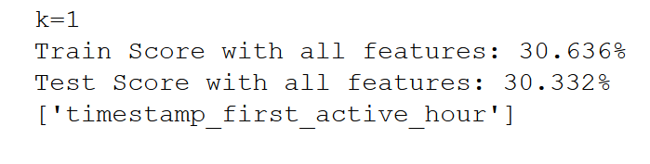
Boosting

Slide 25

Question II
Which country
a new user’s
first
booking destination
will be
?

Slide 26
classification
Decision Tree
Logistic regression
SVM
Ensemble
Boosting
Random Forest

Slide 27
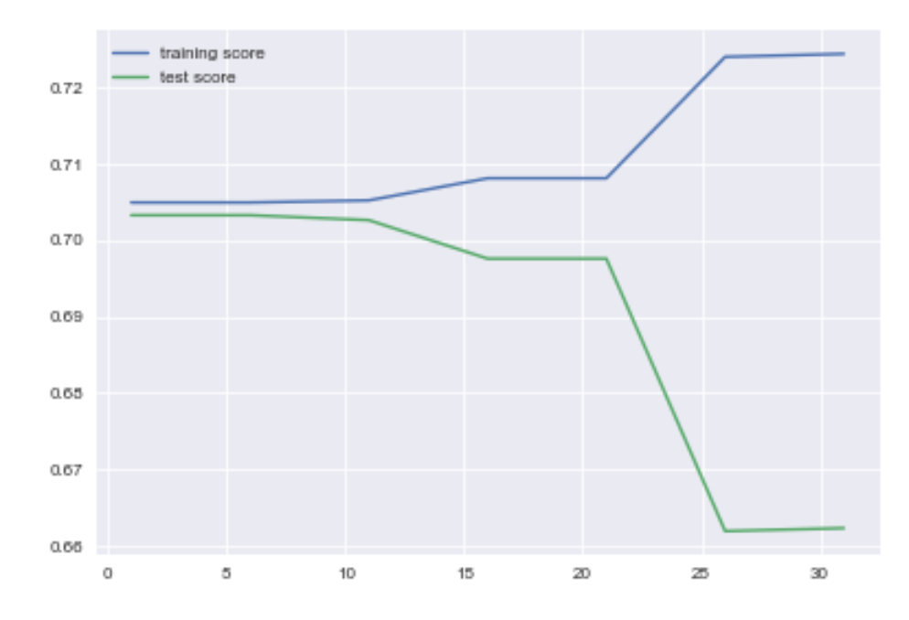
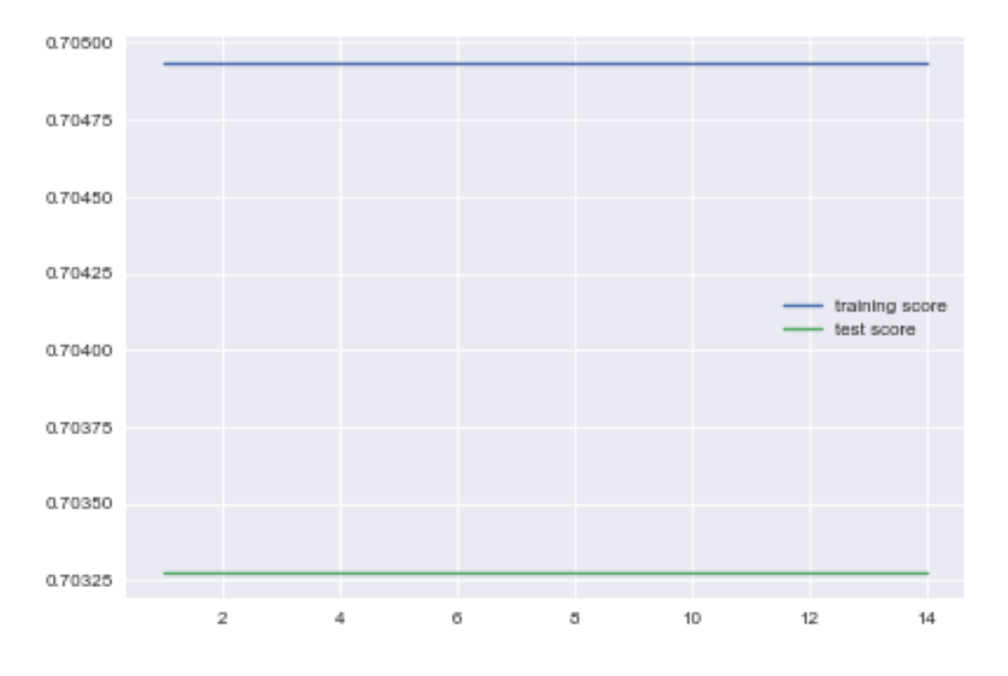
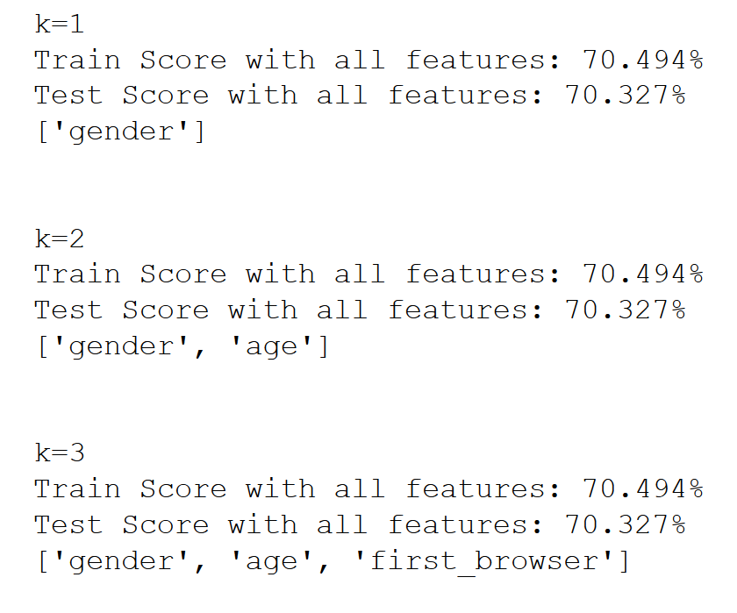
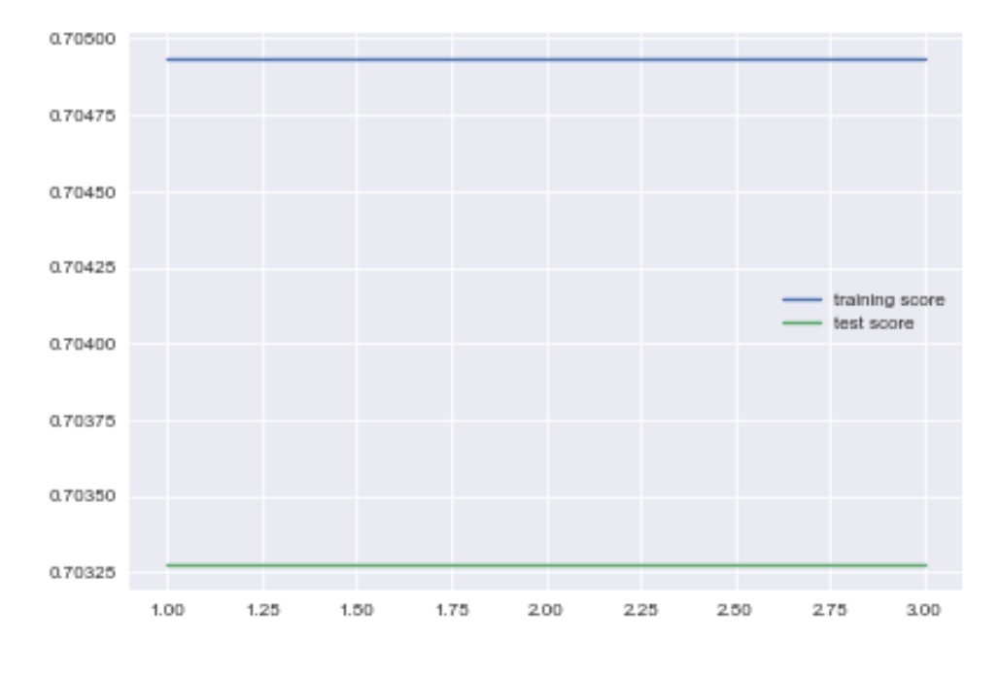
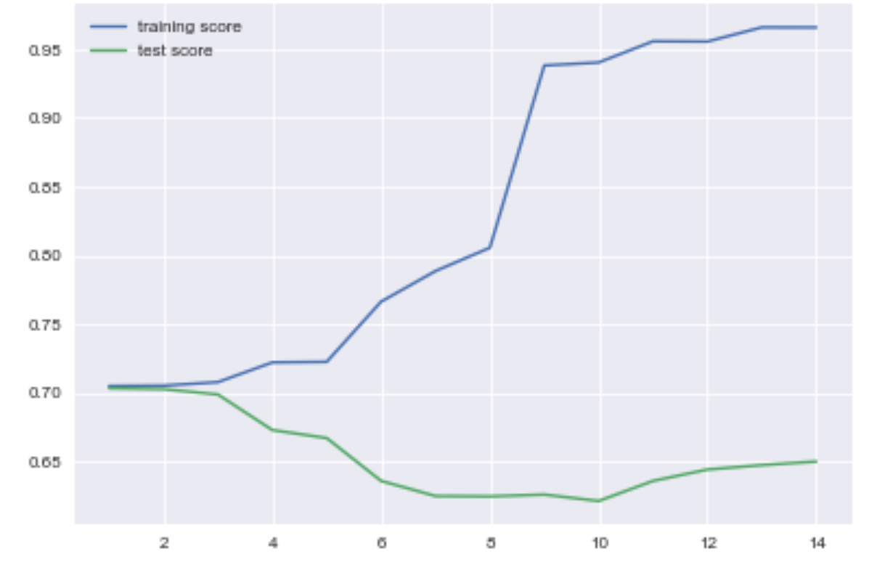
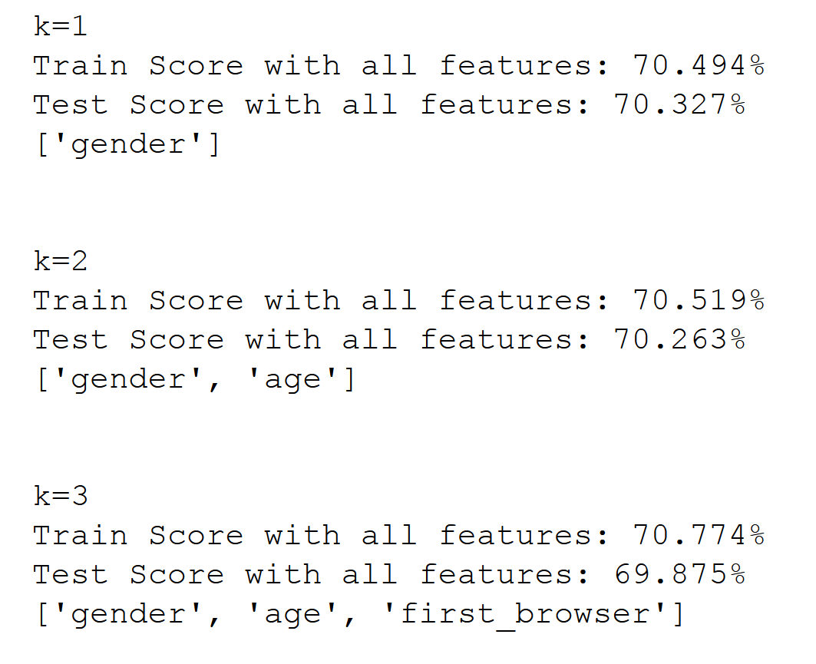
Decision Tree
Logistic Regression
Train Score with all features: 74.553%
Test Score with all features: 62.165%
SVM: 'gender'
Random Forest

Slide 28
Conclusion
Neither model is particularly useful.
Destination Prediction:
58% of data is classified as “NDF”
29% US domestic travel
all other locations occur less than 5% of the time
Highly skewed data, our model is good at predicting whether they will travel domestically or not at all. That is not the purpose of the model.
Time To Book Prediction:
Model is only 30% accurate.
By random chance we’d guess correctly 25% of the time

Slide 29
If we have more time…
Try alternative methods for dealing with missing/unknown data.
Re-bucket TimeDiff into two or three groups
Tried to gain more cases where other destinations were selected.
Potentially split destination model into two separate models.
1 – probability that they will book at all
2 – dropping the NDF label, retry the destination prediction.

Slide 30
Questions?

