Slide 1

See your Facebook posts
You can find everything you posted on facebook
in two easy steps!
Information Type: Working Standard, Disclosure Range: , Information Owner: cosma.cosmin, NTT DATA Romania

Slide 2



Why Facebook?
If you think about social media, the first thing that you think of is Facebook.
The API that Facebook provides offers other products that can be integrated within the app, such as analytics, messenger or jobs.
Information Type: Working Standard, Disclosure Range: , Information Owner: cosma.cosmin, NTT DATA Romania

Slide 3
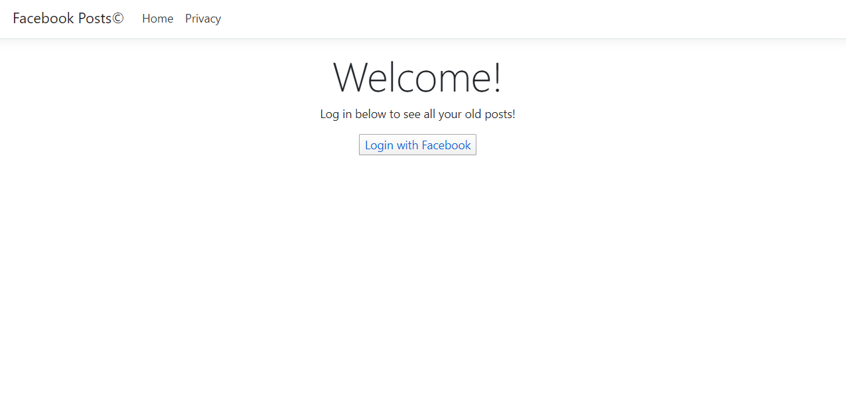
See your past facebook posts in one easy step
To see your Facebook posts you only have to login into your account, and the website searches for all your posts and shows them to you!
Information Type: Working Standard, Disclosure Range: , Information Owner: cosma.cosmin, NTT DATA Romania

Slide 4

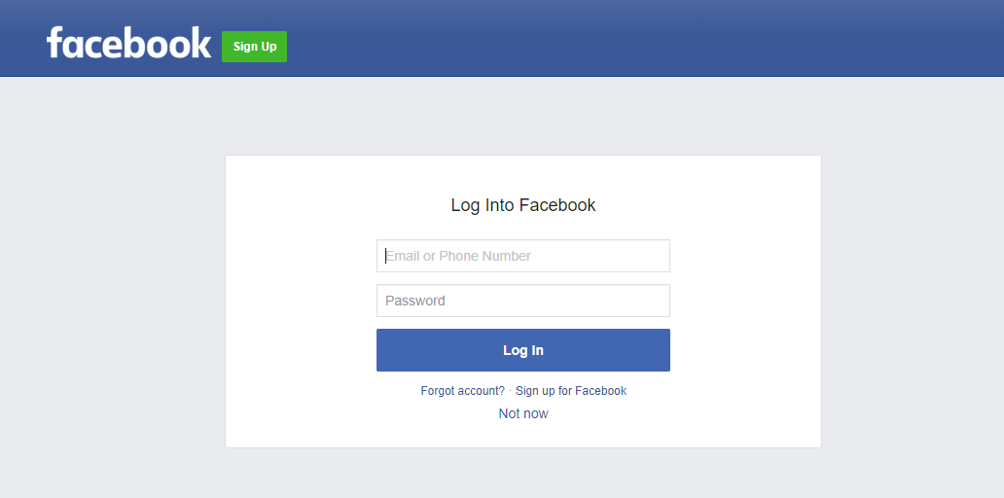
Login process:
After you click on the login button, you will be redirected to Facebook to enter your credentials.
That's it. After succesfully logging in you only have to wait and watch the magic happen!
Information Type: Working Standard, Disclosure Range: , Information Owner: cosma.cosmin, NTT DATA Romania

Slide 5
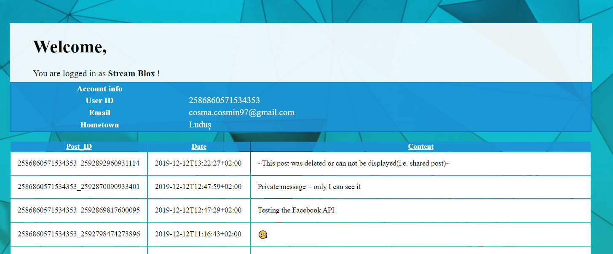
See your posts:
When the website is finished loading you should see some of your general facebook account info, like your email,username,home town.
Below the basic information you will find your posts.
Information Type: Working Standard, Disclosure Range: , Information Owner: cosma.cosmin, NTT DATA Romania

Slide 6
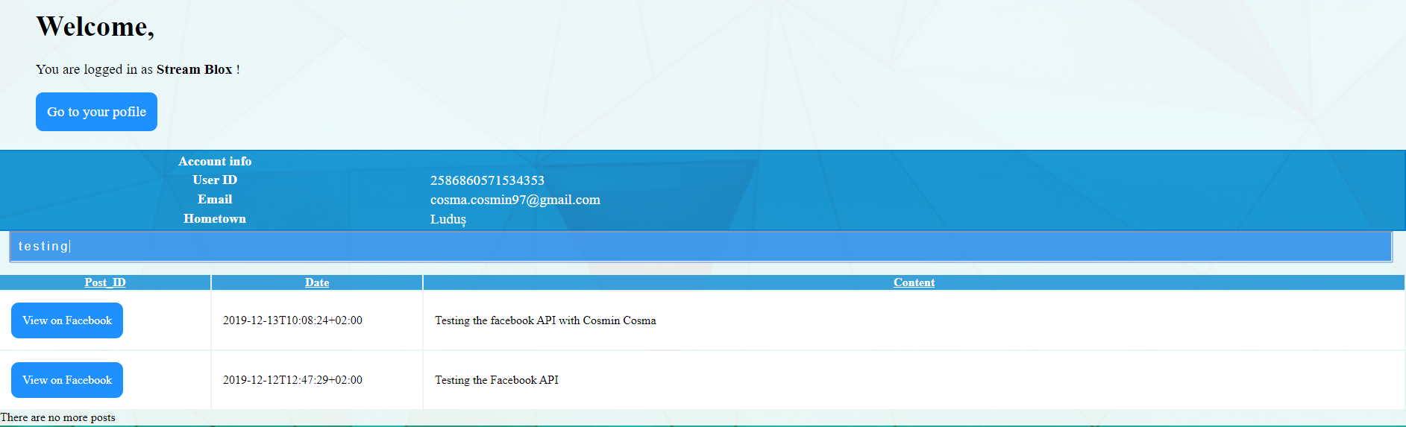
Search posts:
You can search for specific posts by typing some of its content into the search bar, as showing above.
Information Type: Working Standard, Disclosure Range: , Information Owner: cosma.cosmin, NTT DATA Romania

