Slide 1

See your Facebook posts
You can find everything you posted on facebook
in two easy steps!

Slide 2
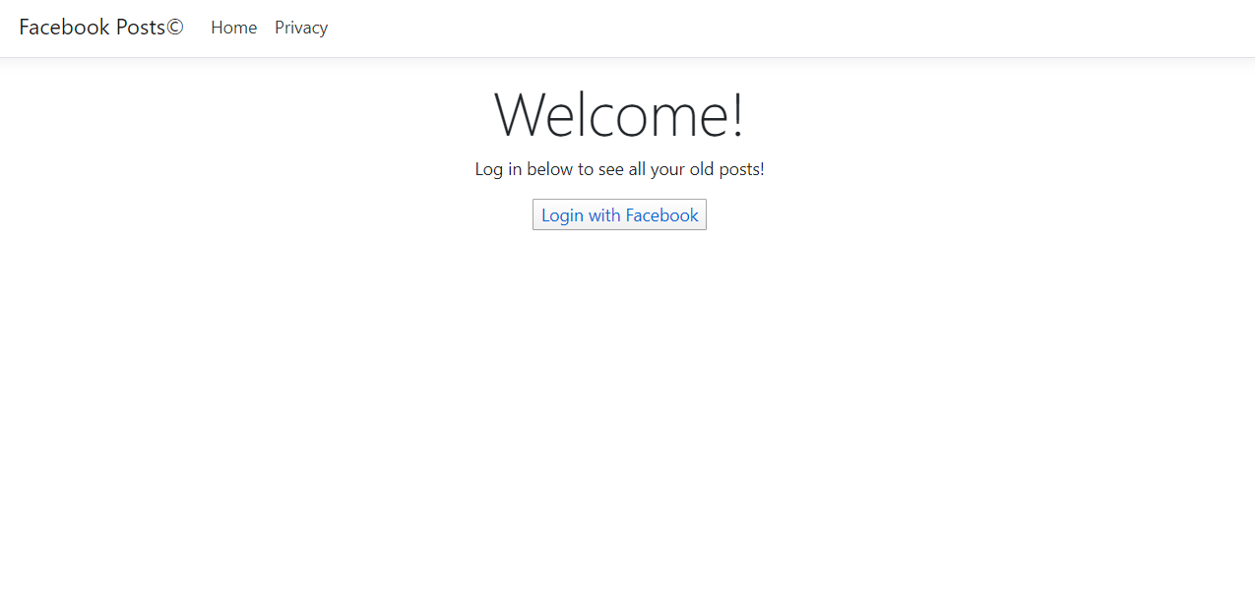
See your past facebook posts in one easy step
To see your Facebook posts you only have to login into your account, and the website searches for all your posts and shows them to you!

Slide 3

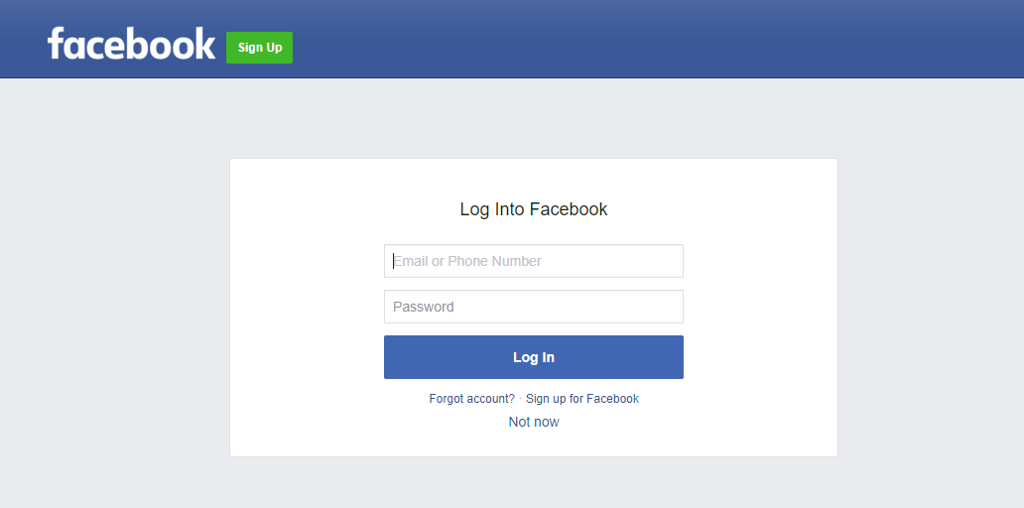
Login process:
After you click on the login button, you will be redirected to Facebook to enter your credentials.
That's it. After succesfully logging in you only have to wait and watch the magic happen!

Slide 4
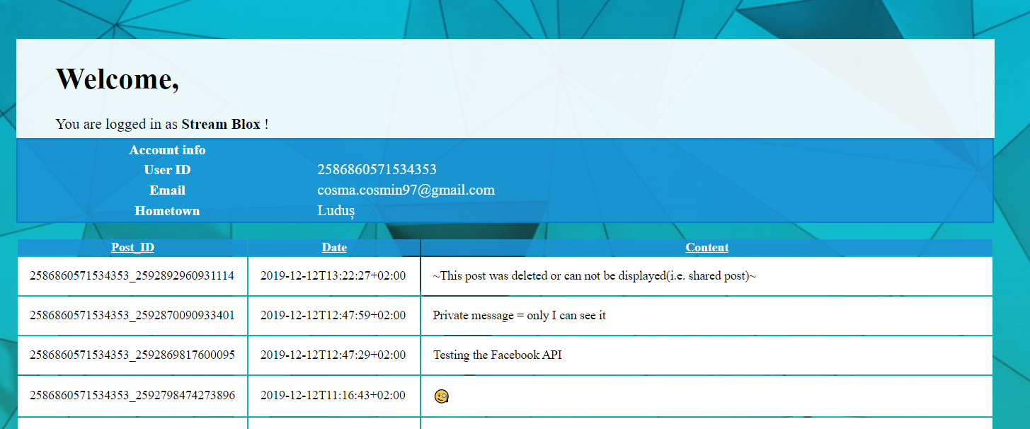
See your posts:
When the website is finished loading you should see some of your general facebook account info, like your email,username,home town.
Below the basic information you will find your posts.

