Slide 1
Cybersecurity Merit Badge
2025
“Shall we play a game?”

Slide 2
Instructor Info
Chris Jones
  Merit Badge Counselor for Cybersecurity
  Committee Chair, Pack 439 & Troop 439
  Contact Info:
    Cell: 509-979-9721
    Email: chriscjones@pm.me
  Class resources
    https://github.com/ccjones007/meritbadge

Slide 3
Chris’ Career
Master in Computer Science from WSU
Started career as Research Scientist @ BBN Technologies
Became a backend/server developer
  Worked at TriGeo Network Security for 7 years
  Solarwinds for 3 years
Research-QA Engineer at Tenable Network Security
Senior Software Engineer at Tenable Network Security
Tech Lead/ Senior Software Engineer at J-Mack Technologies

Slide 4
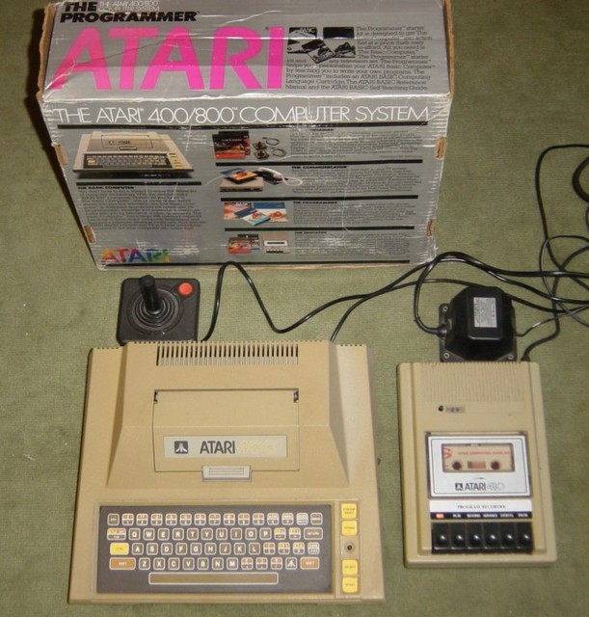
Chris’ First Computer

Slide 5
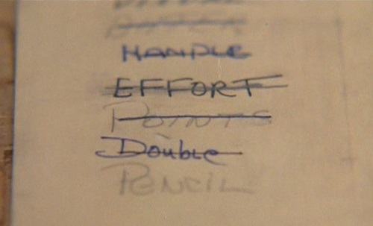
Shall we play a game?
https://www.youtube.com/watch?v=F7-H1U7T4y0

