Slide 1
Pages
Lading Page: Dashboard (1)
Demographics (2)
Offense Category (3)
Length of case (4)
Courts (5)
About: description of the project and us (6)
Data: Table mini description of data (7)
Map: Map of the county (total cases, percentage of offense category [80%/20%]) (8)

Slide 2
Charts
Data 1 | Data 2 | Data 3 | Data 4 | Data 5 | Type of chart | Landing | Speciffic page
AGE_AT_INCIDENT | Court (filter) | Offense (filter) | Sentence (filter) | ID | Pie chart | No | Demographic
GENDER | Court (filter) | Offense (filter) | Sentence (filter) | ID | Pie chart | No | Demographic
RACE | Court (filter) | Offense (filter) | Sentence (filter) | ID | Pie chart | No | Demographic
Commitment term/unit | OFFENSE_CATEGORY | commitment type (filter) | Court (filter)???? |  | Bar chart | Yes | Offense Category
LENGTH_OF_CASE_in_Days | Commitment term/unit | Offense (filter) | COMMITMENT_TYPE (filter) | AGE_AT_INCIDENT | Line/scatter graph | Yes | Length of case
LENGTH_OF_CASE_in_Days | Commitment term/unit | Offense (filter) | COMMITMENT_TYPE (filter) |  | Box plot | No | Length of case
COURT_NAME | COMMITMENT_TYPE | Commitment term/unit (filter) | Offense (filter) | ID | Multi Color Bar chart | Yes | Courts
AGE_AT_INCIDENT | COMMITMENT_TYPE | Commitment term/unit (filter) | Court (filter) | ID | Line/scatter graph | Yes | Courts
OFFENSE_CATEGORY | COMMITMENT_TYPE | COMMITMENT_UNIT | COMMITMENT_TERM |  | Multilevel pie chart | Yes | Offense Category
GENDER | RACE | AGE_AT_INCIDENT |  |  | Multilevel pie chart | Yes | Demographic
Index(['case_id', 'case_participant_id', 'charge_id', 'charge_version_id', 'court_facility', 'court_name', 'age_at_incident', 'gender', 'race', 'charge_disposition', 'length_of_case_in_days', 'current_sentence', 'primary_charge', 'sentence_date', 'offense_category', 'commitment_term', 'commitment_unit', 'sentence_type', 'date_year', 'month', 'year'],

Slide 3
Index(['case_id', 'case_participant_id', 'charge_id', 'charge_version_id', 'court_facility', 'court_name', 'age_at_incident', 'gender', 'race', 'charge_disposition', 'length_of_case_in_days', 'current_sentence', 'primary_charge', 'sentence_date', 'offense_category', 'commitment_term', 'commitment_unit', 'sentence_type', 'date_year', 'month', 'year'],
Case
Charge
Participant
Court
Sentence
Case_participant_id ID
court_facility
court_name
age_at_incident
gender
race
charge_disposition
length_of_case_in_days
current_sentence
offense_category
sentence_date
commitment_term
commitment_unit
sentence_type
date_year
month
year
Court_id ID
Case_participant_id
Court_id

Slide 4
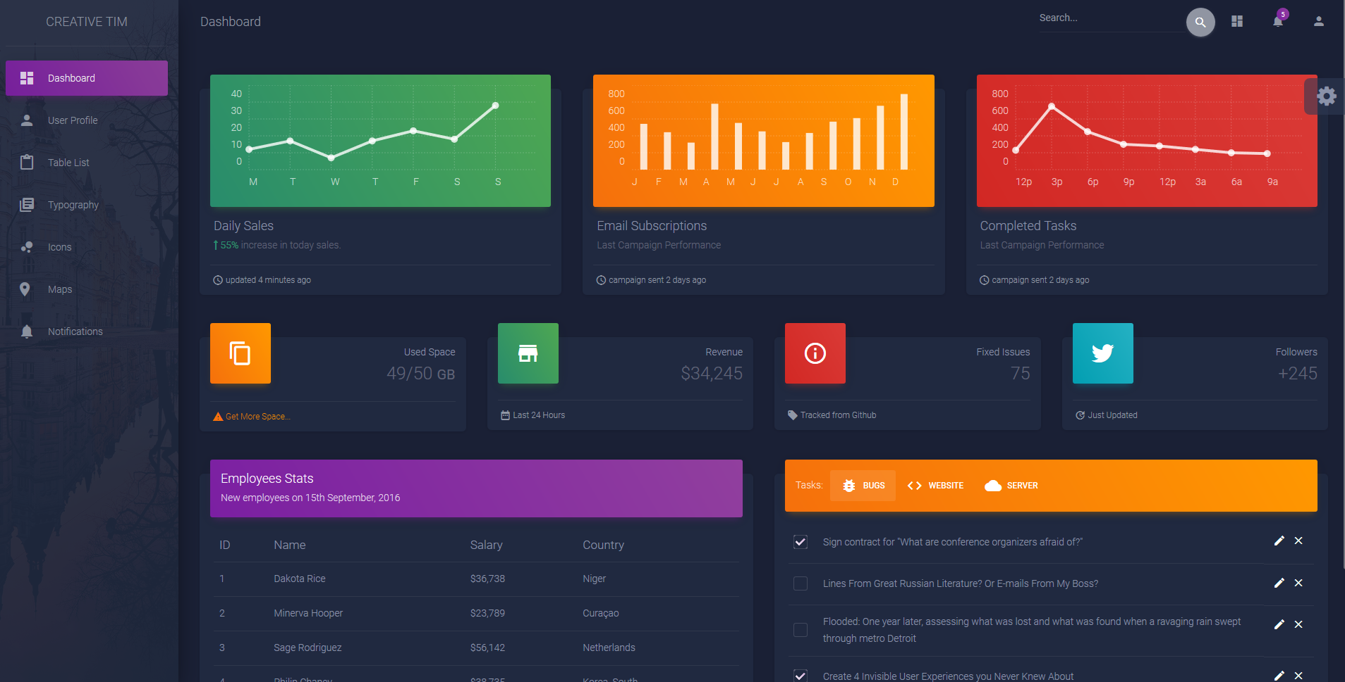
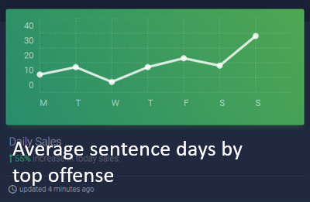
Sentences in Cook County
Dashboard
Type of offense
About
Data
Map of county
Average sentence days by top offense

Slide 5
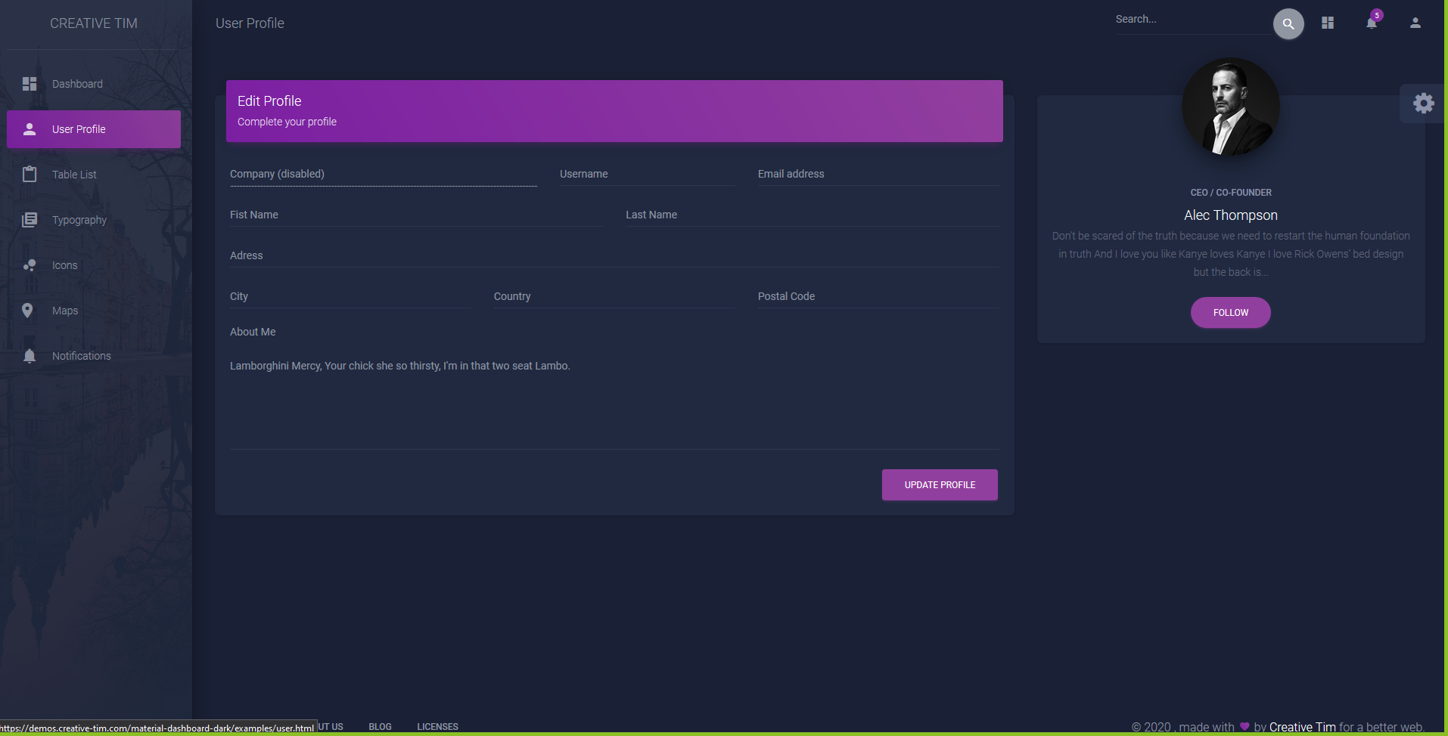
Sentences in Cook County
Dashboard
About
Data
Map of county

Slide 6
General Data
Average sentence days by top offense
Court Average sentence days
Average sentence days by age at incident
Type of offense
20% Women
80% Male
20% White
80% Black

Slide 7
Column | Type
COURT_FACILITY | Court
COURT_NAME | Court
AGE_AT_INCIDENT | Demographics
GENDER | Demographics
RACE | Demographics
CHARGE_DISPOSITION | Disposition
LENGTH_OF_CASE_in_Days | Duration
CURRENT_SENTENCE | Filter
PRIMARY_CHARGE | Filter
SENTENCE_DATE | Filter
CASE_ID | ID
CASE_PARTICIPANT_ID | ID
CHARGE_ID | ID
CHARGE_VERSION_ID | ID
DISPOSITION_CHARGED_OFFENSE_TITLE | Offense
OFFENSE_CATEGORY | Offense
COMMITMENT_TERM | Sentence
COMMITMENT_TYPE | Sentence
COMMITMENT_UNIT | Sentence
SENTENCE_TYPE | Sentence

