Slide 1
Pages
Lading Page: Dashboard (1)
Demographics (2)
Offense Category (3)
Length of case (4)
Courts (5)
About: description of the project and us (6)
Data: Table mini description of data (7)
Map: Map of the county (total cases, percentage of offense category [80%/20%]) (8)

Slide 2
Charts
Data 1 | Data 2 | Data 3 | Data 4 | Data 5 | Type of chart | Landing | Speciffic page
AGE_AT_INCIDENT | Court_name(filter) | Offense_category (filter) | SENTENCE_TYPE (filter) | ID | Pie chart | No | /Demographics
GENDER | Court_name(filter) | Offense_category (filter) | SENTENCE_TYPE (filter) | ID | Pie chart | No | /Demographics
RACE | Court_name (filter) | Offense_category (filter) | SENTENCE_TYPE (filter) | ID | Pie chart | No | /Demographics
Commitment term/unit(corresponding terms) | OFFENSE_CATEGORY(count) | sentence type (filter) | Court_name (filter) |  | boxplot chart | Yes | /index /Offense category(in depth analysis)
LENGTH_OF_CASE_in_Days | Commitment term/unit | Offense_category (filter) | SENTENCE_TYPE (filter) | AGE_AT_INCIDENT | scatter graph | Yes | /index /Length of case(in depth)
LENGTH_OF_CASE_in_Days | Offense_category | SENTENCE_TYPE (filter) | Court_name(filter) |  | Box plot | No | /Length of case
COURT_NAME | SENTENCE_TYPE(count) | Offense_category |  | ID | Multi Color Bar chart | Yes | /index /Courts
AGE_AT_INCIDENT | Commitment term/unit | SENTENCE_TYPE(filter) | Court (filter) | ID | scatter graph | Yes | /index /Courts
ID(ALL CASES | OFFENSE_CATEGORY | SENTENCE_TYPE | COURT_NAME(filter only in /O_C) |  | Multilevel pie chart | Yes | /index(general) /Offense_Category
GENDER | RACE | AGE_AT_INCIDENT |  |  | Multilevel pie chart | Yes | /index(general /Demographic

Slide 3
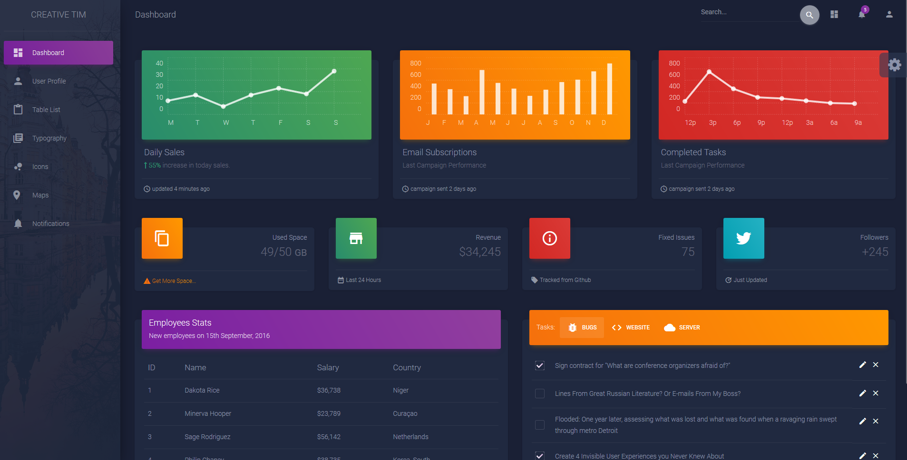
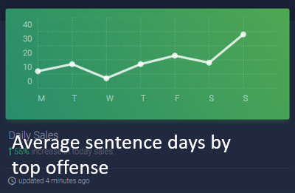
Sentences in Cook County
Dashboard
Type of offense
About
Data
Map of county
Average sentence days by top offense

Slide 4
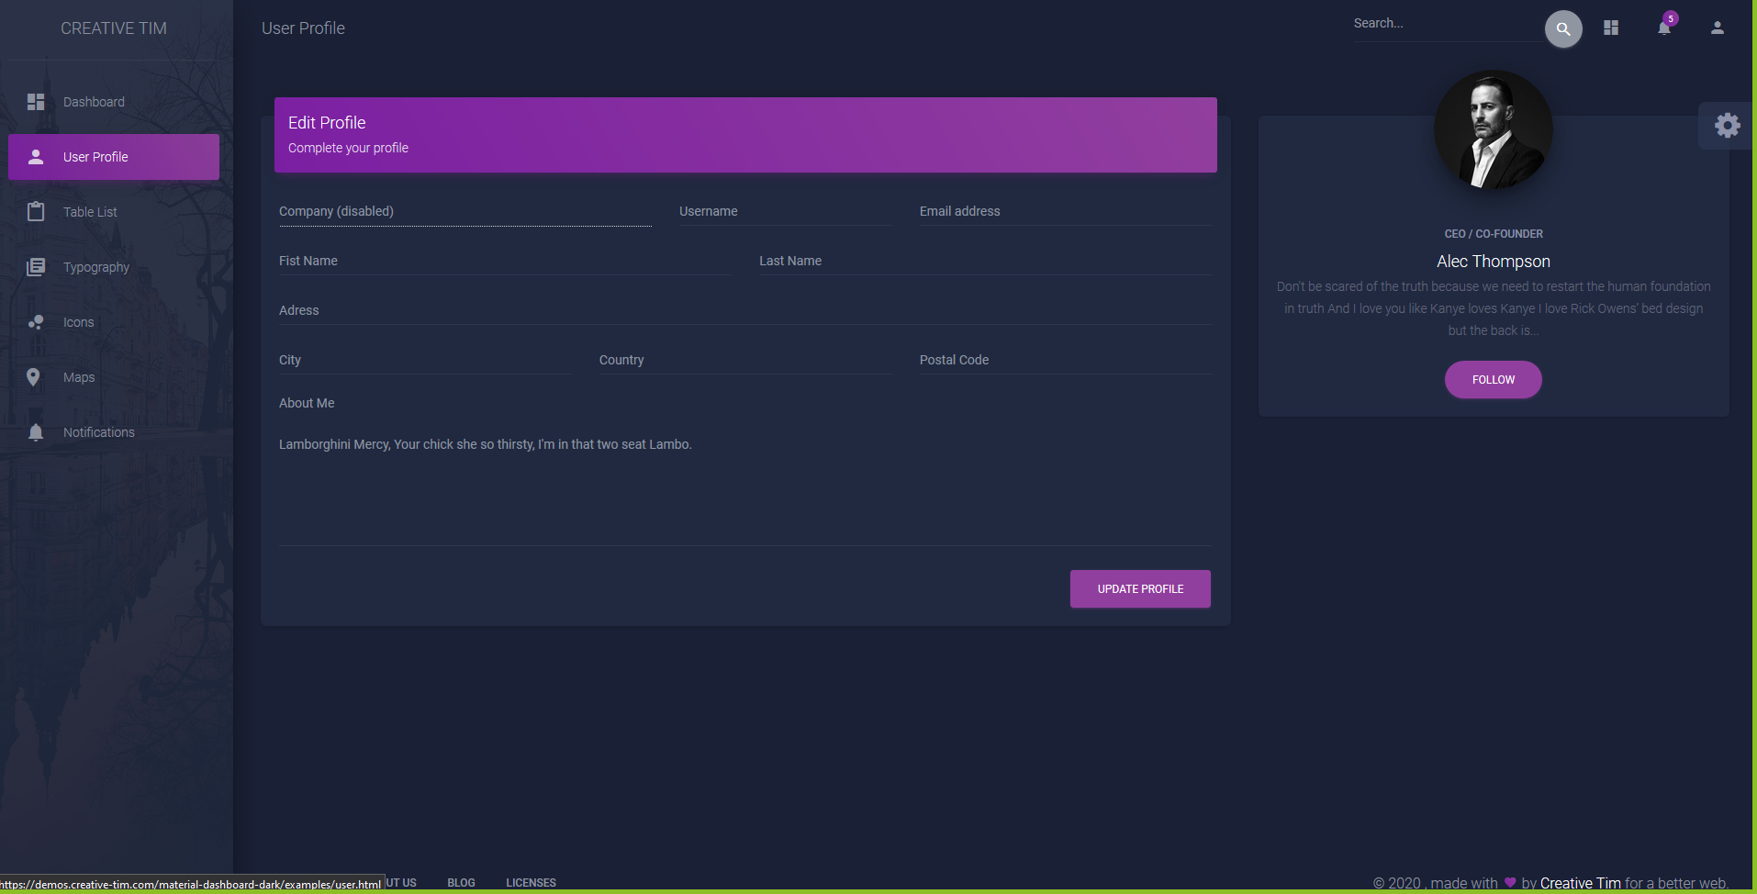
Sentences in Cook County
Dashboard
About
Data
Map of county

Slide 5
General Data
Average sentence days by top offense
Court Average sentence days
Average sentence days by age at incident
Type of offense
20% Women
80% Male
20% White
80% Black

Slide 6
Column | Type
COURT_FACILITY | Court
COURT_NAME | Court
AGE_AT_INCIDENT | Demographics
GENDER | Demographics
RACE | Demographics
CHARGE_DISPOSITION | Disposition
LENGTH_OF_CASE_in_Days | Duration
CURRENT_SENTENCE | Filter
PRIMARY_CHARGE | Filter
SENTENCE_DATE | Filter
CASE_ID | ID
CASE_PARTICIPANT_ID | ID
CHARGE_ID | ID
CHARGE_VERSION_ID | ID
DISPOSITION_CHARGED_OFFENSE_TITLE | Offense
OFFENSE_CATEGORY | Offense
COMMITMENT_TERM | Sentence
COMMITMENT_TYPE | Sentence
COMMITMENT_UNIT | Sentence
SENTENCE_TYPE | Sentence

