Slide 1
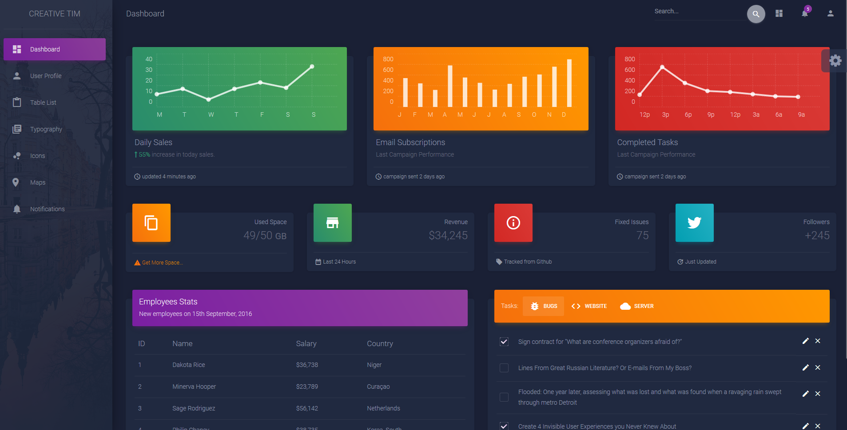
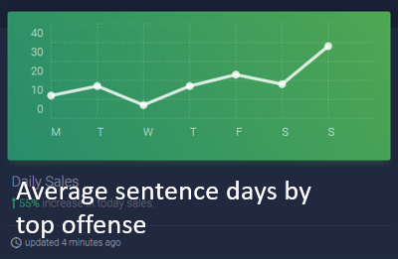
Sentences in Cook County
Dashboard
Type of offense
About
Data
Map of county
Average sentence days by top offense

Slide 2
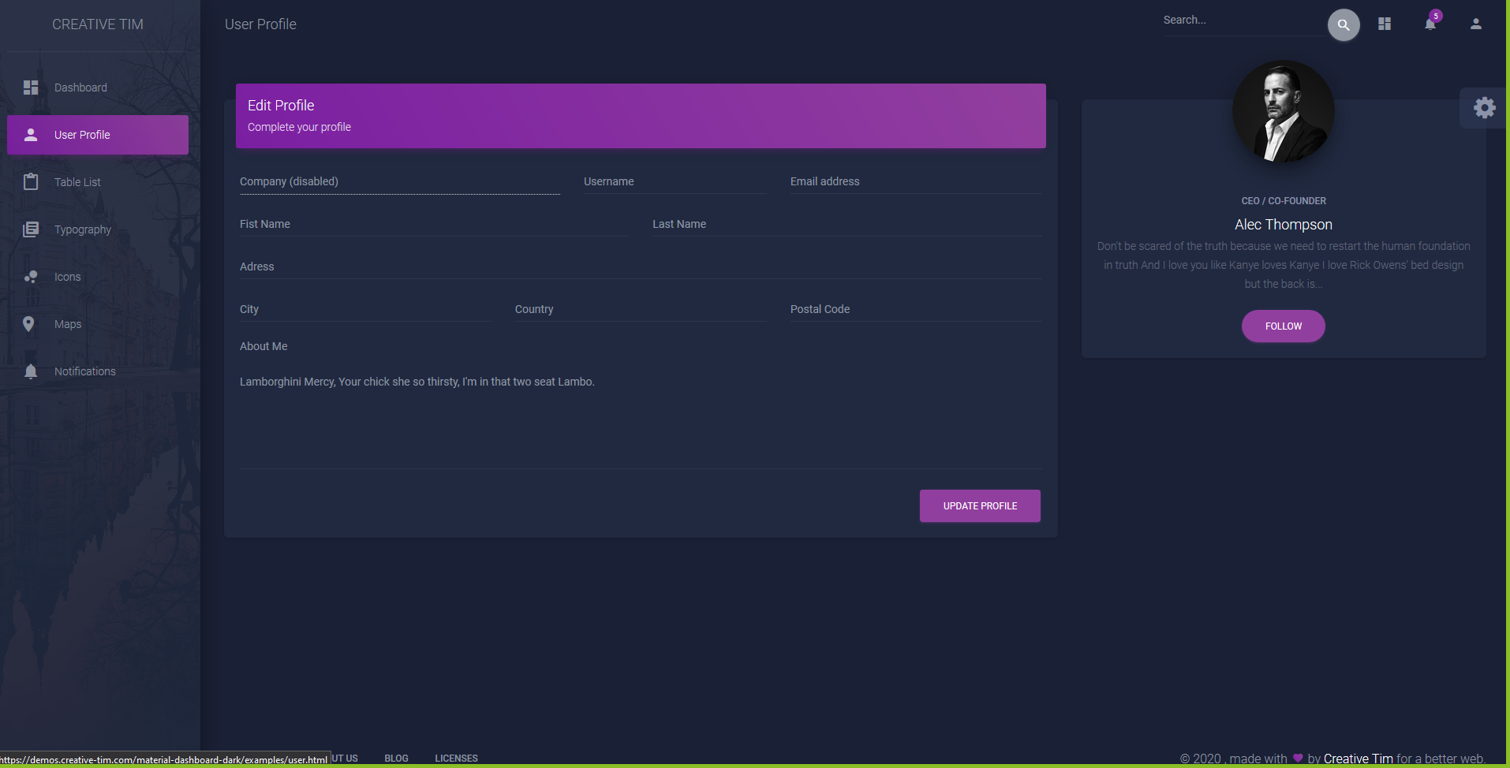
Sentences in Cook County
Dashboard
About
Data
Map of county

Slide 3
General Data
Average sentence days by top offense
Court Average sentence days
Average sentence days by age at incident
Type of offense
20% Women
80% Male
20% White
80% Black

Slide 4
Column | Type
COURT_FACILITY | Court
COURT_NAME | Court
AGE_AT_INCIDENT | Demographics
GENDER | Demographics
RACE | Demographics
CHARGE_DISPOSITION | Disposition
LENGTH_OF_CASE_in_Days | Duration
CURRENT_SENTENCE | Filter
PRIMARY_CHARGE | Filter
SENTENCE_DATE | Filter
CASE_ID | ID
CASE_PARTICIPANT_ID | ID
CHARGE_ID | ID
CHARGE_VERSION_ID | ID
DISPOSITION_CHARGED_OFFENSE_TITLE | Offense
OFFENSE_CATEGORY | Offense
COMMITMENT_TERM | Sentence
COMMITMENT_TYPE | Sentence
COMMITMENT_UNIT | Sentence
SENTENCE_TYPE | Sentence

