Slide 1


Slide 3


Slide 4

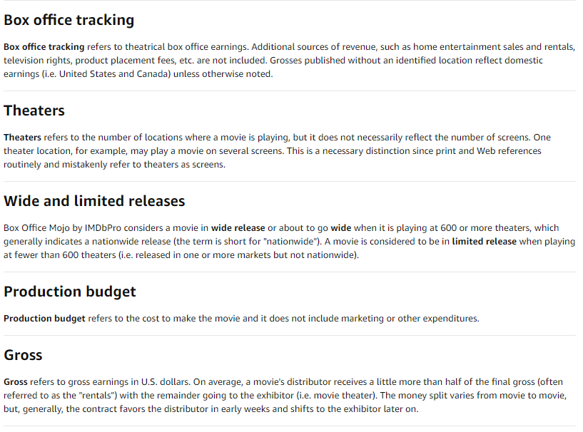
For Gross Income, we considered all the data in the database

Slide 5
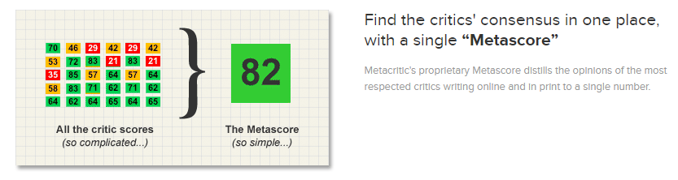

Slide 6
Considerations - General data
# Directors | 2,630
# of Movies | 5,913
Max # Movies per Director | 34
Years | 1931 to 2019

