Slide 1


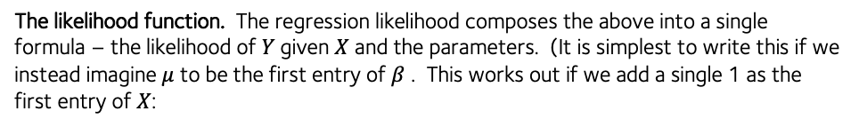







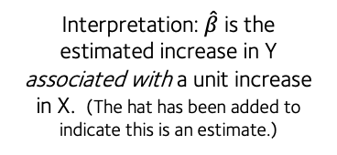








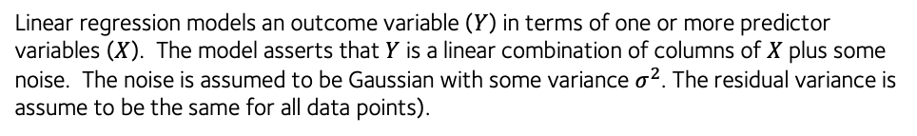


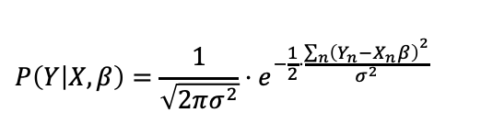
Linear regression cheatsheet
Gavin Band, WHG GMS Programme 2021
Linear regression models an outcome variable ($Y$) in terms of one or more predictor variables ($X$). The model asserts that $Y$ is a linear combination of columns of $X$ plus some noise. The noise is assumed to be Gaussian with some variance $σ^{2}$. The residual variance is assume to be the same for all data points).
Basic linear regression (maximum likelihood) in R:
> fit = lm( Y ~ X, data = D )
> coefficients(fit)
(Intercept) X
0.0007606242 0.3135072376
> logLik(fit)
'log Lik.' -132.981 (df=3)
> residuals(fit)
1 2 3 4
-0.6115976 -0.3239313 0.7034511 -0.2934937 . . .
> summary(fit)$coefficients
Estimate Std. Error t value Pr(>|t|)
(Intercept) 0.0007606242 0.09412669 0.008080856 0.9935689071
X 0.3135072376 0.08512788 3.682780013 0.0003778035
$$Y=μ+X_{1}β_{1}+X_{2}β_{2}+…X_{d}β_{d}+ε$$
$$ε\sim N(0,σ^{2})$$
Or using matrix notation:
$$Y=μ+Xβ+ε$$
$$ε\sim N(0,σ^{2})$$
Matrix multiplication of the d-dimensional row vector of predictors X and the d-dimensional column vector of of parameters $β$
“residual” error for this data point
Regression “slope” ($\hat{β}$)
This turns out to have an analytic solution:
Interpretation: $\hat{β}$ is the estimated increase in Y associated with a unit increase in X. (The hat has been added to indicate this is an estimate.)
$$\hat{β}= {\left(X^{t}X\right)}^{−1}X^{t}Y$$
Maximum likelihood estimate (MLE)
$$Y$$
$$\text{variance}\left(\hat{β}\right)=σ^{2}{\left(X^{t}X\right)}^{−1}$$
Variance of MLE
“intercept”
($μ$)
$$\text{se}\left(\hat{β_{j}}\right)= \sqrt{σ^{2}{{\left(X^{t}X\right)}_{jj}}^{−1}}$$
Standard error of MLE
$$0$$
$$1$$
$$2$$
$$3$$
$$4$$
But what if you want to fit with prior information included? Use brms package:
$$X$$
> library( bmrs )
> fit = brm(
Y ~ X,
data = data,
prior = set_prior( “normal(0,1)” )
)
> fit$fit
Inference for Stan model: ca2436c230608c2ca38ebc402110120d.
4 chains, each with iter=2000; warmup=1000; thin=1;
post-warmup draws per chain=1000, total post-warmup draws=4000.
mean se_mean sd 2.5% 25% 50% 75% 97.5% n_eff Rhat
b_Intercept 0.25 0.00 0.05 0.16 0.22 0.25 0.28 0.34 3549 1
b_X -0.05 0.00 0.04 -0.13 -0.08 -0.05 -0.02 0.03 4293 1
sigma 0.45 0.00 0.03 0.39 0.42 0.44 0.47 0.51 3729 1
lp__ -65.24 0.03 1.25 -68.44 -65.82 -64.91 -64.32 -63.81 1972 1
Samples were drawn using NUTS(diag_e) at Thu Nov 11 17:56:07 2021.
For each parameter, n_eff is a crude measure of effective sample size,
and Rhat is the potential scale reduction factor on split chains (at
convergence, Rhat=1).
The likelihood function. The regression likelihood composes the above into a single formula – the likelihood of $Y$given $X$ and the parameters. (It is simplest to write this if we instead imagine $μ$ to be the first entry of $β$ . This works out if we add a single 1 as the first entry of $X$:
For a single sample:
$$P\left(Y | X,β\right)=\frac{1}{\sqrt{2πσ^{2}}}⋅e^{−\frac{1}{2}⋅\frac{{\left(Y−Xβ\right)}^{2}}{σ^{2}}}$$
Squared residual (distance) from regression line
The outcome values are assumed independent of each other (probabilities multiply). So for multiple samples the likelihood is:
$$P\left(Y | X,β\right)=\frac{1}{\sqrt{2πσ^{2}}}⋅e^{−\frac{1}{2}⋅\frac{{\sum_{n}{\left(Y_{n}−X_{n}β\right)}}^{2}}{σ^{2}}}$$
“sum of squared errors”
For multiple samples:
($n=1,…,N)$
The exponent is negative. Maximising the likelihood is therefore the same as minimizing the sum of squared errors – it finds the ‘best-fitting line’.

Slide 2


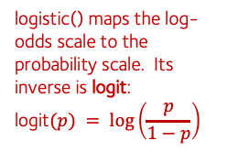




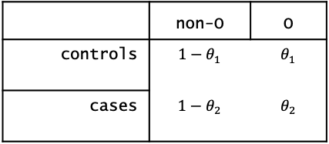


Logistic regression cheatsheet
Gavin Band, WHG GMS Programme 2021
Logistic regression is a bit like linear regression, but models a binary outcome instead of a continuous one. To motivate it, first consider a 2x2 table like this one:
Basic linear regression (maximum likelihood) in R:
> fit = lm( Y ~ X, data = D )
> coefficients(fit)
(Intercept) X
0.0007606242 0.3135072376
> logLik(fit)
'log Lik.' -132.981 (df=3)
> residuals(fit)
1 2 3 4
-0.6115976 -0.3239313 0.7034511 -0.2934937 . . .
> summary(fit)$coefficients
Estimate Std. Error t value Pr(>|t|)
(Intercept) 0.0007606242 0.09412669 0.008080856 0.9935689071
X 0.3135072376 0.08512788 3.682780013 0.0003778035
 | non O bld. grp. | O bld.grp
Population controls | 3420 (a) | 3925 (b)
Cases |  | 2738 (d)
Data from MalariaGEN, “Insights into malaria susceptibility from the genomes of 17,000 individuals”, https://doi.org/10.1038/s41467-019-13480-z
We’d like to know if the frequency differs between cases and controls – is there evidence that O is protective?
One way to measure this is to compute the odds ratio . The sample odds ratio is just $\frac{ad}{bc}$. But this is just a point estimate of the effect size – we want a full model.
The simplest way to model this is to put a separate frequency in each row:
 | non-O | O
controls | $$1−θ_{1}$$ | $$θ_{1}$$
cases | $$1−θ_{2}$$ | $$θ_{2}$$
And then say that the counts in each row follow a binomial distribution with the given frequency. (This was justified as on the sampling cheatsheet.)
The odds ratio is then:
$$OR =\frac{θ_{2}(1−θ_{1})}{θ_{1}(1−θ_{2})}$$
IN practice we will use the logarithm of the odds ratio (log odds ratio) instead. It’s nicer because it takes values on the whole real line (while the OR is between 0 and $∞$). To do this, first define the logistic function:
> library( bmrs )
> fit = brm(
Y ~ X,
data = data,
prior = set_prior( “normal(0,1)” )
)
> fit$fit
Inference for Stan model: ca2436c230608c2ca38ebc402110120d.
4 chains, each with iter=2000; warmup=1000; thin=1;
post-warmup draws per chain=1000, total post-warmup draws=4000.
mean se_mean sd 2.5% 25% 50% 75% 97.5% n_eff Rhat
b_Intercept 0.25 0.00 0.05 0.16 0.22 0.25 0.28 0.34 3549 1
b_X -0.05 0.00 0.04 -0.13 -0.08 -0.05 -0.02 0.03 4293 1
sigma 0.45 0.00 0.03 0.39 0.42 0.44 0.47 0.51 3729 1
lp__ -65.24 0.03 1.25 -68.44 -65.82 -64.91 -64.32 -63.81 1972 1
Samples were drawn using NUTS(diag_e) at Thu Nov 11 17:56:07 2021.
For each parameter, n_eff is a crude measure of effective sample size,
and Rhat is the potential scale reduction factor on split chains (at
convergence, Rhat=1).
1
logistic() maps the log-odds scale to the probability scale. Its inverse is logit:
$$\text{l}\text{ogit}(p) = log\left(\frac{p}{1−p}\right)⁡$$
# in R
logistic <- function( x ) {
exp(x) / ( 1 + exp(x))
}
0
$$x$$
Now we reparameterise the table in terms of a baseline log-odds and a log-odds ratio:
$$θ_{1}=\text{logistic}(μ)$$
or written the other way round:
$$μ=\text{logi}\text{t}(θ_{1})$$
$$θ_{2}=\text{logistic}(μ+β)$$
$$β=\text{logit} \left(θ_{2}\right)−\text{logit} (θ_{1})$$
Probability / frequency scale
Log-odds scale

Slide 3
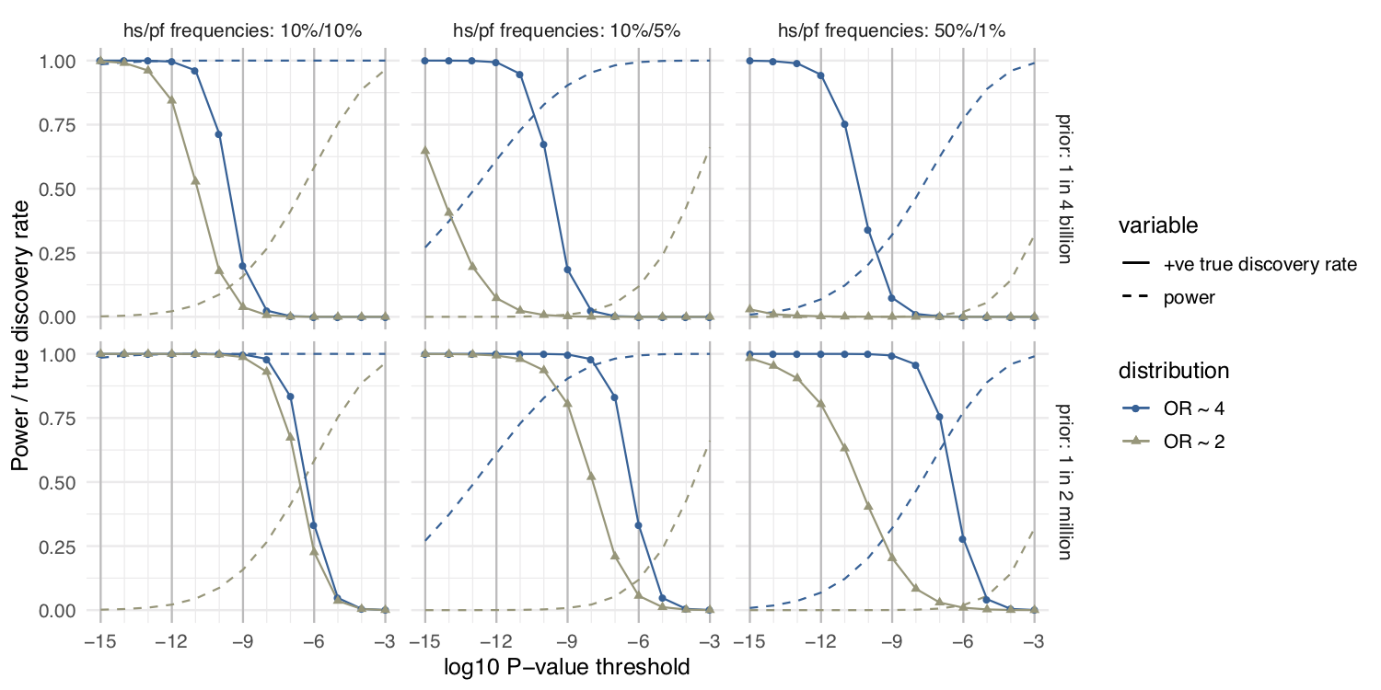

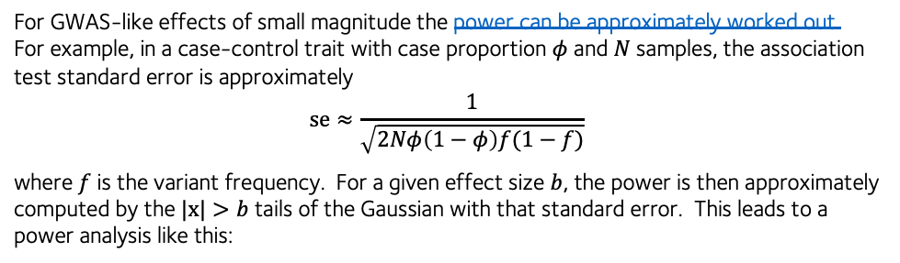

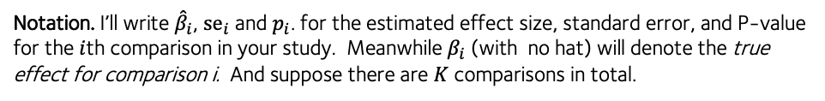


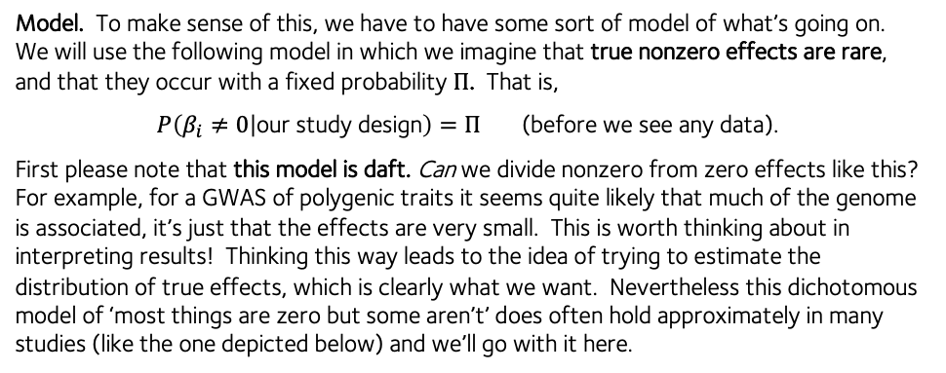
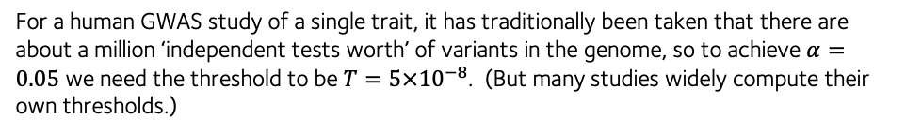
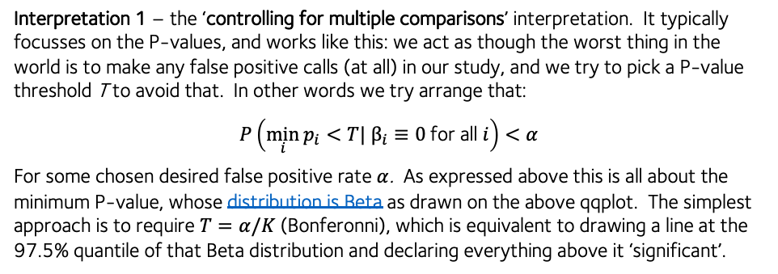

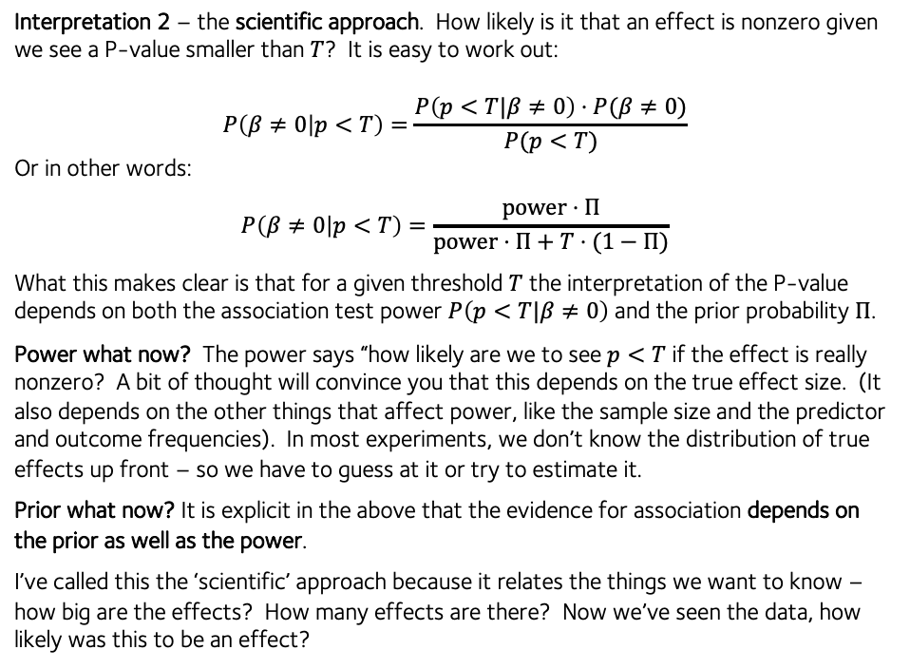
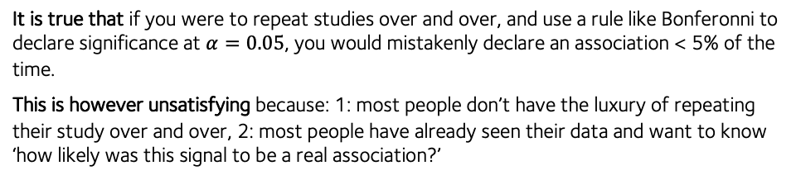
Interpreting evidence cheatsheet
It is true that if you were to repeat studies over and over, and use a rule like Bonferonni to declare significance at $α=0.05$, you would mistakenly declare an association < 5% of the time.
This is however unsatisfying because: 1: most people don’t have the luxury of repeating their study over and over, 2: most people have already seen their data and want to know ‘how likely was this signal to be a real association?’
Gavin Band, WHG GMS Programme 2021
Let’s suppose you have run your GWAS or other large-scale study, and now you have a bunch of effect size estimates, standard errors, and P-values or Bayes factors. How do you interpret them?
Notation. I’ll write ${\hat{β}}_{i}$, ${\text{se}}_{i}$ and $p_{i}$. for the estimated effect size, standard error, and P-value for the $i$th comparison in your study. Meanwhile $β_{i}$ (with no hat) will denote the true effect for comparison i. And suppose there are $K$ comparisons in total.
Interpretation 2 – the scientific approach. How likely is it that an effect is nonzero given we see a P-value smaller than $T$? It is easy to work out:
$$P\left(β≠0 | p<T\right)=\frac{P\left(p<T|β≠0\right)⋅P(β≠0)}{P(p<T)}$$
Or in other words:
$$P\left(β≠0 | p<T\right)=\frac{\text{power}⋅Π}{\text{power}⋅Π+T⋅(1−Π)}$$
What this makes clear is that for a given threshold $T$ the interpretation of the P-value depends on both the association test power $P\left(p<T|β≠0\right)$ and the prior probability $Π$.
Power what now? The power says “how likely are we to see $p<T$ if the effect is really nonzero? A bit of thought will convince you that this depends on the true effect size. (It also depends on the other things that affect power, like the sample size and the predictor and outcome frequencies). In most experiments, we don’t know the distribution of true effects up front – so we have to guess at it or try to estimate it.
Prior what now? It is explicit in the above that the evidence for association depends on the prior as well as the power.
I’ve called this the ‘scientific’ approach because it relates the things we want to know – how big are the effects? How many effects are there? Now we’ve seen the data, how likely was this to be an effect?
Model. To make sense of this, we have to have some sort of model of what’s going on. We will use the following model in which we imagine that true nonzero effects are rare, and that they occur with a fixed probability $Π$. That is,
$P\left(β_{i}≠0 | \text{our} \text{study} \text{design}\right)=Π$ (before we see any data).
First please note that this model is daft. Can we divide nonzero from zero effects like this? For example, for a GWAS of polygenic traits it seems quite likely that much of the genome is associated, it’s just that the effects are very small. This is worth thinking about in interpreting results! Thinking this way leads to the idea of trying to estimate the distribution of true effects, which is clearly what we want. Nevertheless this dichotomous model of ‘most things are zero but some aren’t’ does often hold approximately in many studies (like the one depicted below) and we’ll go with it here.
Apply Bayes’ rule to LHS
P-value passes Bonferroni correction if above this line.
Observed $–{\text{log}}_{10} P$
2.5%-97.5% quantiles of a $\text{Beta}(i,K+1−i)$ distribution
(E.g. qnorm() in R)
Whole study
For GWAS-like effects of small magnitude the power can be approximately worked out. For example, in a case-control trait with case proportion $φ$ and $N$ samples, the association test standard error is approximately
$$s\text{e}≈\frac{1}{\sqrt{2Nφ\left(1−φ\right)f(1−f)}}$$
where $f$ is the variant frequency. For a given effect size $b$, the power is then approximately computed by the $|x|>b$ tails of the Gaussian with that standard error. This leads to a power analysis like this:
Benjamini-Hochberg FDR method
After removing a signal
Expected $–{\text{log}}_{10} P$
Interpretation 1 – the ‘controlling for multiple comparisons’ interpretation. It typically focusses on the P-values, and works like this: we act as though the worst thing in the world is to make any false positive calls (at all) in our study, and we try to pick a P-value threshold T to avoid that. In other words we try arrange that:
$$P\left(\min_{i}{p_{i}}<T| β_{i}≡0 \text{for} \text{all} i\right)<α$$
For some chosen desired false positive rate $α$. As expressed above this is all about the minimum P-value, whose distribution is Beta as drawn on the above qqplot. The simplest approach is to require $T=α/K$(Bonferonni), which is equivalent to drawing a line at the 97.5% quantile of that Beta distribution and declaring everything above it ‘significant’.
A probability, or expectation over repeated studies
Power (dashed lines) decreases as threshold gets more strict
Example The plot on the left is for a disease at 1% frequency and a SNP at 50% frequency, with a prior of 1 in 2 million.
For an experiment to be successful, we want to have a threshold that gives us high power (chance to detect signals) and a high chance that the detected signals are real.
Probability
For a human GWAS study of a single trait, it has traditionally been taken that there are about a million ‘independent tests worth’ of variants in the genome, so to achieve $α=0.05$ we need the threshold to be $T=5×{10}^{−8}$. (But many studies widely compute their own thresholds.)
$P(β≠0|p<T)$ i(sold lines) ncreases as threshold gets more strict
P-value threshold $T$

