Slide 1
Capstone Project
Dungeon Crawler Video Game
Christopher Clark
Morgan Channel
Raymond Chui
Cedric Crawford

Slide 2
Concept
Inspired by The Legend of Zelda
  2D
  Aerial View
  Dungeon Crawler
Uses the Godot Game Engine
  Cross-Platform
  Open-Sourced
  Free to Use

Slide 3
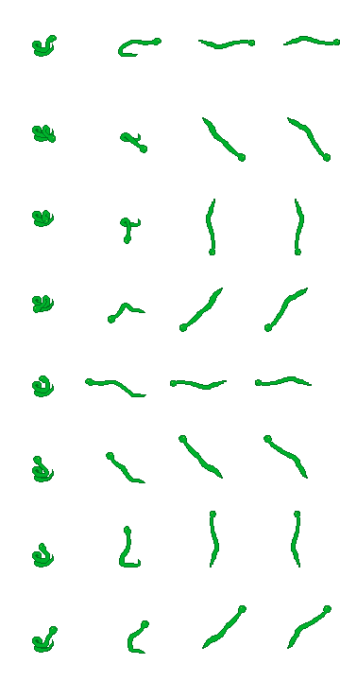
Artwork

Slide 4


Artwork

Slide 5




Artwork

Slide 6
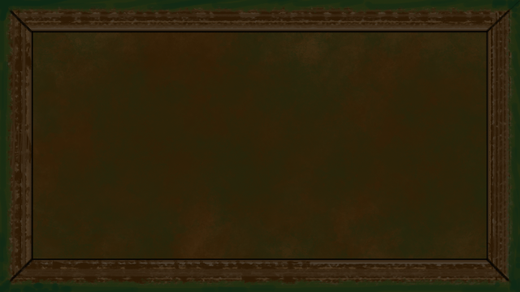

Artwork

Slide 7

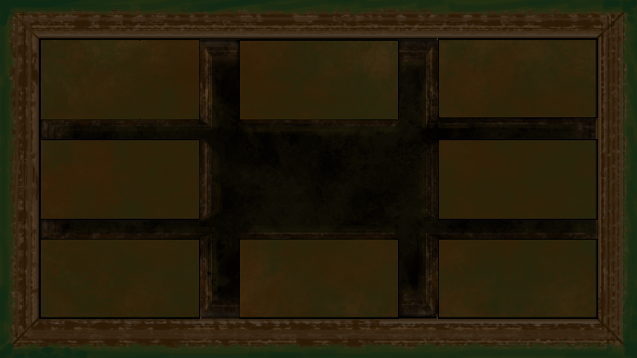

Artwork

Slide 8
What’s Done and What’s Next?
Completed
Basic Artwork for player
Basic Art for enemies and Dungeon
Prototyping code for most functionality in dungeon
Future

