Slide 2


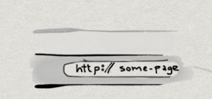

MODEL
CONTROLLER
VIEW
DATABASE

