Slide 1
M55M1 NPU Keyword Spotting Inference on Zephyr
Chun-Chieh Li

Slide 2
Overview
Introduce this example code
Optimize model
Introduce Zephyr
Install development environment
Kernel configuration system (Kconfig)
Devicetree

Slide 3
This example code
Application: Demo machine learning keyword spotting (關鍵詞檢測) inference on Zephyr
MCU: M55M1
NPU
DMIC
OS: Zephyr
Board: NuMaker-X-M55M1D
M55M1 BSP KeywordSpotting: https://github.com/OpenNuvoton/M55M1BSP/tree/master/SampleCode/MachineLearning/KeywordSpotting
Download: [M55M1] NPU Keyword Spotting Inference - MCU BSP & Example Code | Nuvoton NuForum

Slide 4
Software development flow
Trained and quantized model
PC
Vela
Command stream
Vela-compiled model
Cortex-M CPU
Ethos-U NPU
User app
TensorFlow Lite Micro
Ref kernels
CMSIS-NN kernels
Ethos-U driver

Slide 5
Directory structure
zephyrproject
EC_M55M1_Zephyr_ML_KWS
Library
StdDriver | Zephyr build system files to pull in lacking peripheral driver header and source files
SampleCode
ExampleCode
Zephyr_ML_KWS | Source files of example code
ThirdParty
ml-embedded-evaluation-kit | Inference preprocessing/postprocessing header and source files
zephyr | Zephyr module YAML file

Slide 6
Application control flow
Initialize platform, drivers, TFLM, etc.
Zephyr: MPU, UART, GPIO, NPU
Non-OS: DMIC
Record audio clip via DMIC
Preprocess recorded audio (MFCC) clip to specified input tensor format for inference
Run keyword spotting inference
Postprocess output tensor format usable by external applications

Slide 7
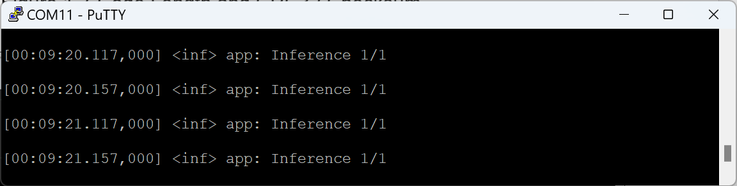
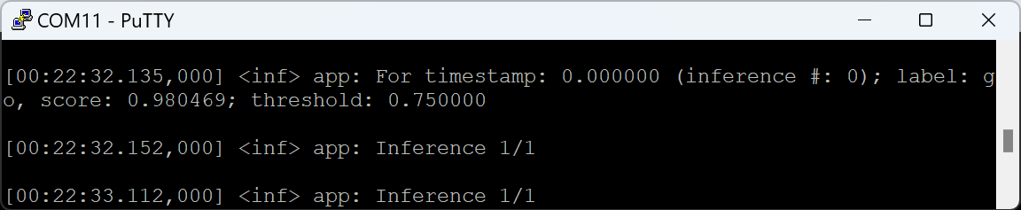
Demo result
Host terminal program: 115200/8-N-1
Steps
Type ‘kws resume’
Speak trained keyword like ‘Go’
EC_M55M1_Zephyr_ML_KWS/SampleCode/ExampleCode/Zephyr_ML_KWS/src/Model/Labels.cpp
"yes", "no", "up", "down", "left", "right", "on", "off", "stop", "go",

Slide 8
Optimize the model (1/3)
Download DS-CNN Medium INT8 model
Original model: ds_cnn_m_quantized.tflite
https://github.com/Arm-Examples/ML-zoo/tree/master/models/keyword_spotting/ds_cnn_medium/model_package_tf/model_archive/TFLite/tflite_int8
Optimize using Vela
$ vela ds_cnn_m_quantized.tflite --output-dir . --accelerator-config ethos-u55-256 --optimise Performance
Optimized model: ds_cnn_m_quantized_vela.tflite
Bit-accurate

Slide 9
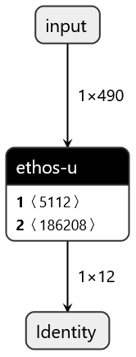
Optimize the model (2/3)
Netron
https://netron.app/

Slide 10
Optimize the model (3/3)
Match Ethos-U NPU config among:
Ethos-U RTL config: For M55M1, Ethos-U55, 256 macs_per_cycle
Vela command line: --accelerator-config ethos-u55-256
Ethos-U core driver config (ETHOSU_TARGET_NPU_CONFIG): "ethos-u55-256"

Slide 11
Introduce Zephyr (1/3)
Open-source RTOS
Target connected, resource-constrained, and embedded system
License: Apache 2.0 license
Support architecture: Arm Cortex-M, R, A, Intel x86, RISC-V, ARC, and Xtensa
Support language: C/C++
Support toolchain: Cross GCC for Cortex-M

Slide 12
Introduce Zephyr (2/3)
Build system: CMake-based (CMake + Ninja)
Configuration system: Kconfig and Devicetree
Inherited from Linux kernel but re-implemented in Python for portability to non-Unix OS
West tool, a versatile meta-tool for
Managing external projects (Git repositories)
Building projects
Flashing hardware (pyOCD or OpenOCD)

Slide 13
Introduce Zephyr (3/3)
Support development environment
CLI
https://docs.zephyrproject.org/latest/develop/getting_started/index.html
VS Code
https://github.com/OpenNuvoton/Nuvoton_Tools/blob/master/Documents/VSCode_ZephyrIDE.md
Host environment
Can develop on Windows, Linux, and macOS
Git Bash for Windows

Slide 14
Install development environment (1/6)
Python (3.10)
Add into PATH
Git
Add into PATH
Git Bash as CLI
CMake (3.20.5) & Ninja
Add into PATH
Python virtual environment
$ mkdir zephyrproject
$ python -m venv zephyrproject/.venv
$ source zephyrproject/.venv/Scripts/activate

Slide 15
Install development environment (2/6)
West
$ pip install --upgrade west
Example code
$ unzip -d zephyrproject EC_M55M1_Zephyr_ML_KWS_V1.00.zip
$ mv zephyrproject/EC_M55M1_Zephyr_ML_KWS_V1.00 zephyrproject/EC_M55M1_Zephyr_ML_KWS
West workspace ‘zephyrproject’
Manifest repository: EC_M55M1_Zephyr_ML_KWS/west.yml vs. zephyr/west.yml
$ cd zephyrproject
$ west init --local EC_M55M1_Zephyr_ML_KWS

Slide 16
Install development environment (3/6)
Pull in external dependencies (EC_M55M1_Zephyr_ML_KWS/west.yml)
$ west update
zephyrproject/
|-- EC_M55M1_Zephyr_ML_KWS
|-- modules
|-- optional
`-- zephyr
zephyrproject/modules/
|-- hal
| |-- cmsis_6
| |-- ethos_u
| `-- nuvoton
`-- lib
|-- cmsis-dsp
`-- cmsis-nn
zephyrproject/optional/
`-- modules
`-- lib
`-- tflite-micro

Slide 17
Install development environment (4/6)
Pull in external dependencies (zephyr/west.yml)
$ west update
zephyrproject/modules/
|-- bsim_hw_models
| `-- nrf_hw_models
|-- crypto
| |-- mbedtls
| `-- tinycrypt
|-- debug
| |-- mipi-sys-t
| |-- percepio
| `-- segger
|-- fs
| |-- fatfs
| `-- littlefs
|-- hal
| |-- adi
| |-- afbr
| |-- altera
| |-- ambiq
| |-- atmel
| |-- bouffalolab
| |-- cmsis
| |-- cmsis_6
| |-- espressif
| |-- ethos_u
| |-- gigadevice
| |-- infineon
| |-- intel
| |-- libmetal
| |-- microchip

Slide 18
Install development environment (5/6)
Python dependencies, including pyOCD
$ west packages pip –install
Zephyr SDK toolchain
arm-zephyr-eabi vs. arm-none-eabi
$ west sdk install --install-base toolchains --toolchains arm-zephyr-eabi --no-hosttools
Support pyOCD flash for M55M1
Download Nuvoton.NuMicroM55_DFP.x.y.z.pack
Create zephyrproject/pyocd.yaml
pack:
- C:\Users\<USER>\Downloads\Nuvoton.NuMicroM55_DFP.<x.y.z>.pack

Slide 19
Install development environment (6/6)
Vela compiler
$ pip install --upgrade ethos-u-vela
Exit Python virtual environment
$ deactivate

Slide 20
Build this example code
Enter Python virtual environment
$ source zephyrproject/.venv/Scripts/activate
Enter West workspace ‘zephyrproject’
$ cd zephyrproject
Compile
$ west -v build -b numaker_m55m1 EC_M55M1_Zephyr_ML_KWS/SampleCode/ExampleCode/Zephyr_ML_KWS
Flash
$ west flash
Exit Python virtual environment
$ deactivate

Slide 21
Kernal configuration system (Kconfig)
Purpose: Allow to enable, disable, and parameterize software components, drivers, and OS features without having to change any source code
Can tailor CMake files, C/C++ files, linker script files
Constituent files
Kconfig* files: Define configuration options (Kconfig symbols)
*.conf files: Set configuration values (Kconfig fragments)
.config file: Generated merged configuration file
autoconf.h: Generated C macro file per above

Slide 22
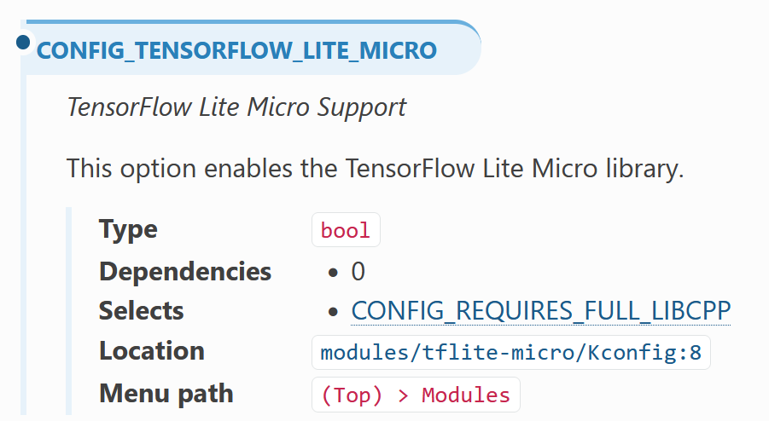
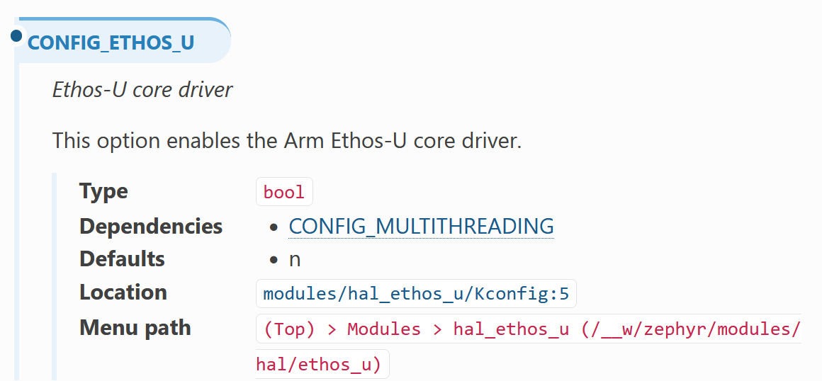
Kconfig: Search
Kconfig search
https://docs.zephyrproject.org/latest/kconfig.html

Slide 23
Kconfig: Generated merged files (1/2)
Generated combined configuration file
build/zephyr/.config
build/zephyr/.config
CONFIG_NVT_ML_REQUIRES_ETHOS_U=y
CONFIG_NVT_ML_TFLM_TENSOR_ARENA_SIZE=280000
CONFIG_NVT_ML_KWS_INPUT_DMIC=y
# CONFIG_NVT_ML_KWS_INPUT_WAVE_BLOB is not set
CONFIG_NVT_ML_REQUIRES_KWS_MODEL_DS_CNN_M_QUANTIZED=y
CONFIG_NVT_ML_KWS_MODEL_DS_CNN_M_QUANTIZED_ETHOS_U55_256_SPEED=y
# CONFIG_INPUT is not set
# CONFIG_WIFI is not set
# CONFIG_REGULATOR is not set
CONFIG_SYSTEM_WORKQUEUE_STACK_SIZE=1024
CONFIG_MAIN_STACK_SIZE=4096

Slide 24
Kconfig: Generated merged files (2/2)
Generated C header file
build/zephyr/include/generated/zephyr/autoconf.h
Auto-included via ‘-imacros autoconf.h’
build/zephyr/include/generated/zephyr/autoconf.h
#define CONFIG_NVT_ML_REQUIRES_ETHOS_U 1
#define CONFIG_NVT_ML_TFLM_TENSOR_ARENA_SIZE 280000
#define CONFIG_NVT_ML_KWS_INPUT_DMIC 1
#define CONFIG_NVT_ML_REQUIRES_KWS_MODEL_DS_CNN_M_QUANTIZED 1
#define CONFIG_NVT_ML_KWS_MODEL_DS_CNN_M_QUANTIZED_ETHOS_U55_256_SPEED 1
#define CONFIG_SYSTEM_WORKQUEUE_STACK_SIZE 1024
#define CONFIG_MAIN_STACK_SIZE 4096

Slide 25
Kconfig: Define config options (1/3)
EC_M55M1_Zephyr_ML_KWS/SampleCode/ExampleCode/Zephyr_ML_KWS/Kconfig:
config NVT_ML_TFLM_TENSOR_ARENA_SIZE
int "TFLM tensor arena size"
default 280000
help
Define TFLM tensor arena size

Slide 26
Kconfig: Define config options (2/3)
EC_M55M1_Zephyr_ML_KWS/SampleCode/ExampleCode/Zephyr_ML_KWS/Kconfig:
choice NVT_ML_KWS_INPUT_CHOICE
prompt "Choose ML keyword spotting input source"
default NVT_ML_KWS_INPUT_DMIC if BOARD_NUMAKER_M55M1
default NVT_ML_KWS_INPUT_WAVE_BLOB
config NVT_ML_KWS_INPUT_DMIC
bool "DMIC as KWS input"
help
Use digital microphone as keyword spotting input
config NVT_ML_KWS_INPUT_WAVE_BLOB
bool "Wave blob as KWS input"
help
Use embedded wave blob as keyword spotting input
endchoice

Slide 27
Kconfig: Define config options (3/3)
EC_M55M1_Zephyr_ML_KWS/SampleCode/ExampleCode/Zephyr_ML_KWS/Kconfig:
choice NVT_ML_KWS_MODEL_CHOICE
prompt "Choose ML keyword spotting model"
default NVT_ML_KWS_MODEL_DS_CNN_M_QUANTIZED_ETHOS_U55_256_SPEED
config NVT_ML_KWS_MODEL_DS_CNN_M_QUANTIZED_ETHOS_U55_256_SPEED
bool "DS-CNN Medium KWS model, vela-compile for speed"
select NVT_ML_REQUIRES_ETHOS_U
select NVT_ML_REQUIRES_KWS_MODEL_DS_CNN_M_QUANTIZED
help
Use DS-CNN Medium keyword spotting model, type INT8,
vela-compile for Ethos-U55/256 MAC, optimize for speed
endchoice

Slide 28
Kconfig: Set config values (1/3)
Cache
CONFIG_CACHE_MANAGEMENT
FPU
CONFIG_FPU
CONFIG_FPU_SHARING
CONFIG_FP_HARDABI
Compiler optimization level
CONFIG_SIZE_OPTIMIZATIONS (-Os) (default)
CONFIG_SIZE_OPTIMIZATIONS_AGGRESSIVE (-Oz)
CONFIG_SPEED_OPTIMIZATIONS (-O2)
CONFIG_DEBUG_OPTIMIZATIONS (-Og)
CONFIG_NO_OPTIMIZATIONS (-O0) (stack overflow)
EC_M55M1_Zephyr_ML_KWS/SampleCode/ExampleCode/Zephyr_ML_KWS/prj.conf
CONFIG_CACHE_MANAGEMENT=y
CONFIG_FPU=y
CONFIG_FPU_SHARING=y
CONFIG_FP_HARDABI=y
CONFIG_SPEED_OPTIMIZATIONS=y

Slide 29
Kconfig: Set config values (2/3)
Main stack
CONFIG_MAIN_STACK_SIZE
Logging
CONFIG_LOG
CONFIG_REQUIRES_FLOAT_PRINTF (floating-point)
CONFIG_LOG_BLOCK_IN_THREAD (few messages dropped)
C++ language
CONFIG_CPP
CONFIG_STD_CPP17
EC_M55M1_Zephyr_ML_KWS/SampleCode/ExampleCode/Zephyr_ML_KWS/prj.conf
CONFIG_MAIN_STACK_SIZE=4096
CONFIG_LOG=y
CONFIG_REQUIRES_FLOAT_PRINTF=y
CONFIG_LOG_BLOCK_IN_THREAD=y
CONFIG_CPP=y
CONFIG_STD_CPP17=y

Slide 30
Kconfig: Set config values (3/3)
CMSIS DSP
CONFIG_CMSIS_DSP
CONFIG_CMSIS_DSP_COMPLEXMATH, CONFIG_CMSIS_DSP_FASTMATH, CONFIG_CMSIS_DSP_TRANSFORM, etc.
Shell
CONFIG_SHELL (kws resume, kws suspend, etc.)
TensorFlow Lite Micro & Ethos-U
CONFIG_TENSORFLOW_LITE_MICRO
CONFIG_ETHOS_U
EC_M55M1_Zephyr_ML_KWS/SampleCode/ExampleCode/Zephyr_ML_KWS/prj.conf
CONFIG_CMSIS_DSP=y
CONFIG_CMSIS_DSP_COMPLEXMATH=y
CONFIG_CMSIS_DSP_FASTMATH=y
CONFIG_CMSIS_DSP_TRANSFORM=y
CONFIG_SHELL=y
CONFIG_TENSORFLOW_LITE_MICRO=y

Slide 31
Devicetree
A hierarchical data structure used to describe H/W and its boot-time configuration
For system, memory base/size (Flash, SRAM), CPU frequency, etc.
For peripheral, register base, interrupt, pins, etc.
Unlike Linux kernel, Zephyr parses the DTS at compile time and generates C language macros, rather than blob.
Separate H/W specifics from application logic
No hardcode
Retarget without change to C/C++ code

Slide 32
Devicetree: Constituent files
DTS files (*.dts): Contain board-level definitions and configuration
DTS include files (*.dtsi): Contain SoC-level or board-level definitions and configurations to be included
DTS overlay files (*.overlay): Allow customizing or overriding H/W configurations
DTS binding files (*.yaml): Define which properties are valid within a node and link H/W device to S/W driver

Slide 33
Devicetree: Binding
zephyr/dts/bindings/arm/nuvoton,numaker-npu.yaml:
compatible: "nuvoton,numaker-npu"
include: ["arm,ethos-u.yaml", reset-device.yaml]
properties:
reg:
required: true
interrupts:
required: true
resets:
required: true
clocks:
required: true
zephyr/dts/arm/nuvoton/m55m1h2l.dtsi:
npu0: npu@40003000 {
compatible = "nuvoton,numaker-npu";
reg = <0x40003000 0x1000>;
interrupts = <13 0>;
resets = <&rst NUMAKER_SYS_NPURST>;
clocks = <&pcc NUMAKER_NPU0_MODULE 0 0>;
secure-enable;
privilege-enable;
status = "disabled";
};
zephyr/dts/bindings/arm/arm,ethos-u.yaml:
compatible: "arm,ethos-u"
include: base.yaml
properties:
reg:
required: true
interrupts:
required: true
secure-enable:
type: boolean
privilege-enable:
type: boolean
fast-memory-region:
type: phandle
zephyr/drivers/misc/ethos_u/ethos_u_numaker.c:
#define DT_DRV_COMPAT nuvoton_numaker_npu

Slide 34
Devicetree: Include tree (1/2)
Board DTS file (--board)
zephyr/boards/<VENDOR>/<BOARD>/<BOARD>.dts
Included SoC-level DTSI file (#include)
zephyr/dts/arm/nuvoton/<SOC>.dtsi
Included C header file (#include)
*.h
zephyr/boards/nuvoton/numaker_m55m1/numaker_m55m1.dts
#include <nuvoton/m55m1h2l.dtsi>
#include "numaker_m55m1-pinctrl.dtsi"
#include <zephyr/dt-bindings/input/input-event-codes.h>

Slide 35
Devicetree: Include tree (2/2)
Board overlay file
<PROJECT>/boards/<BOARD>.overlay
<PROJECT>/app.overlay
EC_M55M1_Zephyr_ML_KWS/SampleCode/ExampleCode/Zephyr_ML_KWS/boards/numaker_m55m1.overlay
&npu0 {
status = "okay";
};
&gpiob {
status = "okay";
};

Slide 36
Devicetree: Generated files (1/2)
Combined DTS file
build/zephyr/zephyr.dts
build/zephyr/zephyr.dts
/soc/npu@40003000
/ {
soc {
npu0: npu@40003000 {
compatible = "nuvoton,numaker-npu";
reg = < 0x40003000 0x1000 >;
interrupts = < 0xd 0x0 >;
resets = < &rst 0x400006 >;
c locks = < &pcc 0x3d 0x0 0x0 >;
secure-enable;
privilege-enable;
status = "okay";
};

Slide 37
Devicetree: Generated files (2/2)
C macro header file
build/zephyr/include/generated/zephyr/devicetree_generated.h
build/zephyr/include/generated/zephyr/devicetree_generated.h
/soc/npu@40003000
/*
* Devicetree node: /soc/npu@40003000
*/
/* Node's full path: */
#define DT_N_S_soc_S_npu_40003000_PATH "/soc/npu@40003000"
/* Node's name with unit-address: */
#define DT_N_S_soc_S_npu_40003000_FULL_NAME "npu@40003000"
#define DT_N_S_soc_S_npu_40003000_FULL_NAME_UNQUOTED npu@40003000
#define DT_N_S_soc_S_npu_40003000_FULL_NAME_TOKEN npu_40003000

Slide 38
Devicetree: How to access (1/2)
Decode generated C macro
DT_: Common prefix for Devicetree macros
_S_ : Forward slash ‘/’
_N_ : Node
_P_: Property
build/zephyr/zephyr.dts
/ {
soc {
npu0: npu@40003000 {
compatible = "nuvoton,numaker-npu";
reg = < 0x40003000 0x1000 >;
interrupts = < 0xd 0x0 >;
… };
};
};
build/zephyr/include/generated/zephyr/devicetree_generated.h
#define DT_N_S_soc_S_npu_40003000_P_reg {1073754112 /* 0x40003000 */, 4096 /* 0x1000 */}

Slide 39
Devicetree: How to access (2/2)
Can be accessed by driver, subsystem, or user application
Access via Devicetree API instead of directly
zephyr/drivers/misc/ethos_u/ethos_u_numaker.c
static const struct ethos_u_numaker_config ethos_u_numaker_config_##inst = {
.base_addr = (void *)DT_INST_REG_ADDR(inst),
.clkctrl_dev = DEVICE_DT_GET(DT_PARENT(DT_INST_CLOCKS_CTLR(inst))),
.pcc = NUMAKER_PCC_INST_GET(inst),
.reset = RESET_DT_SPEC_INST_GET(inst),
.irq_config = ethos_u_numaker_irq_config_##inst,
.secure_enable = DT_INST_PROP(inst, secure_enable),
.privilege_enable = DT_INST_PROP(inst, privilege_enable),
};

