Slide 1
Integrate M55M1 Ethos-U NPU with Zephyr
MS30 李俊杰
4/29/2025

Slide 2
Overview
Software development flow
Model replacement and verification
Ethos-U driver porting guide

Slide 3
Software development flow
Trained and quantized model
PC
Vela
Command stream
Vela-compiled model
Cortex-M CPU
Ethos-U NPU
User app
TensorFlow Lite Micro
Ref kernels
CMSIS-NN kernels
Ethos-U driver

Slide 4
Software environment
Zephyr west
Vela
pip install ethos-u-vela
TensorFlow Lite Micro
Optional zephyr module
west config manifest.project-filter -- +tflite-micro; west update
Ethos-U core driver
Default zephyr module
west update

Slide 5
Download trained model
Arm Model Zoo
Example: keyword_spotting_cnn_small_int8
Model: cnn_s_quantized.tflite
Input: testing_input/input/0.npy
Output: testing_output/identity/0.npy

Slide 6
Compile model with Vela
Compile targeting M55M1 NPU (Ethos-U55, 256 macs_per_cycle)
vela cnn_s_quantized.tflite --output-dir . --accelerator-config ethos-u55-256
Original model: cnn_s_quantized.tflite, run entirely by CPU
Vela-compiled model: cnn_s_quantized_vela.tflite, run by Ethos-U and CPU
Bit-accurate: same input/output apply to both models

Slide 7
Replace model/input/output (1/2)
Convert model/input/output to C array from binary
xxd -c 16 -i cnn_s_quantized.tflite cnn_s_quantized.tflite.h
xxd -c 16 -i cnn_s_quantized_vela.tflite cnn_s_quantized_vela.tflite.h
xxd -c 16 -i testing_input/input/0.npy testing_input/input/0.npy.h
xxd -c 16 -i testing_output/identity/0.npy testing_output/identity/0.npy.h

Slide 8
Replace model/input/output (2/2)
Replace into zephyr tflm_ethosu sample
Sample: zephyr/samples/modules/tflite-micro
cnn_s_quantized_vela.tflite.h → keyword_spotting_cnn_small_int8_ethos_u55_256/model.h
testing_input/input/0.npy.h → keyword_spotting_cnn_small_int8_ethos_u55_256/input.h
testing_output/identity/0.npy.h → keyword_spotting_cnn_small_int8_ethos_u55_256/output.h
Note for input/output, the first 128 bytes are header and don’t copy to sample

Slide 9
Sample: tflm_ethosu (1/3)
Model
Locate at section .rodata.tflm_model
Require 16-byte aligned
Tensor arena (NPU buffer)
Locate at section .noinit.tflm_arena
Require Cache line aligned (32-byte aligned)
Override Ethos-U dcache flush/invalidate
ethosu_flush_dcache
ethosu_invalidate_dcache
Input/Output
No special allocation requirement because they will copy to/from above tensor arena

Slide 10
Sample: tflm_ethosu (2/3)
Build with Ethos-U
west -v build -b numaker_m55m1 zephyr/samples/modules/tflite-micro/tflm_ethosu
Build without Ethos-U
west -v build -b numaker_m55m1 zephyr/samples/modules/tflite-micro/tflm_ethosu -DCONFIG_TAINT_BLOBS_TFLM_ETHOSU=n

Slide 11
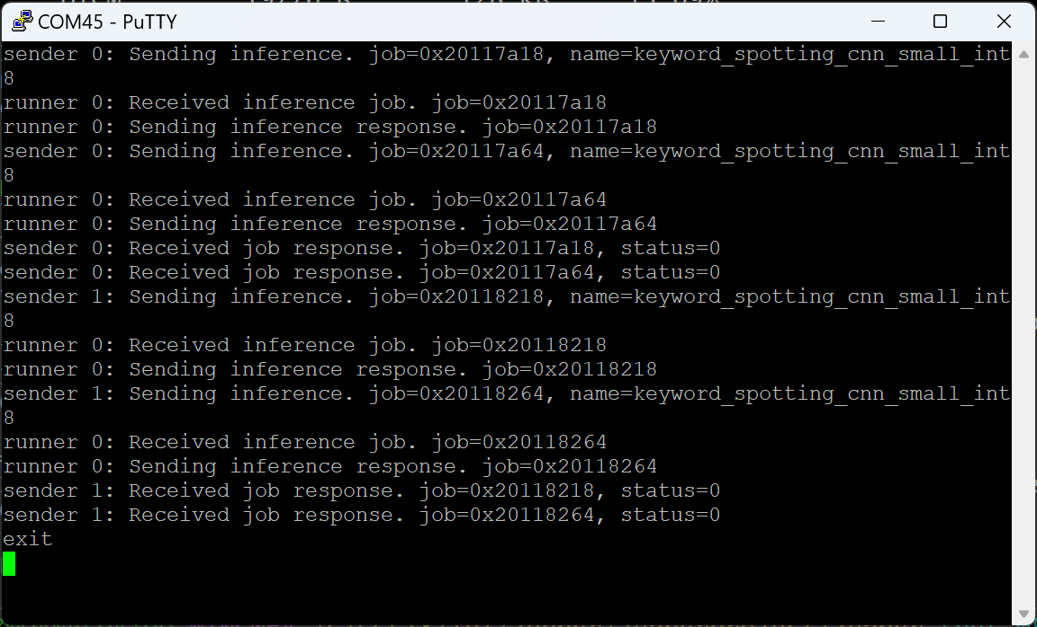
Sample: tflm_ethosu (3/3)

Slide 12
Ethos-U zephyr driver
In-tree
Zephyr frontend of Ethos-U core driver
Devicetree binding file
Data cache flush
Data cache invalidate
Devicetree node
Driver source

Slide 13
Ethos-U core driver
Zephyr external module
Its Arm source
Match Ethos-U NPU config
For M55M1, ethos-u55, 256 macs_per_cycle
Match Ethos-U NPU config among:
Ethos-U RTL config
Vela command line
Ethos-U core driver config

Slide 14
Thank You

