Slide 1

Instalily.ai case study:
Saatva AI chatbot
Creator / Presenter : Tristan Lin
Find me @: tlin3@andrew.cmu.edu
Github: https://github.com/cclintris/instalily-saatva-chatbot

Slide 2
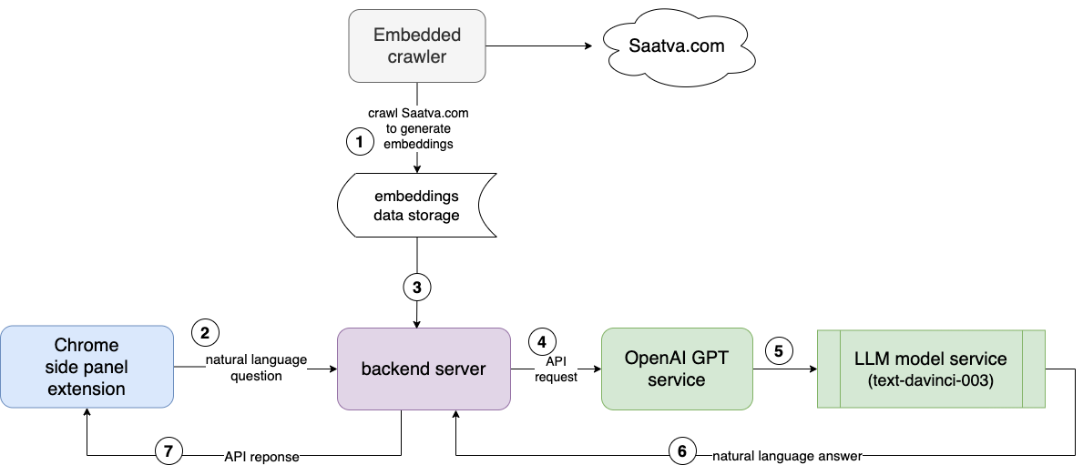
System architecture design

Slide 3
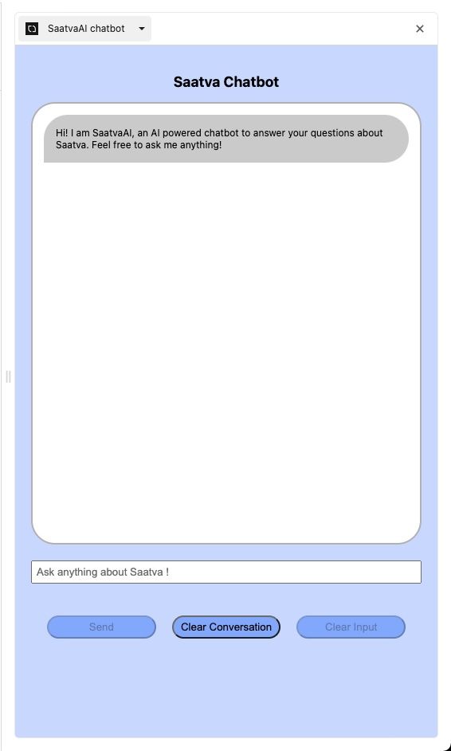
Chrome Extension Frontend UI
Side Panel
Supports Natural Language
Opens automatically when Saatva.com tab visited
Good usability

Slide 4
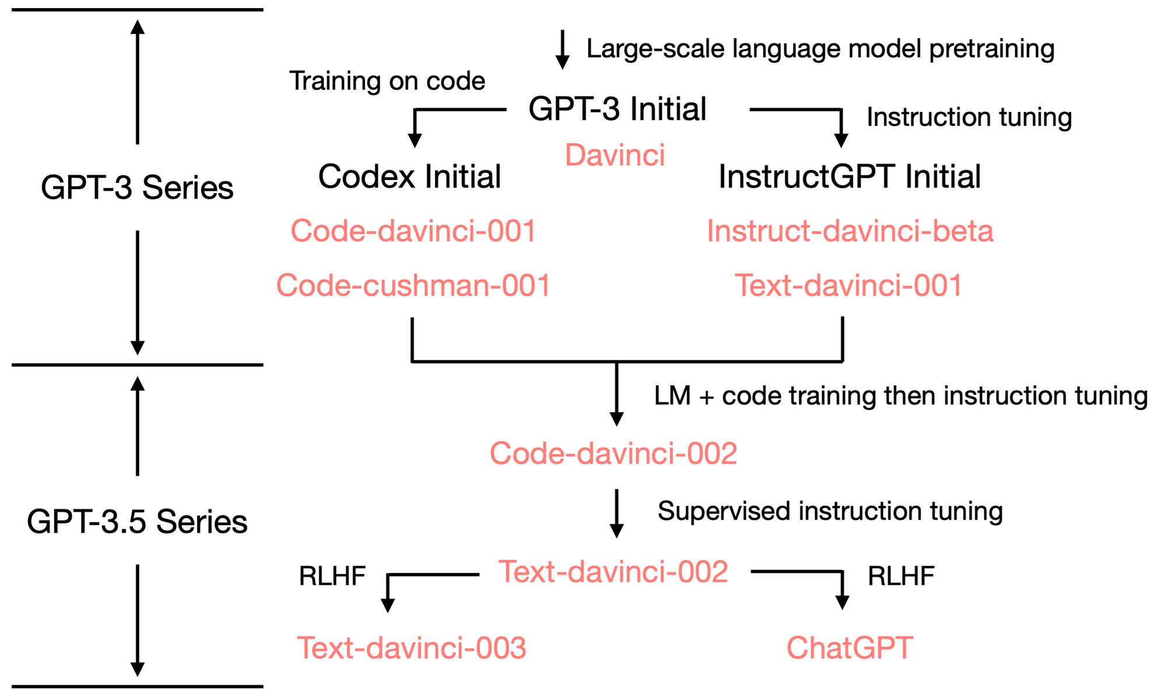
LLM model research & choice
OpenAI GPT 3.5 model
-> text-davinci-003
Higher Quality Writing
Instruction Following Task
Trained with newer dataset

Slide 5
Demo

Slide 6
Thank you!

