Slide 1
Fujitsu and Containers.
Hiroyuki Kamezawa <kamezawa.hiroyu@jp.fujitsu.com>
Senior Professional Engineer
Fujitsu

Slide 2
My Backgound
Fujitsu
Japan’s largest IT service Provider and No 5. in the world.(*)
We do everything in ICT.
Cloud, HPC, Middleware, Server(x86/Mainframe/Unix), Network, Storage, Smartphone, PC…..
159,000 Fujitsu people supports customers in more than 100 countries.
I myself has been working for Linux Kernel with teams of Nanjing Fujitsu Nanda Software Technology for several years.
*Source: Gartner, 2014 vendor revenue base, " Market Share: IT Services, 2014" 31 March 2015 (GJ15180)

Slide 3
Fujitsu’s work in Linux

Slide 4
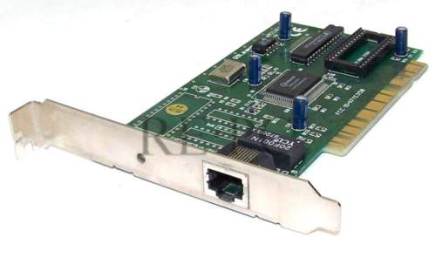
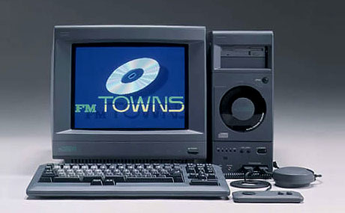
Quick history of Fujitsu with OSS
In early 90s
NIC drivers
GNU utils for PC

Slide 5

Motivation for Linux/OSS
An Operating system which we ourselves can be responsible for
with openess.
Ｆｕｊｉｔｓｕ
Ｆｕｊｉｔｓｕ
Ｆｕｊｉｔｓｕ
OSS
Community
Tightly coupled
HW+OS
OS Vendor
Distributor
Customers
Customers
Customers
‘80
All Fujitsu
‘90
Unix Age
‘00
Open Source

Slide 6
Our ideas for Linux developments
Enable hardware features (for RAS).
Features for detecting/investigating problems.
Features for protecting customer’s workload.

Slide 7
For supporting customers.
kdump
Hotplug
Host
Linux
Device
Replacing Hardware devices without
stopping a system.
PCI, CPU, Memory……
Dumping Host’s memory image to disk
for investigating kernel issues.
Btrfs
a file system with
Copy-on-Write
snapshot/rollback
Multi disk scale-out, resize.
We also contributed qemu-kvm’s
dump features.
Ex)kvm’s init button doesn’t work.

Slide 8
For protecting customers.
Cgroup
LTP (Linux Test Project).
APP
APP
APP
656 commits since 2010.(25%)
OS
Glibc man enhancements.
Running workloads in stable
by limiting resource usage.
Fixing glibc’s MT-Safe spec.

Slide 9
Containers

Slide 10
What is container ?
app
A
app
A’
app
B
Containers
bins
libs
bins
libs
bins
libs
VM
app
A
app
A’
app
B
guest OS
guest OS
guest OS
app
C
bins
libs
bins
libs
bins
libs
Hypervisor
HostOS
Server
Server
A technology to divide the system into boxes(containers).
A technology to run applications in boxes(containers).

Slide 11
System Container
Linux Container(lxc) has been known as
A tool for divide the system into boxes for handling multiple workloads.
A tools and kernel features to create virtual environment on a host OS.
Virtual OS Resources
Virtual Environment with file tree
Resource and Security Isolation
Used for consolidation.
One container per a virtual OS.
Hosting service.
Virtual OS
Virtual OS
login
app
A
app
B
login
app
C
daemons
bins
libs
daemons
bins
libs
HostOS
Server

Slide 12
Application Container
Another aspects of container has been known as
A tool for running applications.
A tools and kernel features to create application runtime environment.
Virtual Environment with file tree
Resource and Security Isolation
Application management eco-system.
Will be used for building block..
One container per a service.
App delivery platform.
Application
Environment
app
A
app
A
app
A’
app
C
bins
libs
bins
libs
bins
libs
bins
libs
HostOS
Server

Slide 13
Where we see containers in Fujitsu ?
Unix(Solaris)/Mainframe.
Providing virtual OS for consolidation
OS support division
Linux/Windows/VMWare support division
PaaS service (Cloud Foundry)
PaaS backend is container.
MW products for providing multi-tenancy.
Providing workload isolation.
A MW product for cloud + DevOps
Providing application management system based on app. containers.
High Performance Computing
Providing resource control, runtime environment, suspend/resume.
System Containers.
App Containers.

Slide 14
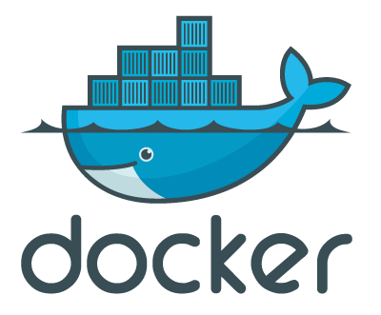

Today’s talk is about…..
AND
Open Container Initiative
An Application Container Engine
Common container spec.

Slide 15
Docker
A tool for delivering and deploying applications.
Creating a container for running an application.
Package an application and its environment into a small image (XXXMBytes) and deliver it.
Benefit / Use case
Development with testing(CI/CD)
Decoupling applications and systems, increasing application portability.
Running applications everywhere.
Application lifecycle can be decoupled from the system’s.
Clean application delivery and deployment.
App cluster’s qualities can be controlled under codes.
Add-on method for appliance.
A base for application lifecycle management tool.
A base for cloud workload controller

Slide 16
Docker’s Motivation
“The app need to be everywhere and nowhere”
“Docker is an open-source engine that automates the deployment of any applications as a lightweight, portable, self-sufficient container that will run virtual”
“The real value of Docker is not technology”
“It’s getting people to agree on something”
Solomon Hykes (Docker inc. CTO)

Slide 17
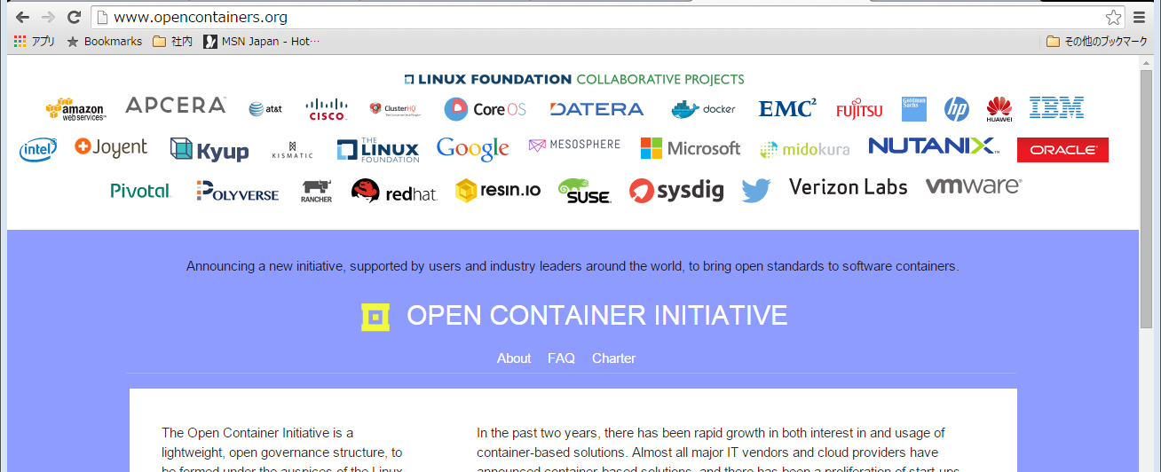
OCI: Spec. of containers.
Open Container Initiative (https://www.opencontainers.org/)
Generating a portable spec. with tests for keeping the spec.
“runC” as implementation of container based on the spec.
Got started since 2015/Jun.

Slide 18
Current situation (in Fujitsu)
Docker is very easy to use/try.
Helps development/tests very much.
DevOps solution with docker+openstack is required.
Preparing a product based on kuberentes
Some customers are asking for supports.
What kind of middleware to be moved onto docker ?
Application server, searching engine, bigdata…
It has been heavily changing, not stable yet.
When it can be used in production system ?
Java took 4 years in Fujitsu.
A development team started.

Slide 19
Our motivation/attitude for container development.
Containers(docker) will be used in Enterprise.
For customers and support,
We start from our experience with Linux/kvm.
Trying fixes rather than “workaround by OPs”
Build Once, debug everywhere

Slide 20
Problems and Development items for now.
Problems based on our/our customer’s use cases.
Dump.
Portability
Resource control, monitoring.
Virtualization
Spec and Tests.

Slide 21
Dump
Problem
When application got fatal error, kernel can generate memory dump of the app for debugging.
Application’s coredump may be dumped into container’s volume.
This means XX Peta Bytes of coredump can be stored into XXMBytes of container’s image/volume.
Current implementation in Linux
At default, coredump is generated into a process’s current working directory..
A kernel has system-wide parameter “/proc/sys/kernel/core_patterns” to specify target device.
Current Container implementation
“core_patterns” are shared between containers.
/proc filesystem is read-only and cannot be modified via container.
Idea for fixing.
Provide a kernel feature to specify core_patterns per namespace.
Provide a kernel feature to pass file descriptor to core_patterns.
Allow docker daemon to handle container’s coredump via pipe.

Slide 22
Coredump Meta Data
Problem
Usual application container doesn’t include debugger
To debug apps with using coredump, App’s binary, coredump, all libraries are required.
We need to bring all things to our support site from user’s site.
Current Fujitsu’s support tool (not with container)
We have a tool to grab all required modules at once for customer support.
Idea for fixing.
Managing Container meta data(docker inspect) and image with coredump image.
a way to mount container image into a host.

Slide 23
Portability
Problem
An application image may assume host environment.
Example of instruction of application image: To change timezone, overwrite it by mounting host’s /etc/timezone into container.
This instruction is from an image based on Ubuntu but /etc/timezone is not in CentOS.
This “copying information from host” manner can be easily broken.
Idea for fixing
Using environment variable in the guest will be the best.
No dependencies to image’s file tree structure
Another idea
Modify the image with using Dockerfile, in maintainable manner ?

Slide 24
Modifying images in a maintainable manner
Background.
Current image handling is based on
Works inside container with using shell or other tools.
Copy file from a host.
Problems
Application container image may not contains shell or other tools.
Copy from a host implies dependencies from container to host.
Idea
Add “PATCH” feature to Dockerfile for patching image.
Add “docker edit” for modifying docker image and generating a patch.
……Better idea is welcomed.

Slide 25
Resource Control
Background
Resource controlling is mostly based on cgroups.
memory cgroup has been enhanced (writeback, blkio-memcg interaction, kmem)
Pid cgroups are added.
Cgroups are now changing (cgroup v2)
Problem
Disk quota
File system (docker storage driver) feature
Issue was reported in 2014/Jan but not fixed.
Idea for fixing.
Implement quota in storage driver
Btrfs have quota per subvolume.
Still investigating others but overlay may need some idea.

Slide 26
Resource Monitoring
Background
Resource usage/metrics are implemetened in cgroup.
Cgroups itself is in production use, some feedbacks from users.
Small troubles.
Per-cpu-per-cgroup sys/user system usage is required for scheduling jobs.
Per-cgroup maximum anonymous memory usage is required for sizing.
-> Just try to fix it.
A problem with checkpoint/restart
At checkpoint/restart, resource usage statistics cannot be restored.
Guessing other params metrics should be restored.
Per-process accounting, starttime, elapsed ….
Network metrics

Slide 27
Virtualization.
Problems
SYSVIPC(shmem,msgq,semaphore) limiting parameters cannot be changed.
POSIX IPC (/dev/shm..) are in fixed size.
Multi-nic networks.
Per container firewall management.
Current implementation
Procfs is read-only. No sysctl will work.
Mount is highly limited. (need to check enhancements in volume plugins)
Using “ip” command from outside of containers.
Idea for fixing
Secure mount option for procfs ……need some ideas.
More volume plugins (NFS, iscsi……)
Docker firewall tooling.
Libnetwork for multiple NICs and networks.

Slide 28
Spec and Tests
Current situation
OCI (Open Container Initiative) tries to fix the specification of container image.
OCI hosts “runc/libcontainer” as reference implementation.
Problems
Anyone cannot check a container implementation meets the OCI spec.
Action to fix
Implementing tests will be the only way.
Now, OCI has been discussing to provide test suites for black box tests …..still under discussion.

Slide 29
Conclusion
We consider docker/container as promising application platform.
We’ve started a team for docker/runC/libconainer
We start from core features for our support based on past experience.
Some of feature needs to change the kernel.
Many small/big problems are remaining.
In virtualization area, volume plugin, libnetwork are now changing situation.
We’ve joined OCI for portable container specification.
Now, docker is 2.5 years old. Let’s see what it will be in 2016, 2017.

