Slide 1
How to Be A Filesystem Developer
Aug 10 2015
Qu Wenruo <quwenruo@cn.fujitsu.com>
Fujitsu Limited.

Slide 2
Index
Why to be a kernel developer
Why to be filesystem developer
Why to be a Btrfs developer
How to be a FS(Btrfs) developer
Fujitsu Contribution to Btrfs

Slide 3
Why to be a kernel developer
For Individual
Fame of Old-school hacker among community
Polish the skill and more challenge
More $$$
For Enterprise
Reputation
Lead on latest technology
Easier maintenance

Slide 4
Why to be a filesystem developer
Increasing demand on storage
Big data(GFS)
Flash storage(SquashFS/Jffs2/F2FS)
Container(Btrfs)
VM
…

Slide 5
Why to be a Btrfs developer
Bleeding Edge
Feature rich
Already have
CoW, compression, deduplication, RAID …
Under active development:
Inband deduplication
Subpage sector size support
Separate qgroup accounting for medata and data
…
Bugfix
Btrfs is not as stable as traditional fs like xfs/ext4 yet
More features -> More code -> More bugs

Slide 6
Why to be a Btrfs developer
Next generation filesystem
Btrfs is considered as next generation filesystem
Some projects are already using btrfs
Systemd
Docker
OpenSUSE
Facebook
…
Lead on latest technology
Example: Oracle Database with ZFS deduplication

Slide 7
How to be a FS(Btrfs) developer
Road map to be a Btrfs developer
Kernel Btrfs developer
Btrfs-progs developer
Understanding on-disk format
Normal use, bug report and QA

Slide 8
How to be a FS(Btrfs) developer
Normal use bug report and QA
Try to use/test btrfs
Recommend rolling distribution to test latest filesystem
Latest kernel
Latest btrfs-progs
For example Archlinux
Understanding Subvolume/Volume usage
Top Level Subv 5
Volume1
Volume2
Subv 257
Dir1
File1
Dir1
File1
File4
File5
Dir2
File2
File3
Subv 258
File2
File3
File4
Subv 259
File5
Volume Level Management
Subvolume Level Management

Slide 9
How to be a FS(Btrfs) developer
Normal use bug report and QA
Bug report
With detailed info
Kernel/btrfs-progs version
Kernel backtrace if needed
Reproducer if reproducible
QA
Need a little more skills
Compile latest kernel and btrfs-progs from source
Git (from clone to bisect)

Slide 10
How to be a FS(Btrfs) developer
QA
Performance test
Phoronix Test Suite
All in one, with openbenchmark database, nice chart
Sysbench
Fio
…
Function test
Fstests(old xfstests)
LTP
Testing thoery
Stress test
Regression test
…

Slide 11
How to be a FS(Btrfs) developer
Understanding on-disk format
Why starting from that
On-disk data is static
No C codes involved
Existing good tool to exam them: dumpe2fs, btrfs-debug-tree

Slide 12
How to be a FS(Btrfs) developer
Understanding on-disk format
Btrfs stands for B-tree fs
All metadata is stored in a B-tree
Level 2 (Max to Lv.7)
Nodes
Bytenr: 4K
Level 1
Nodes
Bytenr: 8K
Bytenr: 12K
Level 0
Leaves
Bytenr: 16K
Bytenr: 20K
Bytenr: 24K
Bytenr: 28K

Slide 13
How to be a Btrfs developer
Inside btree
Node
Records pointer (bytenr) to its child lead/node
Leaf
Records detailed info with its index KEY
Node at Bytenr: 8K
Child leaf/node is at bytenr 20K
Child first Key is (XX, XX, XX)
Child leaf/node is at bytenr 16K
First key is (257, EXTENT_DATA,0)
Leaf at bytenr: 16K
Index Key is (257, EXTENT_DATA, 0)
Extra data is at XXX offset inside the leaf

Slide 14
How to be a FS(Btrfs) developer
Practice with btrfs-debug-tree
With almost every detail of btrfs b-tree
Debug-tree -> do some opertaion -> debug-tree
Don’t forgot to call ‘sync’ before debug-tree
To see how btrfs records files and dirs
If careful enough, you can also see how Btrfs do CoW
‘fs tree’ should be the easiest start point
Reference
Extra explain on btrfs features(2015 LinuxCon Japan)
About each KEY type and corresponding data structure
https://btrfs.wiki.kernel.org/index.php/Btree_Items

Slide 15
How to be a FS(Btrfs) developer
Btrfs-progs developer
Why starts from btrfs-progs?
Single thread (mostly)
No concurrence, no hidden deadlock(mostly)
Direct metadata operation
No extra infrastructure
Can use what you learn in previous step
Quick review
Special thanks for David Sterb
Needed skill
C programming
GDB for debugging
Understanding Btrfs B-tree

Slide 16
How to be a FS(Btrfs) developer
Development directions
Btrfs-debug-tree enhancement
Easiest one
Can refer to existing codes quite easily
Help you to understand b-tree
Btrfsck enhancement
More challenge
A little complicated data structure
May fix your own problem
Btrfs-convert debug
Most complicated
Needs to refer to kernel codes
Not solved yet
Easy
Hard

Slide 17
How to be a FS(Btrfs) developer
Btrfs kernel developer
The hardest part, a lot of challenges
Extra kernel facility (from VFS to memory management)
Kernel trace/debugging.
Concurrency (Hell of deadlock)
Old, bad commented codes.
…
Needs much more time to test
Just make it run, without panic/BUG_ON/warning
Function test
Performance test
But also huge accomplishment when patch is merged

Slide 18
How to be a FS(Btrfs) developer
Challenges(Kernel facilities)
Kernel Doc => LWN => Google => RTFC(fs) => RTFC(facility)
Syscall
Mount/open/read/write/unlink…
User space
VFS black magic
Superblock
Inode
Dentry
Address space
…
Memory Management
Memory alloc/free
Filemap
Page management
(Dirty/writeback/…)
…
Concurrency
Spinlock/mutex/rcu
…
Call
Use
Use
FS (btrfs/ext*/xfs)
Call
Use
Block device
BIO
…
Security
Linux Security Module
Kernel space

Slide 19
How to be a FS(Btrfs) developer
Challenges(Kernel trace/debugging)
Hard to debug compare to user-space program
Recompile takes a lot of time
Kernel panic is hard to capture
Hard to set breakpoint/watchpoint
…
Solutions
Use ccahe/distcache , and only recompile given module
Use Kdump to capture crash
Use VM with gdb to set kernel breakpoint/watchpoint
Or old fashion pr_info()
…

Slide 20
How to be a Btrfs developer
Challenges(Concurrency)
Kernel is designed for performance, not education.
Concurrency is everywhere, tons of lock, mutex, workqueue, wait_event
Lockdep is the best solution.
Need to enable in kernel config
It’s runtime detection, needs tests to trigger it.
With quite good output explaining how it will cause deadlock
But not perfect, only detect spinlock/rwlock/mutex and so on. Not support for wait_event
‘echo w > /proc/sysrq-trigger’ as fallback method
Just read the “Funning” code

Slide 21
How to be a Btrfs developer
Challenge (Extra kernel facility)
The extra kernel facility, especially VFS(Virutal File System), is the hardest part.
VFS with its friend Memory Management makes things quite hard.
Page management
Kernel and user-space memory
Page cache
Page status
Filemap
So write call just do early check, no real write
Written data are all kept by page cache
When dirty page hits a threshold or manually sync, they will be written back
…
Solution?
Read the “Funning” Code, Again and again

Slide 22
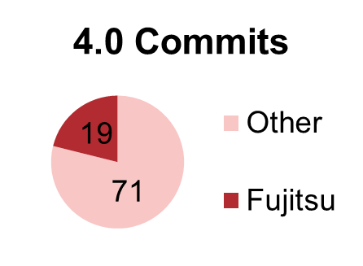
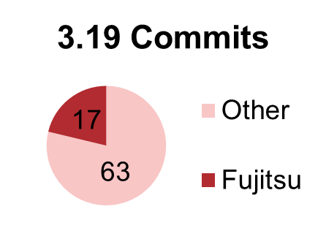
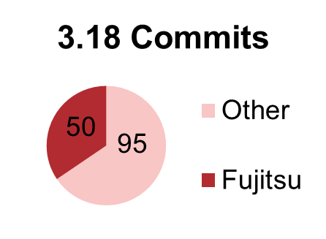
Developments Statistics
Btrfs Kernel Contribution from Fujitsu

Slide 23
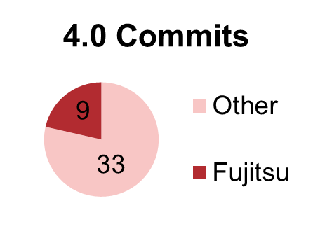
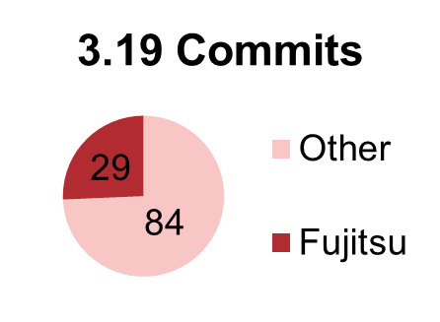
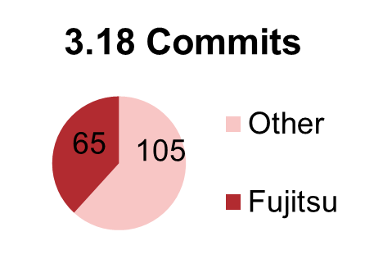
Developments Statistics
Btrfs-progs Contribution from Fujitsu

Slide 24
Index
Future Plans
Quota Reserve space framework rework
Inband de-duplication
Btrfs-convert rework
RAID5/6 readahead

Slide 25
Future Plans
Quota reserve space framework rework(Submitted)
Accurate quota reserve space for write
Avoid reserve same space for several times
Use a rb-tree tree to record which data range is already reserved
Submitted too late and patchset too big, will be delayed to 4.4.
Inband de-duplication(RFC submitted)
In memory extent<->hash tree
Controllable overhead and memory usage
On-disk extent<-> hash tree planned (Thanks Liu Bo)

Slide 26
Future Plans
Btrfs-convert rework(WIP)
Btrfs-convert bugs already located
Support separate chunks profile after convert
RAID5/6 readahead
Make it work again
May created a unified readahead framework

Slide 27
QA
QA Time now

