Slide 1
虚拟化和KVM的现状，发展以及未来
董耀祖 （Eddie Dong）
首席工程师
Intel开源软件技术中心

Slide 2
Agenda
Virtualization
KVM
Server → Client
Looking Ahead

Slide 3
Native vs. VM
Application
Application
...
Application
VM₀
VM₁
App
App
...
App
App
App
...
App
Operating System
Device Drivers
...
…
Guest OS₀
Guest OS₁
IDE
NIC
GFX
Physical Host Hardware
Processors
Memory
Graphics
Virtual Machine Monitor (VMM)
Physical Host Hardware
Network
Storage
Keyboard / Mouse
Without VMs: Single OS owns all hardware resources
With VMs: Multiple OSes share hardware resources

Slide 4
Why Virtualization ?
Provide Multiple Machine Instances ☺
Run multiple OSes
Improved Utilization: Server Consolidation
Isolation/Security
Fine-grain Resource Management
10%, 15% of Physical machine resource as a selling unit
Elastic Resource Management
Migration, Load balance

Slide 5
Commercial Product
VMware ESX/GSX/Workstation
1999年始，开创了PC虚拟化的时代
Xen
2003年, 第一个开源hypervisor
成为Vmware的强力竞争对手
KVM
后发先至，一出世就直接进入Linux
Virtual PC/Hyper-V
Virtualbox
Parallels
Notes:
OLS 2005…

Slide 6
Agenda
Virtualization
KVM
Server → Client
Looking Ahead

Slide 7
KVM and the Year 2006/2007
KVM Driver Born (~10K patch): 12/10/2006
commit 6aa8b732ca01c3d7a54e93f4d701b8aabbe60fb7
Author: Avi Kivity <avi@qumranet.com>
Date: Sun Dec 10 02:21:36 2006 -0800
Active Support from Andrew / Linus
……
Signed-off-by: Andrew Morton akpm@osdl.org
Signed-off-by: Linus Torvalds <torvalds@osdl.org>

Slide 8
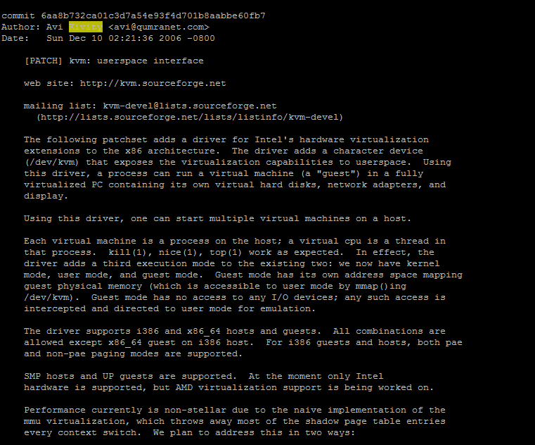

Slide 9
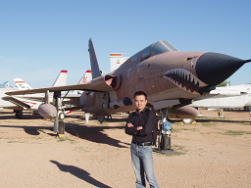
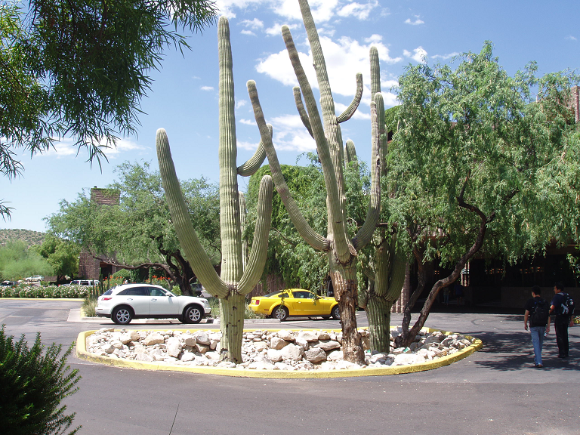
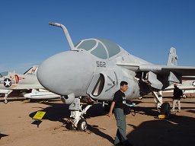
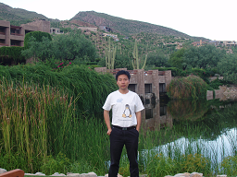
KVM Forum Starting from 2007
第一届KVM大会大约来了3/40个人，在8月炎热的亚利桑那州的Tucson。
第二届翌年6月在加州的葡萄酒产地Napa。
Notes:
Vmware 出席
Microsoft出席

Slide 10
KVM architecture
Qemu
Guest1
Guest2
Virtio
Service
Apps
Apps
Kernel
Kernel
VMX non-root operation
VMX root operation
VCPU2 Holder
VCPU1 Holder
VCPU3 Holder
Virtio
Device Drivers
Virtio
Device Drivers
Guest Mode
KVM I/F
VM Exit/Entry
Host Mode
KVM
Linux Kernel

Slide 11
转折点
IBM/Redhat switched from Xen to KVM
Qumranet Acquired by Redhat in 2008
RHEL6 dropped Xen support - 2010
I/O effort: Virtio, Vhost, macvtap etc.
Notes:
Virtio--- IBM
2nd KVM Forum in Jun, 2008.
Chris Wright mentioned RH may buy companies in enconimy down turn

Slide 12
Commits per Release
*Source from Paolo Bonzini, 2015 KVM Forum

Slide 13
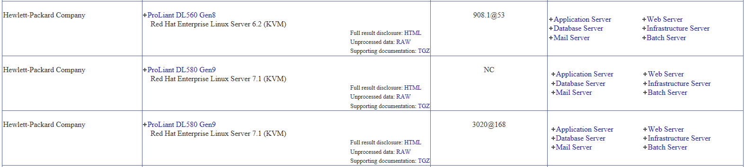
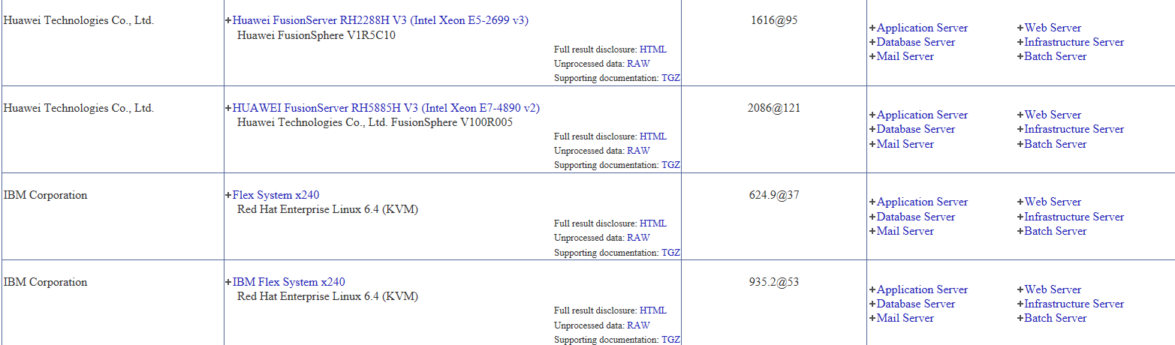
Performance in SPECvirt_sc2013
*Source from http://spec.org/virt_sc2013/results/specvirt_sc2013_perf.html

Slide 14
Agenda
Virtualization
KVM
Server → Client
Looking Ahead

Slide 15
Server vs. Client
Different Focus
Server focuses on Request and Response
Client focuses on user experience
Different Workload
Client workload like office, Browser, Multimedia, entertainment
Different Administrating Model
Home user: No dedicate administrator
SMB users: Dedicated IT with less professional
Enterprise users: Corporate IT with remote support

Slide 16
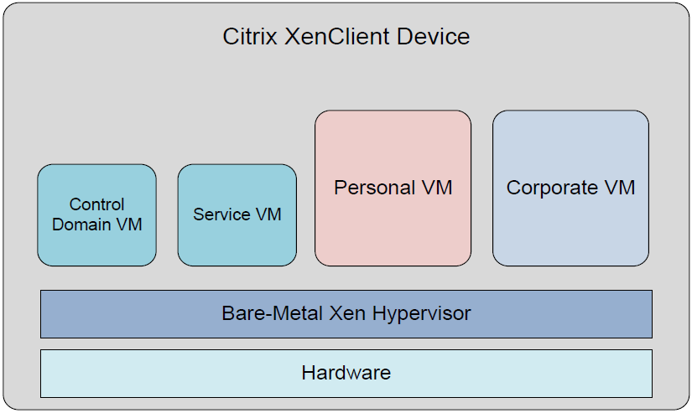
XenClient 1.0 Architecture
*Source from www.citrix.com

Slide 17
Virtual Desktop Infrastructure (VDI)
Run virtual desktop in server, remotely access from client thru network protocol
For centralized IT service
For security
Mostly Windows VDI, Some Linux VDI
Android VDI for security?
Application Virtualization

Slide 18
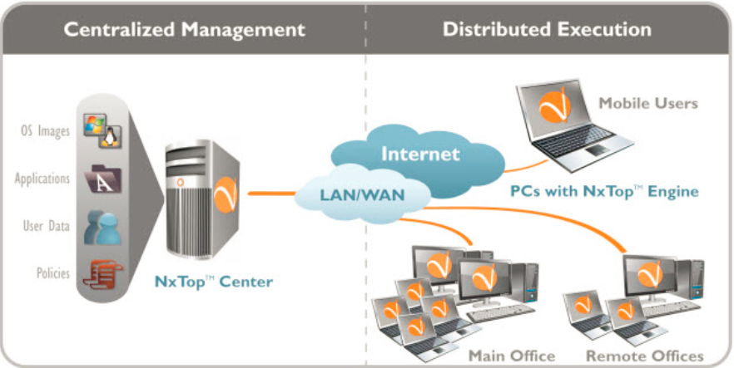
NxTop from Virtual Computer
*Source from http://www.atlantavdi.com/wp-content/uploads/2011/01/NxTop-Datasheet.pdf

Slide 19
Redbend Mobile & Automotive Virtualization
BYOD Usage in Smart Phone
2 OSs share one device
Customized for Android/Mobile Device, such as battery/GPU
ECUs & Head Units Consolidation in Car
Cut hardware cost
More focus on devices

Slide 20
Bromium Micro-Virtualization for Security
*Source from http://www.bromium.com/sites/default/files/Bromium%20Microvirtualization%20for%20the%20Security%20Architect.pdf

Slide 21
Agenda
Virtualization
KVM
Server → Client
Looking Ahead

Slide 22
Is Virtualization Done?
Market keeps growing
Public cloud: 100%+ increase per year
New usages emerge
NFV
High Availability
GPU cloud
New technologies keep coming
Xpoint, NVDIMM etc.

Slide 23
High Availability with VM Replication
Surviving from Hardware Failure
Lock-stepping: VMware
Checkpointing:
Coarse-grain Lock-stepping (COLO)
Hardware
Hardware
VMM
VMM
PVM
SVM
OS
OS
APPs
Fail Over
APPs
VM Replication
Secondary
Primary
Network
Hardware Failure
Storage

Slide 24
3D XPoint Memory Technology
Large capacity, non-volatile
10 times greater density
1000 times faster
How to use ?
How to virtualize?

Slide 25
NVDIMM: Large Persistent Memory
Non-Volatile DIMM (https://en.wikipedia.org/wiki/NVDIMM)
Byte addressable
Large persistent memory
NVDIMM Virtualization

Slide 26
GPU Cloud
GPU Virtualization is hard, but it is doable
SR-IOV-capable GPU
Software Full Virtualization
https://01.org/igvt-g
Virtual Machine
Virtual Machine
Virtual Machine
Virtual Machine
Microsoft Windows
Microsoft Windows
Microsoft Windows
Linux
Application
Application
Application
Application
Intel HD Graphics Driver
Intel HD Graphics Driver
Intel HD Graphics Driver
Intel HD Graphics Driver
vGPU Model
vGPU Model
vGPU Model
vGPU Model
Hypervisor
Intel GVT-g Virtualization Driver
Intel® Processor Graphics

Slide 27
Docker & Lightweight Virtualization
Docker is a Container, but many people runs Docker inside a VM
Security concern due to the sharing of OS kernel
Docker + VM closes the security problem, while remaining
High density
Fast deployment
Docker as a service etc.
Lightweight virtualization
Hyper ( http://hyper.sh/ )
Clear container ( https://01.org/clearlinux )

