Slide 1
xHCI USB3 Debug Port
Intel Open Source Technology Center
Lu Baolu
2015/09

Slide 2
Agenda
What is USB3 debug port?
Why is it needed?
Debug topology
Operation model
Register interface
Software stack
Port multiplexing
USE CASE: early printk
USE CASE: kgdb
Reference

Slide 3
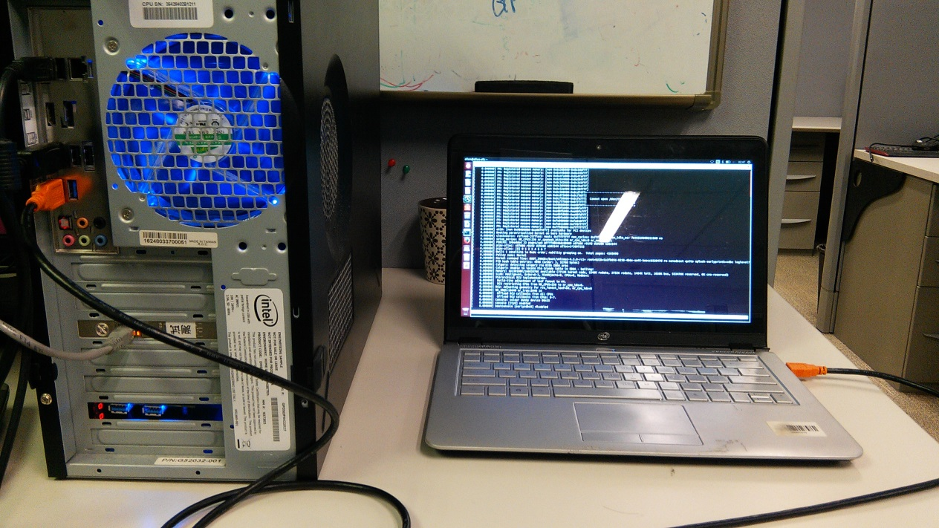
What is USB3 debug port
Optional xHCI feature defined in 7.6 of xHCI specification
Independent of the xHCI host interface
Debug device fully compliant with USB framework
Provide the equivalent of a very high performance full-duplex serial link
Only works with USB super speed.

Slide 4
Agenda
What is USB3 debug port?
Why is it needed?
Debug topology
Operation model
Register interface
Software stack
Port multiplexing
USE CASE: early printk
USE CASE: kgdb
Reference

Slide 5
Why is it needed?
PC2001 System Design Guide requires debug capabilities in all system
Low cost solution for legacy free debugging
Good alternative for serial port
10x higher data rate than USB2 debug port

Slide 6
Agenda
What is USB3 debug port?
Why is it needed?
Debug topology
Operation model
Register interface
Software stack
Port multiplexing
USE CASE: early printk
USE CASE: kgdb
Reference

Slide 7
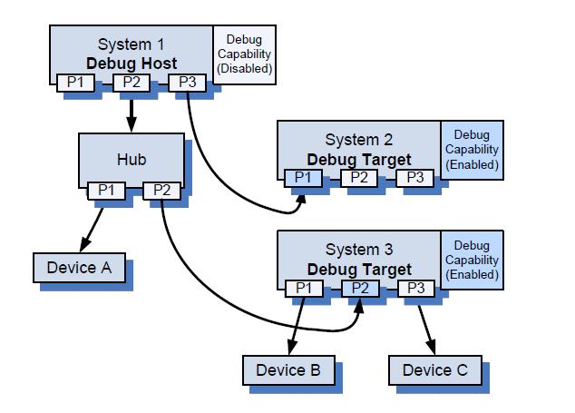
Debug topology
Multiple Debug Targets may be attached to a single Debug Host.
A Debug Target may only connect to a Debug Host through a Root Hub port of the target.
Debug Target: System Under Test
Debug Host: Debug Target enumerates as USB debug device to the Debug Host, allowing a Debug Host to access a Debug Target through the standard USB software stack.

Slide 8
Agenda
What is USB3 debug port?
Why is it needed?
Debug topology
Operation model
Register interface
Software stack
Port multiplexing
USE CASE: early printk
USE CASE: kgdb
Reference

Slide 9
Operational model
Bulk In/Out transfers:
Software prepares a TRB (transfer request buffer contains pointer to DMA buffer and some control fields) in the head of the transfer ring.
Software ring the endpoint door bell.
Hardware schedules the transfer over USB.
Hardware prepares a TRB in the head of the event ring.
Software check the head of event ring periodically until seeing the completion TRB.
Control transfers:
Hardware takes the responsibility to handle all control transfer requests sending from the debug host.
xHCI spec defines bits in register interface so that software knows the status or result of control transfers.

Slide 10
Agenda
What is USB3 debug port?
Why is it needed?
Debug topology
Operation model
Register interface
Software stack
Port multiplexing
USE CASE: early printk
USE CASE: kgdb
Reference

Slide 11
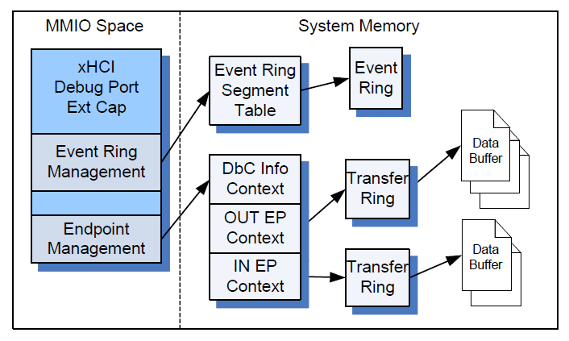
Register interface
Door bell
Event ring management
Control and status
Port management
Endpoint management
Device descriptor Information

Slide 12
Agenda
What is USB3 debug port?
Why is it needed?
Debug topology
Operation model
Register interface
Software stack
Port multiplexing
USE CASE: early printk
USE CASE: kgdb
Reference

Slide 13
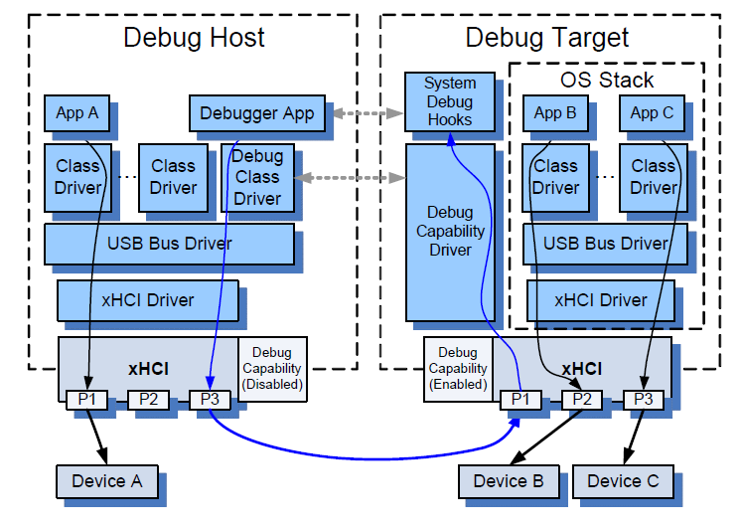
Software stack
Linux lacks of “Debug Capability Driver” in this block.
Debug capability driver manages debug capability hardware through register interface.
Debug capability driver provides ops like read(), write() and control() to upper level debug hooks.

Slide 14
Agenda
What is USB3 debug port?
Why is it needed?
Debug topology
Operation model
Register interface
Software stack
Port multiplexing
USE CASE: early printk
USE CASE: kgdb
Reference

Slide 15
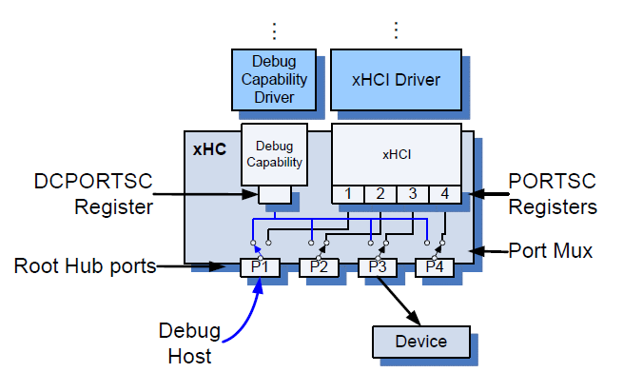
Port multiplexing
A debug port is always multiplexed with the first xHCI root hub port.
The root hub port is assigned to the debug capability and operating in an upstream facing mode when debug capability is enabled.
When root hub port is assigned to the debug capability, it appears through the xHCI as a fully functional root hub port that never sees a device attach.

Slide 16
Agenda
What is USB3 debug port?
Why is it needed?
Debug topology
Operation model
Register interface
Software stack
Port multiplexing
USE CASE: early printk
USE CASE: kgdb
Reference

Slide 17
USE CASE: early printk
Check whether debug capability is supported.
# cat /sys/kernel/debug/usb/xhci/<pci_bus_name>/extcap
...
@ffffc90001c88700 0a USB Debug Capability
...
Enable the following kernel configure options on debug target:
CONFIG_EARLY_PRINTK
CONFIG_EARLY_PRINTK_XDBC
Enable the following kernel configure options on debug host:
CONFIG_USB_SERIAL
CONFIG_USB_SERIAL_DEBUG
Start minicom and press Y as soon as debug target is enumerated.

Slide 18
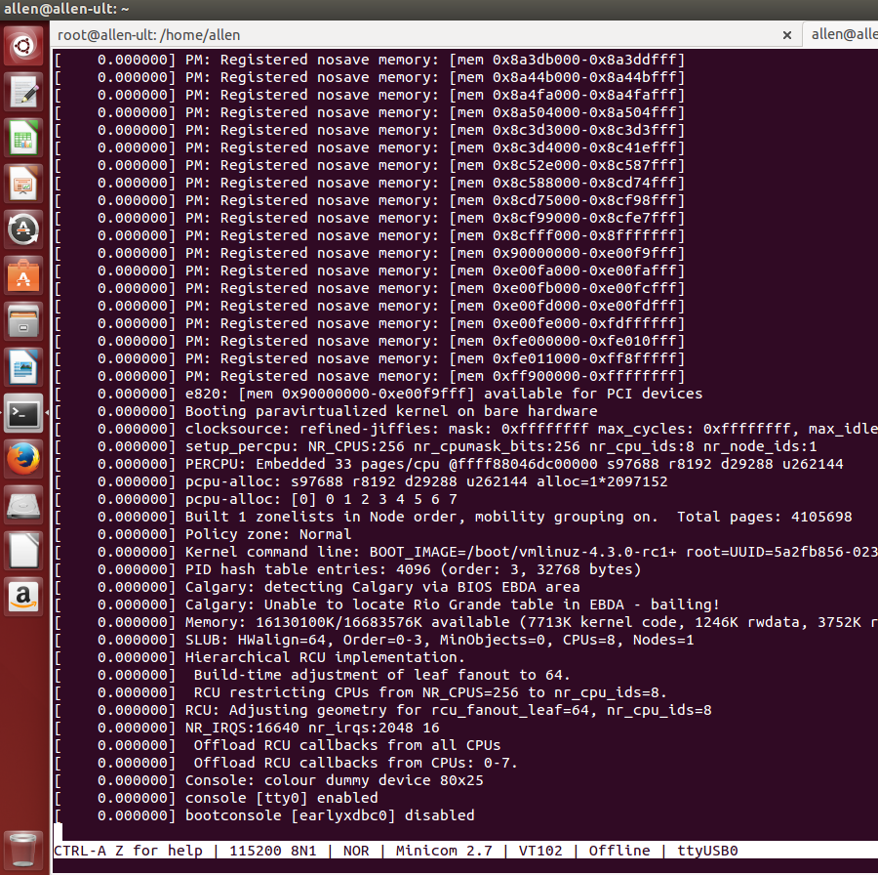
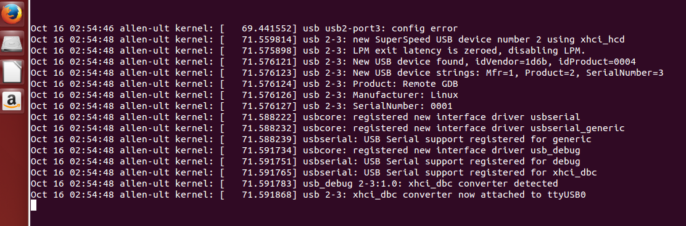
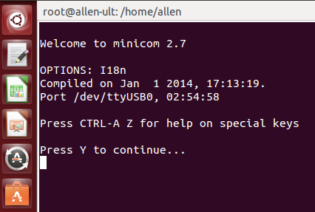
USE CASE: early printk
This feature is targeted to v4.4.

Slide 19
Agenda
What is USB3 debug port?
Why is it needed?
Debug topology
Operation model
Register interface
Software stack
Port multiplexing
USE CASE: early printk
USE CASE: kgdb
Reference

Slide 20
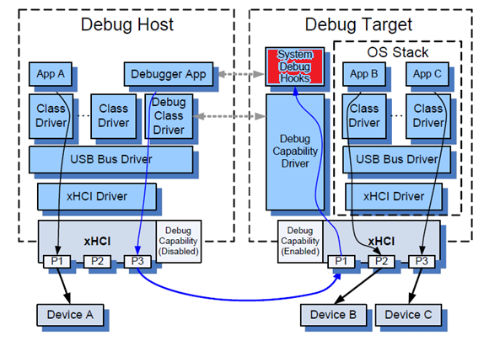
USE CASE: kgdb
Any system debugger could be hooked to DbC.

Slide 21
Reference
eXtensible Host Controller Interface for Universal Serial Bus http://www.intel.com/content/dam/www/public/us/en/documents/technical-specifications/extensible-host-controler-interface-usb-xhci.pdf
http://www.coreboot.org/EHCI_Debug_Port
http://composter.com.ua/documents/USB-2.0-Debug-Port%28John-Keys%29.pdf

Slide 22
Thank you!

