Slide 1
Detecting Reference Count Bugs in Linux without Semantic Assumptions
Junjie Mao, Yu Chen
Tsinghua University
October 15, 2015

Slide 2
Contents
Reference counts (refcount) and refcount bugs in Linux
Related work
Detecting refcount bugs using inconsistency analysis
Bugs found and time cost
Conclusion

Slide 3
Refcounts in Linux
Refcounts is widely adopted in Linux.
Memory management: klist, kobject
Runtime power management
Refcount bugs can cause critical system failures.
System panics
Out of memory
Sending requests to devices in low-power state
Preventing devices from suspending

Slide 4
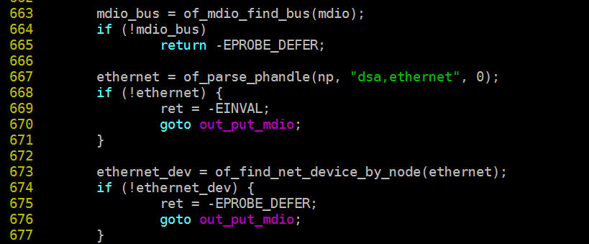
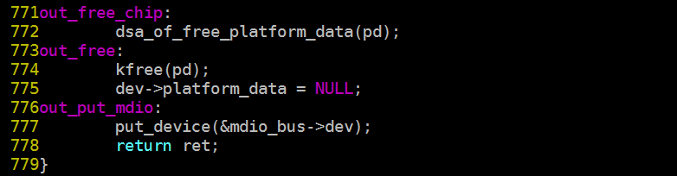
Refcount Bugs in Linux
9861f72074c7 net: fix net_device refcounting

Slide 5
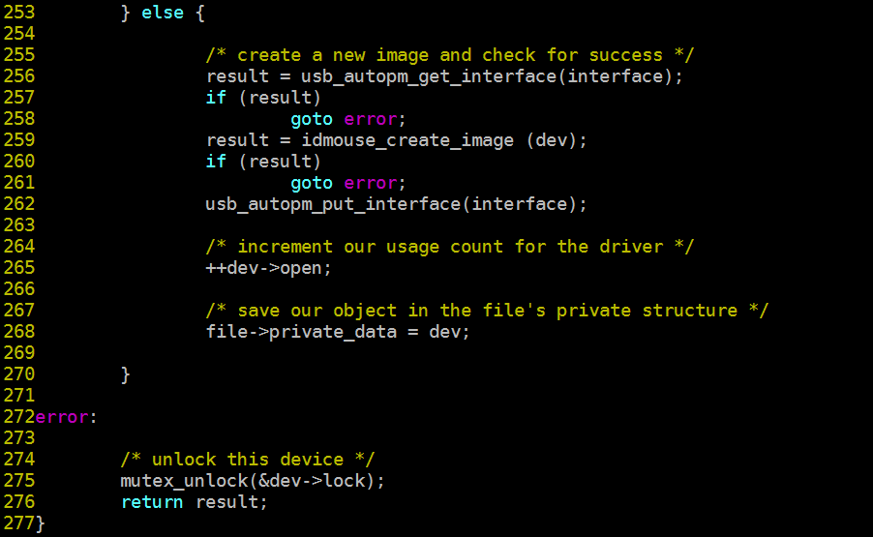
Refcount Bugs in Linux
A bug we find in drivers/usb/misc/idmouse.c

Slide 6
Refcount Bugs in Linux
What makes refcounts non-trivial to be used correctly?
Lack of precise descriptions on API behaviors
Complicated handling of error conditions

Slide 7
Related Work
Model-checking based techniques for C programs^{1,2}
Cannot apply directly to large-scale software such as Linux kernel
Cpychecker and Pungi for python/C programs³
Both assume that any function in python/C programs should have balanced refcount changes.
This semantic assumption is too strict for Linux.
All refcount APIs and their wrappers in various subsystems
A refcount incremented in one function can be decremented asynchronously in another function.
M. Emmi, R. Jhala, E. Kohler, and R. Majumdar. Verifying reference counting implementations. In TACAS 2009
A. Lal and G. Ramalingam. Reference count analysis with shallow aliasing. Information Processing Letters, 111(2):57–63, 2010.
S. Li and G. Tan. Finding reference-counting errors in python/C programs with affine analysis. In ECOOP 2014

Slide 8
Our Goal
A scalable technique for detecting refcount bugs in Linux…
… WITHOUT any semantic assumption on how functions should change refcounts.

Slide 9
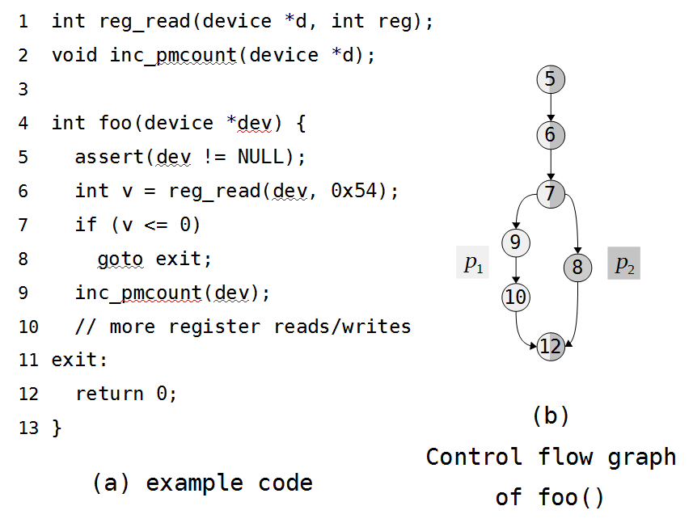
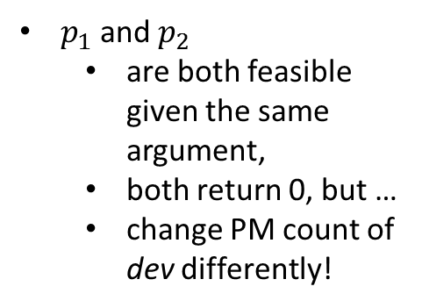
Main Idea
$p_{1}$ and $p_{2}$
are both feasible given the same argument,
both return 0, but …
change PM count of dev differently!

Slide 10
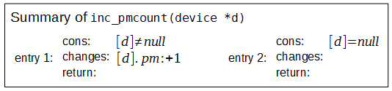
Inconsistency Analysis
Each function is summarized using a set of triples (called entries)
cons: the path constraint under which this entry takes effect
changes: how refcounts are changed
return: the value returned by the function
Example:
[d]: the argument
[d].pm: the PM use count in [d]

Slide 11
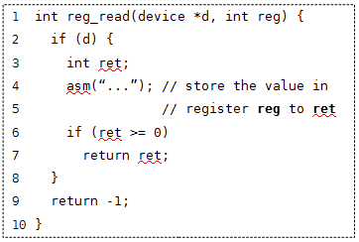
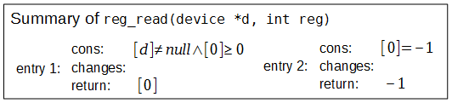
Inconsistency Analysis (cont.)
Another example
[0]: the return value
The path constraints also include conditions on the return value

Slide 12
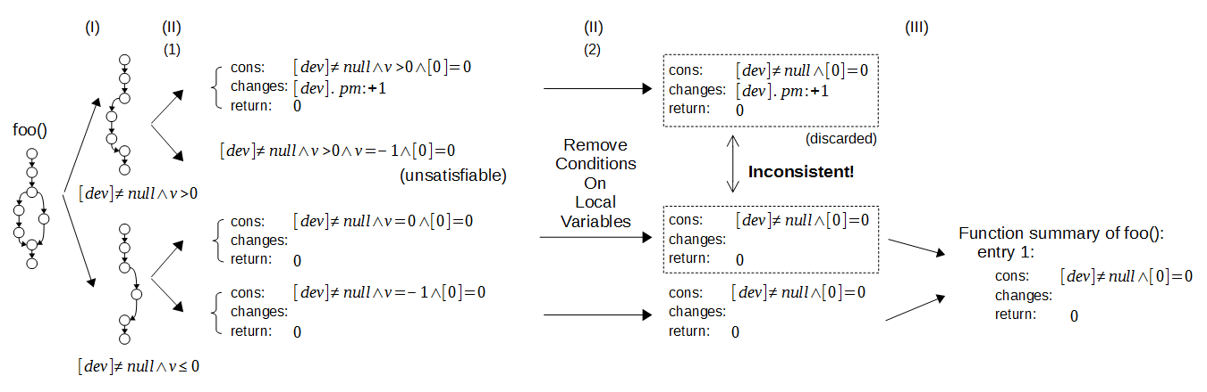
Inconsistency Analysis
Summarize a function using summaries of the callees: an example.

Slide 13
Inconsistency Analysis

Slide 14
Inconsistency Analysis

Slide 15
Inconsistency Analysis

Slide 16
Implementation
We implement the analysis as an LLVM pass called RID (Refcount Inconsistency Detector).
Summaries of fundamental refcount APIs (kref, pm_runtime, etc.) are predefined in RID.
Function summaries
Function summaries
(optional)
RID
LLVM bitcode
Warnings

Slide 17
Analyzing Linux in parallel
For large scale software like Linux, we analyze the program in parallel based on a preprocessing of the module dependence graph.
ixgbe_…
vf.c
ixgbe_common.c
ixgbe_main.c
ixgbevf_main.c
pci-driver.c
net/core/dev.c

Slide 18
Analyzing Linux in parallel
For large scale software like Linux, we analyze the program in parallel based on a preprocessing of the module dependence graph.
ixgbe.bc
ixgbevf.bc
kernel.bc

Slide 19
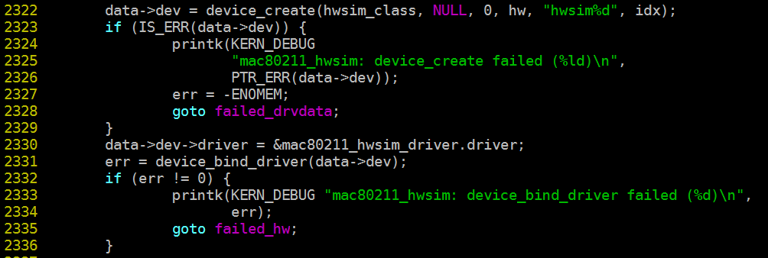
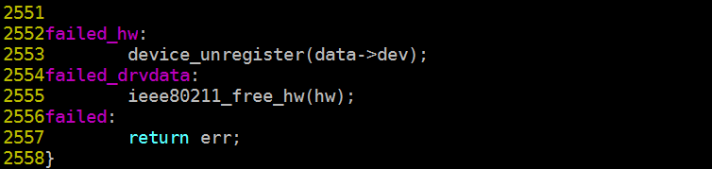
Bugs Found
805dbe17d1c8 drivers/net/wireless/mac80211_hwsim.c
(Our motivating example. Reported by LKP)

Slide 20
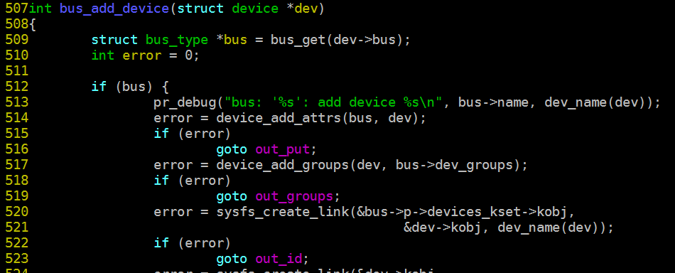
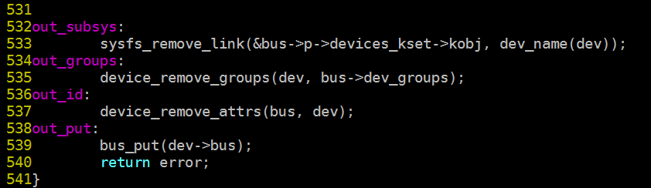
Bugs Found
1c34203a1496 drivers/base/bus.c

Slide 21
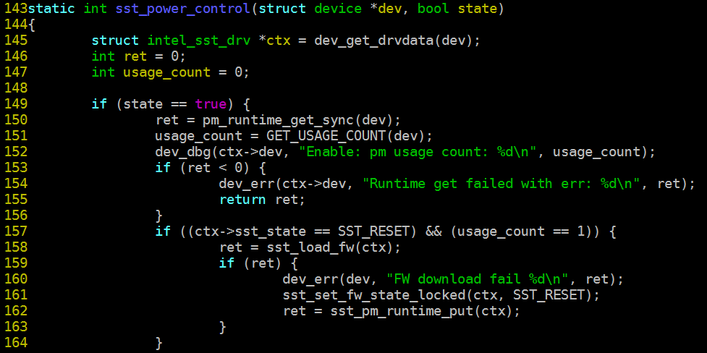
Bugs Found
e1d46d30d133 sound/soc/intel/atom/sst/sst_drv_interface.c

Slide 22
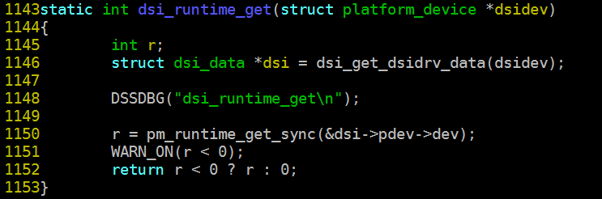
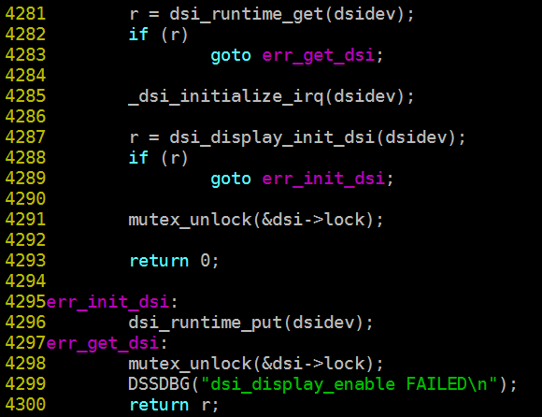
Bugs Found
drivers/video/fbdev/omap2/dss/dsi.c
Among all calls to pm_runtime_get() and pm_runtime_get_sync() in Linux v3.17, 96 of them handle error conditions but 67 of them fails to do so correctly!

Slide 23
Categories of the Bugs
Handling error conditions improperly
Neglecting error conditions
Misunderstand API behaviors
Some refcount changes are implicit or anti intuitive and not well-documented.
Anti intuitive behaviors are a significant source of bugs!

Slide 24
Time Cost
Machine Configuration
2 ×Xeon E5620 (8 cores in total)
8G memory
Time cost of analyzing PM usage counts:
 | serial | parallel
Kernel all-yes build with gcc & LLVM (-j16) | 45m14s
Dependence graph analysis | 2m07s
Linking bitcode files (-j16) | 45s
Inconsistency Analysis (-j16) | 166m27s | 66m53s
Total |  | 115m

Slide 25
Conclusion
What makes refcounts non-trivial to be used correctly?
How inconsistency checking can help?
Lack of precise descriptions on API behaviors
Refcount changes are automatically collected from the source
Complicated handling of error conditions
Paths in a function are enumerated and analyzed separately
We believe inconsistency checking can also help detect bugs of other kinds.

Slide 26
Thanks!

